Slide 1


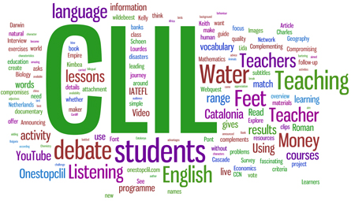
Angleščina skozi osnovnošolski kurikul
English Through Primary School Curriculum
Course Requirements
2022−23

Slide 2
Lectures | Tutorial | Individual work | ECTS
30 | 30 | 60 | 4
Karmen Pižorn (30) Edwin Harris | Tina Rozmanič (30) Edwin Harris | Work done at home
Password for Moodle: CLIL_matters2023

Slide 3
Resources – what do I need?
Spletna učilnica (e-classroom/Moodle): the name of the subject: Angleščina skozi osnovnošolski kurikul/English through Primary School Curriculum; password: CLIL_matters2023
All materials will be available in the e-classroom/Moodle.

Slide 4
Syllabus Outline
The students:
study and apply CLIL (content and language integrated learning) approach
plan CLIL lessons and teach a CLIL topic in EFL
design a CLIL mind map
are able to transfer the outcomes of CLIL to other similar school contexts, such as multilingual classes
study plurilingual education and its similar approaches
acquire, notice and use the terms/texts that are characteristic of the texts and teaching materials in English language of other school subjects/areas
Do the MOOC on Plurilingual education

Slide 5
Assessment
Exam parts | %
Lesson preparation, teaching, lesson feedback (project work) | 40
Portfolio | 20
Written exam | 40

Slide 6
Exam parts | %
Lesson planning, teaching, feedback | 40
You will teach in groups of 2 students.
Project work consists of:
Part 1: a lesson plan, a unit checklist, a self-reflection sheet
Part 2: teaching of ONE lesson
Part 3: ONE lesson observation: while 2 students are teaching, 2 students are observing and then they swap.

Slide 7
Lesson planning, teaching, and feedback (1)
In groups of TWO, you will teach an English language lesson. You’ll be given a topic and a grade (class), for example, living on a farm/1st grade.
The topic will be taken from Slovene national curricula (SPO; MAT; GUM; LUM; ŠPO).
Project work consists of preparing a lesson using the uploaded CLIL LESSON PLAN sample. Take a look at the template (CLIL LESSON PLAN TEMPLATE).

Slide 8
Lesson planning, teaching, and feedback (2)
Search for appropriate materials and adapt them for classroom use.
Write step by step lesson plan; next to each activity write the classroom language (simple and short instructions; think of gestures and movements you will use).
Use a UNIT CHECKLIST to find out whether you have followed the required guidelines.
Before the live lesson, send your lesson plan to Tina Rozmanič - the deadline to send your lesson plan is 7 days before the delivery of the lesson in the classroom.
Complete a self-reflection sheet after teaching the lesson.
After your presentation, upload everything in the e-classroom under YOUR ASSIGNMENTS – TEACHING (your lesson plan with all the materials that you worked with, a unit checklist, a self-reflection sheet).

Slide 9
Portfolio
Exam parts | %
Lesson planning, teaching, feedback | 40
Portfolio | 20
Written exam | 40
Part I: Mind map (10 pts)
Part II: MOOC on Plurilingual Education (10 pts)

Slide 10
Portfolio – Part 1: Mind map
Choose a topic within a subject area. Define the school subject which this topic may be used in, for example, plants can be used as a topic within the subject of Natural Sciences.
Define the grade.
The topic needs to be taken from Slovene curriculum.
Prepare a mind map in which you classify the vocabulary according to the 4 Cs (content, culture, cognition and communication: language of/for/through learning; provide example words and phrases you would practise with that topic).
Upload it into the e-classroom under YOUR ASSIGNMENTS - MINDMAPS.

Slide 11
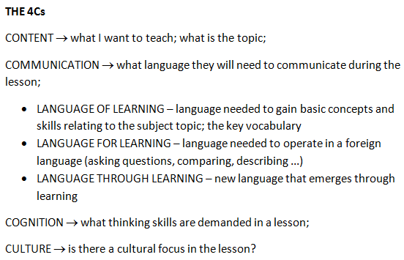
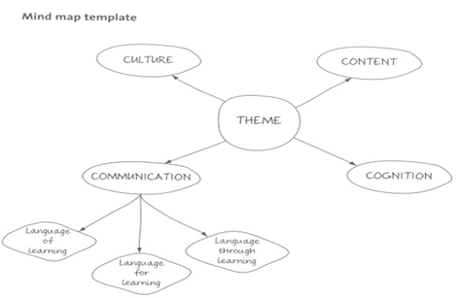

Slide 12
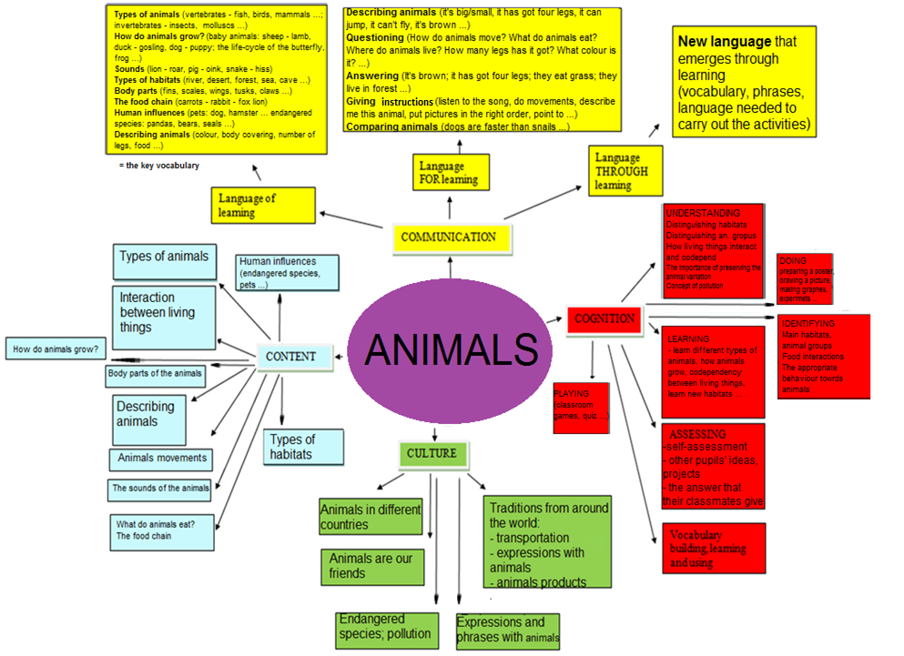
Animals can be used as a topic within the
subject of Natural Sciences, 4th grade

Slide 13
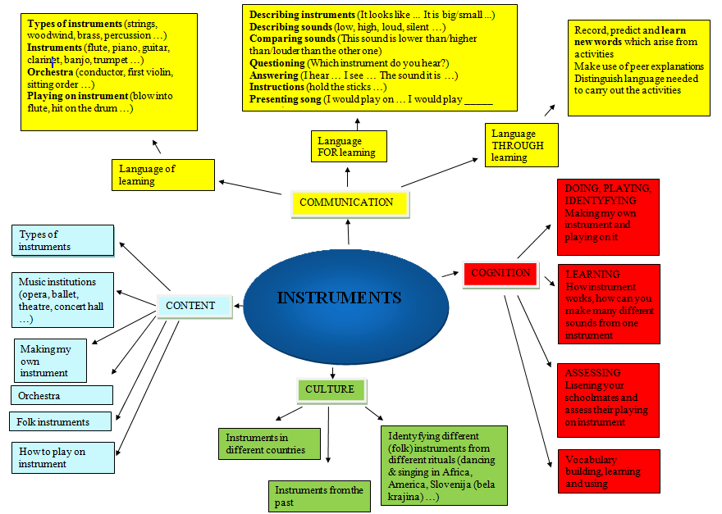
The topic „Instruments“ is a part of the music curriculum (Glasbena umetnost; 3rd grade, 4th grade)

Slide 14
MOOC on Plurilingual education
Link to the MOOC (NOT for Erasmus students!)
https://skupnost.sio.si/course/view.php?id=10918
Password: Plurilingual_23
Complete ALL the tasks in MOOC.
The deadline is 31st May 2023.

Slide 15
WRITTEN Examination
The written examination consists of test tasks which are related to the topics discussed at the lectures only, as well as to the articles and other materials posted in the e-classroom.

Slide 16
We strongly recommend that you attend all of the lectures and practical classes. The topics discussed at the lectures will not be repeated at the practical classes.
Practical classes are compulsory.
You should actively participate and come to the lessons prepared.

Slide 17
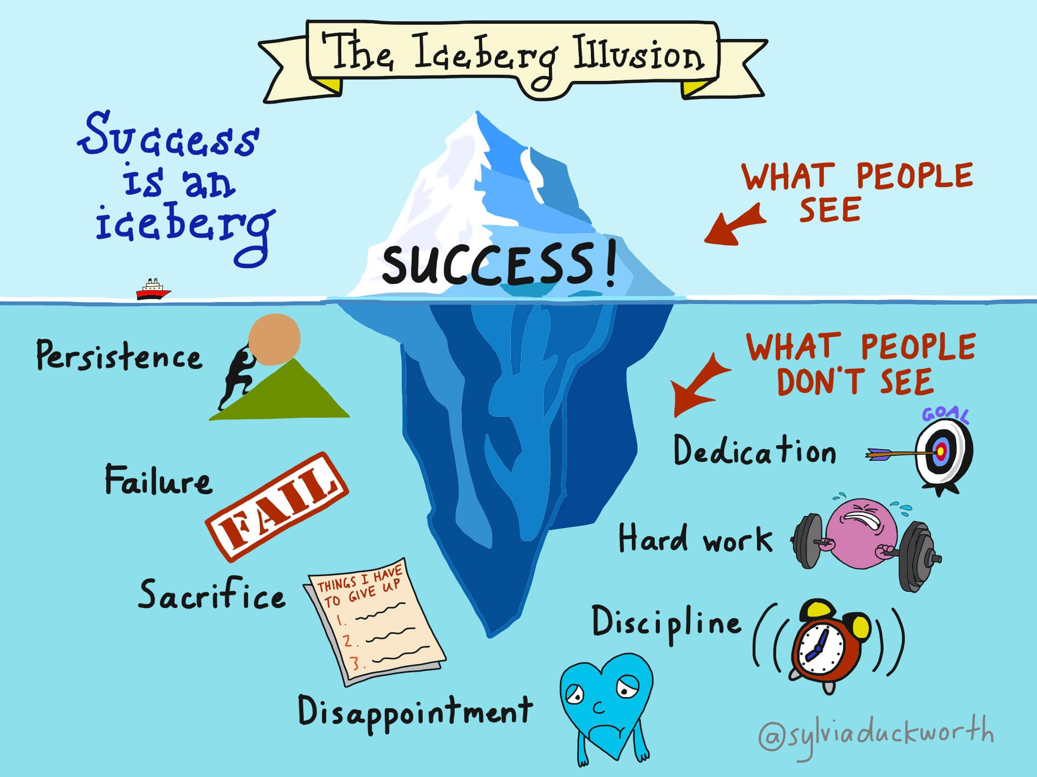
https://clilart.wordpress.com/tag/motivational-quotes-2/

Slide 18
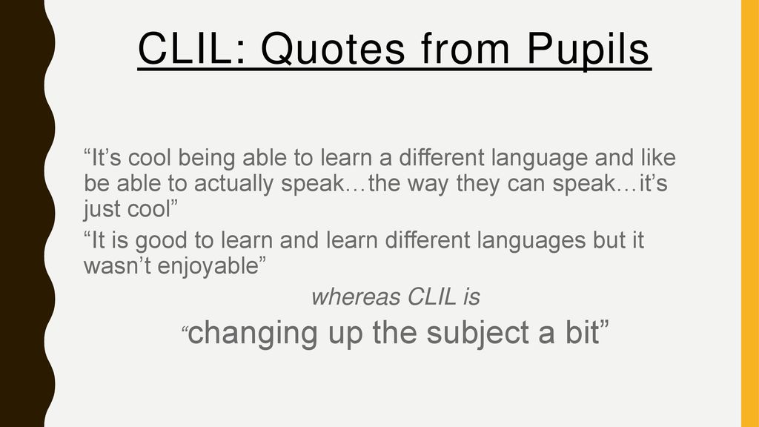
https://www.google.com/search?q=CLIL+quote&client=firefox-b-d&sxsrf=ALeKk01nsUK81hH6nLyDOVXu8EhXypEn-w:1613412199069&tbm=isch&source=iu&ictx=1&fir=nxn6M0J-MPsWrM%252CwpsQam-YqBcUfM%252C_&vet=1&usg=AI4_-kR29gMdhN4DYHwo0rZWFFtOQx5gIQ&sa=X&ved=2ahUKEwiZqIHovOzuAhVETBoKHSCnDdIQ9QF6BAgKEAE#imgrc=yTwF-21TK5SLAM

Slide 19
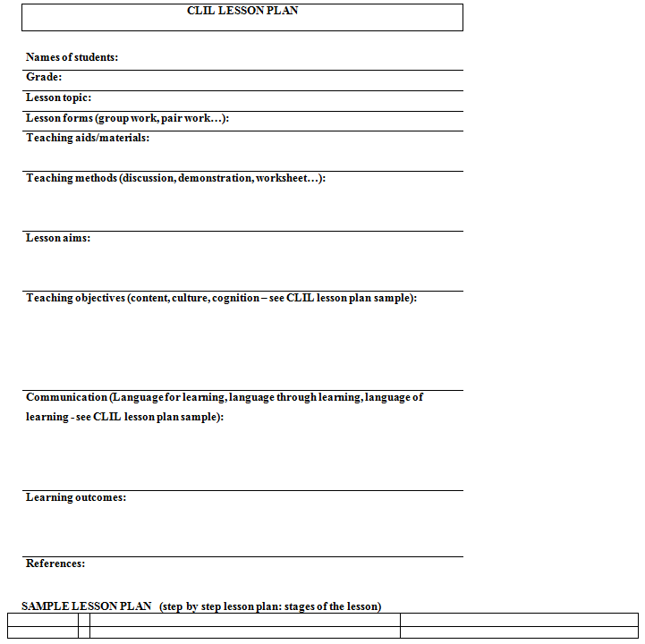

Slide 20
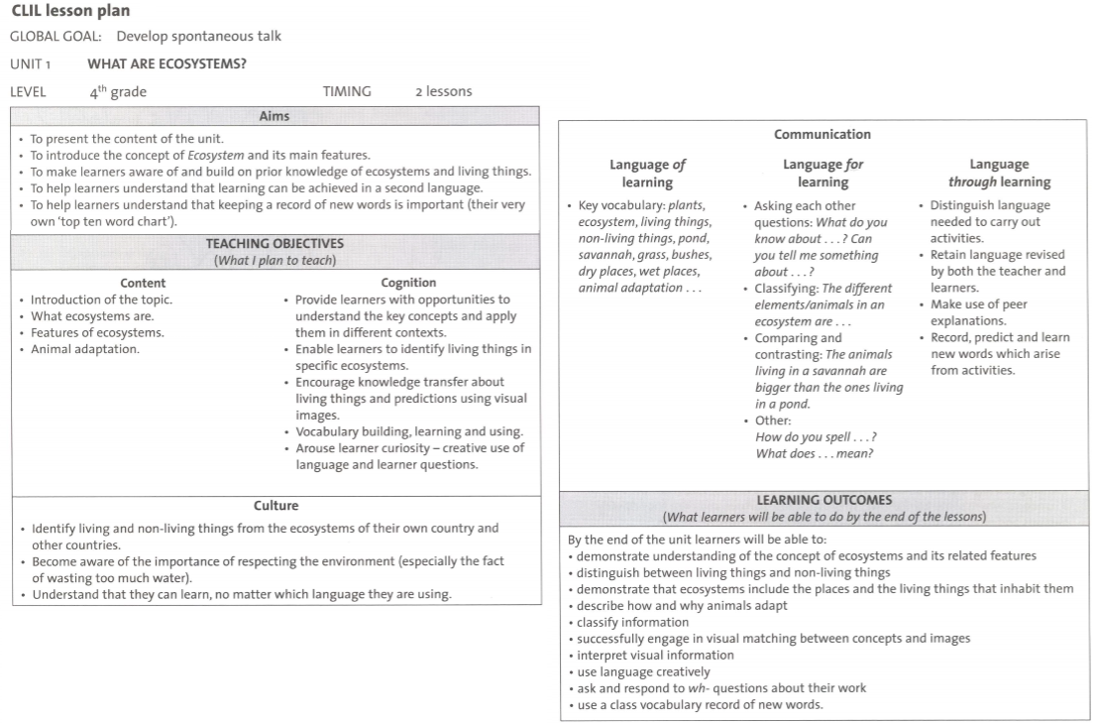

Slide 21
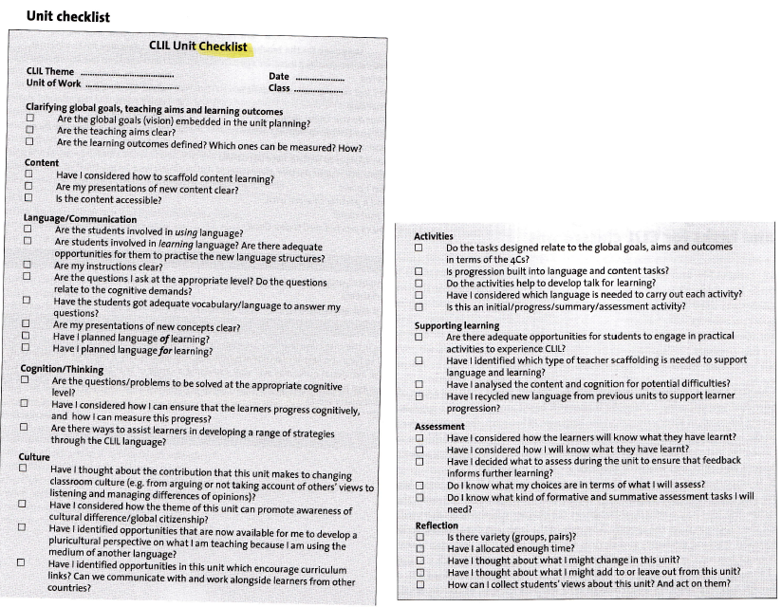

Slide 22
