Slide 1
Part 2: In-depth lecture on plurilingualism
Linguistically sensitive teaching in all classrooms (Listiac)
Jezikovno občutljivo poučevanje v vseh razredih (JOP)
KARMEN PIŽORN, TJAŠA DRŽANIK in TINA ROZMANIČ

Slide 2



About the project
Video
Video (slo)
2019–2022
2 Slovenian partners:
9 universities, 3 ministries, 1 international organisation
Coordinator:

Slide 3
Read more here: http://listiac.org/

Slide 4
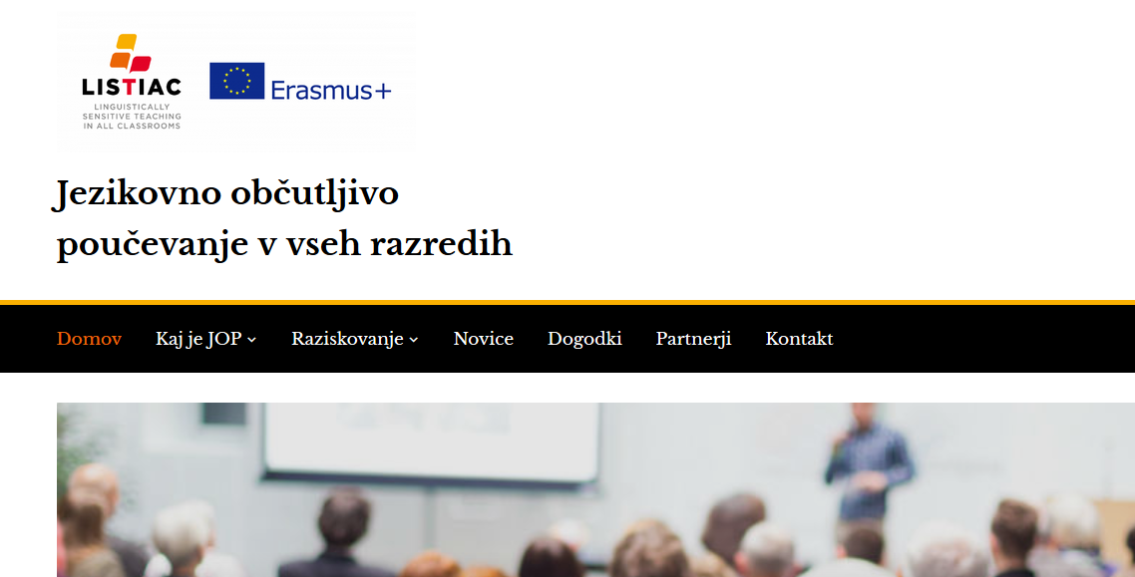
Find articles, videos, materials on LST here: http://jop.splet.arnes.si/

Slide 5
Why?
An average of around one in ten 15-year-old learners speak a different language at home than the language of schooling across the EU member states (Eurydice, 2017).
The linguistic and cultural diversity in European schools is increasing. Yet, it is often considered a threat or burden instead of a resource for
learning and teaching in school. It is important to give students the support they need to become proficient language users at the conversational and academic levels in all subjects. That is why insight in multilingual pedagogies concerns all teachers, not merely the ones teaching languages.

Slide 6
Why?
HEALTHY LINGUISTIC DIET
http://healthylinguisticdiet.com/video/school-education-gateway/
http://healthylinguisticdiet.com/video/lucide/
http://healthylinguisticdiet.com/video/cognitive-effects-of-language-learning-implications-for-smaller-and-indigenous-languages/
http://healthylinguisticdiet.com/

Slide 7
Watch videos
How Language Immersion Can DROWN You (and how to stay afloat): https://www.youtube.com/watch?v=ZwLaFCxfpAA
What do you think/feel when you watch this?
Immersion – Moises: https://www.youtube.com/watch?v=D6HUv2eFdLg&feature=emb_title

Slide 8
What is plurilingual competence?
Linguistically sensitive teaching in all classrooms calls for the teacher’s ability to utilise and to encourage the use of pupils’ plurilingual competence in the whole school. This competence involves the ability to call flexibly upon an inter-related, uneven, plurilinguistic repertoire to:
  switch from one language or dialect (or variety) to another;
  express oneself in one language (or dialect, or variety) and understand a person speaking another;
  call upon the knowledge of a number of languages (or dialects, or varieties) to make sense of a text;
  recognise words from a common international store in a new guise;
  mediate between individuals with no common language (or dialect, or variety), even with only
  a slight knowledge oneself;
  bring the whole of one’s linguistic equipment into play, experimenting with alternative forms
  of expression;
  exploit paralinguistics (mime, gesture, facial expression, etc.).
Source: Council of Europe (2018) Common European Framework of Reference for Languages: Learning, teaching, assessment (CEFR): Companion volume with new descriptors.

Slide 9
Plurilingual education
“Manner of teaching, not necessarily restricted to language teaching, which aims to raise awareness of each individual’s language repertoire, to emphasise its worth and to extend this repertoire by teaching lesser used or unfamiliar languages. Plurilingual education also aims to increase understanding of the social and cultural value of linguistic diversity in order to ensure linguistic goodwill and to develop intercultural competence.”
Source: Council of Europe and the European Centre for Modern Languages

Slide 10
What do we mean by plurilingual education?
Plurilingual education has two major aspects – education for plurilingualism and education through plurilingualism. Understanding and experiencing the diversity of languages and cultures is both an aim of and a resource for quality education. Its practice is based on a number of key concepts:

Slide 11
A holistic view of languages in education – rather than considering each language as a separate entity each in its own compartment, there is a global approach to all the languages present in learning environments. They include the « language of schooling » which is usually the national language of the country or region ; languages spoken at home by the learners, which are frequently not the same ; foreign languages learnt as subjects in the school and in some cases classical languages like Latin and Greek as well as the languages used to teach different subject areas in CLIL (Content and Language Integrated Learning) approaches. Common strategies and plural complementary approaches can result in more effective language learning.

Slide 12
Plurilingual education embraces all language learning, e. g. home language/s, language/s of schooling, foreign languages, and regional and minority languages.

Slide 13
Intercultural learning supports the personal growth of learners and enhances social cohesion.

Slide 14
Developing every individual’s language repertoire and cultural identities and highlighting the social value of linguistic and cultural diversity lie at the core of plurilingual education.

Slide 15
- social cohesion
- access to quality education for all
Europe is multilingual/plurilingual and in order to fulfil its social and cultural aims, it seeks to provide education adapted to the needs of plurilingual citizens. This includes :
- Europe’s linguistic diversity
- the mobility of Europe's citizens

Slide 17
Linguistic repertoires and partial competences – individual learners develop their own "repertoires" of the different languages they know and use. The competences acquired in one language can be of use in learning another one and there is complementarity and interplay among the languages known. Our competence in a language is always "partial" and our repertoires consist of a number of partial competences in different languages.

Slide 18
Plurilingual competences are empowering for all learners – they are better prepared for employment, for further study, for effective additional language learning and for citizenship.

Slide 20
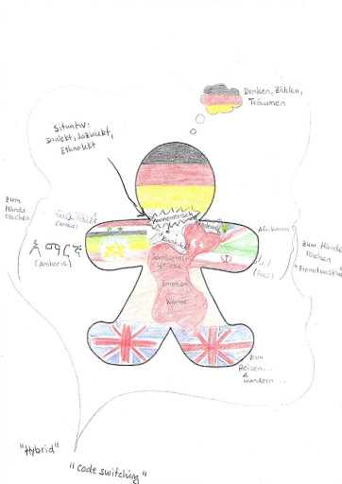

Slide 22
Bilingualism and plurilingualism are "normal" and achievable by all – more than half the population of the world is bi- or plurilingual, so establishing education systems which promote it is a feasible aim.

Slide 23
Cognitive benefits of plurilingual education – there is strong research evidence of the cognitive benefits in being plurilingual and from plurilingual approaches to education, particularly where tasks requiring intellectual flexibility are concerned.
https://www.youtube.com/watch?v=W-ml2dD4SIk&t=139s
https://www.youtube.com/watch?v=6sDYx77hCmI&t=2s

Slide 24
Plurilingual approaches contribute to social integration – acknowledging and valuing the home languages and cultures of migrants help their integration into schools and society; and plural approaches encourage the development of openness, respect and intercultural competences in all learners. This in turn can contribute to more harmony in our schools and our society.

Slide 25
How to Establish a Classroom Environment that Embraces Linguistic Diversity | School Education Gateway
https://www.youtube.com/watch?time_continue=36&v=Y2-jtnBQNBo&feature=emb_title
Posnetek odgovori na vprašanje, kako ustvariti razredno klimo, ki bo odprta do jezikovne diverzitete.
1. dovolite učencem, da uporabljajo svoj materni jezik
2. spodbujajte učence, da uporabljajo svoj prvi jezik in pokažite zanimanje zanj
3. omogočite učencem, da uporabljajo svoj materni jezik kot vir učenja: ustvarite spodbudno učno okolje

Slide 26
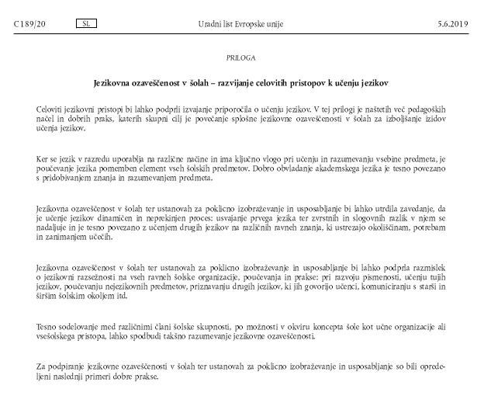
Language awareness in schools - developing comprehensive approaches to language learning (The Council Of The European Union, 2019)
Jezikovna ozaveščenost v šolah – razvijanje celovitih pristopov k učenju jezikov

Slide 27
Part 3: Practical classes - Group discussion on plurilingualism (LST) using a dialogue mat

Slide 28
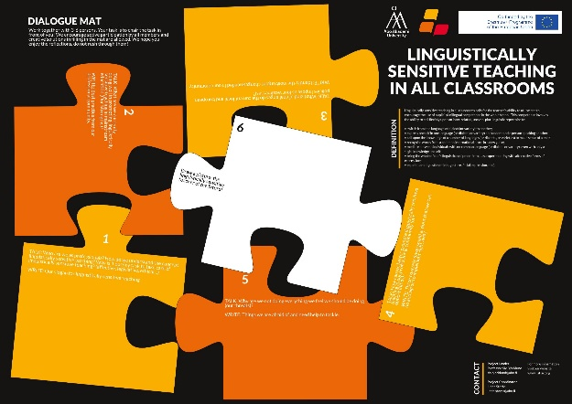
Plan:
Read and sign the consent.
Make groups of 3/6 students maximum.
The ‘dialogue mat’ is divided in 6 sections. Each section includes
  a short info / orientation, a question to elicit reflections and free
  space to write things down.
What is a dialogue mat?
• A tool for interactive teacher education staff reflections about LST
in our professional context.
• It engages us to reflect about why LTS is important in our work.
• It helps us to identify our LST related strengths, weaknesses, opportunities and threats.

Slide 29
Plan:
Read the information and the guiding questions of the dialogue mat. Then discuss and decide within your group how to complete it. You can use Slovene or English – choose the language in which you feel more comfortable. (50min)
Present your dialogue mat and your drawing to the rest of the class. Which one of the pictures is the best and why? (10min)
Give feedback (10min):
  Did you find this activity/reflection useful? Why?
  What would you recommend to do as a reflection activity on linguistically sensitive teaching?

Slide 30

It is not about right or wrong answers, but your experiences and feelings. Trust your professional identity.

Slide 31
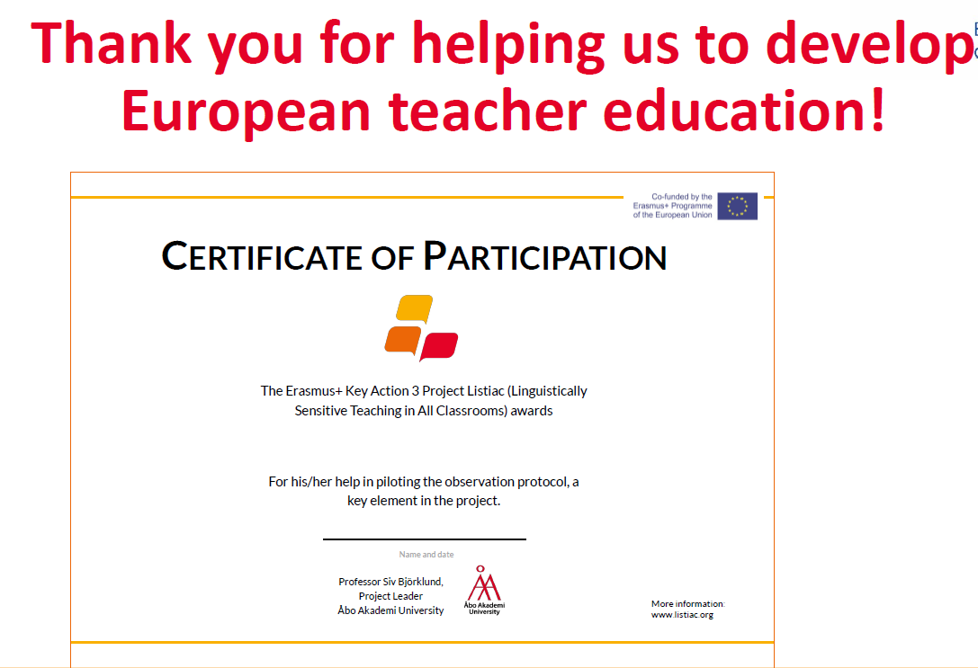

Slide 32
Language friendly school roadmap: https://languagefriendlyschool.org/wp-content/uploads/2019/10/Language-Friendly-School-Roadmap-English.pdf
Primer raznojezičnosti pri pouku 2.51 (Comparons nos langues): https://www.youtube.com/watch?time_continue=9&v=tP2D6qQIABw&feature=emb_logo

Slide 33
The European Pillar of Social Rights in 20 principles
1. Education, training and life-long learning
Everyone has the right to quality and inclusive education, training and life-long learning in order to maintain and acquire skills that enable them to participate fully in society and manage successfully transitions in the labour market.

