Slide 1
CLIL as a theoretical concept
Prepared by Karmen Pižorn

Slide 2
What are theoretical implications for integrating content and language learning?
CLIL is NOT about translating first-language teaching and learning into another language in the hope that learners will be immersed in a language bath and seamlessly learn in another language.
CLIL is not another method of teaching foreign language through grammar.
CLIL should be understood as the potential for emergent synergies by integrating content and language.

Slide 3
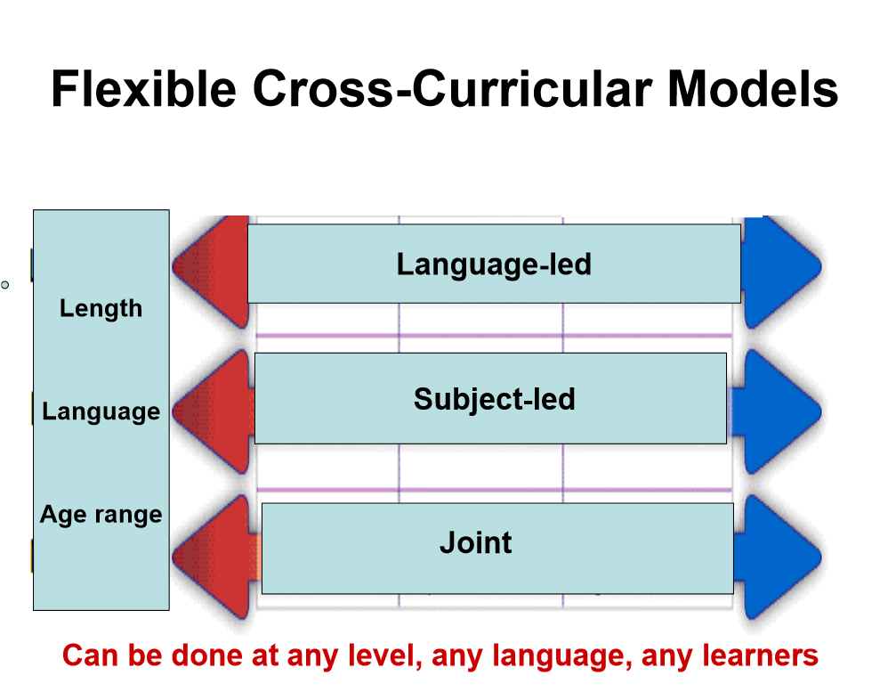
http://www.cremit.it/public/documenti/seminar.pdf

Slide 4
Connecting CONTENT learning and LANGAUGE learning

Slide 5
The CONTENT of learning
CONTENT dependent on the context
Content may range from elements taken directly from a national curriculum to a project based on topical issues (interdisciplinary)
Animal habitat
Designing an eco-friendly house
Olympic games
Shapes

Slide 6
The learning of content: Synergies, scaffolding and social interaction
Consider the impact of general learning theories
WHAT of content teaching/HOW of content teaching
banking model : social-constructivist model
The importance of encouraging active student learning
Focuses on interactive, mediated and student-led learning
Social interaction between learners and teachers and scaffolded (supported) learning by sb/sth more expert
Zone of proximal development (Vygotsky): learning that is always challenging yet potentially within reach of individual learners on condition that appropriate support is available
Transmission of knowledge where the teacher deposits information and skills into the memory bank of the learner
Tends to be teacher-controlled and teacher-led

Slide 7
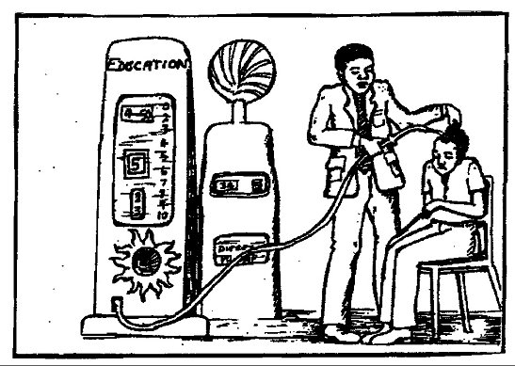
Banking education is a term used by Paulo Freire to describe and critique the traditional education system. The name refers to the metaphor of students as empty containers which educators must deposit knowledge into. This reinforces a lack of critical thinking and knowledge ownership in students, which in turn reinforces oppression.
http://www.infed.org/thinkers/et-freir.htm

Slide 8
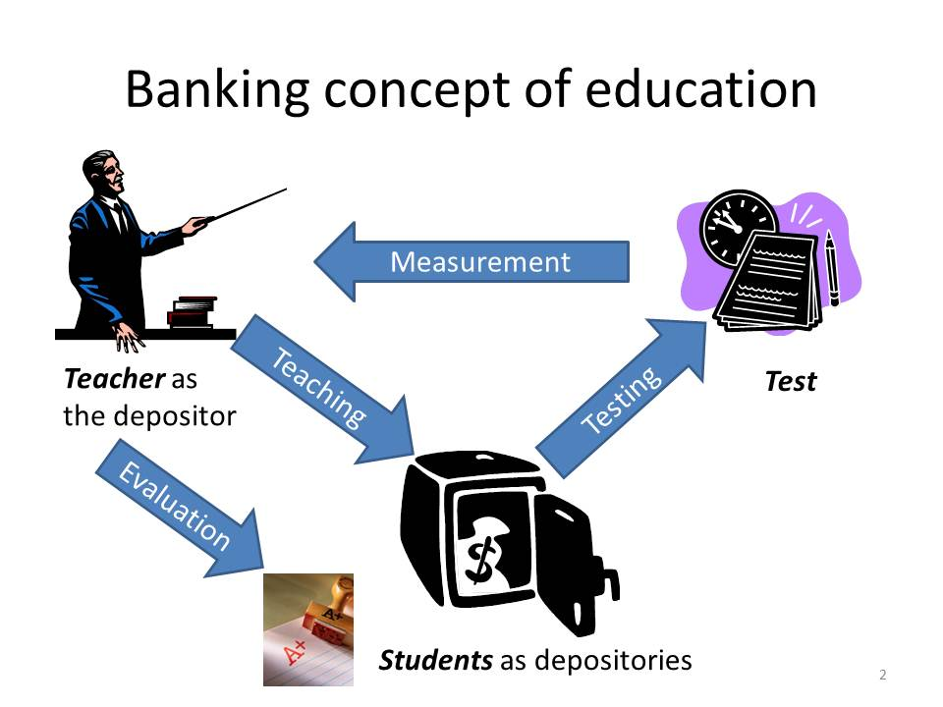

Slide 9
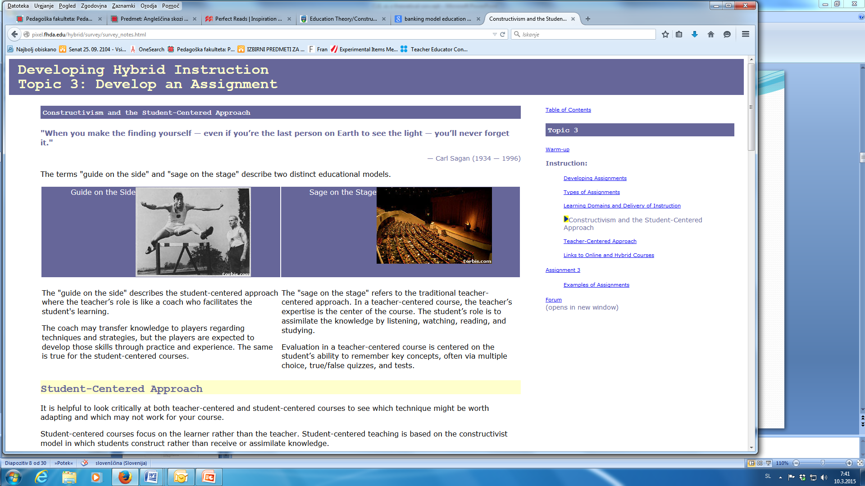
SAGE: someone who is wise and shows good judgment
http://pixel.fhda.edu/hybrid/survey/survey_notes.html

Slide 10
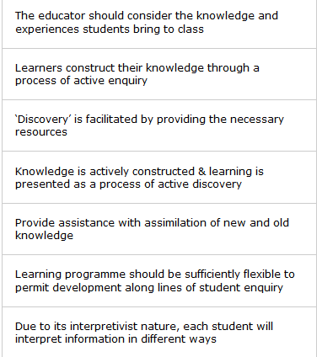

Role of the teacher social-constructivist model
Constructivist teachers do not take the role of the "sage on the stage." Instead, teachers act as a "guide on the side" providing students with opportunities to test the adequacy of their current understandings

Slide 11
The learning of content: cognitive engagement, problem solving and higher-order thinking
For content learning to be effective learning, students must be cognitively engaged
Learners need to be intellectually challenged in order to transform information and ideas, to solve problems, to gain understanding and to discover new meaning

Slide 12
Towards a thinking curriculum: Dimension and processes

Slide 13
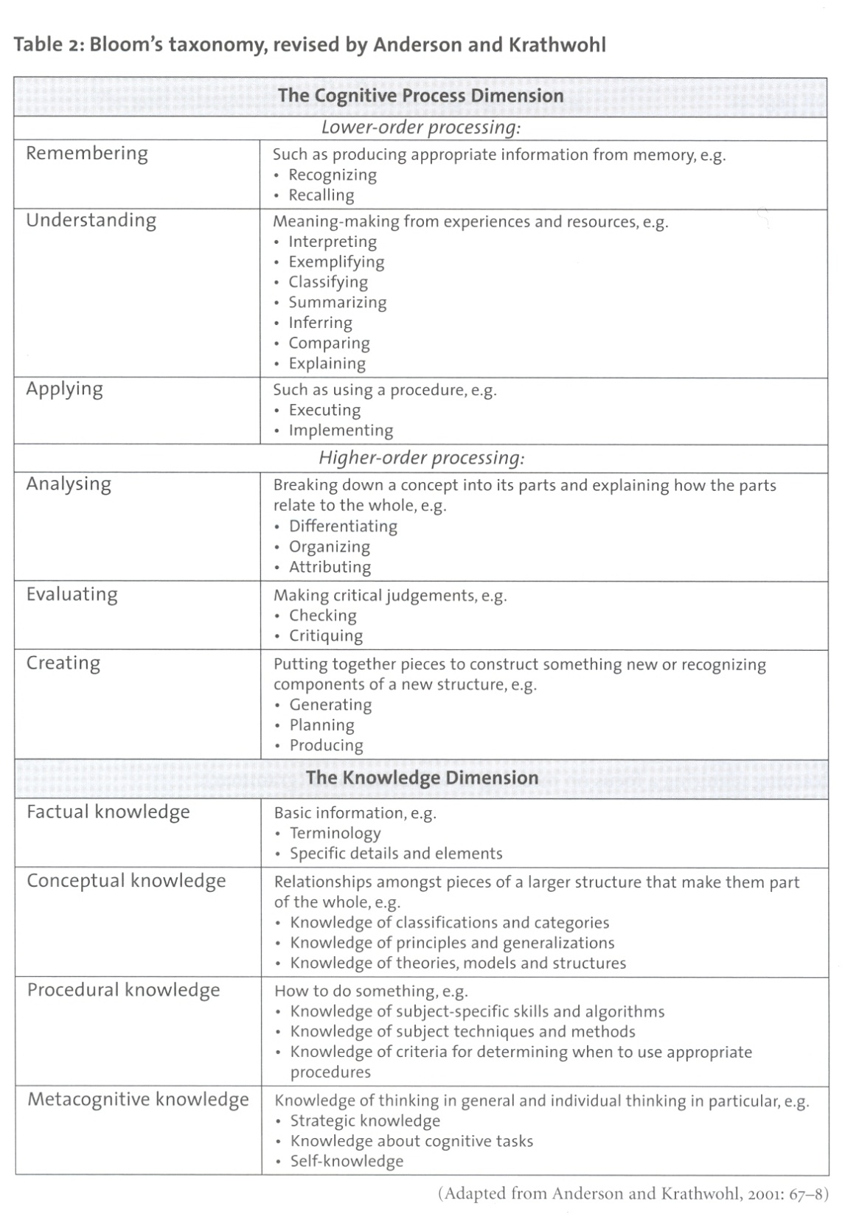

Slide 14
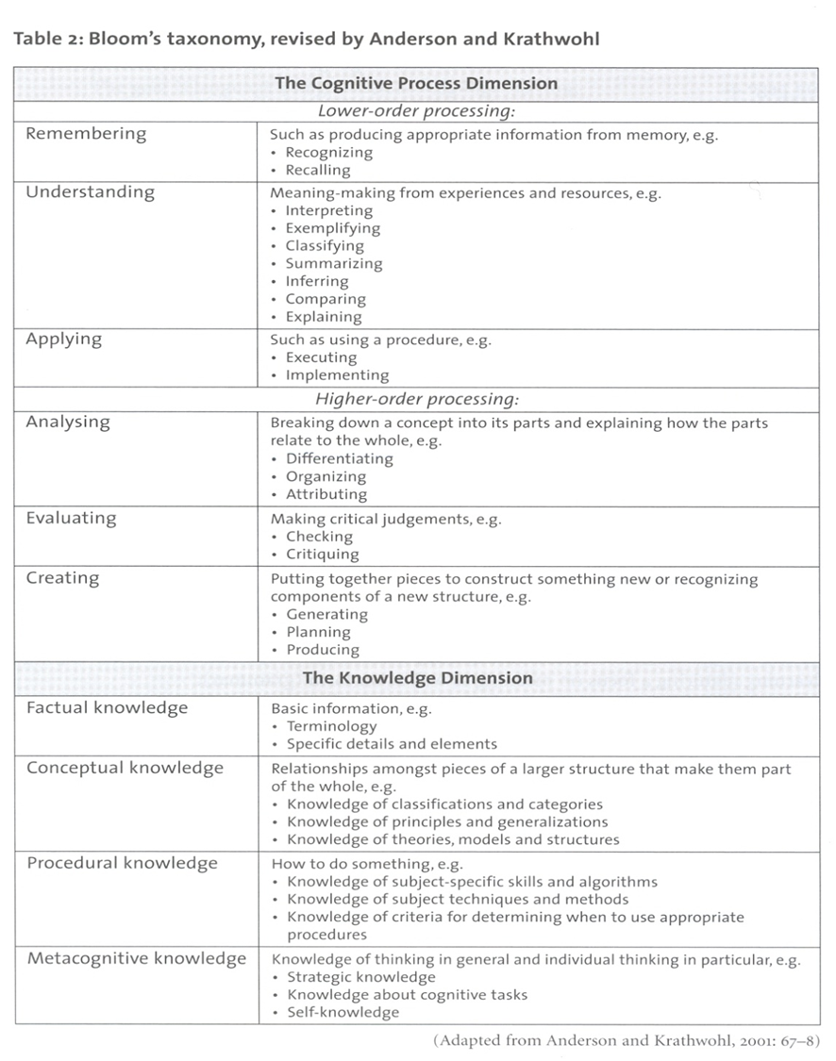

Slide 16
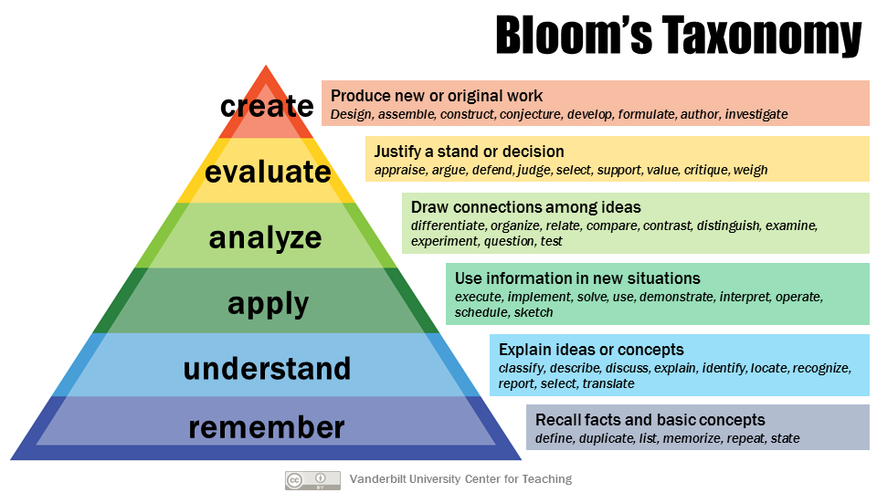
https://s3-us-west-2.amazonaws.com/prodengblogs/assets/2018/07/29428436431_170dc675d7_o1.png

Slide 17
LANGUAGE learning
and
LANGUAGE using

Slide 18
Students should learn how to learn the language and how to use the language.
The importance of dialogic learning
A pedagogic dilemma: In the CLIL setting learners need to engage in dialogic learning using the foreign language in which they may not be able to express themselves?
See an example

Slide 19
An example
A younger learner needs to use the past tense in the CLIL language to describe an experiment in science, and if the past tense has not been learned in a formal grammar class, then the CLIL class will need to provide access to the appropriate use of the tense in that context.
The language needed in CLIL settings does not necessarily follow the same grammatical progression one would find in a language-learning setting.
How to solve this dilemma?

Slide 20
The Language Triptych or how to integrate cognitively demanding content with language learning and using
Language OF learning
CLIL linguistic progression
Language learning and language using
Language FOR learning
Language THROUGH learning

Slide 21
/ˈækses/
Language OF learning
The language needed for learners to access basic concepts and skills related to the subject topic.
Grammatical progressions in using modal verbs to predict the future of ecosystems
Key vocabulary/phrases
Language of describing, defining, explaining, hypothesizing
Effective use of future tenses

Slide 22
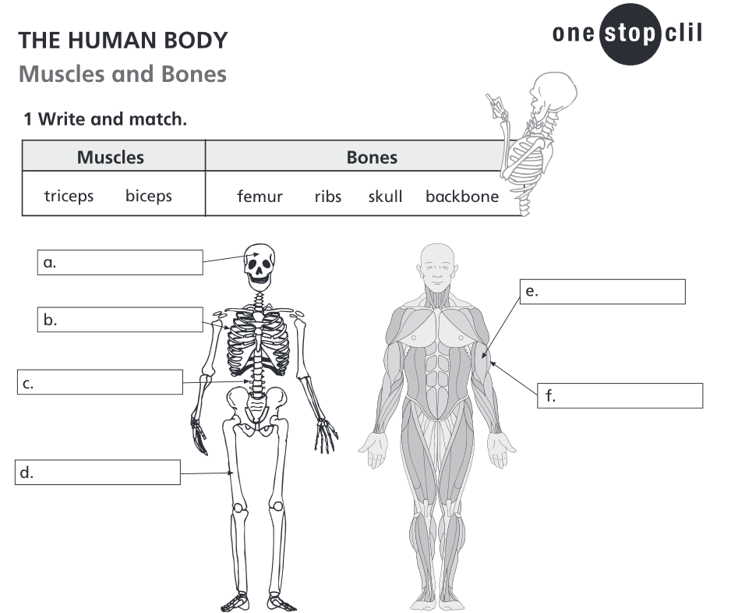
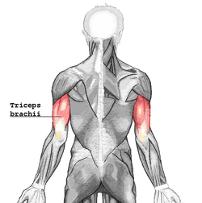
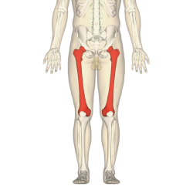
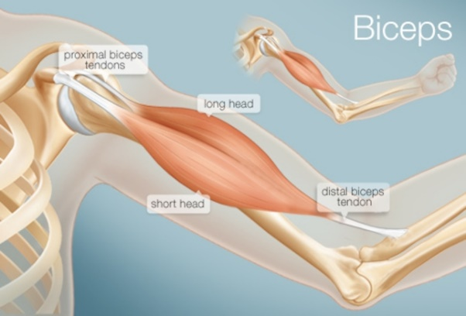

Slide 23
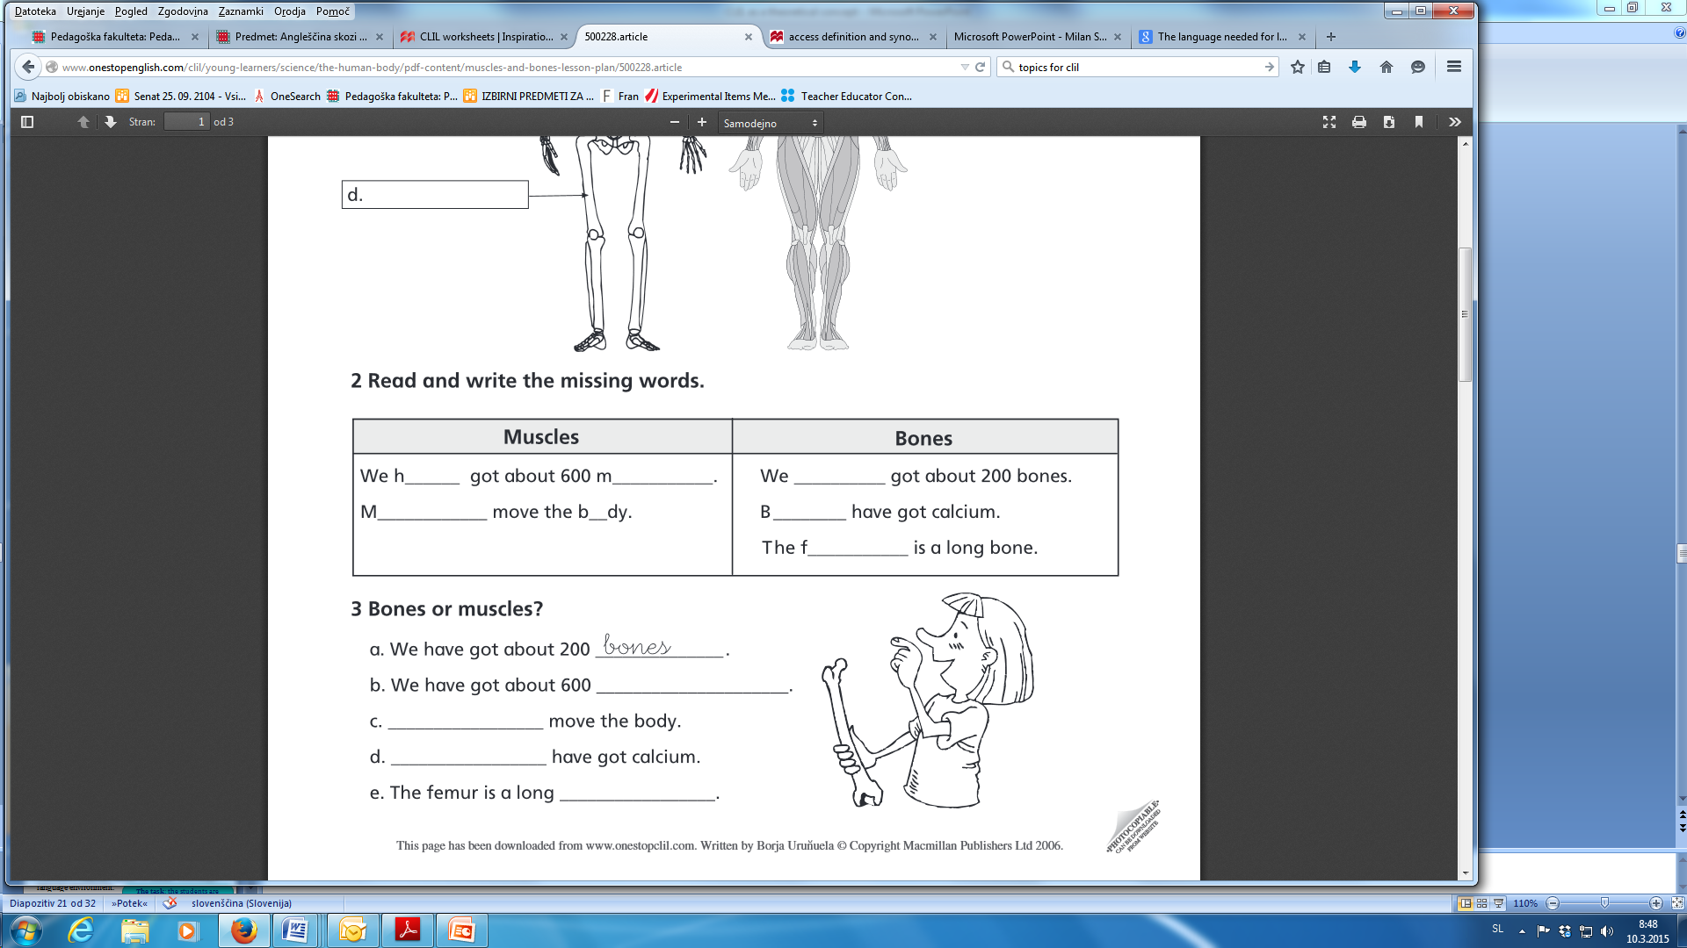
DEM BONES - It is dialect for "them bones" which is dialect for "those bones".
https://www.youtube.com/watch?v=e54m6XOpRgU

Slide 24
Language FOR learning
The kind of language needed to operate in a foreign language environment.
The task: the students are required to organize, research and present
In groups: asking and answering questions using evidence
Language to build arguments and disagreements
Writing a simple research report
Language for project work

Slide 25
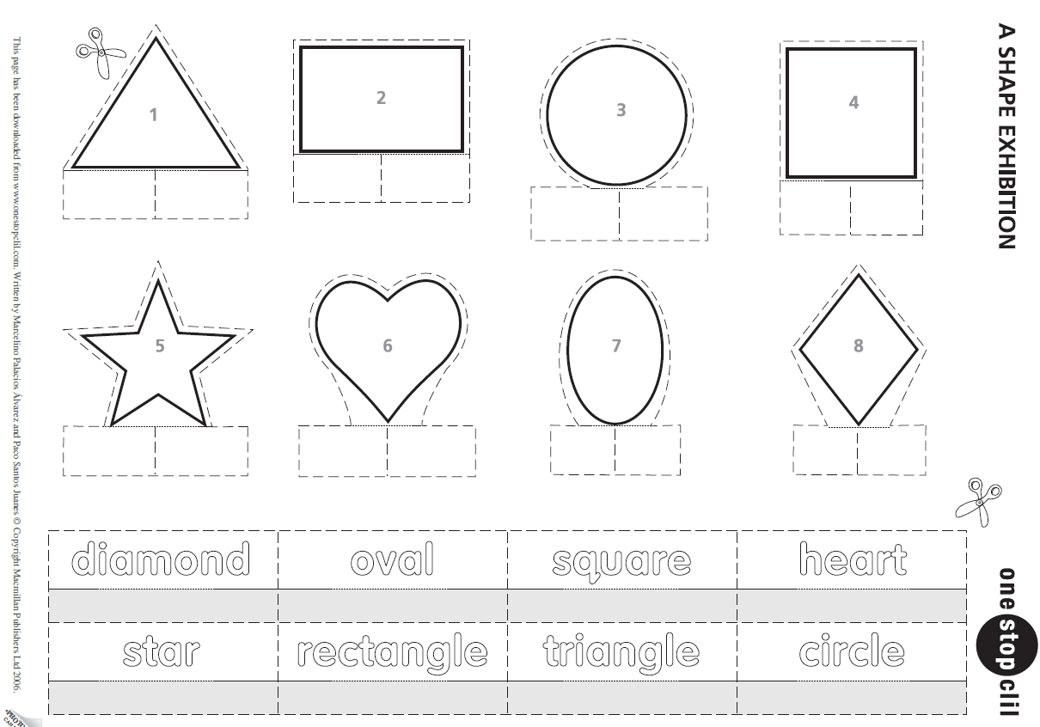
ˈəʊv(ə)l
ˈrekˌtæŋɡ(ə)l

Slide 26
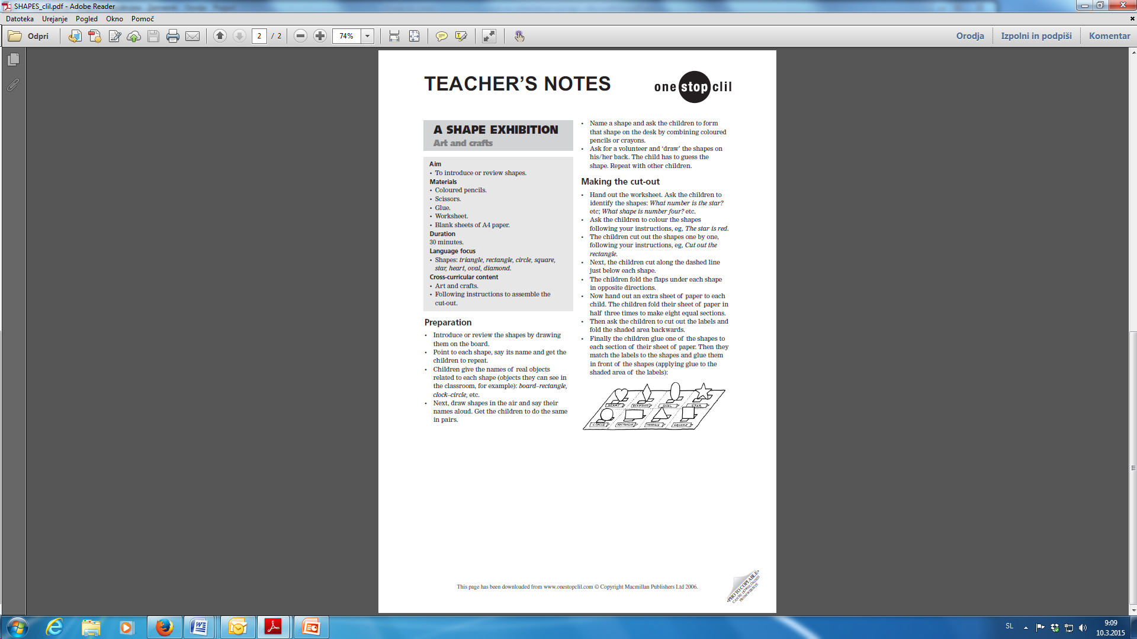

Slide 27
Language THROUGH learning
New language will emerge through learning.
Make use of opportunities to encourage learners to articulate their understanding
HABITATS project:
  Language through learning may emerge if during the mini-project preparation, students working in groups need language to express a new idea which they have constructed and which is not in their resources.
  Using feedback, dictionary skills, presenting evidence, recycling discussion skills at a higher level.

Slide 28
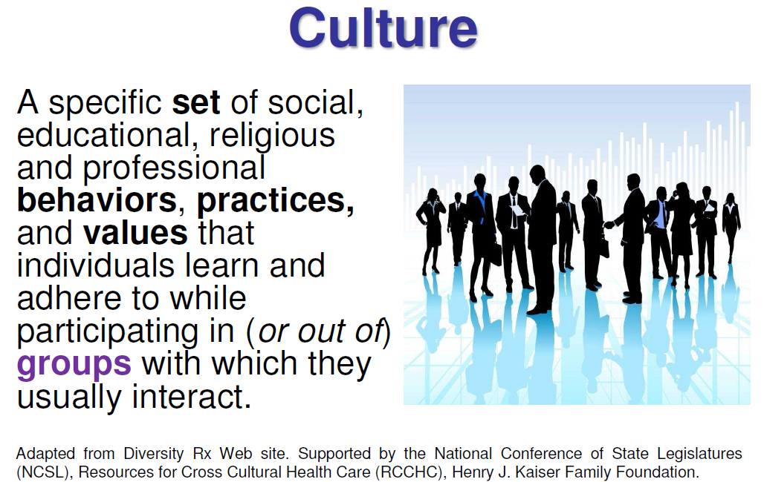

Slide 29
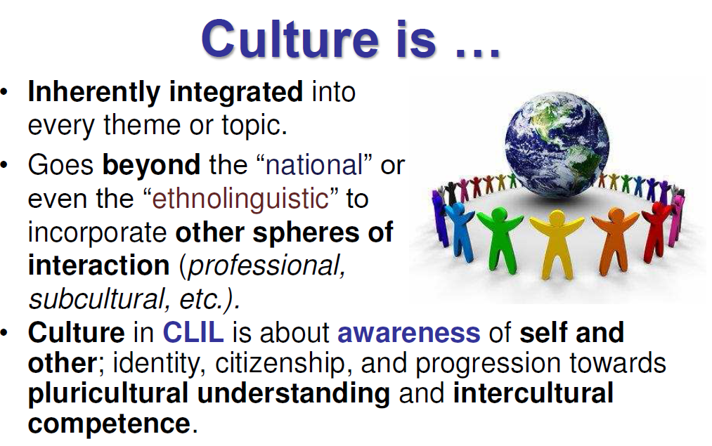

Slide 30
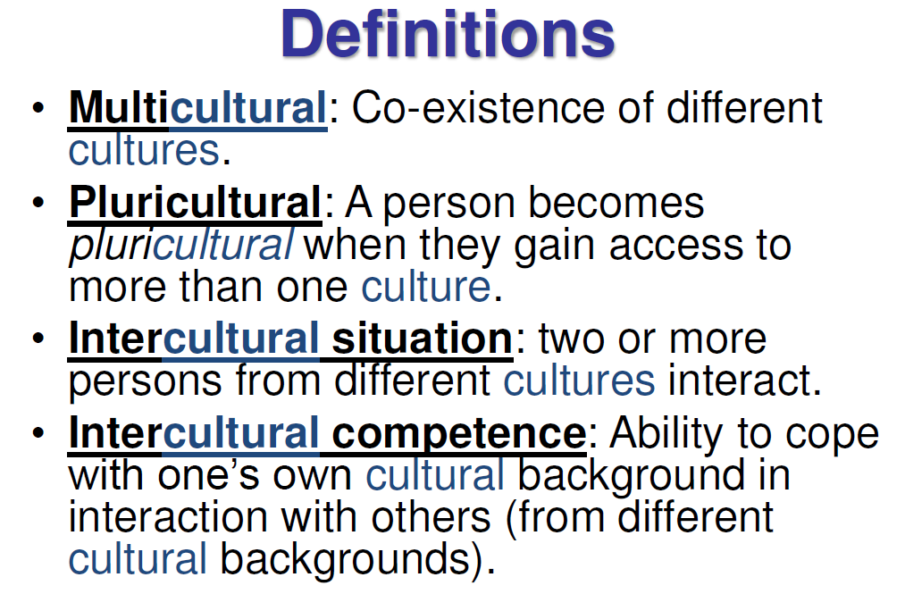

Slide 31
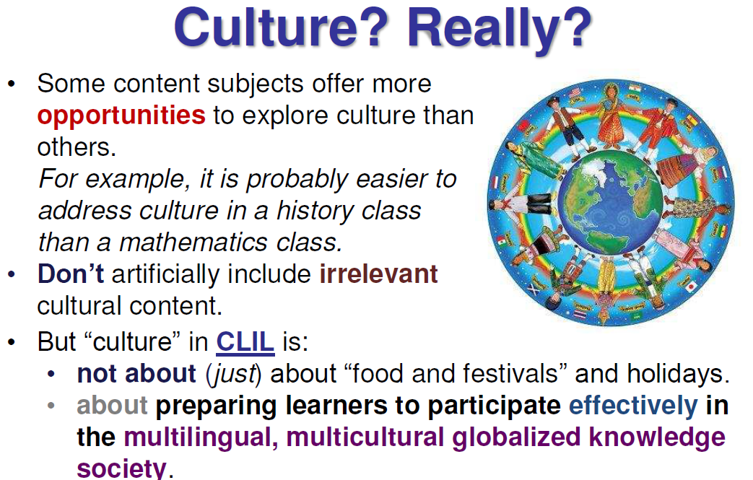

Slide 32
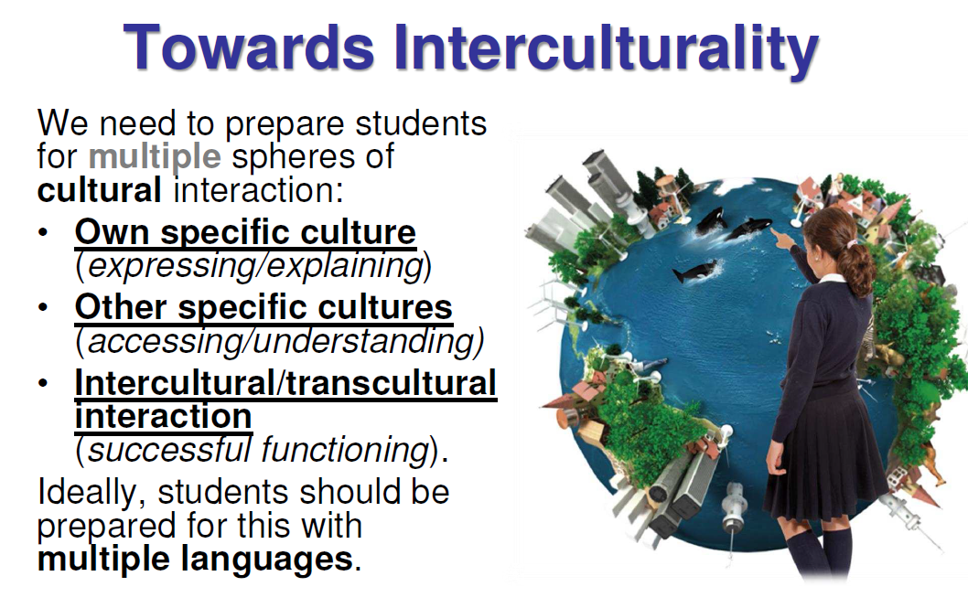

Slide 33
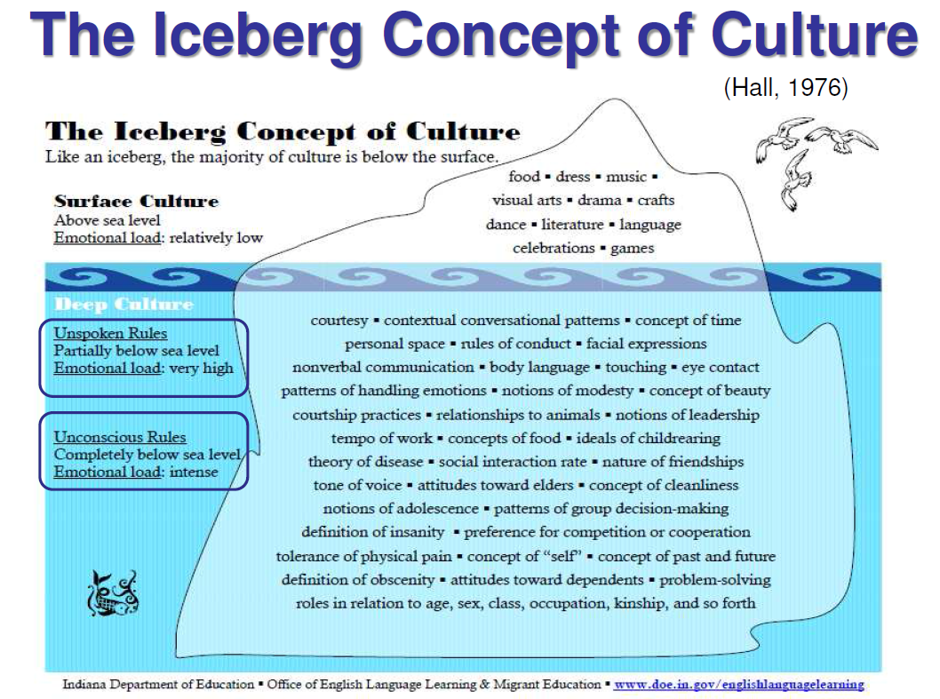

Slide 34
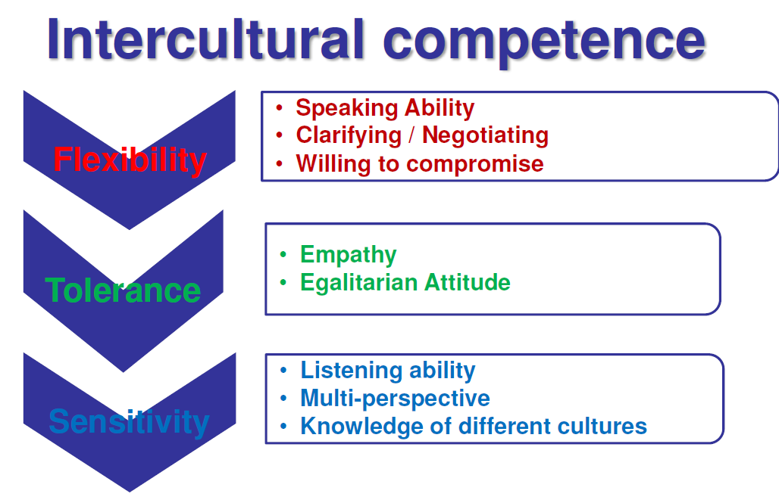

Slide 35
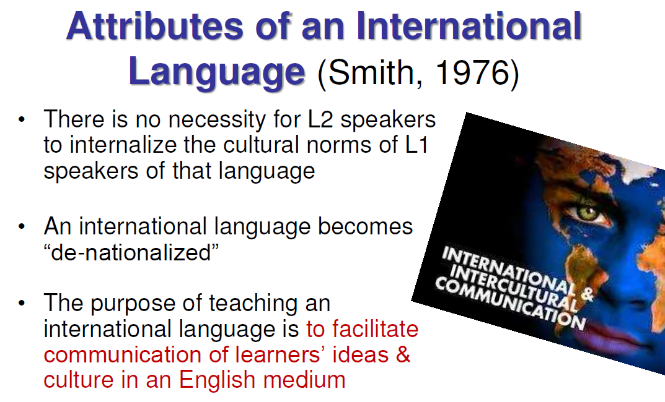
ˈætrɪˌbjuːt

Slide 36
From cultural awareness to intercultural understanding
Cultural awareness may focus on knowledge about different cultures, but we should move towards intercultural understanding.
Interconnectedness between the different elements of CLIL strengthens when links between language, cognitive processing and CULTURE are explored.
CLIL opens the door to intercultural understanding where learners have experiences which they do not have in a monolingual setting. (global citizenship)
CLIL teachers should develop whole-school partnerships and use technologies

Slide 37
Socio-cultural interaction may lead to
DEEP LEARNING involves the critical analysis of new ideas, connecting them to already-known concepts, and leads to understanding and long-term retention of those so that they can be used for problem solving in unfamiliar contexts.

Slide 38
Intercultural dialogue
Involves using skills to mediate between one’s own and other cultures. It starts with raising awareness about one’s own cultures, including culturally learners attitudes and behaviours.
Learners critically apply and analyse social processes and outcomes
To achieve this, learners need to engage in interactive and dialogic learning within the classroom and beyond

Slide 39
The 4 Cs Framework
Content (subject matter)
Communication (language learning and using)
Cognition (learning and thinking processes)
Culture (developing intercultural understanding and global citizenship)

Slide 40
CONTEXT
CONTEXT
CULTURE
CULTURE
COMMUNICATION
CONTENT
COGNITION
CULTURE
CULTURE
CONTEXT
CONTEXT

Slide 41
The 4Cs is built on the following principles:
Content matter is not only about acquiring knowledge and skills, it is about the learner CREATING their own knowledge and understanding and DEVELOPING skills (personalised learning)
Content is related to learning and thinking (cognition).
Thinking processes need to be analyzed for their linguistic demands.
Language needs to be learned which is related to the learning context, to learning through that language, to reconstructing the content. This language has to be transparent and accessible.

Slide 42
The 4Cs is built on the following principles:
Interaction in the learning context is fundamental to learning.
The relationship between cultures and languages is complex. Intercultural awareness is fundamental to CLIL.
CLIL is embedded in the wider educational context.

Slide 43
Integration of content and language needs
that CLIL teachers adopt an inquiry-based approach to classroom teaching and learning
to be built on a theory of practice when CLIL teachers articulate their implicit knowledge and understanding about teaching and learning and their implicit knowledge becomes explicit through this process

Slide 44
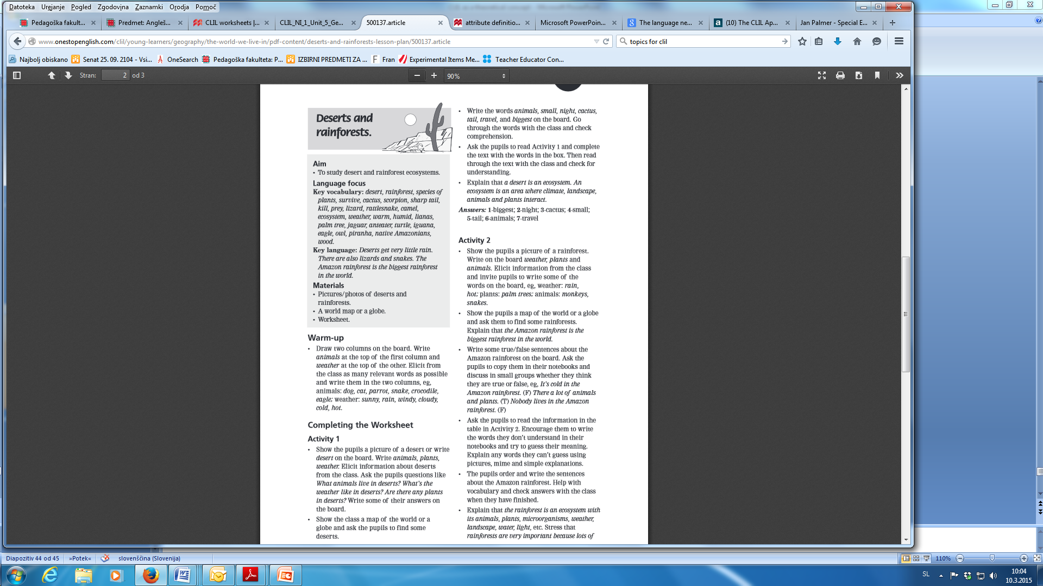
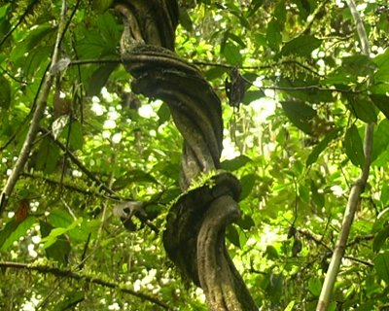
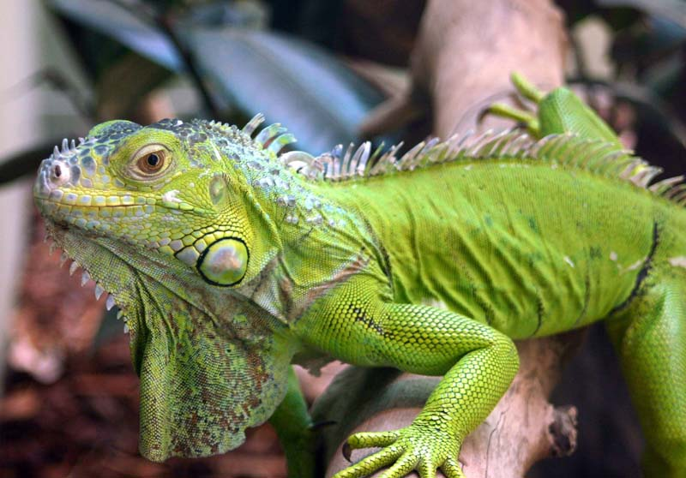
Liana is any of various long-stemmed, woody vines that are rooted in the soil at ground level and use trees, as well as other means of vertical support, to climb up to the canopy to get access to well-lit areas of the forest.
(lɪˈɑːnə )
pəˈrɑːnə
Iguana (ɪˈɡwɑːnə)

Slide 45
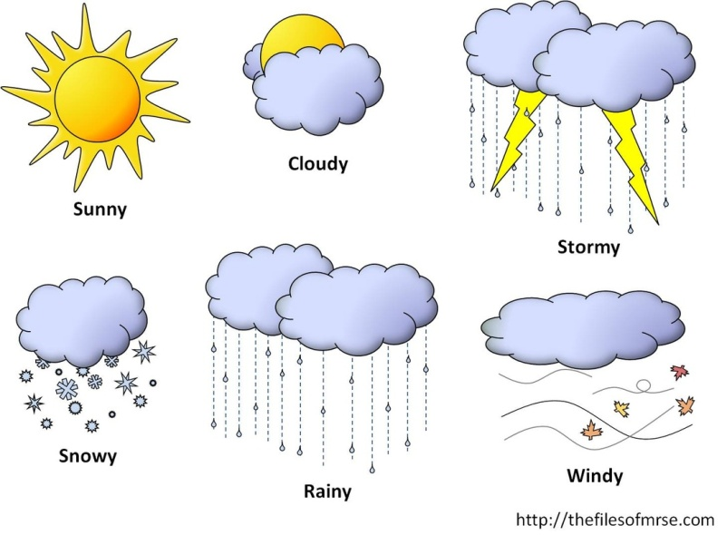
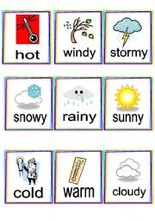
Animals | Weather
dog
cat
parrot
snake
crocodile
eagle

Slide 46
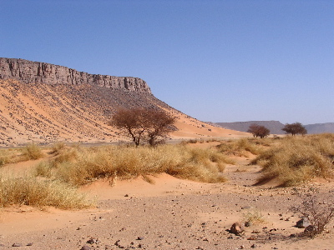



Slide 47
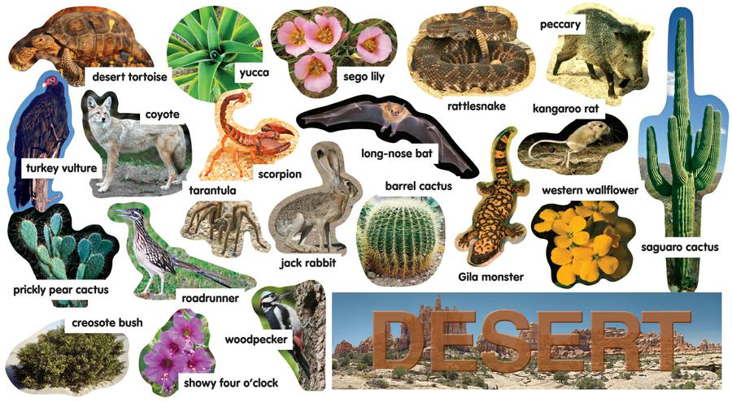
Animals | Plants | Weather
What animals live in deserts?
What’s the weather like in deserts?
Are there any plants in deserts?

Slide 48
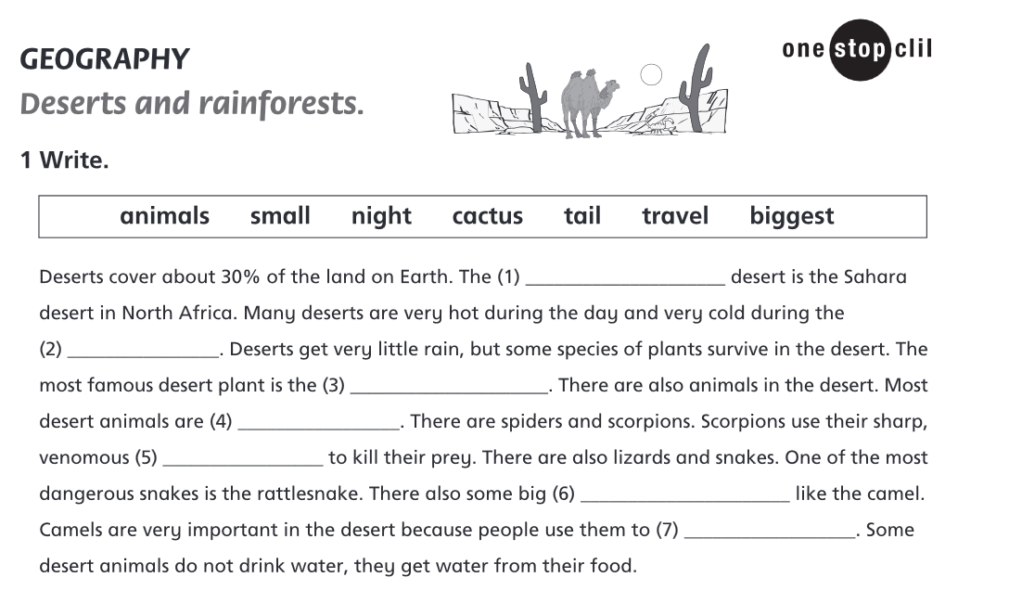

Slide 50
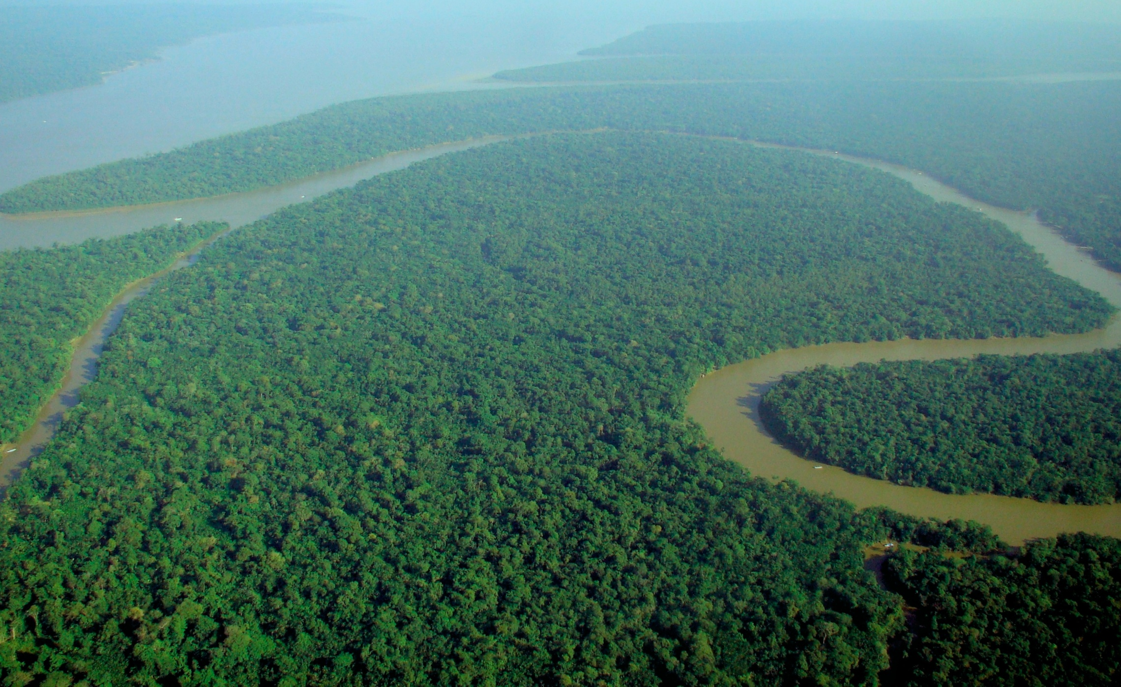
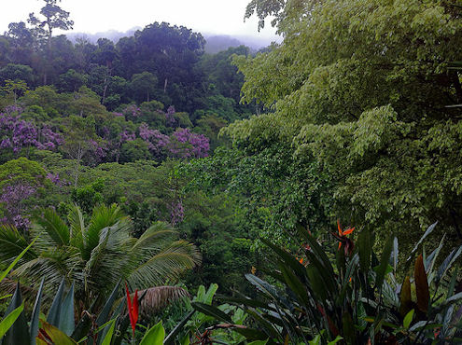

Slide 51


Slide 52
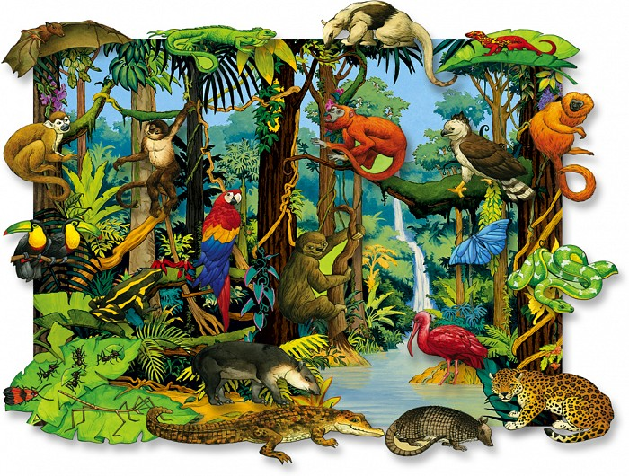
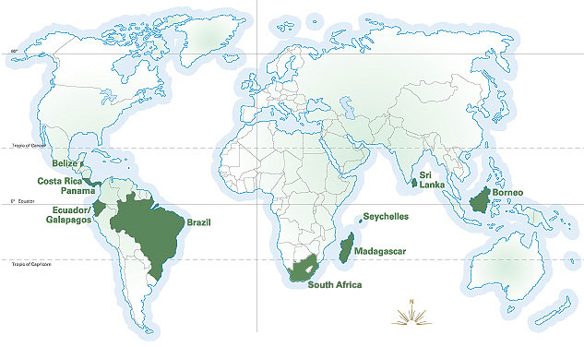
Animals | Plants | Weather

Slide 53
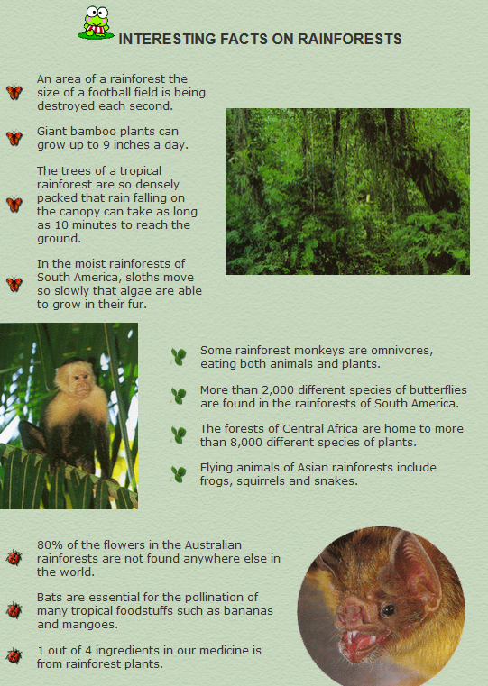
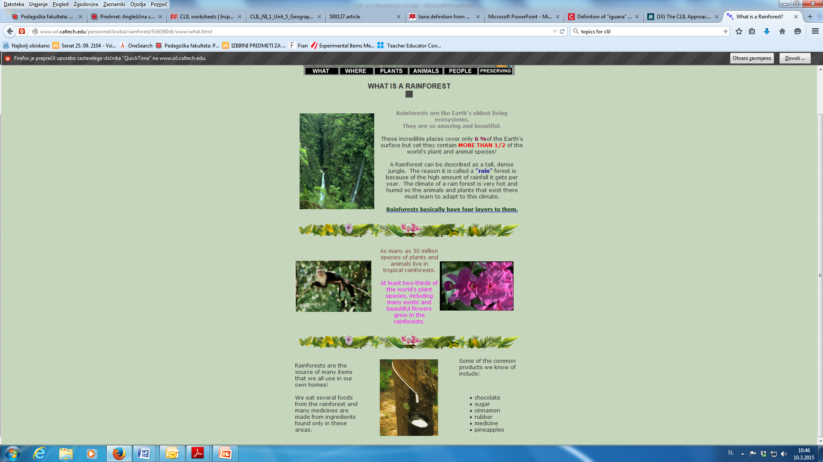

Slide 54
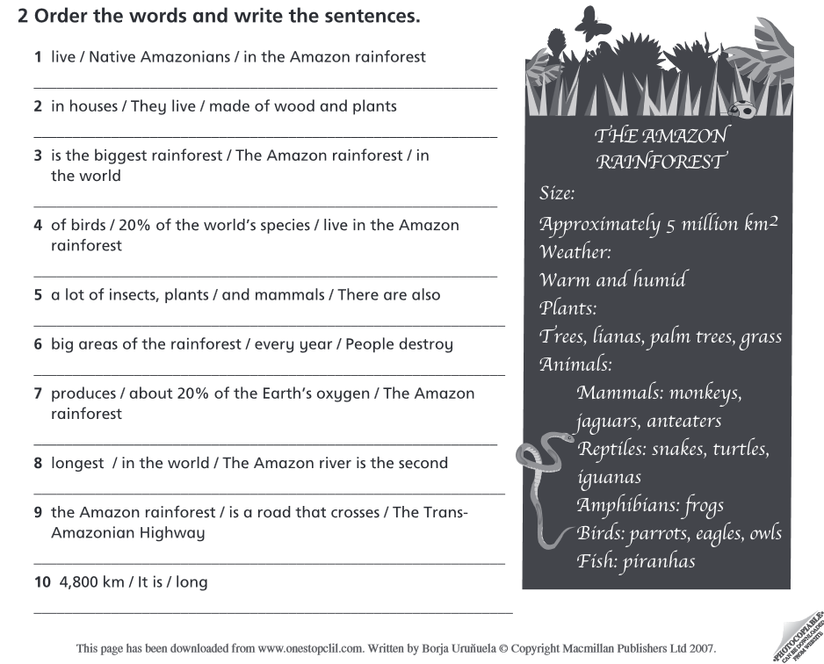

Slide 55
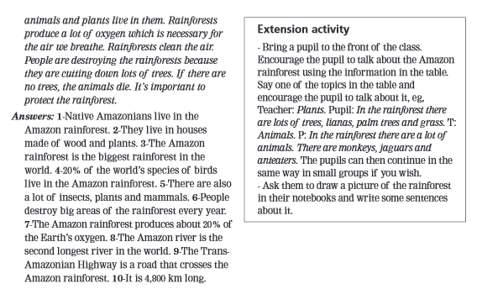

Slide 56
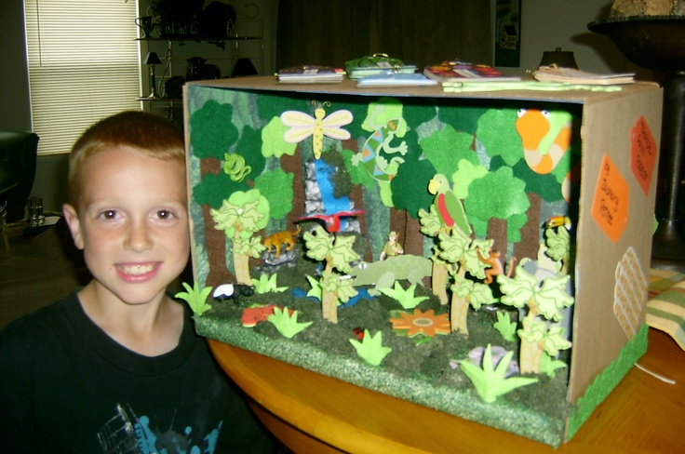
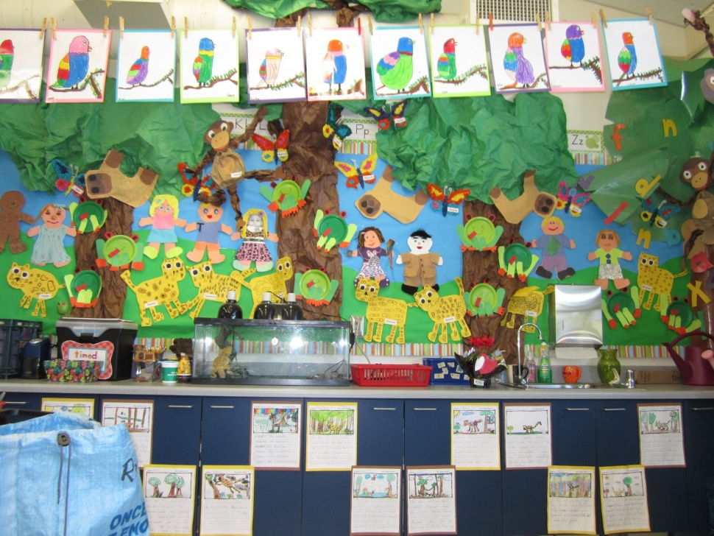
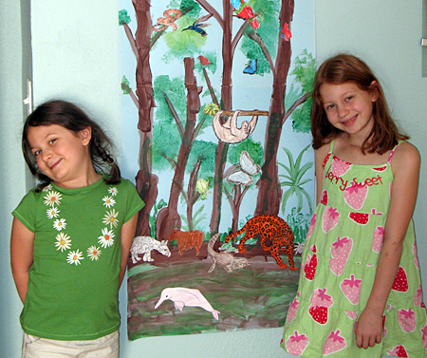
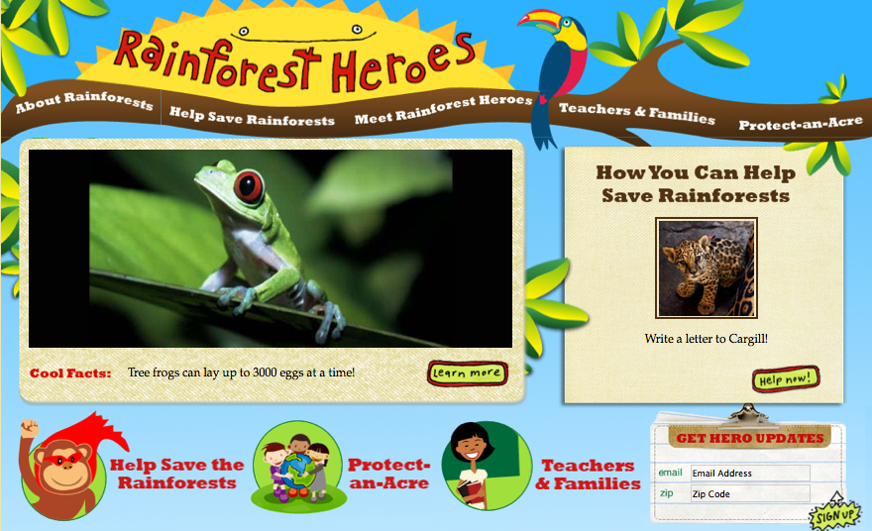

Slide 57
THE CLIL MATRIX
2 | 3
1 | 4
HIGH
COGNITIVE DEMANDS
LOW
LOW
HIGH
LINGUISTIC DEMANDS

