Slide 1



Slide 2

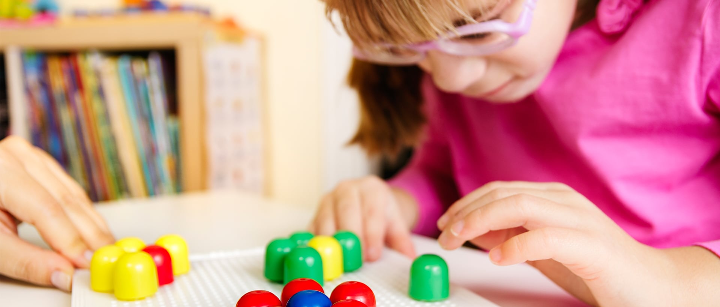

Social Skills Make Inclusive Life Easier
A training programme for teachers and staff working with young people who have Visual Impairment
(https://ibvi.org/blog/educational-options-for-blind-and-visually-impaired-kids/)
https://ibvi.org/wp-content/uploads/2019/12/IBVI_Blog_Education_For_Blind_Kids_1920x820.jpg

Slide 3
Social skills and Visual Impairment
Much of social interaction is non verbal and social cues and body language may be abstract concepts to the child with Visual Impairment. The development of social skills needs careful consideration as it differs considerably from that of their sighted peers.
Children who are visually impaired can find it difficult to acquire social skills that are vital for developing relationships and understanding social situations throughout their lifetime. It cannot be assumed that they will develop social skills automatically like their sighted peers. This has an impact both in school and in the wider world.

Slide 4
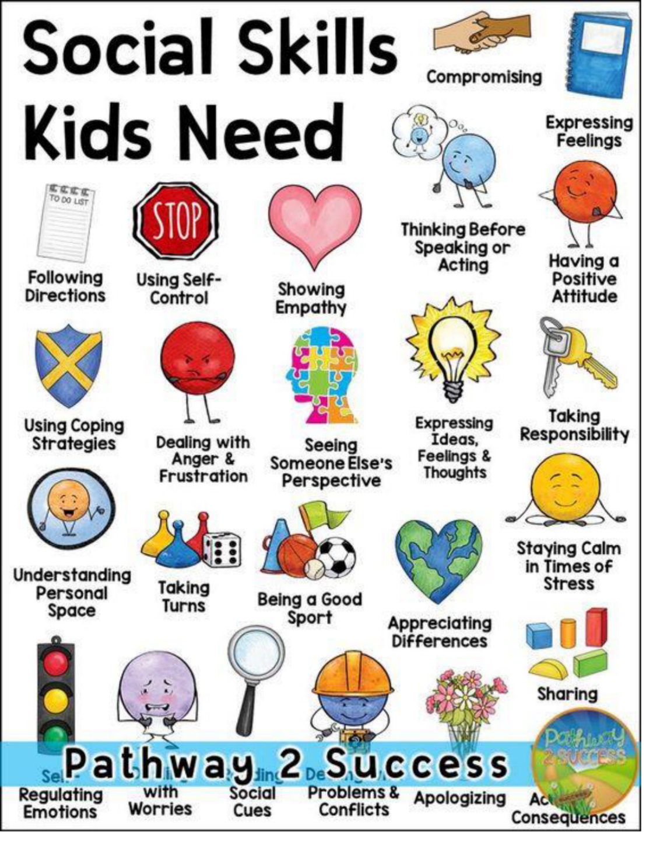
https://i0.wp.com/www.thepathway2success.com/wp-content

Slide 5

Question:
How do we communicate?
https://stock.adobe.com/uk/images/questions/

Slide 6

How many did you think of?
Speaking
Listening
Gesture
Sounds
Eye contact
Body language
Facial expressions
Social media
Any others?
https://clipartix.com/communication-clipart-image-43681/

Slide 7

How many of these rely on vision?
https://www.futurity.org/fact-checking-unreliable-sources-1584962/looking-through-magnifying-glass_1600-2/

Slide 8
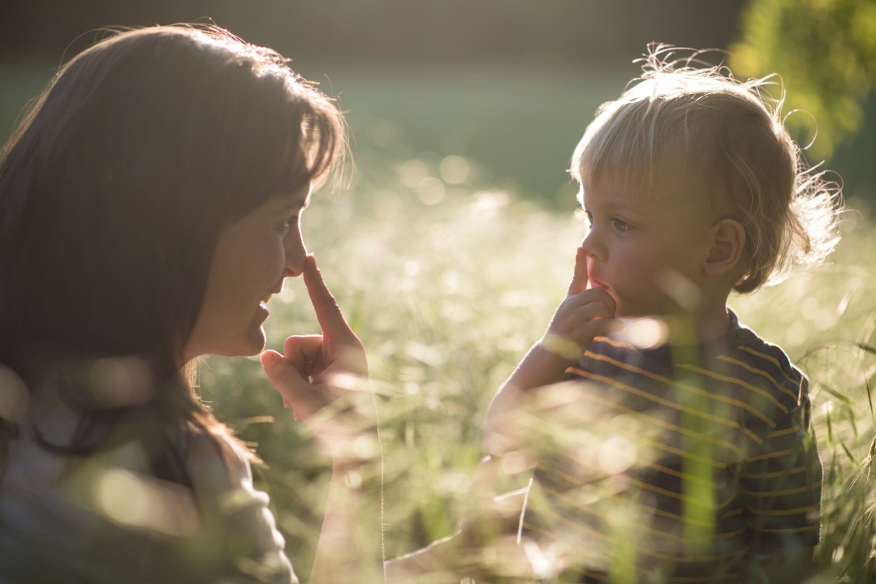
What does this mean for the child or young person with visual impairment or no sight?
A huge amount of social communication is non- verbal and relies on sight. We call this ‘Incidental Learning ’.
Copying
Imitation
Observing
Meeting different people
Being in a range of social situations
Children with impaired vision often find it very challenging to understand social situations and to interact with others.
https://kids.lovetoknow.com/wiki/Children_Learn_Best_by_Observing_Behavior_of_Adults

Slide 9
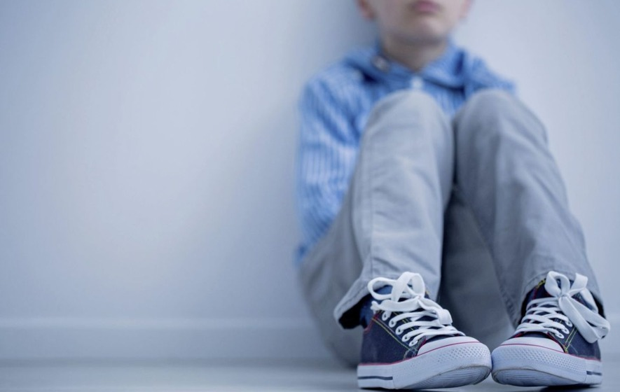
How can this affect the child with visual impairment?
Lack of confidence
Inappropriate behaviour
Withdrawal
Abstract concepts (moon)
Shutting down
Learned helplessness
Isolation
Depression
Lack of motivation
Aggression
Inability to make friends
Fewer career opportunities
Frustration
All of these have a direct and negative effect on relationships and learning.
https://www.irishnews.com/picturesarchive/irishnews/irishnews/2018/01/05/123421506-773911eb-77f5-4b7d-9ed1-bd9985c31b40.jpg

Slide 10
Why teach social skills?
“If you’re blind, how do you know where to look when someone is talking to you? Or when to shake someone’s hand? Or what “personal space” means? These are just some of the skills children who are blind must explicitly be taught, since they don’t have the benefit of observing the actions and reactions of their family and friends in social situations.”
Perkins school for the Blind

Slide 11
Why teach social skills?
“Sighted children observe and imitate people’s social behaviours, learning from any visual cues given. This is known as incidental learning. If these opportunities aren’t available to a child, understanding and development of appropriate social behaviour can become fragmented. Having appropriate social skills is crucial to a child’s everyday interactions. They enable the child to interact with others, establish friendships and later develop personal and work relationships”. RNIB 2017

Slide 12
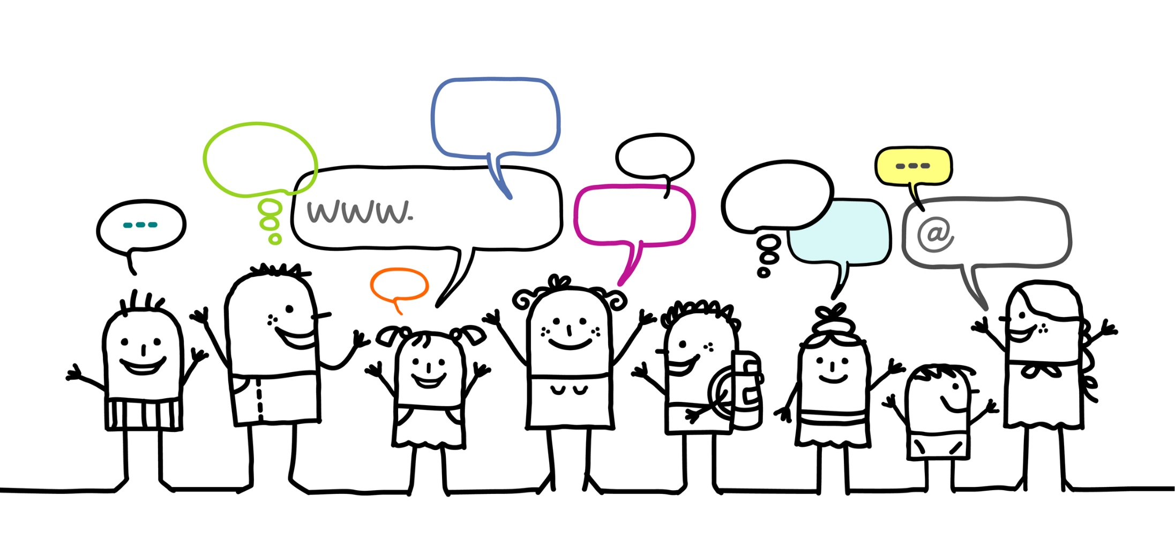
How can we support the development of social skills?
https://arfamiliesfirst.com/social-skills-programs/

Slide 13
Social Skills Make Inclusive Life Easier
5 themes
Who am I?
My strengths and challenges, body posture, mannerisms, confidence and talents
Mindfulness
How to manage my feelings
Empowerment
Asking for help, awareness of social skills, going outside my comfort zone
How do I communicate?
Listening, assertiveness, having an active conversation, personal space, audio description
My social network and activities
Making friends, social contacts at school and at home, leisure activities, thinking about careers

Slide 14

Theme 1: Who am I ?
https://www.creativeworld.co.uk/wp-content/uploads/2018/10/shutterstock_198152975.jpg

Slide 15
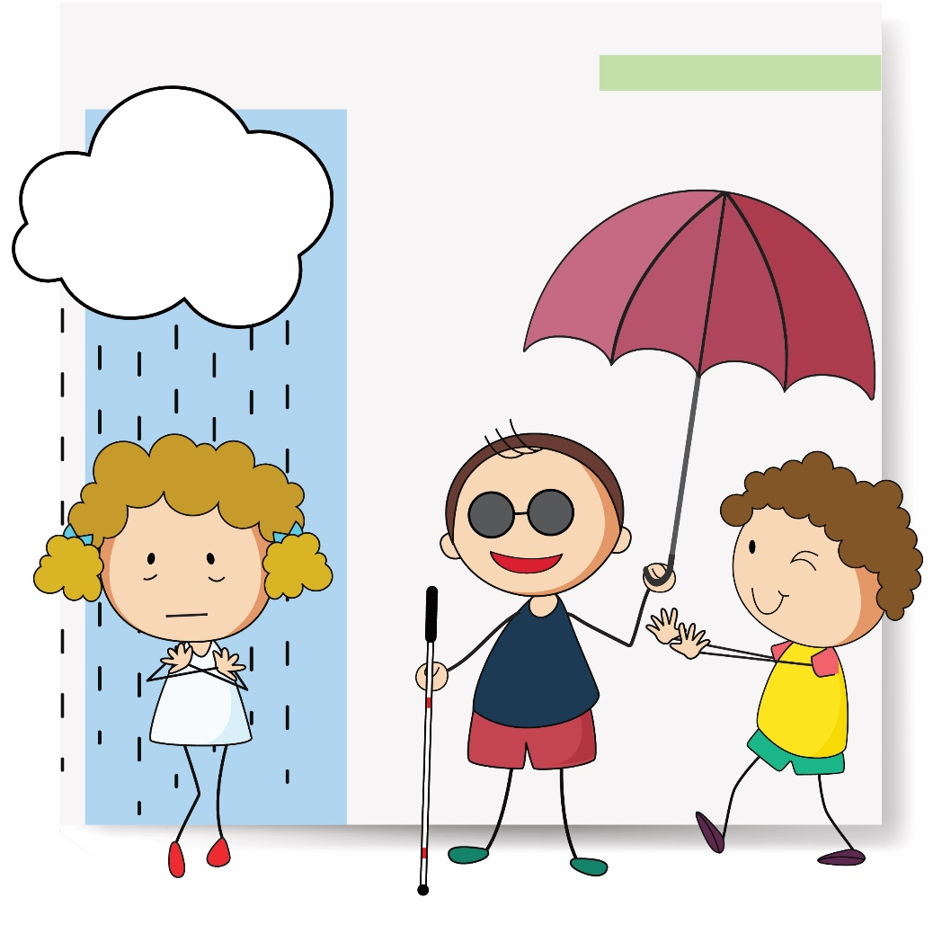
Developing empathy and recognising emotions
Developing listening skills- different tones of voice and what emotions these signify
Understanding what different sounds mean and linking these to feelings e.g. crying=upset, hurt, sad
Understanding that other people feel differently
Learning appropriate responses to sounds e.g. crying “are you hurt?” “what happened?” “you can talk to me if you are feeling sad”

Slide 16
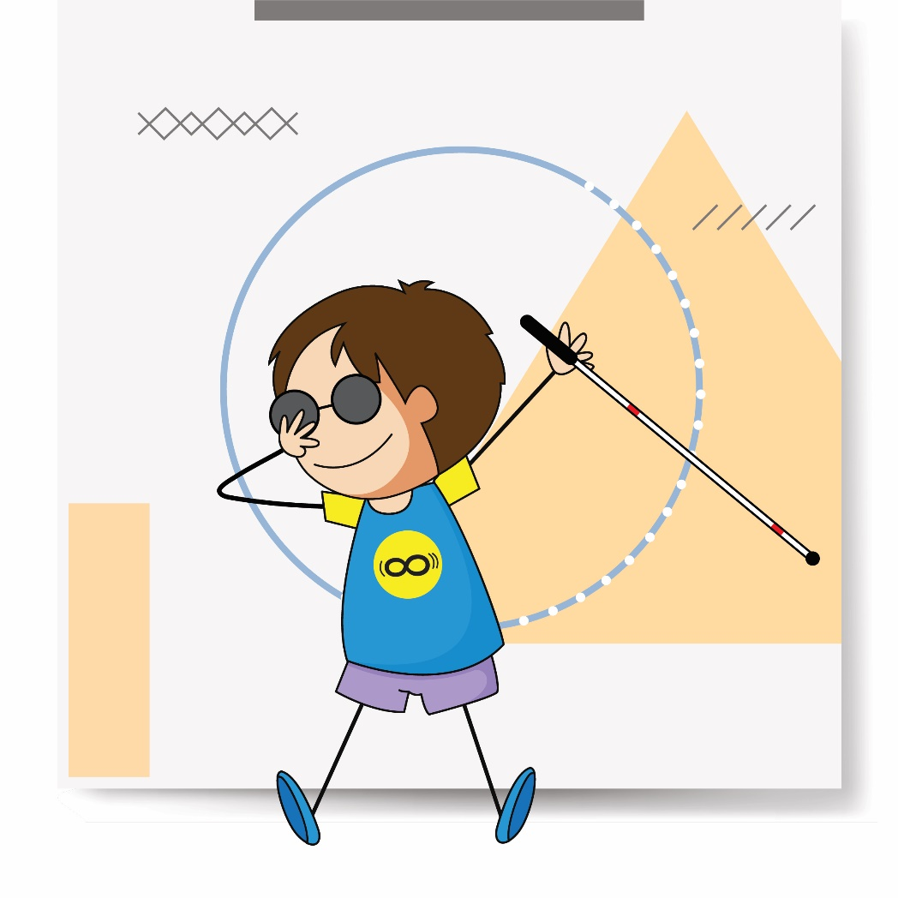
Addressing mannerisms
Finding out about what may be socially unacceptable behaviour, e.g. nose picking, grabbing, touching intimate areas of the body, eating with mouth open, rocking, eye pressing

Slide 17

Body posture
Keeping head up- you might have an agreed cue for this e.g. “show me your lovely face”, or a tap on the shoulder
Maintaining good posture- explaining how this may look to others and the importance of back health
Talking about what their posture says to others

Slide 18
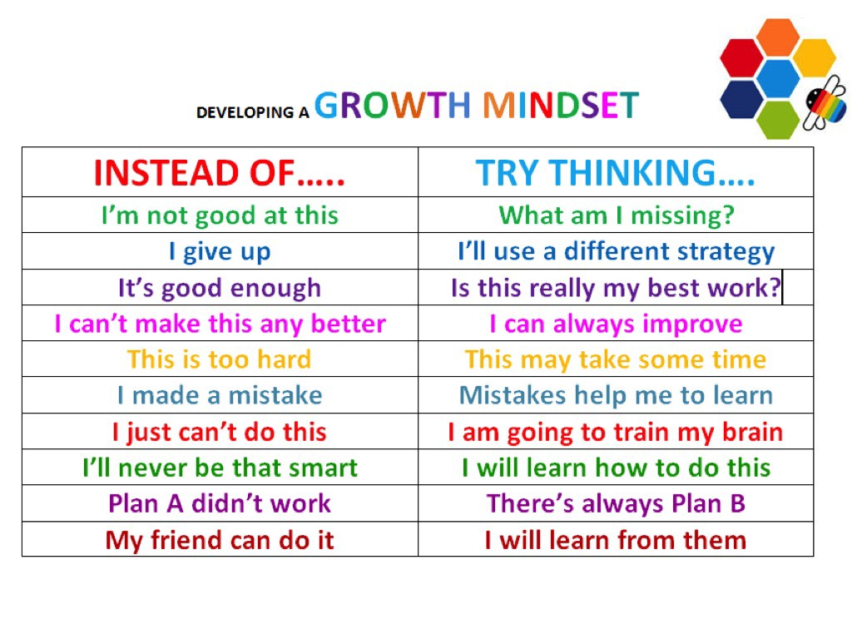
Encouraging a Growth Mindset
https://medium.com/@veraliruiyu/how-to-develop-the-growth-mindset-8de56f47384d

Slide 19

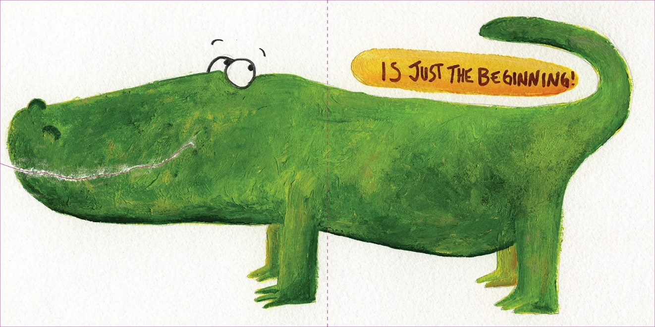
Beautiful Oops
https://www.youtube.com/watch?v=0JsnciXX7CE
Watch the video of the book Beautiful Oops. Think about how you could incorporate some of these ideas in your classroom
Salzberg, Barney The Beautiful Oops Workman Publishing 2009

Slide 20

Using Drama with su
https://w7.pngwing.com/pngs/196/88/png-transparent-yellow-and-blue-masks-illustration-theatre-cinema-drama-theater-drama-office-s-text-heart-smiley.png

Slide 21
Drama for students with Visual Impairment – developing social skills and empathy
Drama and role-play are wonderful tools to teach VI children about the world around them and explore their place in it.
Drama provides a safe space to explore the feelings of others as well as ourselves. Children can actually experience the issues, relationships and environments that effect their world. They can experiment with various responses both emotional and practical.
Drama creates a distance where children can feel the feeling without getting caught up in the emotion. By engaging in drama in this way they are getting equipped with the skills to integrate socially and build meaningful relationships.

Slide 22
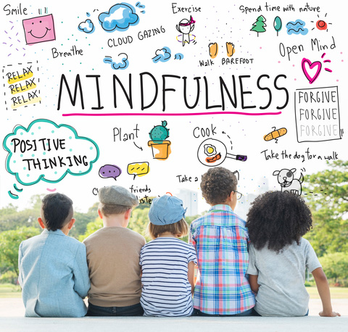
Theme 2: Mindfulness
https://www.mentalup.co/blog/mindfulness-for-kids

Slide 23
Mindfulness, Visual Impairment and social skills
Mindfulness activities help us to connect with ourselves. Only when we are secure in ourselves can we begin to connect with others, build relationships and develop good social skills.
Children with a VI have added stress in their lives as all forms communication are more complicated for them.
Stress impedes their ability to learn, listen, connect and process emotions.
Regular mindfulness reduces stress and allows children the space they need to process, feel at ease and learn.

Slide 24
A mindfulness exercise to try (approx 6 mins)
Sit in your chair with two feet on the floor, your back against the back of the chair and if it is comfortable for you, gently close your eyes.
Pay attention to your breathing. Follow your breath right to the end as you breathe in and follow the breath right to the end as you breathe out. Just by doing this you might feel your breath slow down. Maybe count your breath in and out and feel the count get slightly longer. (1.5 mins)
See if you can pull the breath down to your tummy. Breathing in your breath goes deep, breathing out your breath goes slow. (1 min)
Now listen. Listen to the noises inside the room and outside the room. Pay attention. See what you notice that you weren’t aware of. (2 mins)
Share what you heard and what your body feels like just by taking some minutes to be still. (2 mins)

Slide 25

Theme 3: Empowerment
https://mindchampsorg.files.wordpress.com/2016/08/confident-child.jpg?w=720

Slide 26
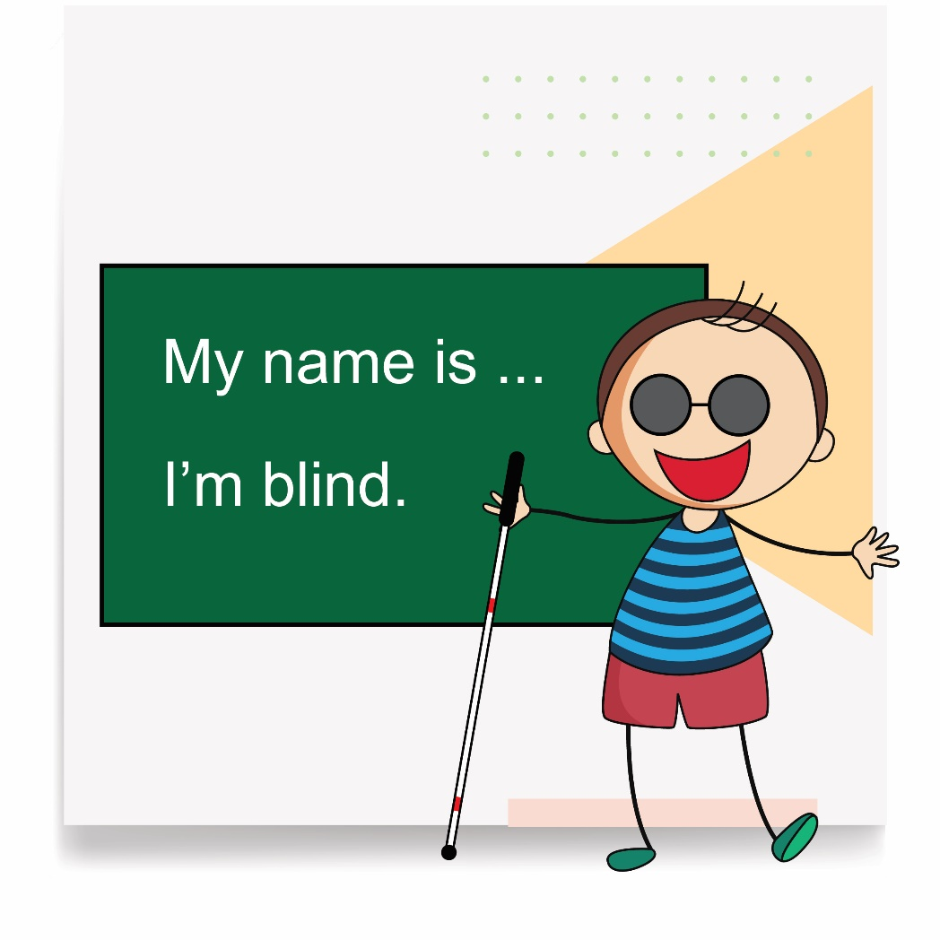
Empowerment
Understanding their visual impairment and being able to explain it to others
Knowing what helps, e.g. print size, magnifiers
Looking after glasses and equipment
Knowing about their strengths
Being aware of what is challenging
Thinking of ways to work around problems
Being able to ‘bounce back’ when things don’t go well
Having a wide range of experiences including managed risk taking
Be prepared to answer questions about blindness simply and naturally.

Slide 27
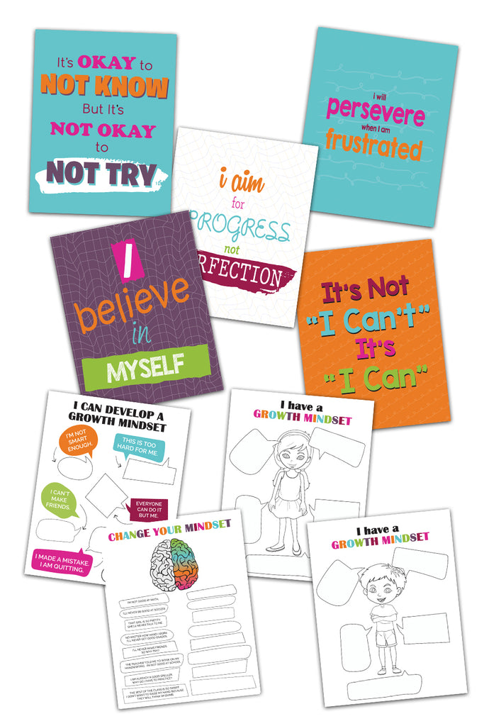
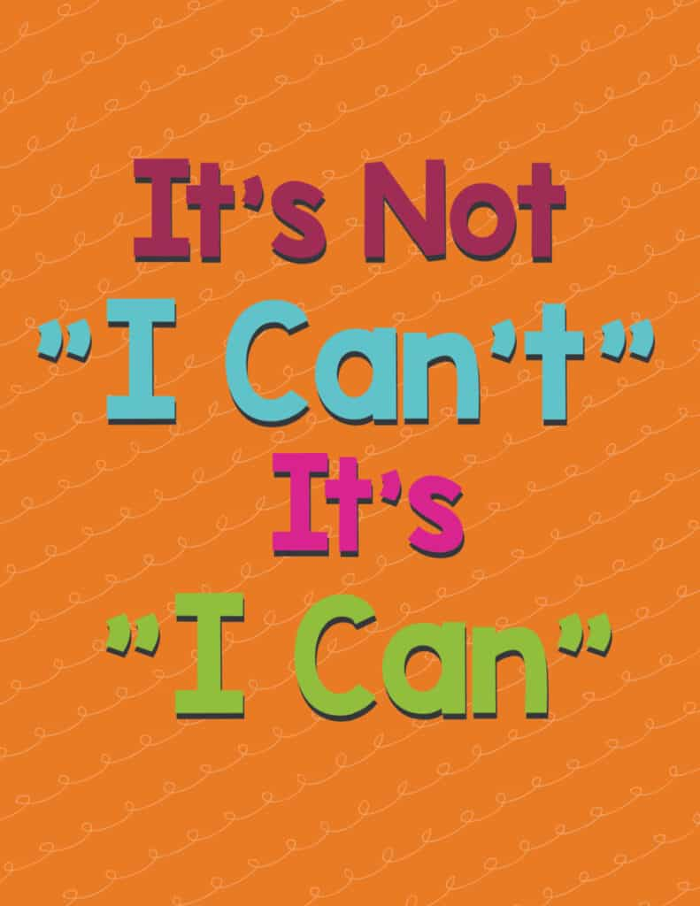
Growth Mindset=Empowerment
https://www.freebiefindingmom.com/wp-content/uploads/2021/10/printable-growth-mindset-quotes-for-kids-its-not-I-cant-its-I-can-791x1024.jpg

Slide 28
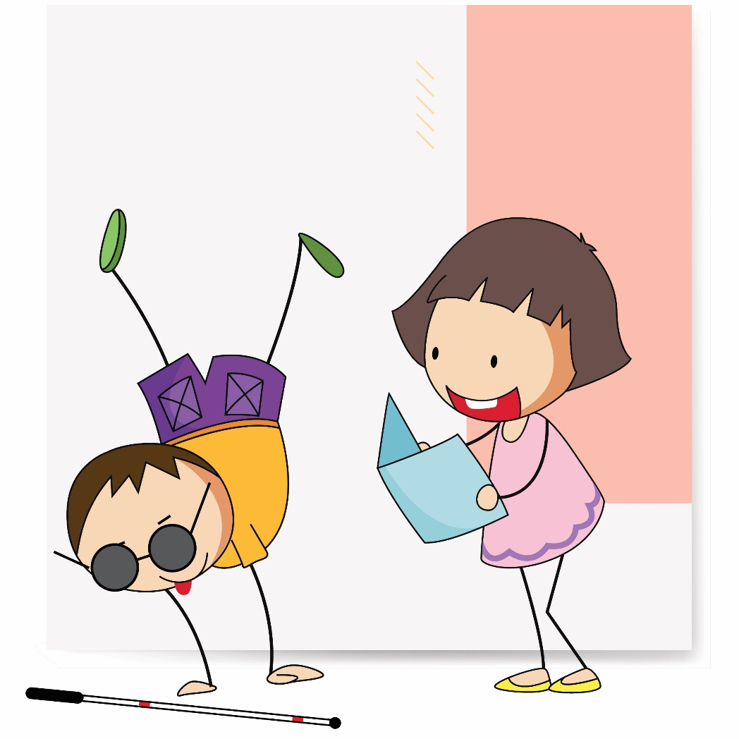
Audio description
Aim to be accurate and objective
Describe who is present and what they are doing
Take a look at the video and discuss

Slide 29

Audio description video
Watch the video and discuss
https://drive.google.com/file/d/1KczVU3PrSaGAvdY_VGiCgVG01MX0tm99/view?usp=sharing
https://freewaysocial.com/wp-content/uploads/2019/08/how-to-upload-a-video-to-youtube.jpg

Slide 30
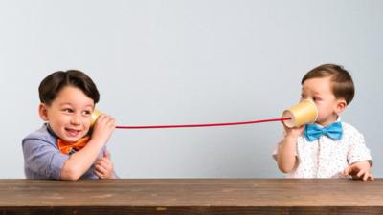
Theme 4: How do I communicate?
https://ichef.bbci.co.uk/news/400/cpsprodpb/E90A/production/_108885695_gettyimages-946040214.jpg

Slide 31
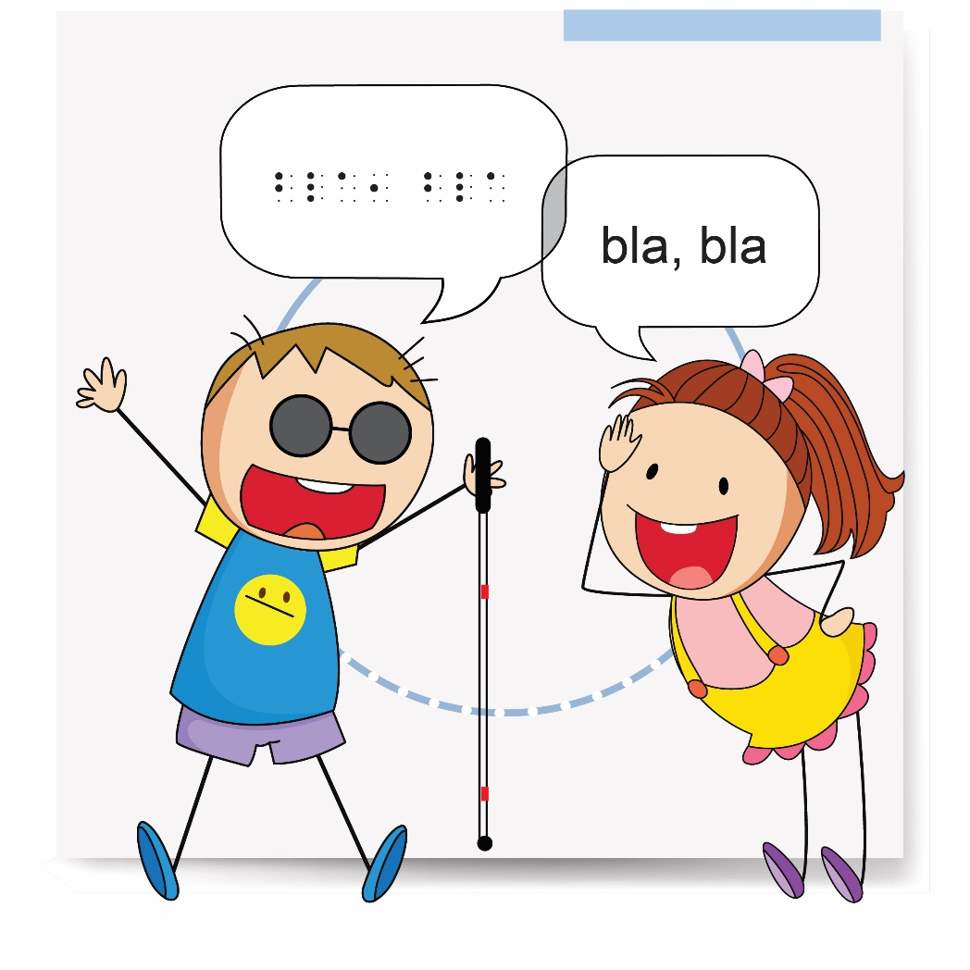
Verbal communication- turn taking
Moving head towards a speaker during conversation
Understanding that other people have different interests
Learning listening skills
Understanding the importance of turn taking
Knowing different questions to ask

Slide 32
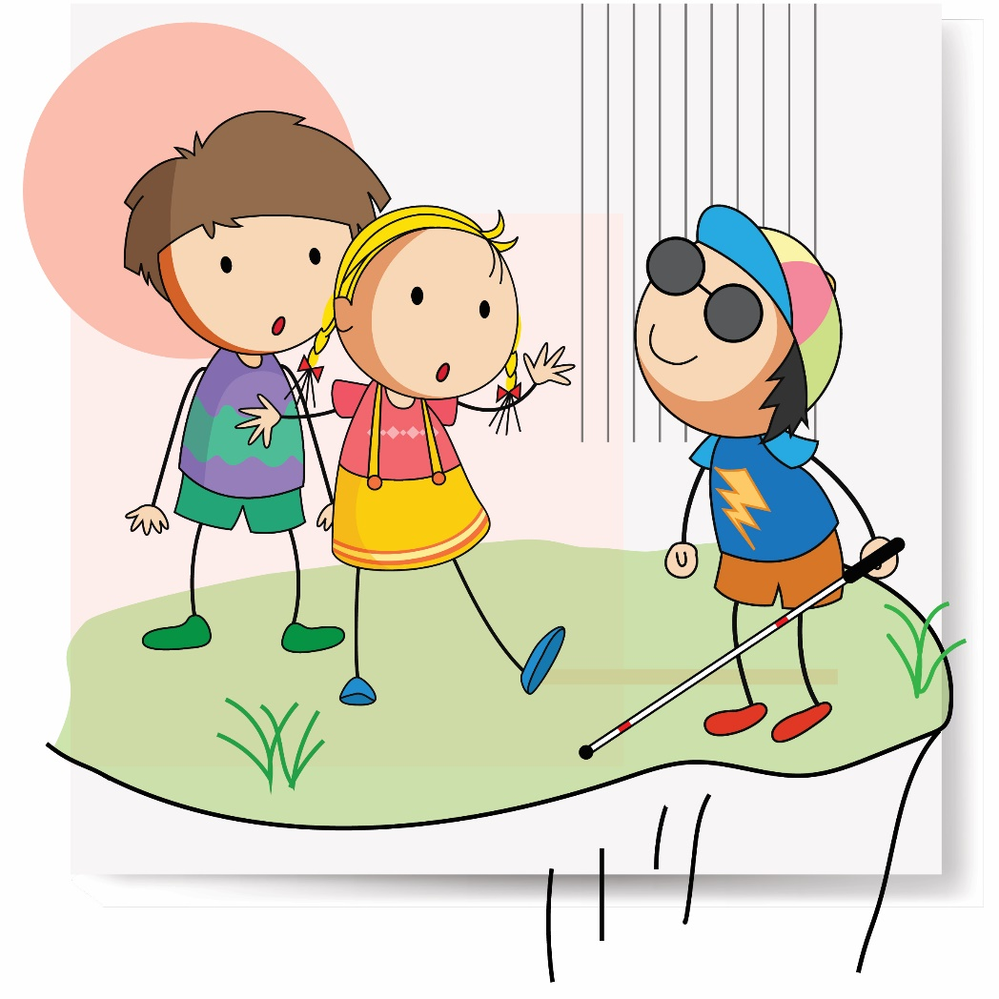
Non verbal communication
Developing listening skills- different tones of voice and what emotions these signify
Understanding different sounds and what they might mean, e.g. yawning, tutting, sighing, slamming a door

Slide 33
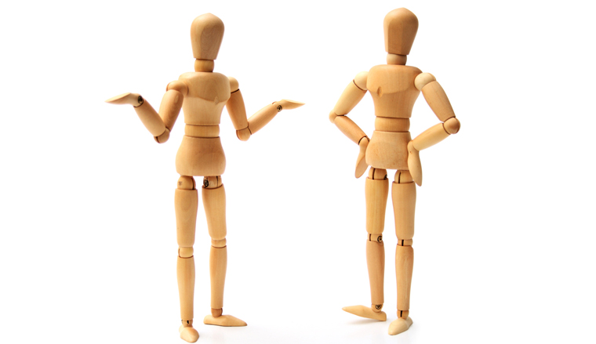
Non verbal communication
Watch the video about non verbal communication and discuss.
https://www.callcentrehelper.com/images/stories/2008/10/body-language.jpg
https://freewaysocial.com/wp-content/uploads/2019/08/how-to-upload-a-video-to-youtube.jpg

Slide 34

Awareness of personal space
Learning about intimate space and public space
Knowing what ‘arms length’ means
Standing at an appropriate distance
Different ways to get attention e.g. hand raising

Slide 35

Theme 5: My social network and activities
https://cdn.psychologytoday.com/sites/default/files/styles/image-article_inline_full_caption/public/field_blog_entry_images/2019-01/january-2019.jpg?itok=KzIVupHr

Slide 36
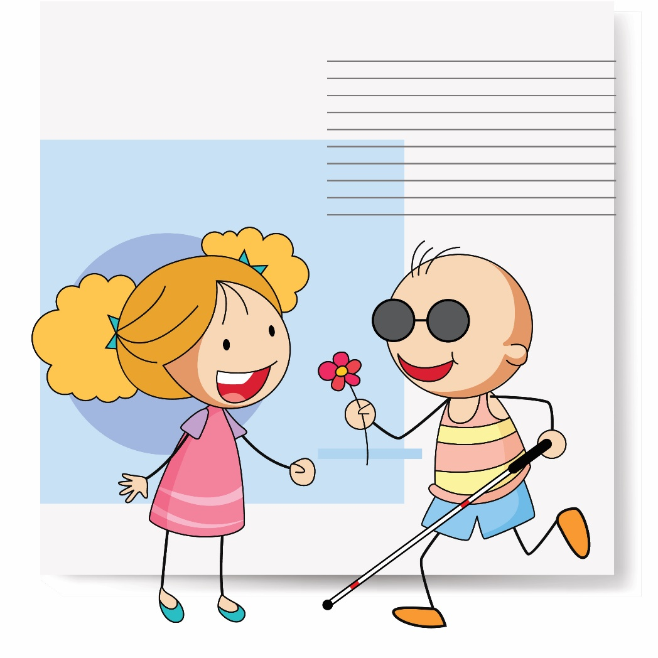
Making friends and initiating conversation
Learning different kinds of greetings for different people
Listening for a gap in the conversation
Practicing appropriate ways to interject e.g. “Excuse me” or “I agree”
Learning to interpret facial expressions (including their own!)
Understanding that people have different interests
How to end a conversation

Slide 37
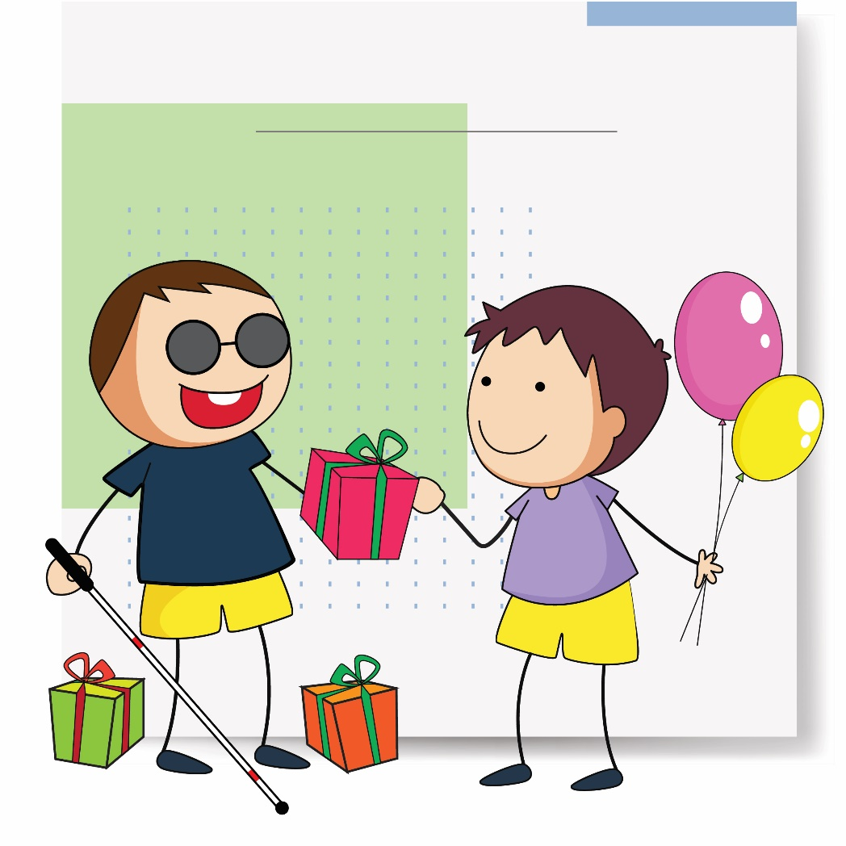
Maintaining contacts
Learning conversation skills- starting and ending a conversation
Understanding a range of relationships and how these are different e.g. bus driver and mum
Checking in with friends, e.g. “How are things today?”
Understanding that everyone has a right to be heard
Different ways to stay in touch. This includes Internet Safety
Thinking about the qualities of a good or ‘real’ friend

Slide 38
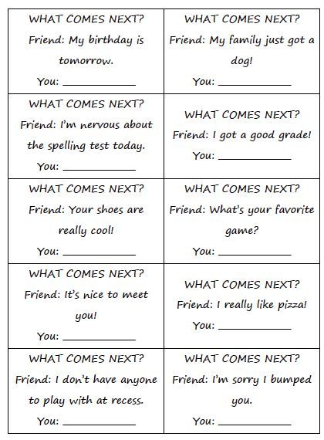
Practicing appropriate social responses
https://www.pinterest.com/danielariggins/therapy-ideas-for-social-thinking/

Slide 39
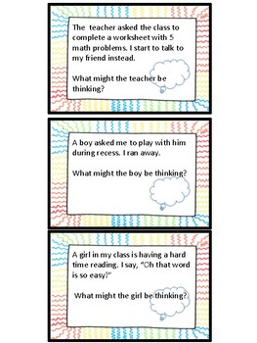
Thinking about other peoples perspective
https://ecdn.teacherspayteachers.com/thumbitem/30-Scenarios-for-Perspective-Taking-3081409-1508093617/original-3081409-1.jpg

Slide 40
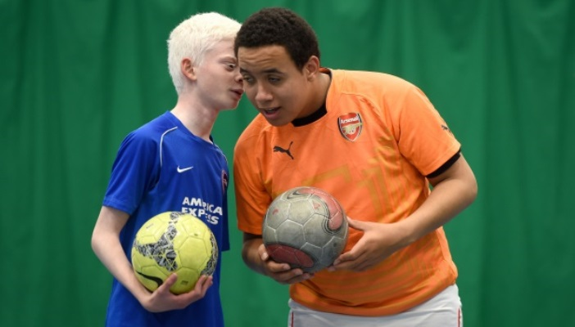
Sport and leisure activities
A wide range of benefits
Relaxation
Health
Self-confidence.
Social contact
https://www.rnib.org.uk/sites/default/files/Football%20social702x400.jpg

Slide 41

Finding a place in society
Knowing your strengths
Widening your interests
Looking at career options
Practicing job interviews
Understanding your visual impairment
Explaining your visual impairment
Gaining work experience
Learning to deal with money.
https://www.sustainable-environment.org.uk/wp-content/uploads/2019/01/Define-community-and-also-discuss-the-differences-between-society-and-community.jpg

Slide 42
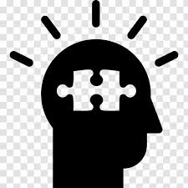
So...what have we learned?
https://encrypted-tbn0.gstatic.com/images?q=tbn:ANd9GcSkKpVYGkGmiOUvEHKo_3cMI9gXmeu0f0MtXQ&usqp=CAU

Slide 43
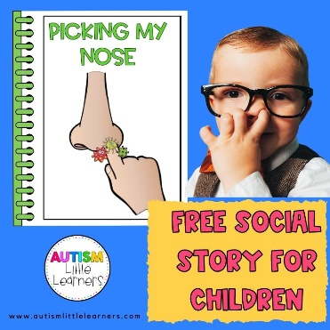
Explicit teaching of social skills involves….
Developing listening skills- different tones of voice and what emotions these signify
Learning different kinds of greetings for different people
Learning to interpret facial expressions (including their own!)
Learning about personal space
Finding out about what may be socially unacceptable behaviour, for example nose picking, grabbing, touching intimate areas of the body
https://i0.wp.com/autismlittlelearners.com/wp-content/uploads/2022/03/picking-nose-story.jpg?fit=800%2C800&ssl=1

Slide 44
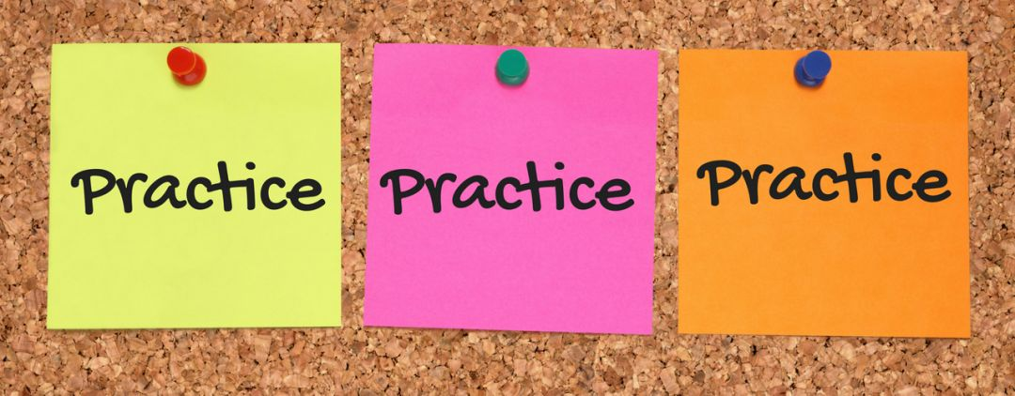
Practice practice practice……
Greeting lots of people in different ways and in different situations
Personal space and intimate space
Moving head towards a speaker
Listening for social cues and what these mean- e.g. sighing, tutting
Keeping head up- “show me your lovely face”
Maintaining good posture
https://www.priorityit.co.nz/wp-content/uploads/2018/01/Practice-1024x400.jpg

Slide 45
Knowing when to take a step back..
“Providing students with fading assistance in social circumstances is key. Talking with the student about who is involved, what they are doing and why can help the student understand the social context. Although it may be difficult to provide, students need honest and sensitive feedback about their behaviour and the impact it may have on social interactions. You can then talk with the student about how they can make judgments about how to change their behaviour”. https://www.teachingvisuallyimpaired.com/social-interactions.html

Slide 46

Time to reflect…
Can you share any ideas that you already use?
Can you think of ways social skills can be embedded in other activities?
https://www.thinkib.net/media/ib/psychology/images/discuss.jpg

Slide 47
Some more social skills resources
https://www.thepathway2success.com/12-basic-social-skills-kids-need/
https://www.teachingvisuallyimpaired.com/social-interactions.html
https://www.perkinselearning.org/videos/webcast/developing-social-skills-children-who-are-blind-or-visually-impaired

Slide 48
"The European Commission's support for the production of this publication does not constitute an endorsement of the contents, which reflect the views only of the authors, and the Commission cannot be held responsible for any use which may be made of the information contained therein."

