Slide 1


Project SMILE too
Social Skills Make Inclusive Life Easier
Empowerment

Slide 2
Statement
A child with visual impairment has fewer developmental opportunities than sighted children.

Slide 3
Statement
I can influence my child’s development

Slide 4
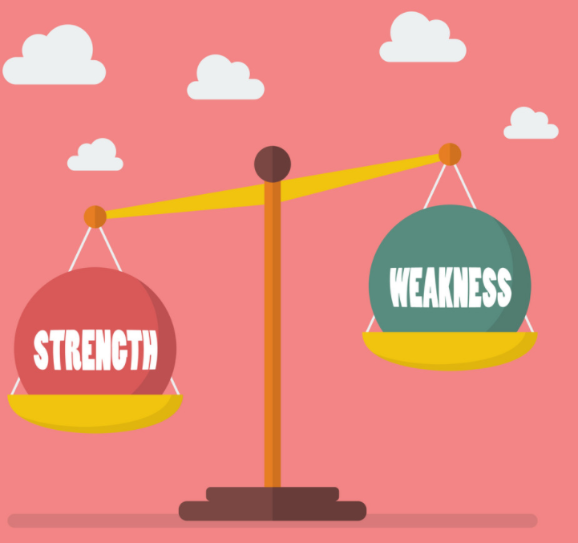
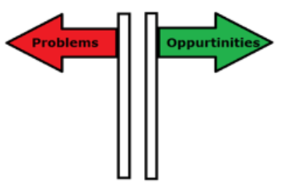
Focus on Strengths
‘Energy flows where attention goes’
What approach do we choose?

Slide 5
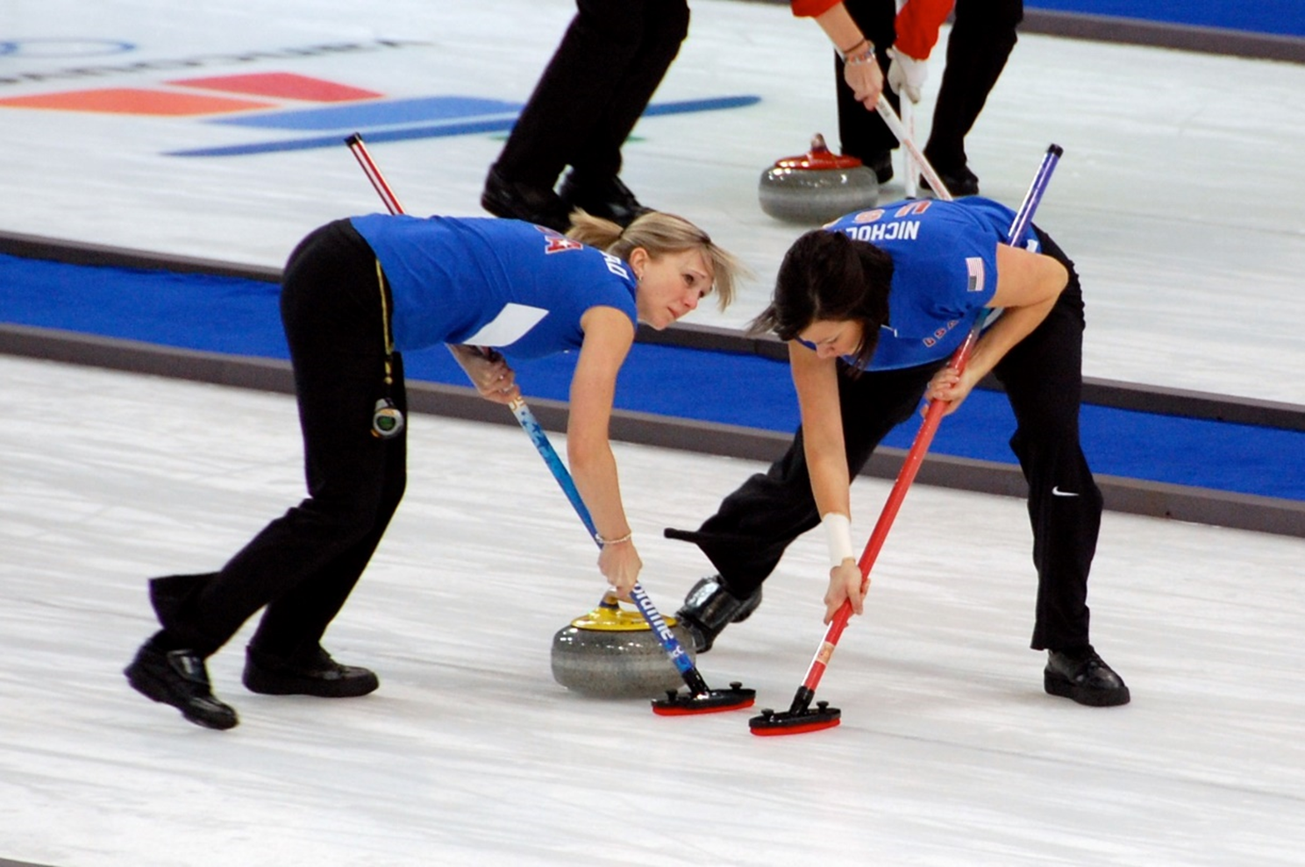
Curling Parents and Professionals

Slide 6
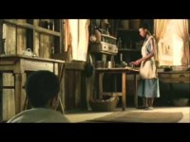
Ray Charles
Youtube video: Ray Charles goes blind and calls for help https://youtu.be/rrVtWTRkFB4

Slide 7
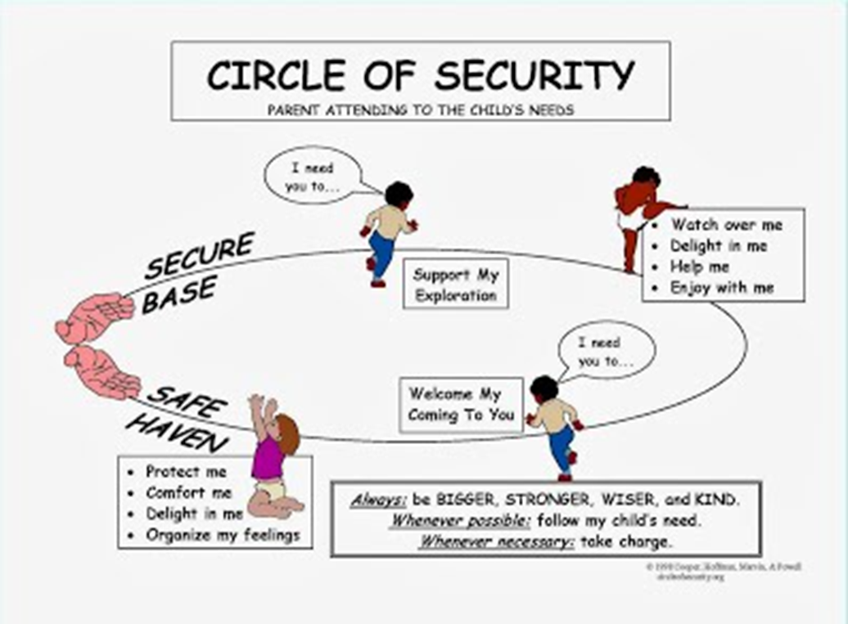
Importance of: EXPLORATION
It is not only about love and comforting
we need to stimulate children to EXPLORE!

Slide 8
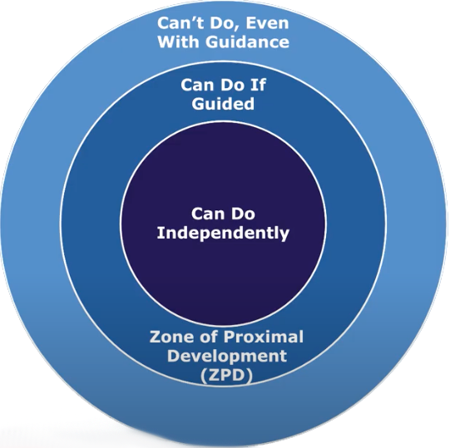
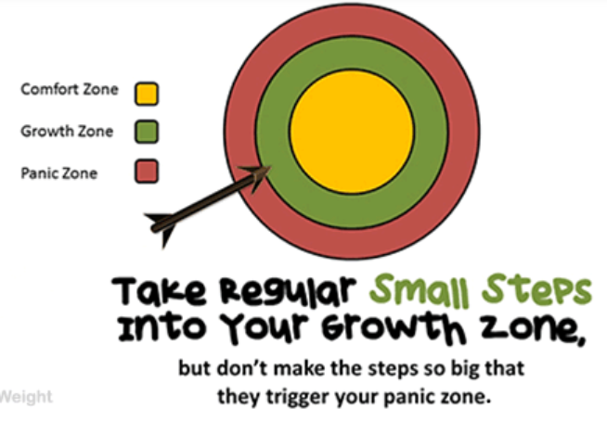
Focus on Exploration

Slide 9
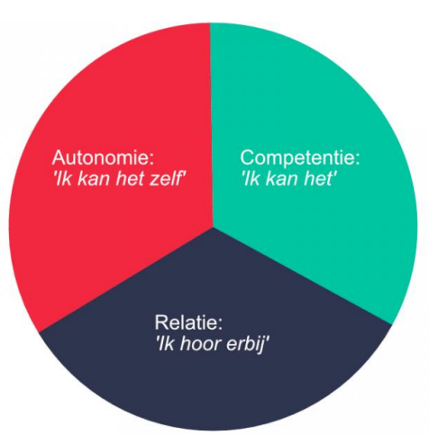
Focus on
Three Basic Psychological Needs
AUTONOMY
‘I can do it myself’
COMPETENCE
‘I can do it’
RELATEDNESS
‘I belong’

Slide 10
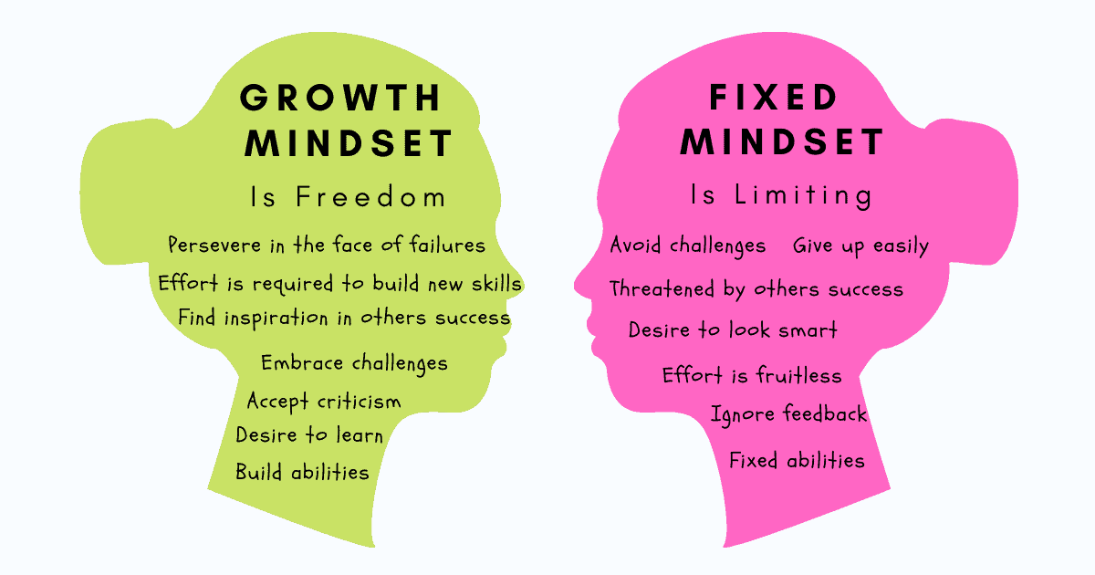
Stimulate a Growth Mindset

Slide 11


"The European Commission's support for the production of this publication does not constitute an endorsement of the contents, which reflect the views only of the authors, and the Commission cannot be held responsible for any use which may be made of the information contained therein."

