Slide 1
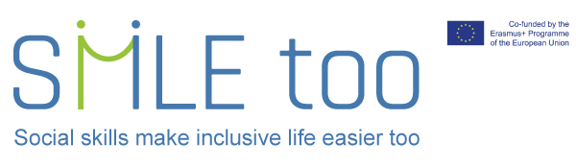


Slide 2

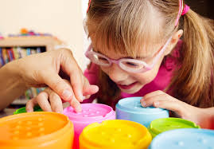

Social Skills Make Inclusive Life Easier
A training programme for parents of children with Visual Impairment
(https://ibvi.org/blog/educational-options-for-blind-and-visually-impaired-kids/)
https://ibvi.org/wp-content/uploads/2019/12/IBVI_Blog_Education_For_Blind_Kids_1920x820.jpg

Slide 3
Social skills and Visual Impairment
Much of social interaction is non verbal and social cues and body language may be abstract concepts to the child with Visual Impairment. The development of social skills needs careful consideration as it differs considerably from that of their sighted peers.
Children who are visually impaired can find it difficult to acquire social skills that are vital for developing relationships and understanding social situations throughout their lifetime. It cannot be assumed that they will develop social skills automatically like their sighted peers. This has an impact both in school and in the wider world.

Slide 4
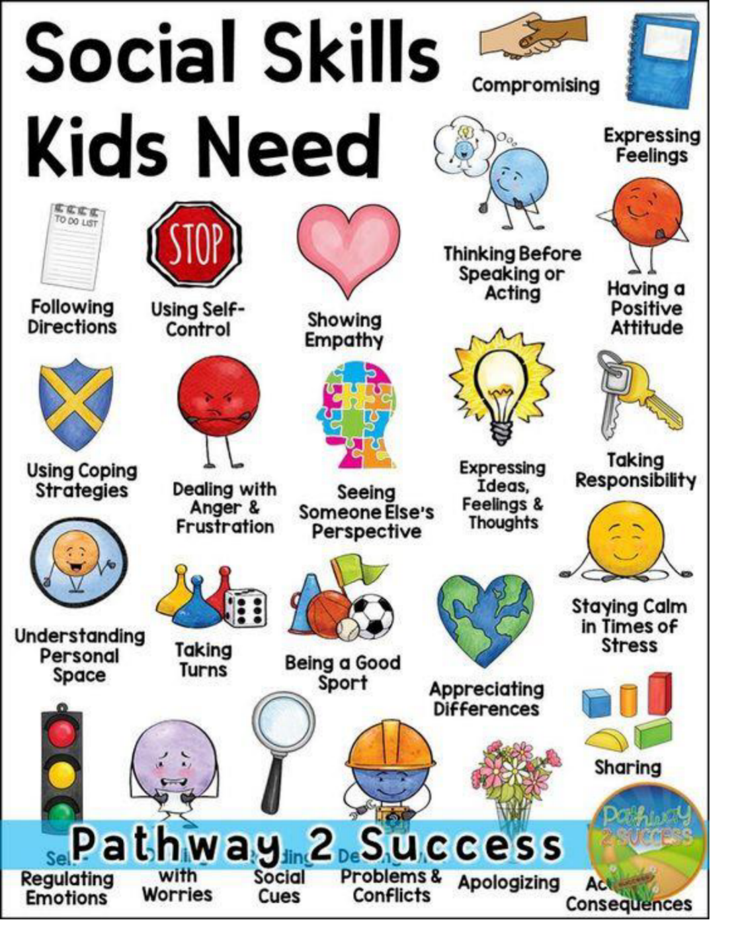
https://i0.wp.com/www.thepathway2success.com/wp-content

Slide 5

Question:
How do we communicate?
https://stock.adobe.com/uk/images/questions/

Slide 6

How many ways to communicate did you think of?
Speaking
Listening
Gesture
Sounds
Eye contact
Body language
Facial expressions
Social media
Any others?
https://clipartix.com/communication-clipart-image-43681/

Slide 7

How many of these rely on vision?
https://www.futurity.org/fact-checking-unreliable-sources-1584962/looking-through-magnifying-glass_1600-2/

Slide 8
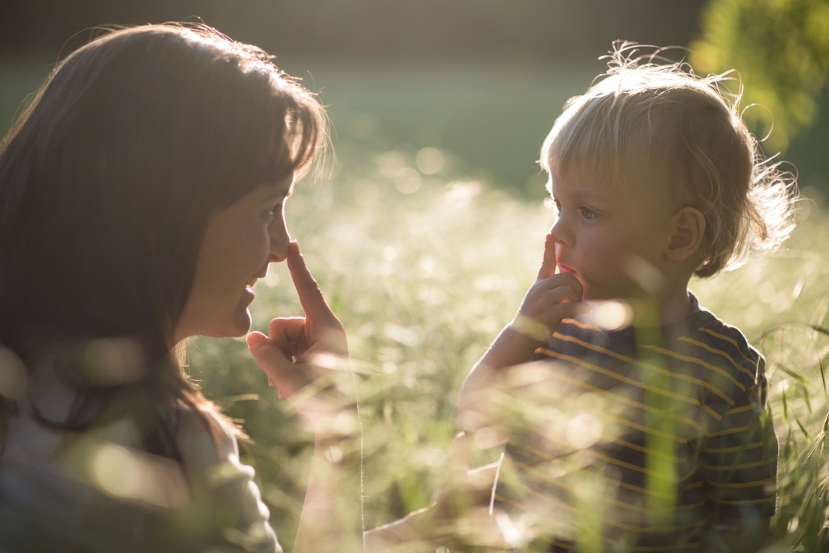
What does this mean for the child or young person with visual impairment or no sight?
A huge amount of social communication is non- verbal and relies on sight. We call this ‘Incidental Learning ’.
Copying
Imitation
Observing
Being in a range of social situations
Meeting different people
Children with impaired vision often find it very challenging to understand social situations and to interact with others.
https://kids.lovetoknow.com/wiki/Children_Learn_Best_by_Observing_Behavior_of_Adults

Slide 9
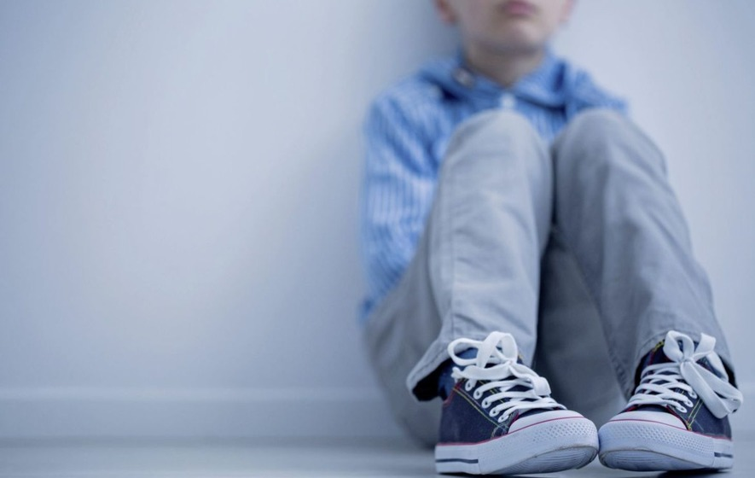
How can this affect the child with visual impairment?
Lack of confidence
Inappropriate behaviour
Withdrawal
Shutting down
Learned helplessness
Isolation
Depression
Aggression
Inability to make friends
Fewer career opportunities
All of these have a direct and negative effect on relationships,
learning and independence
https://www.irishnews.com/picturesarchive/irishnews/irishnews/2018/01/05/123421506-773911eb-77f5-4b7d-9ed1-bd9985c31b40.jpg

Slide 10
Why teach social skills?
“If you’re blind, how do you know where to look when someone is talking to you? Or when to shake someone’s hand? Or what “personal space” means? These are just some of the skills children who are blind must explicitly be taught, since they don’t have the benefit of observing the actions and reactions of their family and friends in social situations.”
Perkins school for the Blind

Slide 11
Why teach social skills?
“Sighted children observe and imitate people’s social behaviours, learning from any visual cues given. This is known as incidental learning. If these opportunities aren’t available to a child, understanding and development of appropriate social behaviour can become fragmented. Having appropriate social skills is crucial to a child’s everyday interactions. They enable the child to interact with others, establish friendships and later develop personal and work relationships”. RNIB 2017

Slide 12
What is SMILE Too?
SMILE stands for Social Skills Make Inclusive Life Easier. As the name suggests, the aim of this 3 year project is to share knowledge about the development of social skills in children and young people who are Visually Impaired with the aim of developing resources for Educators and Parents to support social skills.

Slide 13
"The European Commission's support for the production of this publication does not constitute an endorsement of the contents, which reflect the views only of the authors, and the Commission cannot be held responsible for any use which may be made of the information contained therein."

