Slide 1


Project SMILE too
Social Skills Make Inclusive Life Easier
Empowerment

Slide 2


Developement
Empowerment of parents, teachers and children

Slide 3
Statement
A child with severe MDVI or with deafblindness has fewer developmental opportunities than sighted and hearing children

Slide 4
Statement
I can influence the development
of my son/of my pupil

Slide 5
Statement
Children with severe MDVI or with deafblindness should have the same opportunities as children with sight and hearing

Slide 6
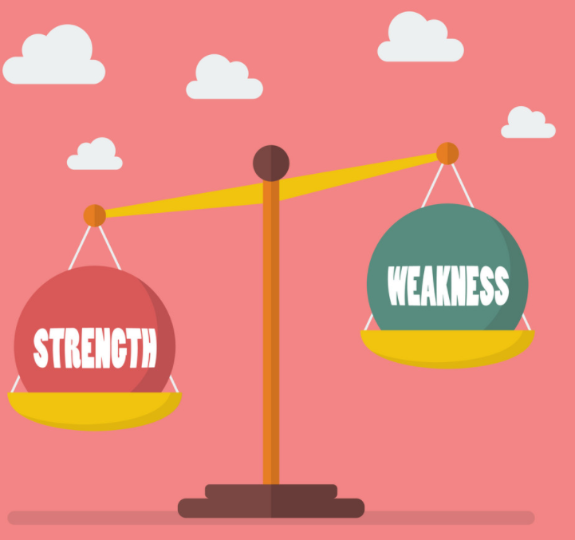
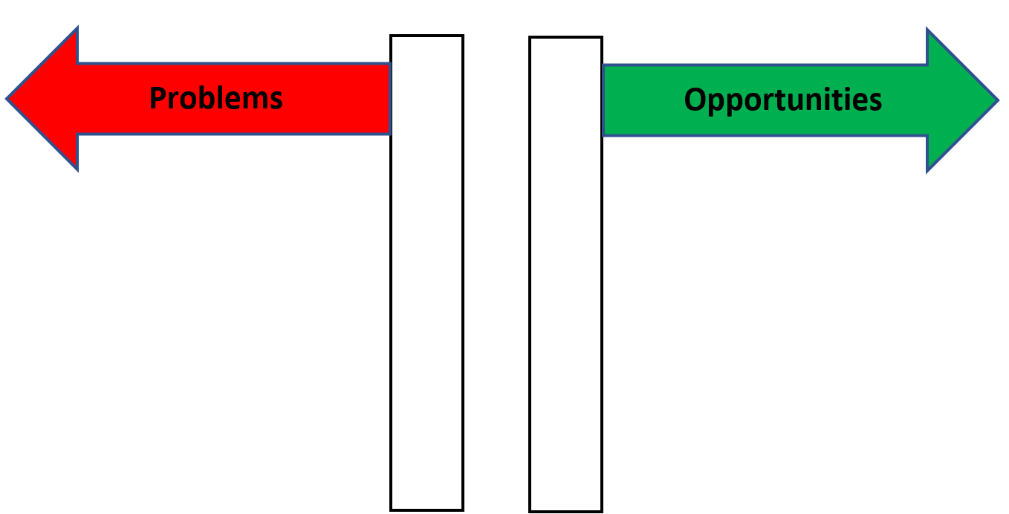
Focus on Strengths
‘Energy flows where attention goes’
What approach do we choose?

Slide 7
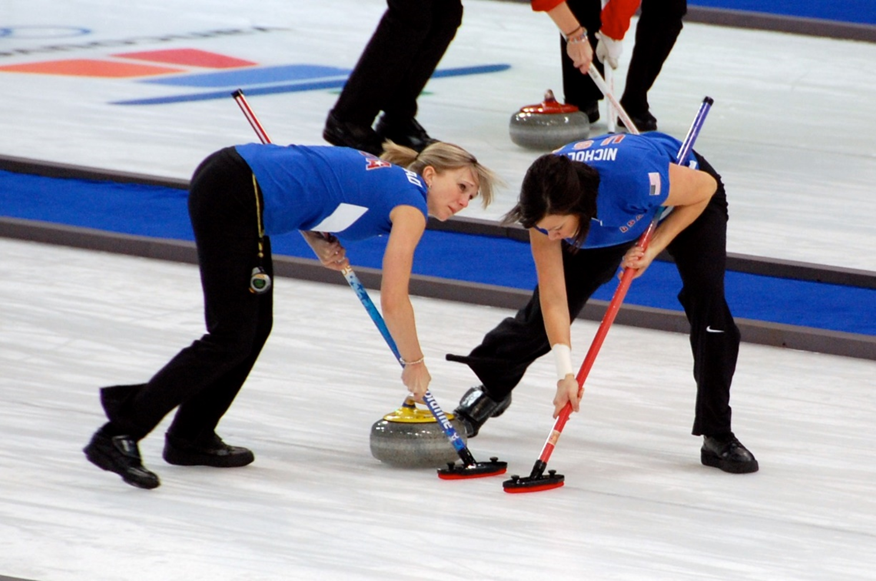
Curling Parents and Professionals

Slide 8
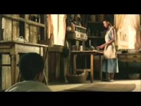
Ray Charles
Youtube video: Ray Charles goes blind and calls for help https://youtu.be/rrVtWTRkFB4
Youtube video: Ray Charles goes blind and calls for help https://youtu.be/rrVtWTRkFB4

Slide 9
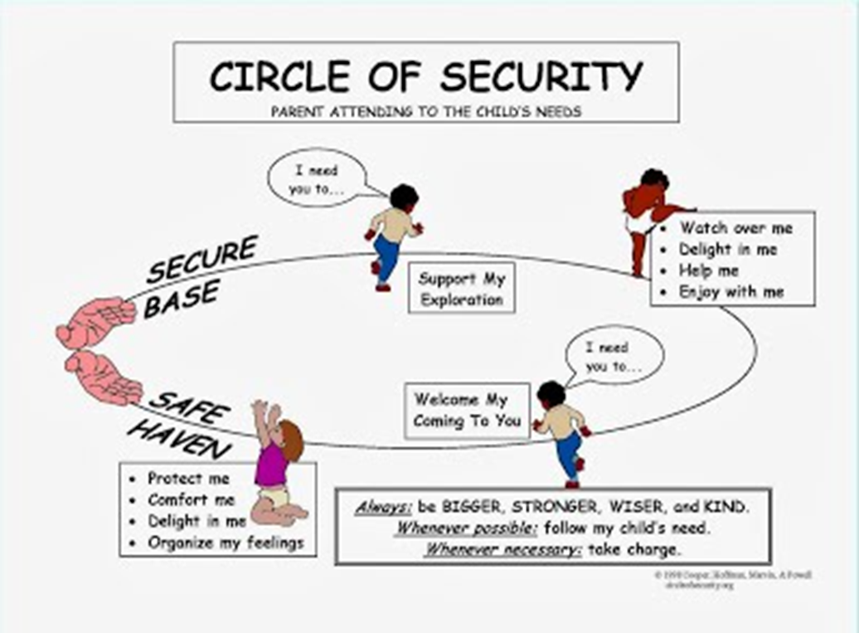
Importance of: EXPLORATION
It is not only about love and comforting
we need to stimulate children to EXPLORE!

Slide 10
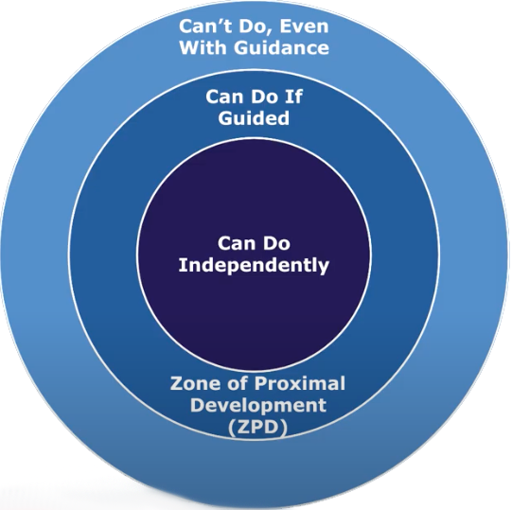
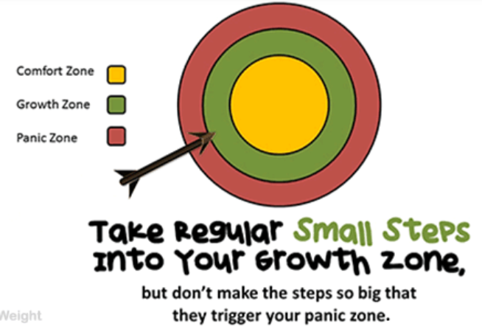
Focus on exploration

Slide 11
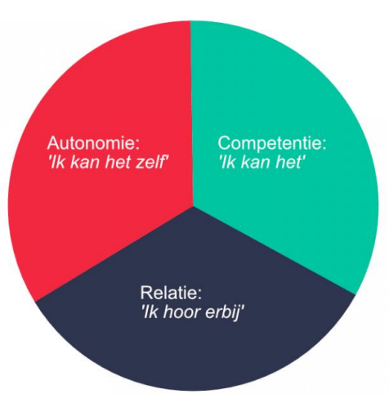
Focus on three basic psychological needs
AUTONOMY
‘I can do it myself’
COMPETENCE
‘I can do it’
RELATEDNESS
‘I belong’

Slide 12
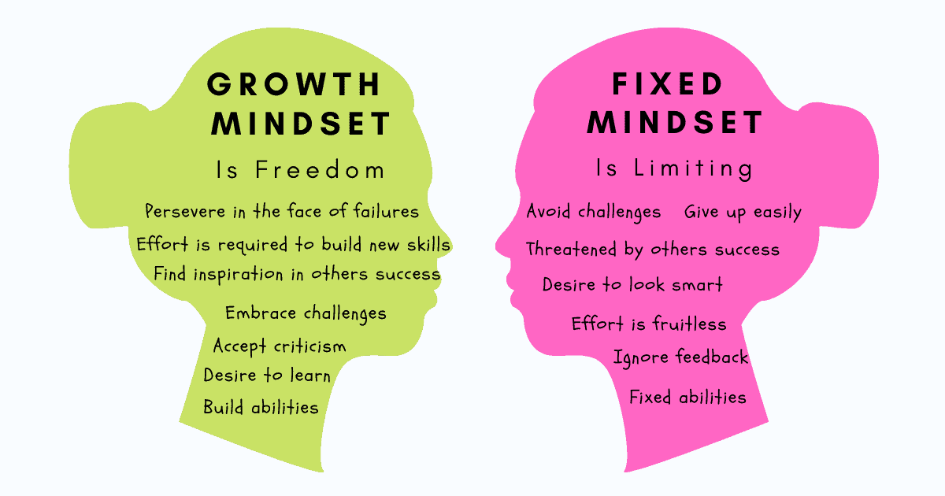
Stimulate a growth mindset

Slide 13

"The European Commission's support for the production of this publication does not constitute an endorsement of the contents, which reflect the views only of the authors, and the Commission cannot be held responsible for any use which may be made of the information contained therein."

