Slide 1


Project SMILE
Social Skills Make Inclusive Life Easier

Slide 2
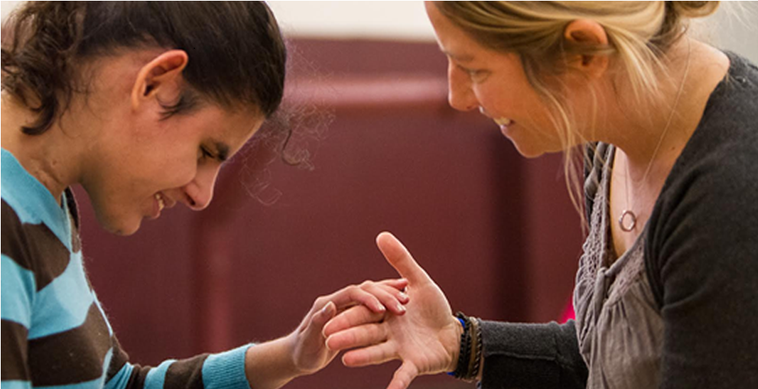
Social skills and students who have Multiple Disabilities and Visual Impairment ​(MDVI)
https://txdeafblindproject.org/communication/interaction-bonding/hand-under-hand-guidance/

Slide 3
“Children with Multiple Disabilities and Vision Impairment (MDVI) have a vision impairment and at least one other disability, which could be cognitive, developmental, and hearing- or mobility-related. Many of these children face challenges with communication, social interactions, movement, and independent living skills. Interventions that might typically work for a child who has one disability don’t necessarily work for children with MDVI because each disability has a compounding effect”. (www.perkins.org/children-with-multiple-disabilities-and-vision-impairment-mdvi)

Slide 4
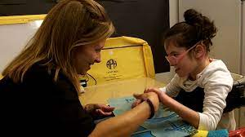
The MDVI population is very diverse and so the process of developing social skills can be more challenging.
https://www.nationaldb.org/media/doc/HandUnderHandTechnique_a.pdf

Slide 5

…but not impossible!
Copyright: (c) Cacaroot | Dreamstime.com

Slide 6
Good Practice:​ 3 areas to focus on
Educational and playful activities- with opportunities to experience being in groups as individual intervention
A Growth Mindset approach- an ethos of inclusion and a willingness to build strong relationships
The learning environment- how to organize the physical space and materials

Slide 7

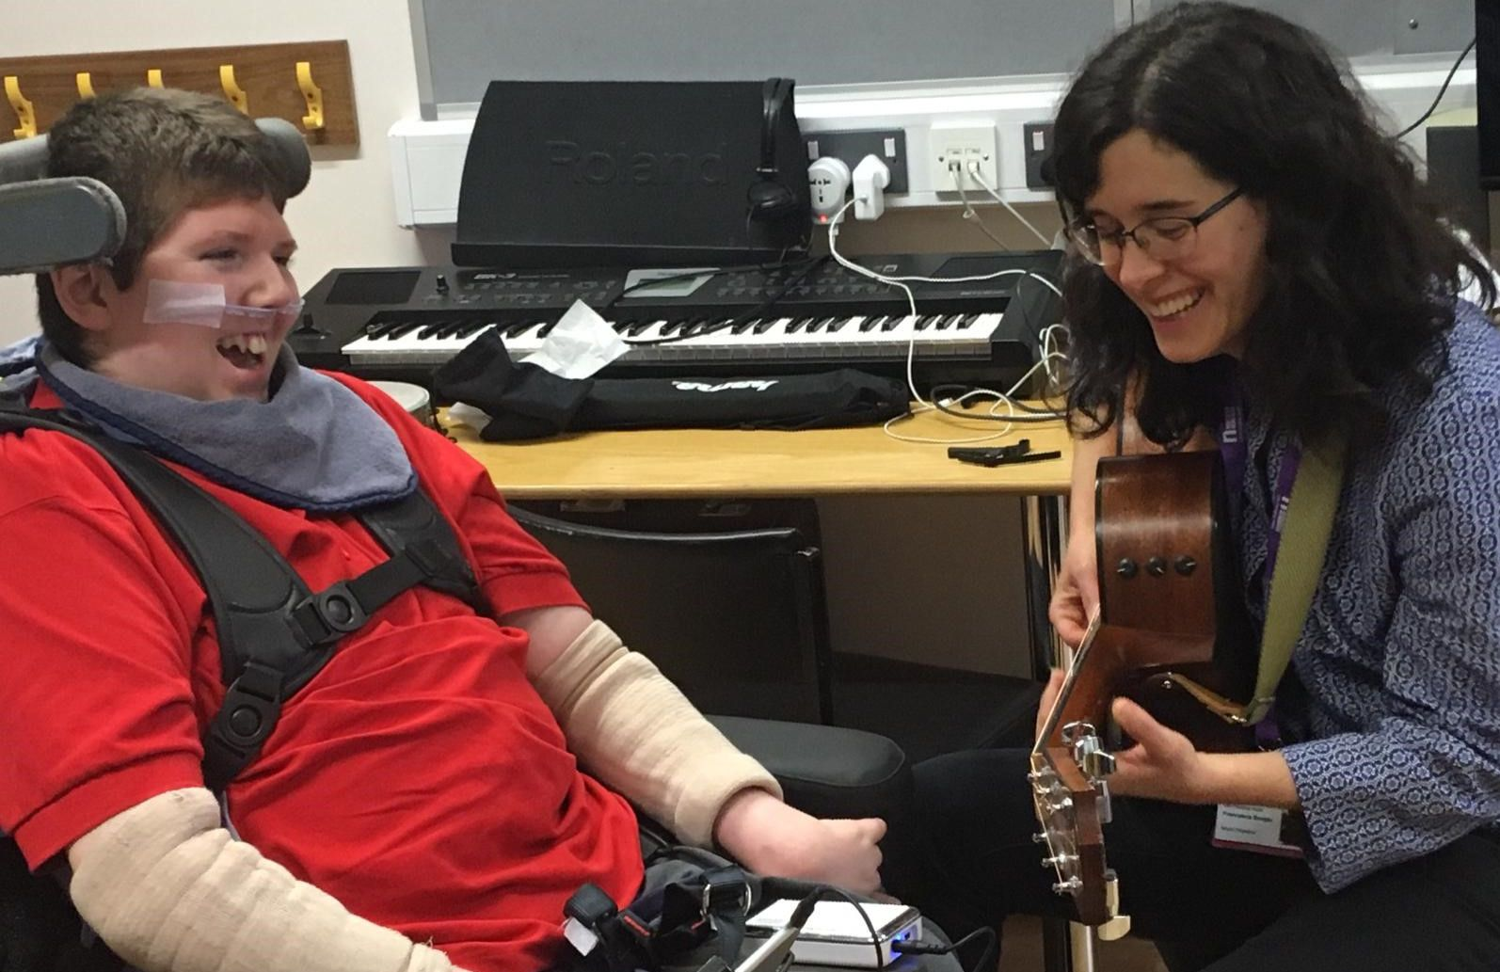
The learning environment
A well planned environment strongly contributes to the success of the educational intervention. It can facilitate communication, autonomy, mobility and orientation and also social interaction.
MDVI Euronet

Slide 8
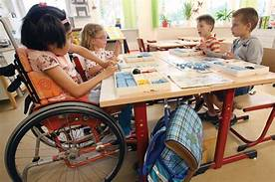
Examples of a positive learning environment
Good quality lighting
A low distraction area- with plain walls and
minimal visual clutter
Access to sensory activities
A quiet area
Tables at the correct height for the individual
students

Slide 9
Educational activities that promote social skills 1
Turn taking- learning to wait, thinking about others
Games that involve give and take ‘’ you take the doll, give me the ball, etc . ‘’- learning about sharing, that others are separate from me
Play musical instruments - learning about joining in, active listening
Movement and songs- learning about self expression, copyong others, joining in, waiting

Slide 10
Educational activities that promote social skills 2
Building games- learning resilience (things sometimes fall apart and that is OK)​
Symbolic play using familiar objects (doll, hairbrush, saucepan...)​- learning about context, practicing living skills, developing relationships
Listening to stories- learning about empathy, other peoples view points, the wider world
Using puppets​- learning about emotions, expressive sounds, copying

Slide 11
Educational activities that promote social skills 3
Craft activities- learning about difference, self expression
Colouring/mark making with various techniques and tools - learning about autonomy, self expression, influence
Ball games- learning about sharing, waiting, turn taking
Psychomotor skills-obstacle courses, rolling, entering tubes, ball games with movement or sound association- learning about movement, bodily autonomy, waiting, sharing

Slide 12
Ways to implement social skills
activities
Welcome greetings for all children- keep this consistent
Start and end of activity indicators- a welcome song, a tidy up tune, objects of reference, preparation for learning bags….
Exploration and knowledge of the environment- always keep resources the student uses in the same place and encourage independence
Help the MDVI student to know who is present and where they are- using voice/ signals / signs/ on body signing/ visuals/ objects depending on the individuals needs

Slide 13
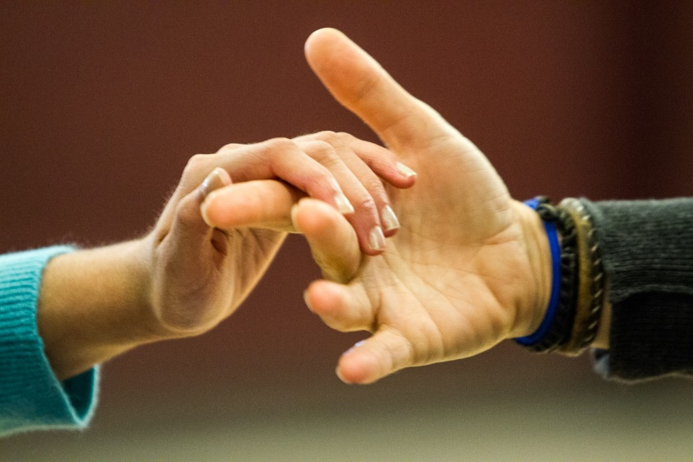
Ways to implement social skills
activities
Hand under hand instead of hand OVER hand. This allows the student to have some control and play a more active part in tasks and in learning
https://www.pathstoliteracy.org/entering-world-tactile-interaction-child-who-deafblind-introducing-new-deafblind-interaction/

Slide 14
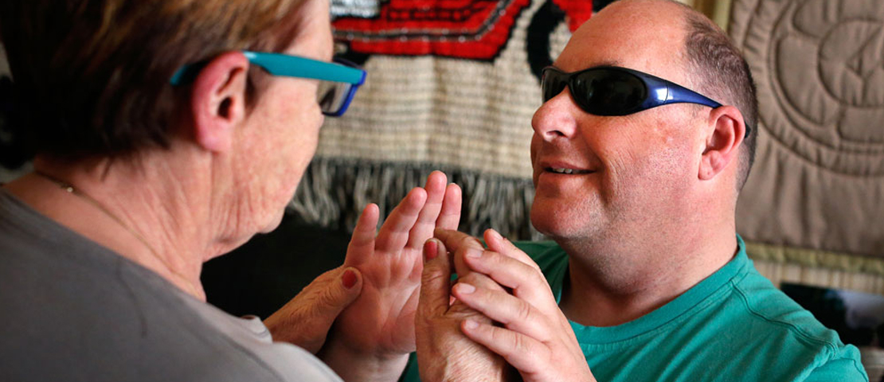
Ways to implement social skills
activities
Modelling- Help the student to understand and take part in an activity by modeling the movements such as rolling clay, clapping hands
https://blindlowvision.org.nz/how-we-can-help/specialist-services/deafblind-services/

Slide 15
Explicit teaching of social skills involves
Developing listening skills- different tones of voice and what emotions they signify
Learning different kinds of greetings for different people​
Learning to interpret facial expressions (including their own!)​
Learning about personal space​
Finding out about what may be socially unacceptable behaviour, for example nose picking, grabbing, touching intimate areas of the body

Slide 16
Provide lots of opportunities to practice social skills by-
Greeting lots of people in different ways and in different situations ​
Moving head towards a speaker​
Listening for social cues and what these mean- e.g. sighing, tutting ​
Keeping head up- “show me your lovely face”​
Maintaining good posture
​
​

Slide 17

Time to reflect…
Can you share any ideas that you already use?
Can you think of ways social skills can be embedded in other activities?
https://www.thinkib.net/media/ib/psychology/images/discuss.jpg

Slide 18


"The European Commission's support for the production of this publication does not constitute an endorsement of the contents, which reflect the views only of the authors, and the Commission cannot be held responsible for any use which may be made of the information contained therein."

