Slide 1


Project SMILE too
Social Skills Make Inclusive Life Easier

Slide 2
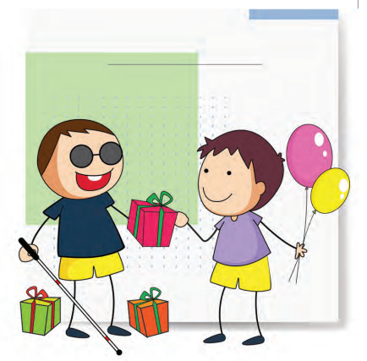
Friends and Hobbies

Slide 3
Let´s talk about….
Friendship
Hobbies

Slide 4
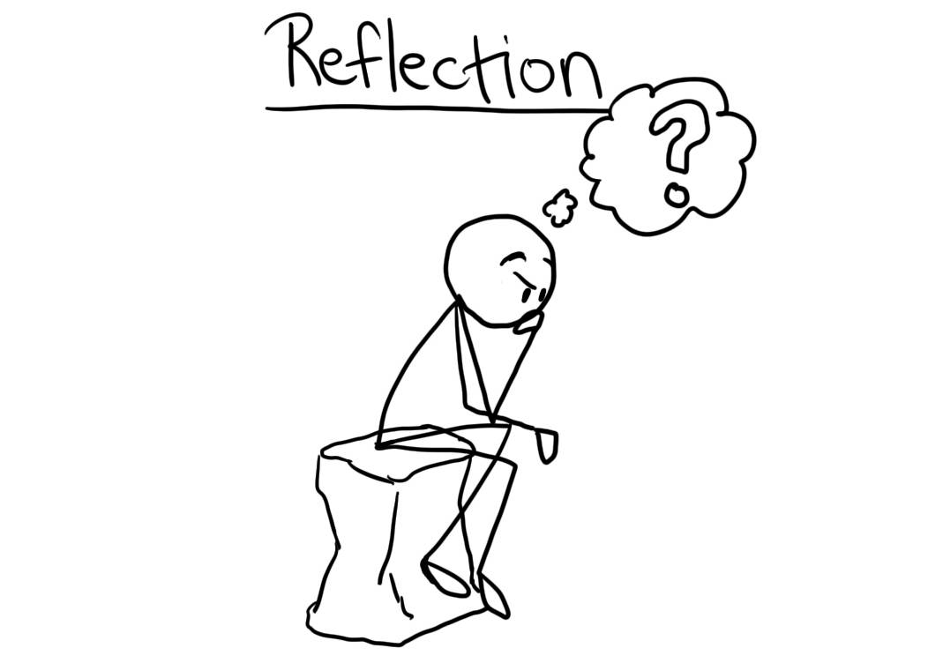
Reflect
• Do you meet other families with/ without children who have a visual impairment? How often?
• How many friends does your child have?
• How did he/she make them?
• Who are your child´s friends?
• Do they spend time with friends at school or also in their free time?
• Does he/she have any hobbies, do sport? Are the hobbies adapted for people with visual impairment?

Slide 5
Possible causes
Fear (parents, adults and child)
Overprotective environment
Opportunities
Learned ‘adaptive’ behaviour
Visual observation limits

Slide 6
Consequences
Social isolation
Limited opportunities
Low self-esteem
Lower social competence

Slide 7
How to support…
Teach perceptual skills
Play ‘sound’ games
Teach body language/ social skills
Teach your child how to play
Support conversation topics/ Roleplay
Be aware of fashion/ trends
Be alert to friendships

Slide 8
How to support…
Awareness training
Buddy system
Encourage ‘talents’/ after school
Organise event’s
Encourage helping others
Join ‘peer’ events/ summer schemes
Encourage independence

Slide 9
Video

Slide 10
Other tips

Slide 11
Thank you

Slide 12


"The European Commission's support for the production of this publication does not constitute an endorsement of the contents, which reflect the views only of the authors, and the Commission cannot be held responsible for any use which may be made of the information contained therein."

