Slide 1
Get into the Christmas Spirit
Mateja Dagarin Fojkar

Slide 2
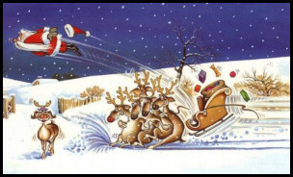
Christmas is the time to fall in love...
...whether you’re a human or a reindeer.

Slide 3
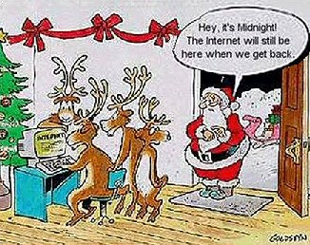
Take your time...
... and spend it with people you love.

Slide 4
XMAS TRADITION IN THE UK
It is a British Christmas tradition that a wish made while mixing the Christmas pudding will come true only if the ingredients are stirred in a clockwise direction and each family member has a stir of the mix. Furthermore, a traditional Christmas dinner in medieval England was the head of a pig prepared with mustard.

Slide 5
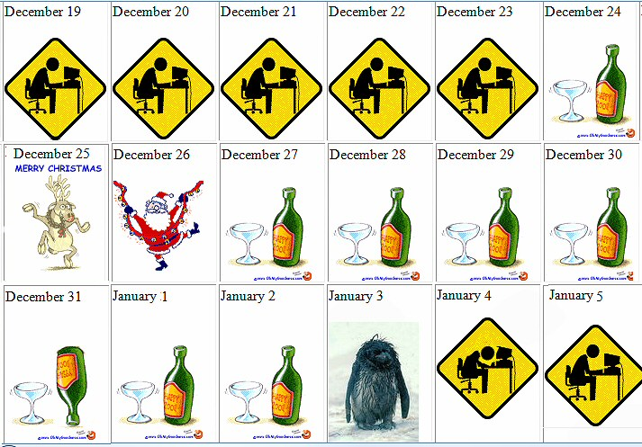

Slide 6
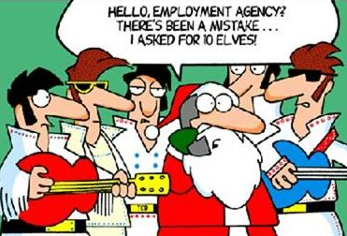

Slide 7
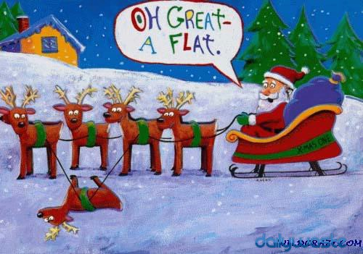

Slide 8
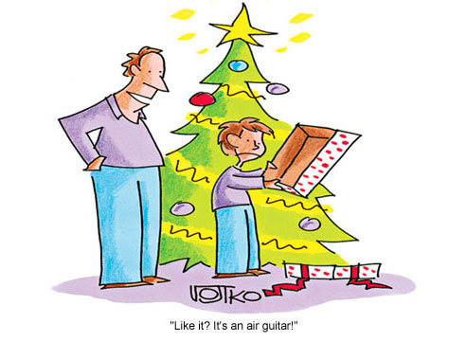

Slide 9
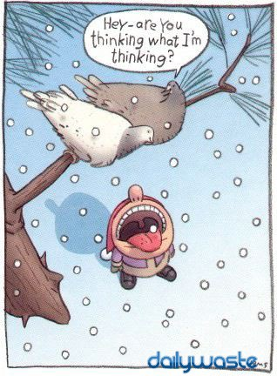

Slide 10
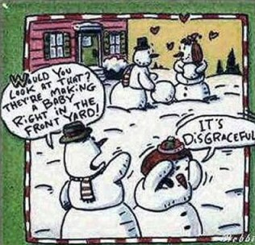

Slide 11
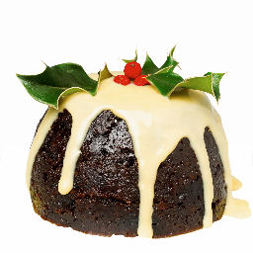
Christmas quiz
What is the traditional dessert in England on December 25?
Christmas pudding

Slide 12
What does the word 'Christmas' mean?
The word Christmas is taken from 'Christ's Mass' or, in the original Latin, Cristes maesse. Christians celebrate the birth of Jesus on this day.

Slide 13
At Christmas, it is customary to exchange kisses beneath a sprig of which plant?
Ivy
Mistletoe
Holly
Spruce

Slide 14
What form of transport does Santa use?
sleigh

Slide 15
How many wise men where there?
1
2
3
4

Slide 16
When are the '12 Days of Christmas'?
December 21 to January 1
December 25 to January 5
December 14 to December 25
Christmas Eve to January 4

Slide 17
How many reindeer does Santa Have?
7
8
9
10

Slide 18
How many sides does a snowflake have?
6
8
10
12

Slide 19
What does Christmas mean to Santa?
What colour skin does Santa have?
What kind of child was Santa?
Who are Santa’s neighbors?
How does he remember who wants what for Xmas?
Where does Santa go shopping?
If Santa died and was reincarnated, what would he want to come back as?
What kind of house does Santa live in?
What does Santa do between December 26 and Dec 23?
How does he get into houses that have no chimneys?
What does Christmas mean to Santa?
Which country does he like visiting best?
What’s his favourite sport?
If Santa could choose a present, what would he choose?
Why does he live in the North Pole, where it is so cold?
Is he married?
Does he have children of his own?
Should he be worried about his weight, or go on a diet?
What are Santa’s bad habits?
What’s Santa’s dream?
What’s Santa’s favourite movie?

Slide 20
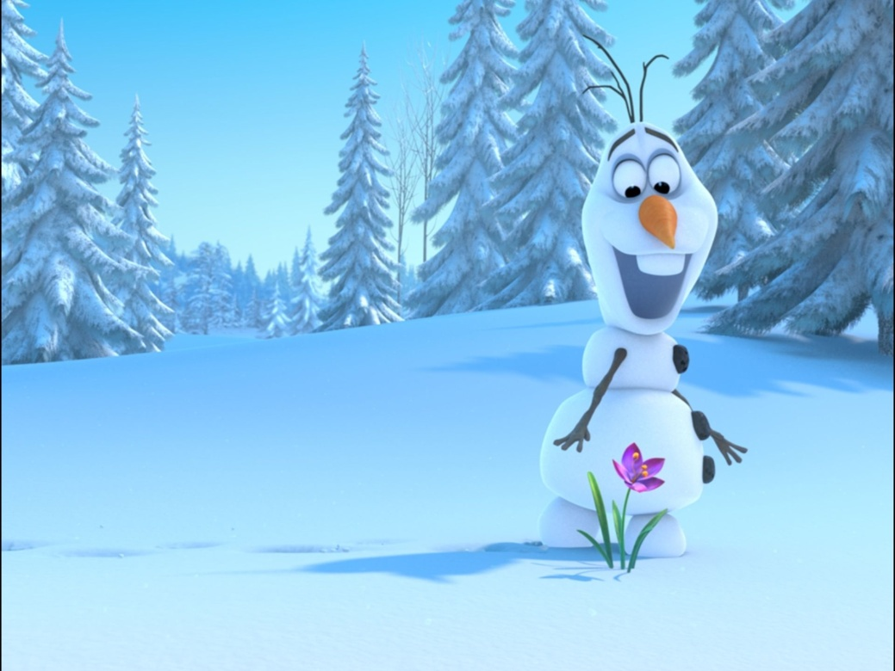
FROZEN
http://www.youtube.com/watch?v=-WdC4DaYIeQ

