Slide 1

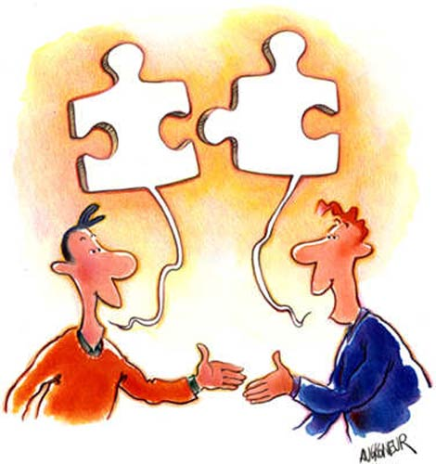
JEZIKOVNO IN MEDKULTURNO 0ZAVEŠČANJE
LANGUAGE AND INTERCULTURAL AWARENESS
Prepared by Mateja Dagarin Fojkar
and Tina Rozmanič

Slide 2
Course description
60 contact lessons (30 lessons – lectures, 30 lessons - practical classes)
Time: Mondays 8.00 – 12.00 (5 lessons) – Room 014
No lessons in May
No textbooks, but plenty of different sources and materials
Reading and browsing through the Internet
Preparing materials for your future classroom work

Slide 3
Course teachers
Lectures (30 hrs): Mateja Dagarin Fojkar
Practical classes (30 hrs): Tina Rozmanič (& Edwin Harris)
Guest lecturers from other countries
Lectures and practical classes do not cover the same topics and both implement interactive work.

Slide 4
Course dates and teachers
20. 2. | Tina Rozmanič & Edwin Harris
27. 2. | Mateja Dagarin Fojkar
6. 3. | Tina Rozmanič & Edwin Harris
13. 3. | Mateja Dagarin Fojkar
20. 3. | Tina Rozmanič & Edwin Harris
27. 3. | Tina Rozmanič & Edwin Harris
3. 4. | Mateja Dagarin Fojkar
17.4. | Mateja Dagarin Fojkar
24. 4. | Tina Rozmanič & Edwin Harris
29. 5. | Mateja Dagarin Fojkar & Edwin Harris

Slide 5
Course topics
Intercultural awareness
Identity
Multiculturalism
Teaching culture
English speaking countries
Landscapes and geography
History
Music
…
Mateja: intercultural awareness, UK & Ireland
Tina: US & Canada, New Zealand, Australia

Slide 6
Minimum Attendance Requirement
Students must maintain a minimum of 70% attendance at practical classes and the lectures in order to be eligible for taking the examination.

Slide 7
Assessment
Part I –presentation in pairs (60%)
Part II – a text of 500 words (30 %)
Part III – a conversation with someone from a different culture (10%)

Slide 8
Assessment – Part I (50%)
You have to prepare (in pairs):
A 30-minute presentation of an intercultural topic to your colleagues.
The presentation has to be interactive and you have to involve the listeners as much as possible.
You are NOT supposed to read but speak freely about the selected topic.
The assessment criteria are available in the e-classroom.
Present some interesting facts about the topic (in the form of quizzes, activities etc.) and at least 2 activities for children (Grade 1 to 6). Do these two activities with us!
Upload your project work file in the e-classroom by 5th June 2023.

Slide 9
Project work file
should include:
- An introduction in which you justify the selection of the topic
a ppt on the topic
a collection of activities (together with web links, online activities, song lyrics, stories, games, worksheets …) – app. 5 of them
2 activities FOR CHILDREN described according to the sample below
1 lesson plan for teaching this topic to children

Slide 10
Sample of an activity description
2. Topic based project
  Name of the activity:
  Aim of the activity:
  Age of learners:
  Approximate length of the activity:
  Description of the activity:
  Language level of learners:
  Skills practised (listening/speaking/reading/writing):
  Vocabulary practised:
  Materials needed:
  Cross – curricular links:
  FREPA/CARAP descriptors: (see pages 24 to 59 of the FREPA document https://www.ecml.at/Portals/1/documents/ECML-resources/CARAP-EN.pdf?ver=2018-03-20-120658-443
  How the activity develops intercultural awareness:
  Classroom organisation (group work, pair work, whole-class …):
  Possible pre- and post- activities:
  Variations (if there are any):
  Additional notes (if applicable):

Slide 11
Assessment – part I
Presentation – 40%
Project work file – 20%

Slide 12
Assessment – Part II
You have to prepare (individually):
a text of 500 words on your culture on a selected topic (30%); upload the text by 9th June 2023.
Topics:
Gender roles
Hand gestures
How can communication go wrong? Communication pitfalls
Meals and table manners in different cultures
Politeness formulas (language and behaviour)
The characteristics of body language
The concept of time/space
Topics for small talks
Business etiquette in one particular culture
Food
Spare time
Education
…

Slide 13
Assessment – Part III (10%)
Record (audio or video) a conversation with someone from a different culture. The conversation should be 8-10 minutes long. You can talk to someone who has moved in recently, an Erasmus student, a friend from abroad …
Ask the person about some interesting facts about his/her culture (holidays, habits …), differences in Slovenia and his culture, how they find Slovenia etc.
Upload the files into the e-classroom by 9th June 2023.

Slide 14
