Slide 1
Research in Music, Culture, and Children’s Education
Patricia Shehan Campbell
Unviersity of Washington (USA) and Carleton University (Canada)

Slide 2
Long-Standing Questions that Orient Research and Practice
* Are children born musical? Is musicality an inherited trait?
* Is musicality naturally acquired? Does it require informal stimulation?
* Can music be taught—in schools, churches, community settings?
* What should be the goal of music education (to sing, play, dance, listen, create)?
* Can a musical education enhance learning-at-large?
* Can musical learning transfer (social-emotional learning, intercultural understanding)?

Slide 3

Research-Based Answers to Questions:
Are children born musical? Is musicality an inherited trait? Yes.
Is musicality naturally acquired? Can musicality be nurtured? Yes.
Can music be taught—in schools, churches, community settings? Yes.
What should be the goal of music education (to sing, play, dance, listen, create)?All.
Can a musical education enhance learning-at-large? Yes.
Can musical learning ”transfer” (social-emotional learning, intercultural understanding)? Yes.

Slide 4
One Productive Research Year: 2013-2014
(2013). Campbell, Patricia Shehan and Trevor Wiggins, editors. The Oxford Handbook on Music in Children’s Lives. New York: Oxford University Press.
(2013). Campbell, Patricia Shehan. Music Education and Diversity. In James A. Banks, editor, Encyclopedia of Diversity in Education. Thousand Oaks, CA: Sage Publishing Inc.
(2013). Schippers, Huib and Patricia Shehan Campbell. Cultural diversity: Beyond ‘Songs from every land’. Invited chapter for Oxford Handbook of Music Education, Gary McPherson and Graham Welch, editors.
(2013). Campbell, Patricia Shehan. Children, Teachers, and Ethnomusicologists: Traditions and Transformation of Music in School. In Barbara Alge, editor, Beyond Borders: Welt-Musik-Padagogik. Rostock, FDR.
(2014). Howard, Karen, Matthew Swanson, and Patricia Shehan Campbell. The diversification of music teacher education: Six cases from a movement in progress. Journal of Music Teacher Education 23: 2.
(2014). Liao, Mei-Ling, and Patricia Shehan Campbell. An analysis of song-leading by kindergarten teachers in Taiwan and the USA. Music Education Research 16:2, 144-161.

Slide 5
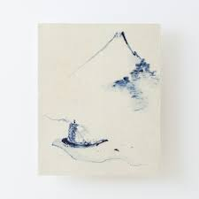

Campbell’s ”Research”, Now (ca. 2022-23)

Slide 6
Scholarship Reconsidered
(Ernest L. Boyer, 1992)
1. Scholarship of discovery, including original research that advances knowledge.
2. Scholarship of integration, including synthesis of information across disciplines, across topics within a discipline or across time.
3. Scholarship of application, involving the application of expertise with results that can be shared external to the academy.
4. Scholarship of teaching, which allows for public sharing with learners, and the opportunity for application and evaluation by others.
5. Scholarship of engagement, or the use of scholarship to solve pressing social, civic, and ethical problems.

Slide 7
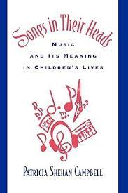
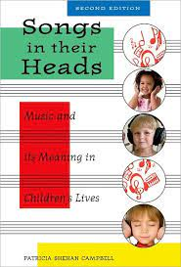
The Scholarship of Discovery (Original)

Slide 8
What do we know?
Children are musical:
Rhythmic, melodic,
mixing music with movement/dance, dramatic play, expressive activity.

Slide 9
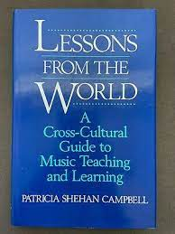
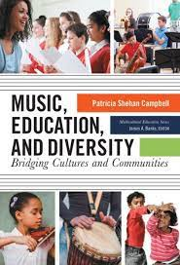
The Scholarship of Integration (Synthesis)

Slide 10
What do we know?
Music learning is oral-aural.
Music is a creative art.

Slide 11
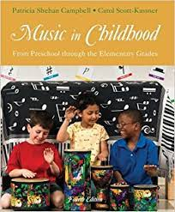
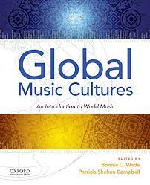
The Scholarship of Application
(Expertise going
External)

Slide 12
How does the research help?
Music in Childhood: We understand music to be teach-able, learn-able, developmental, and with activities and understandings building upon one another-progressively.
Global Music Cultures: All people find music to be useful and meaningful to them in their lives.

Slide 13
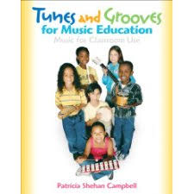
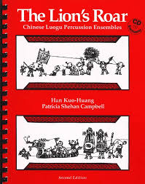
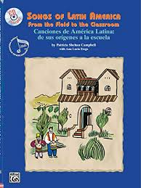
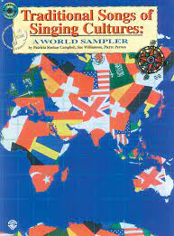
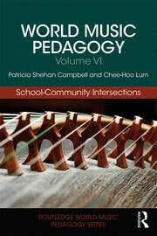
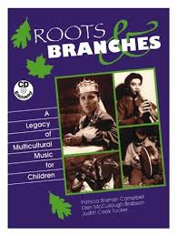
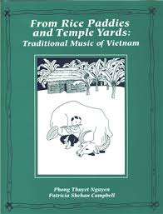
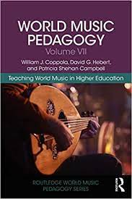
The Scholarship of Teaching
(Sharing for Application)

Slide 14
How does the research help?
Teachers need suggestions for teaching, so that their students might learn, of the BIG and LITTLE music of a people and place.

Slide 15

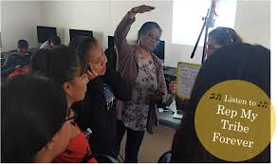
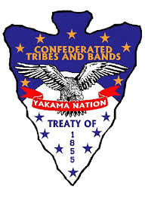
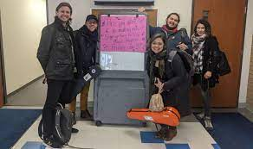
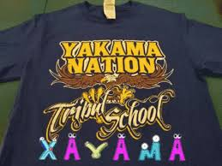
Scholarship of Engagement (Social-Civic)
Journal of Folklore and Education, Journal of Popular Music Education, International Journal of Community Music, Journal of Research in Music Education

Slide 16
How does the research help?
Children belong to more than one musical culture: The culture of their families (maybe), and youth culture. Possibly, they will also belong to the WEAM music culture that is featured in the school music curriculum).

Slide 17
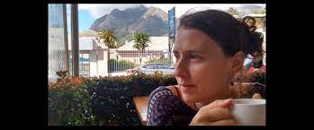
(Jocelyn Mory) Recentering the Borderlands:
Matepe as Sacred Technology from the Mutapa State to the Age of Vapostori

Slide 18
Jocelyn Mory: Recentering the Borderlands
Decolonial scholars insist that the work of decolonization must, at its core, involve understanding and dismantling the Western epistemologies that shape knowledge production in the academy. Historian Mhoze Chikowero identifies a particular scarcity narrative that is rooted in colonial sound archives and permeates current scholarship on African music (2015). His research, along with works by Andrew Mark (2017), shows how this scarcity narrative depicts Zimbabwean music in a state of constant decline and in need of “rescuing” by foreign NGOs and academics, thereby perpetuating foreign control over indigenous cultural property. In this dissertation I respond to Chikowero and Mark’s critical analyses of the scarcity narrative through a case study of matepe, a marginalized music tradition from the northeastern borderlands of Zimbabwe and central Mozambique. I provide a nuanced historical account of matepe music cultures that center localized understandings of music sustainability and cultural adaptation based on archival, ethnographic, and applied methodologies.
The main framework of this dissertation is based on the Nyahuna prophecy, a locally- specific prediction of cultural decline and recovery in northeastern Zimbabwe that was delivered by Nyahuna, a prominent mhondoro (clan) spirit of the Marembe people in 1958. Through his spirit medium, Nyahuna predicted that the Marembe people would go through a period of time in which their cultural traditions would be suppressed – first by war, then by evil spirits, and finally by the growth of independent Apostolic churches, or Vapostori. Ultimately, within the current time period, I argue that musicians actively work towards recontextualizing matepe music to reduce the stigma of the instrument’s spiritual associations without desacralizing it. This recontextualization provides avenues for culture bearers to learn the sounds of matepe music within a predominantly Christian community.
My dissertation research was a multi-year, collaborative project that included the repatriation of over 150 music recordings and 250 photographs of matepe music from the International Library of African Music (ILAM) at Rhodes University in Grahamstown, South Africa. The unpublished archival collections are from the works of Hugh and Andrew Tracey, who recorded matepe music from 1933 to the mid-1990s, during periods of significant political and social upheaval. The archival collections provide a means to address the lack of music scholarship on marginalized ethnic communities in Zimbabwe. This dissertation also builds upon existing anthropological and historical research of southeastern Africa in a way that centers the significance of traditional African music.

Slide 19
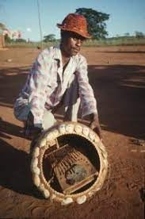
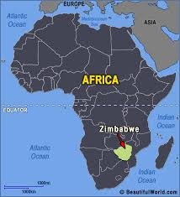
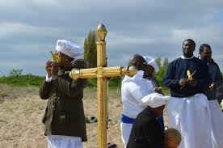
Reclaiming (Music) Culture

Slide 20
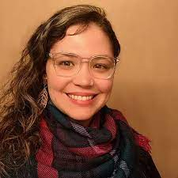
(Juliana Cantarelli Vita)
“Because Songs Reflect the People”:
Archival Recordings of Children’s Music as Pathway to Respectful Resonance

Slide 21
Juliana Cantarelli Vita: Pathway to Respectful Resonance
The musical education of children holds potential for their development of cultural awareness, understanding, and empathy, much of which is dependent upon the integrity of the resources and pedagogical techniques that teachers employ. The archival recordings of ethnomusicologists present rich prospects for teaching and learning music and culture, and for piquing children’s curiosity and increased respect for children across the world. Through the digital-sharing of recordings of a globally diverse gamut of children’s expressive practices and an honoring of children’s agency in determining pedagogical strategies for their interaction with music and its sociocultural features, this dissertation examines a pathway for children’s developing relationships with children, their music, and their cultural values and circumstances.
This research proceeded over a period of six months, documenting curiosities, creativities, and music-culture conceptualizations by 10- and 11-year-old children enrolled in a fifth-grade class in a U.S. based public elementary school. A tripartite “remixed ethnography” was developed, entailing the application of techniques of ethnography, virtual ethnography (and netnography), and auto-ethnography, in order to examine children’s “visits” to the sonic heritages of other children nearby and those in culturally (and geographically) distant locations. The research proceeded in two phases, a pre-COVID in-person and classroom-centered discovery of children’s musical cultures through large- and small-group projects and a COVID-necessitated virtual module of music-culture explorations and creative ventures via online platforms.
The process of children’s agentive role in their discovery of music and culture was closely documented, resulting in a recognition of the capacity of archival recordings of children’s songs to serve as gateway into culturally unfamiliar music and to the cultural situations and surroundings of the children whose voices were featured. Over the course of the two phases of experience and study, the fifth grade children became increasingly attentive to sonic details in the replication of the songs they were learning, as they were also careful that their creative re-arrangements of studied songs did not sonically veer too far from the children whose voices they were listening to. Moreoever, the young students demonstrated a growing consciousness and ever-deepening connection to the children and their cultural circumstances. They developed a solid state of respectful resonance with the children and their cultures through their songs, highlighting the powerful of school musical experiences to build relationships and solidarities, child-to-child and culture-to-culture.

Slide 22

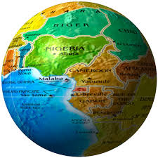
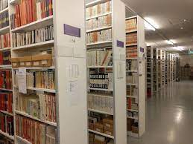
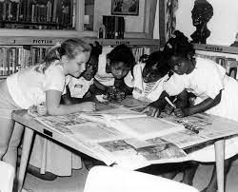
Growing Cultural Sensitivity through the Study of Archived Musical Traditions

Slide 23
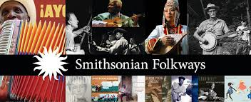

Slide 24
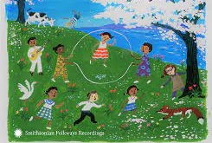
Music for Children,
Music by Children

Slide 25
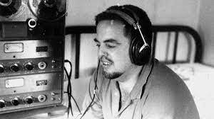
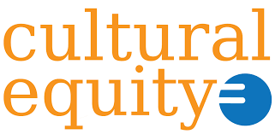
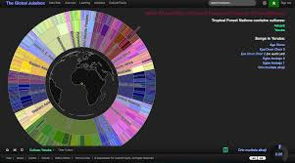
The Association for Cultural Equity

Slide 26
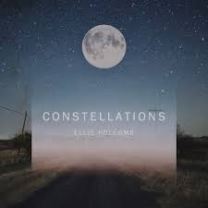
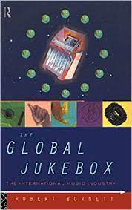
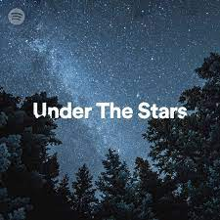
Star-Songs and Constellations
(Slide program inside The Global Jukebox)

Slide 27
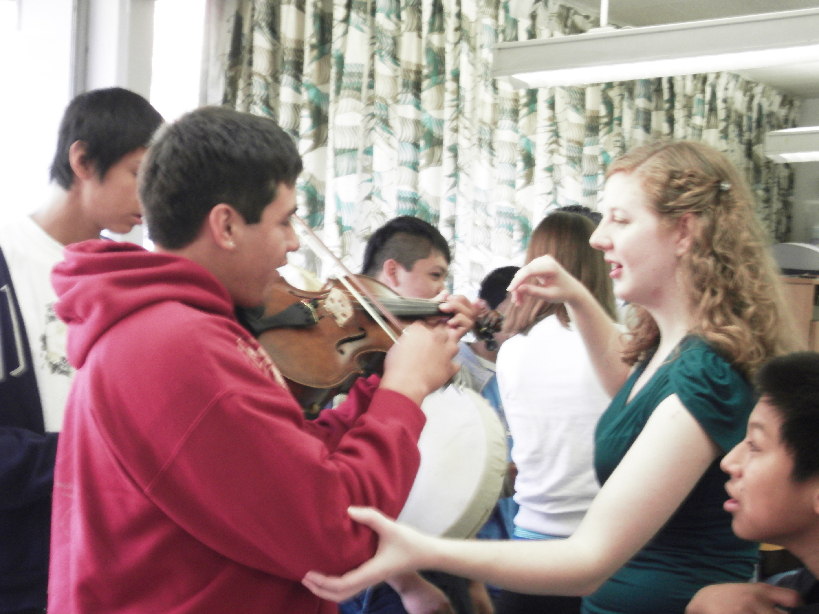
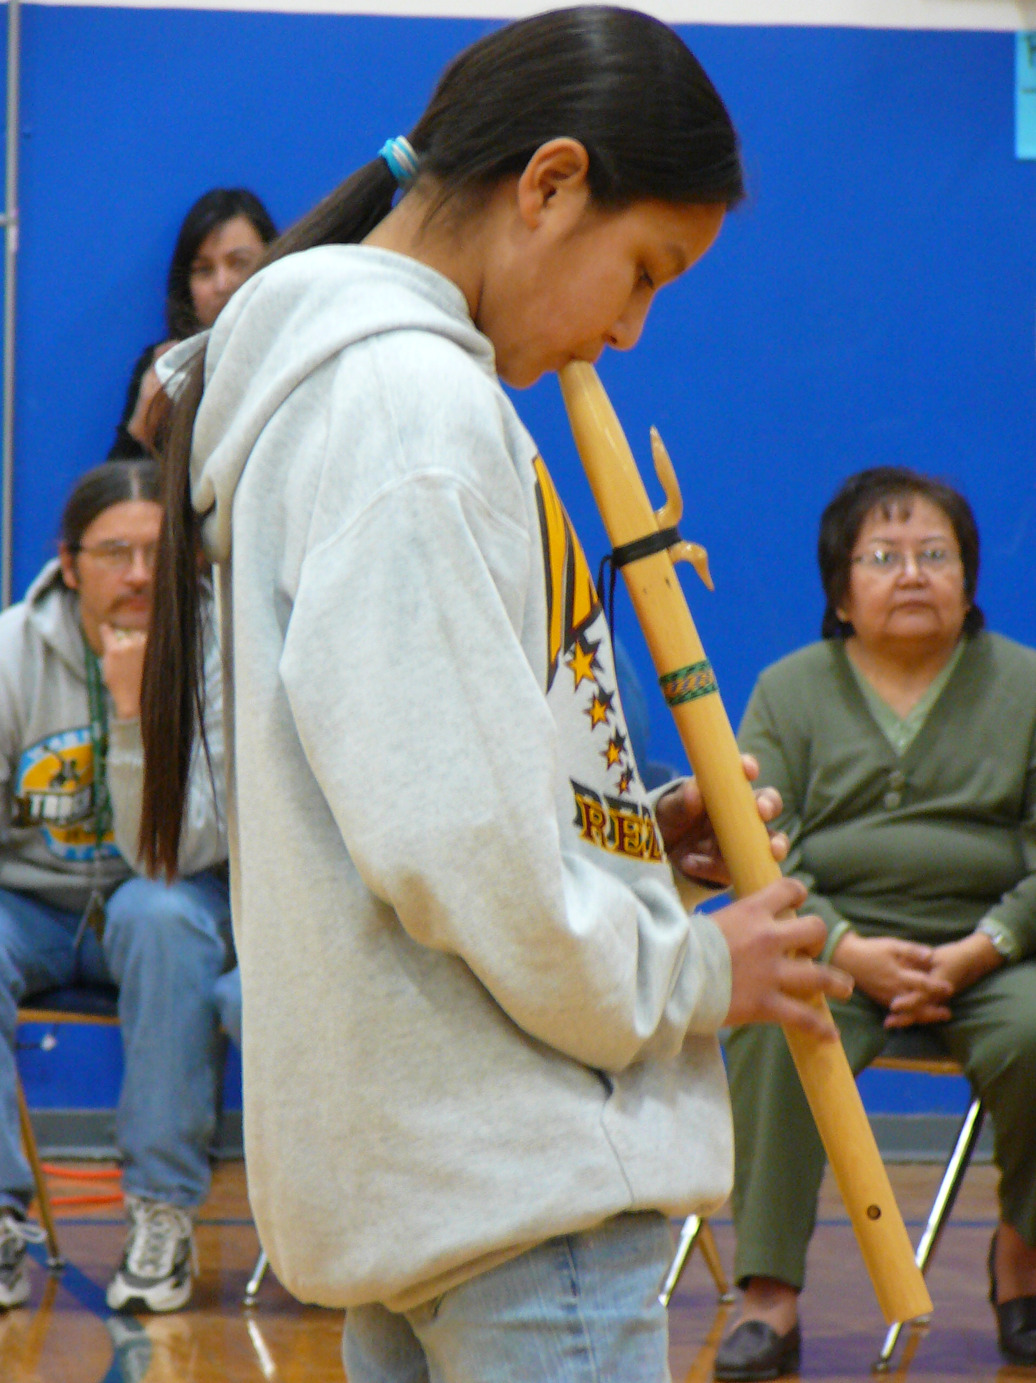
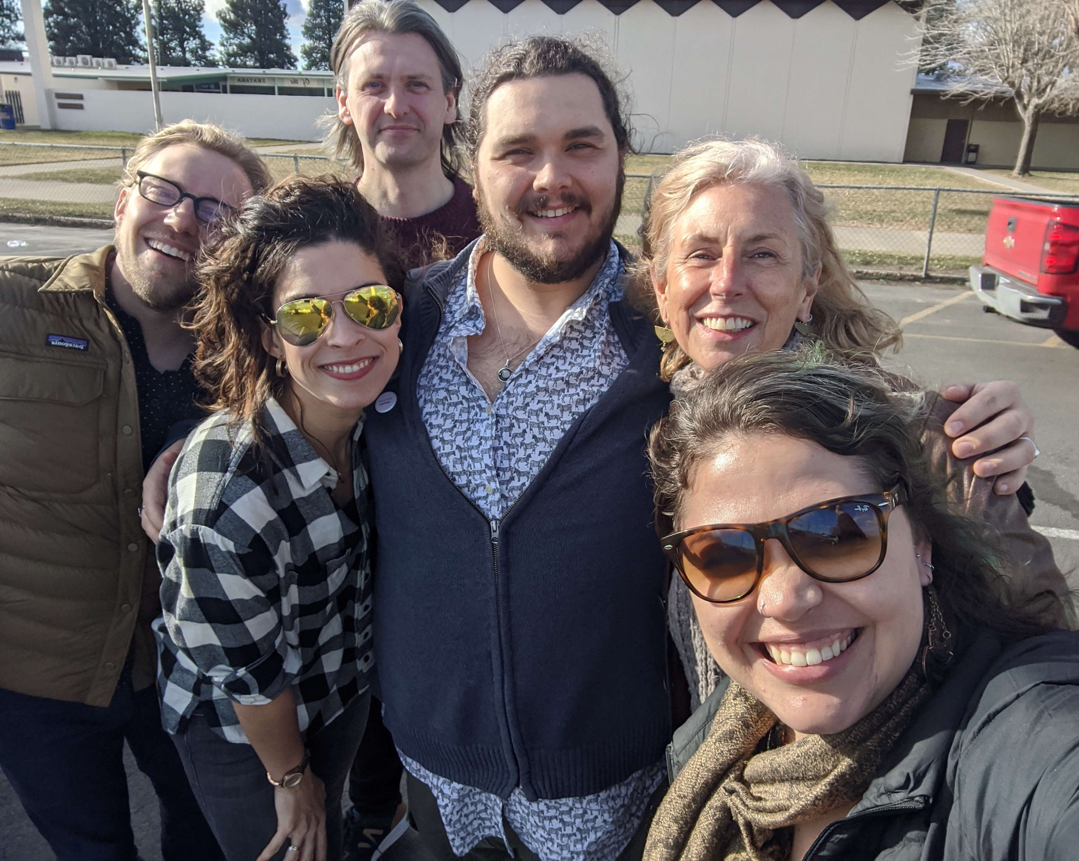
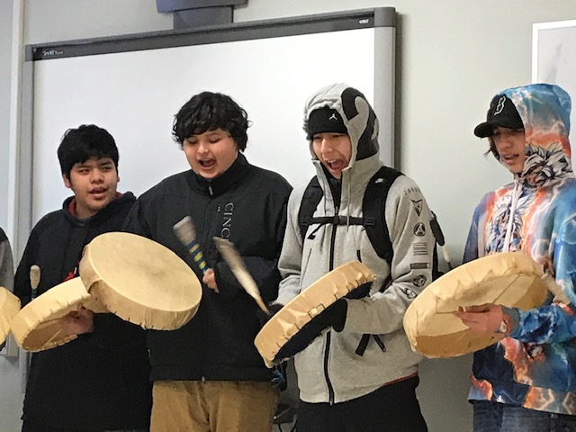
Collaborative Research:
Music Alive! in the Yakima Valley

Slide 28
Selected Publications re: MAYV Involvement
(2020) Igari, K., J. Cantarelli Vita, S. Gestsson, J. Flesher, C. Armstrong. Rep My Tribe Forever: Teaching toward Equity through Collective Song-writing at the Yakama Nation Tribal School. Journal of Folklore and Education.
(2019) Campbell, Patricia Shehan, Mena, Chris, Skuli Gestsson, and Will Coppola, Collective Song-Writing at the Yakama Nation Tribal School. Journal of Popular Music Education 5: 2.
(2018) Campbell, Patricia Shehan and Shannon Dudley. A University Commitment to Collaborations with Local Musical Communities. In the Oxford Handbook of Community Music, Brydie Bartleet and Lee Higgins, editors. New York: Oxford University Press.
(2010) Campbell, Patricia Shehan. Music Alive! In the Yakima Valley. International Journal of Community Music 2:3.
(2009) Soto, Amanda, Chee-Hoo Lum, and Patricia Shehan Campbell. A University-School Partnership for Music Education Students within a Culturally-Distinctive Community. Journal of Research in Music Education.

Slide 29
Works At/Near the Finish Line
Chapter: Teaching World Music: Intersections of Music, Education, and Diversity. In Leon Garcia Corona and Kathleen Wiens, Beyond the Field: Challenges and Opportunities in Ethnomusicology. New York: Oxford University Press. (2022)
Chapter: Creating Culturally Sustaining Spaces in the Compositional Process. (w/ Chris Mena) In M. Kaschub, Handbook on Composition Education. New York: Oxford University Press. (2022)
Article: Families as Small-Community Quarantine Pods of Sociomusical Engagement (w/ Clayton Dahm, Jack Flesher, Juliana Cantarelli Vita, International Journal of Community Music. (2022))
Article: Music in Schools: Taking Stock of Research that Shapes Practice. (w/ Clayton Dahm). Music Review Annual (2022).
Article: Bonding through Music. AmericanEducator (2023)
----------------------------------------------------------------
Chapter: The Grace of His Teaching: Lessons from Micheal O Suilleabhean. (ed. McCarthy and Phelan). [Festschrift, Irish Press]
Chapter: Facilitating Children’s Contributions to the Sustainability of Cultural Communities. (w/ Cantarelli Vita and Flesher). [Canadian Press] (in progress))
Article: Applications of Folk Music Research to Music Teaching and Learning. (Bulgarian Musicology) (in progress))

Slide 30
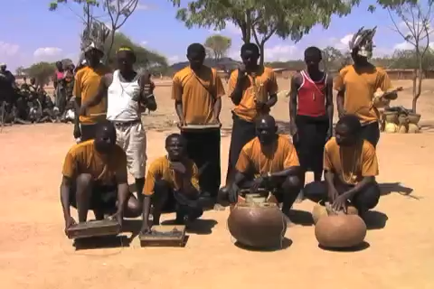

Slide 31
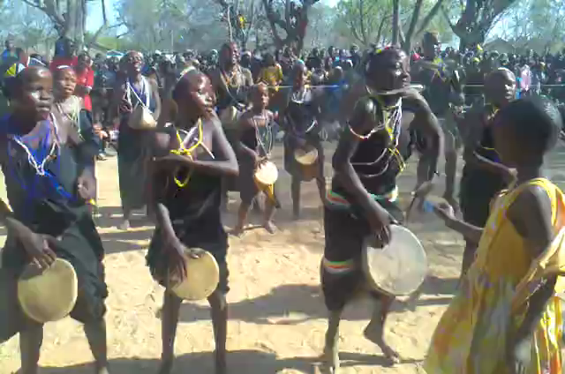
“Rhythmicking Because They Must”
Ngoma by Wagogo Children

Slide 32
Prospectus for the publisher
Title: Community Identity through Music: Tanzania’s Wagogo Festival
Authors: Kedmon Mapana and Patricia Shehan Campbell
Goals/Rationale
We have tentatively assigned a working title to this proposed book: Community Identity through Music: Tanzania’s Wagogo Festival. This work, which is intended for the Routledge Focus Series, is directed at readers with interest in (a) the sustainability of music as cultural identity and (b) the processes by which communities assert their cultural heritage in the face of rapid change. In the Tanzanian village of Chamwino, a central location of Wagogo culture, the envisioning and establishment of a music festival has become a critical means for clarifying and celebrating Wagogo identity. Through a many-splendored program of music and dance groups from Chamwino itself as well as from near and remote villages across central Tanzania, the Wagogo Festival of Tanzania is a case in point of the ways and means of a community finding itself, claiming its deep history, restoring tradition even while it embraces change.
We are two educators, steeped in many years of teaching music to adults and children. We began our separate journeys to academia through performance, Kedmon Mapana (KM) as a chorister and choir director (also dancer and multi-instrumentalist) and Patricia Shehan Campbell (PSC) as a singer and pianist. Both of us are currently teaching in our respective locations, the University of Dar es Salaam in Tanzania and the University of Washington. We are each coming from considerable experience in ethnomusicology, both in our graduate studies as well as through many years of teaching courses such as Music Cultures of Tanzania, Ngoma Performance, Research in the Creative Arts, Music Education in Tanzania (KM) and Proseminar in Ethnomusicology, Ethnographic Research in Music, Ethnomusicology in the Schools, and World Music Cultures (PSC). We met 12 years ago and have been guests at each other’s

Slide 33
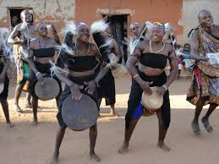
“Working On It” (Mapana-Campbell)
Community Identity through Music: The Case of Tanzania’s Wagogo Festival
Chapter 4: The Wagogo Festival: A Brief History
There they were at the Wagogo Festival, in Chamwino village, Central Tanzania. One-by-one, each group of adult men and women, often about 20 or 25 in multiple columns and lines facing front, made their music for an audience that included the visiting few mzungu (“foreigners”) who sat in chairs before them under the shade of a canvas tent. The Wagogo musicians were clothed in black cotton toga-like outfits (kaniki), and with beaded (sanga) necklaces, head-bands, bracelets and earrings. They played malimbas (thumb-pianos), mazezes (two-stringed fiddles), single-headed muheme drums, and kayama (shakers) made of ….

Slide 34

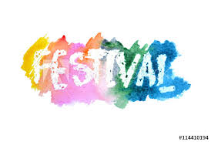


At the seams of several related fields and disciplines within music, this volume explores the experiences of festival performers, organizers and volunteers, and visitors to the festival. It contributes to the field of (Applied) Ethnomusicology in that it puts ethnomusicological knowledge to practical use through a music-centered intervention into a particular community. It addresses the inner workings of a musical community, and is thus attuned to Community Music as a professional field of study that emphasizes active collaboration between individuals who play, create, improvise, and perform music together (and which in the process succeeds in fostering individual growth and community development). It is relevant to the field of Music Education, in that it seeks to understand how music, as a fundamental component of human culture and behavior, is transmitted, preserved, created and performed, and celebrated. In its ethnographic approach to community identity through music, this volume’s case of Tanzania’s Wagogo Festival underscores the ways in which an understanding of the concept of festival (and similar performance events) is both product and process of community efforts, and a testimony to music’s function in asserting identity and the inheritance of cultural heritage.

Slide 35
Research in Music, Culture, and Children’s Education
Patricia Shehan Campbell
Unviersity of Washington (USA) and Carleton University (Canada)

Slide 36
Long-Standing Questions that Orient Research and Practice
* Are children born musical? Is musicality an inherited trait?
* Is musicality naturally acquired? Does it require informal stimulation?
* Can music be taught—in schools, churches, community settings?
* What should be the goal of music education (to sing, play, dance, listen, create)?
* Can a musical education enhance learning-at-large?
* Can musical learning transfer (social-emotional learning, intercultural understanding)?

