Slide 1
How to develop cultural awareness with children?
Mateja Dagarin Fojkar

Slide 2
Cultural activities for children
Think of two activities with which you would talk about cultural issues with primary school children.

Slide 3
Some tips for the classroom
Introducing elements of the young learners’ own culture
Talking to friends and family; sharing stories, and listening to the stories of others’ life experiences and family histories
Talking and writing about own celebrations, traditions, beliefs, and cultural practices + reflecting
Comparing own practices with practices in other cultures
Listing some characteristics of own culture
Embarking on a reading program; purposefully selecting the topics and authors for reading; e.g. choosing authors who represent cultures that vary from your own
Using children’s literature from around the world
Organising readaloud sessions
http://carolivia.com/publications/nappy-hair/nappy-hair-controversy/

Slide 4
How to talk about cultures?
Learning about and respecting their own and other cultures cannot be separated from values and beliefs. Education for cultural diversity must therefore not concentrate only on what is out of the ordinary but must help children to be respectful of what is unfamiliar, to recognise commonality as well as difference and to learn about, and be critical of, their own and other people's culture.
Children need to compare and contrast other cultures with their own – the familiar and the unknown.

Slide 5
We need to help children to experience and understand:
  where they belong;
  similarities and differences between themselves and other people;
  the influences that shape their own and other cultures;
  how to understand themselves and make sense of experience;
  how they can actively create and alter how they understand the world.
Through a process of:
discussion, reflection, change – reaching beyond the boundaries of prior experience and learning to see beyond the framework of beliefs, values and practices in which they grew up.

Slide 6
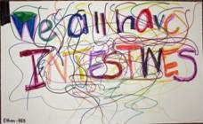
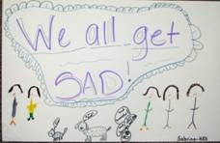
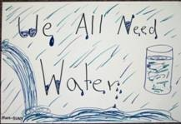
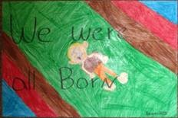
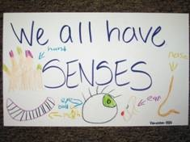
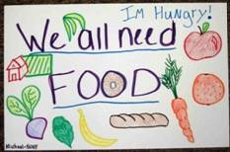
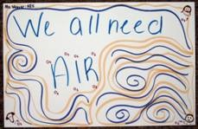
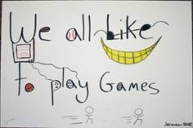
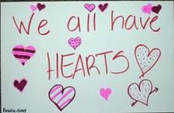
Start with looking at similarities- move beyond the question of why "they" are different from “us” into the question of how "we" are the same.

Slide 7
Books
Whoever you are
My nose, your nose
What does it mean to be global?
Strictly no elephants

Slide 8
Creating videos
Miracles still happen
https://www.youtube.com/watch?v=AHYvWpZdaz8

Slide 9
Activites for children
Take a look at the tasks for children in the resources below (in chapter Publications on inercultural awareness):
G 1, 2: Mirrors and windows - a book
G 3, 4: Using multilingual approaches – a book
G 5, 6: Activities to develop intercultural awareness – a webpage
G 7, 8: Jezikovno in medkulturno uzaveščanje v OŠ
G 9, 10: Language games
Describe the resources to your colleagues.
Do one activity with us.

