Slide 1
USA Education System
AOŠK
Edwin Harris
28 February 2023
University of Ljubljana
Faculty of Education

Slide 2
Today’s plan
Look at an overview of education in the US
Listen to my educational journey
Learn details of college admissions process in the US
Design your own college admissions process

Slide 3

KWL
https://tinyurl.com/kwlaosk

Slide 4
Do you know what these words mean in the context of education in the US? Write down your guesses
Charter
Magnet
Liberal arts college
SAT
GPA
AP

Slide 5
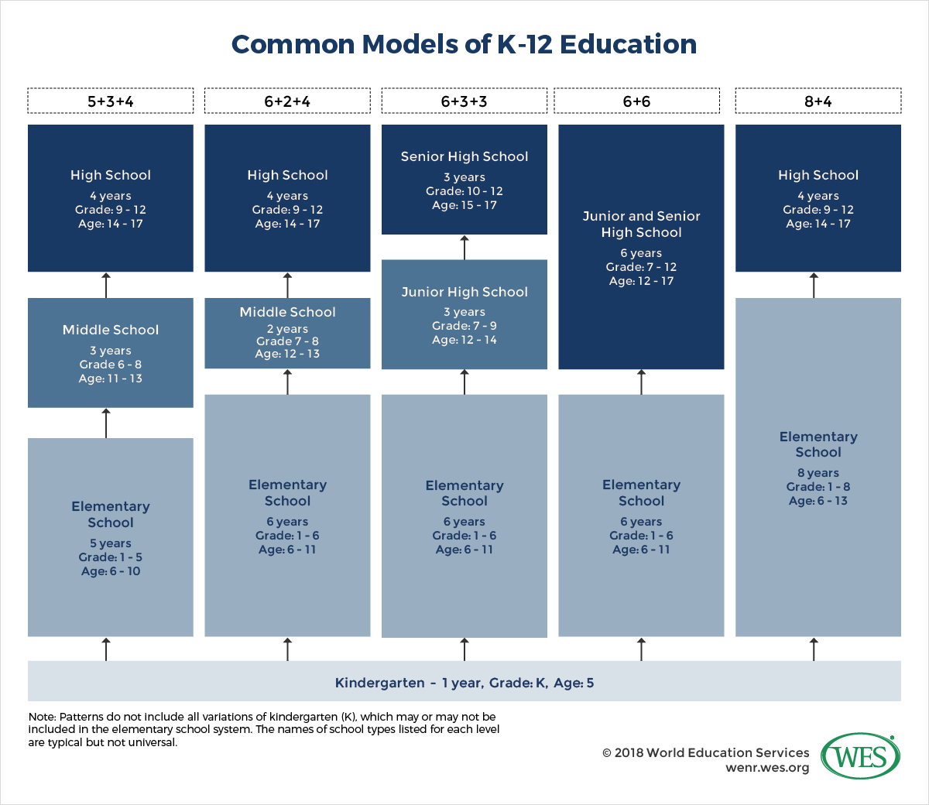

Slide 6
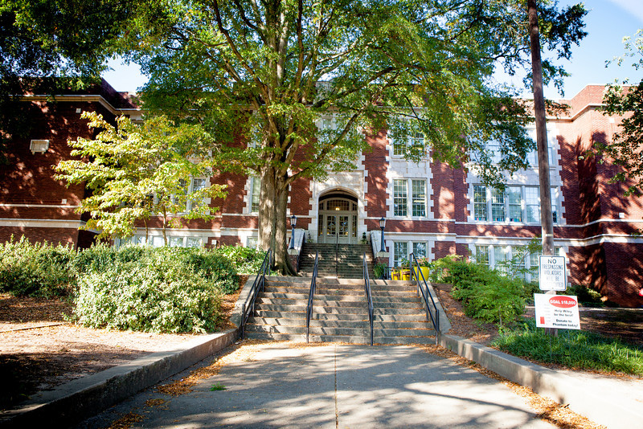
Wiley International Magnet Elementary School
Grades K - 5. Ages 5 - 11
International magnet school
  include[s] world investigations, global perspectives, communication of ideas, and local and global action.
  study world language choices beginning in kindergarten through fifth grade. Language classes are forty minutes per day four days a week and currently include Chinese, French, Spanish, Japanese and German.
  internationally focused Art, Music, and PE courses for forty minutes per day five days a week.
  Twenty-first century tools assist students in learning about the rich world around them and various means of communicating across cultures to become global ambassadors.
  Big ESL program

Slide 7
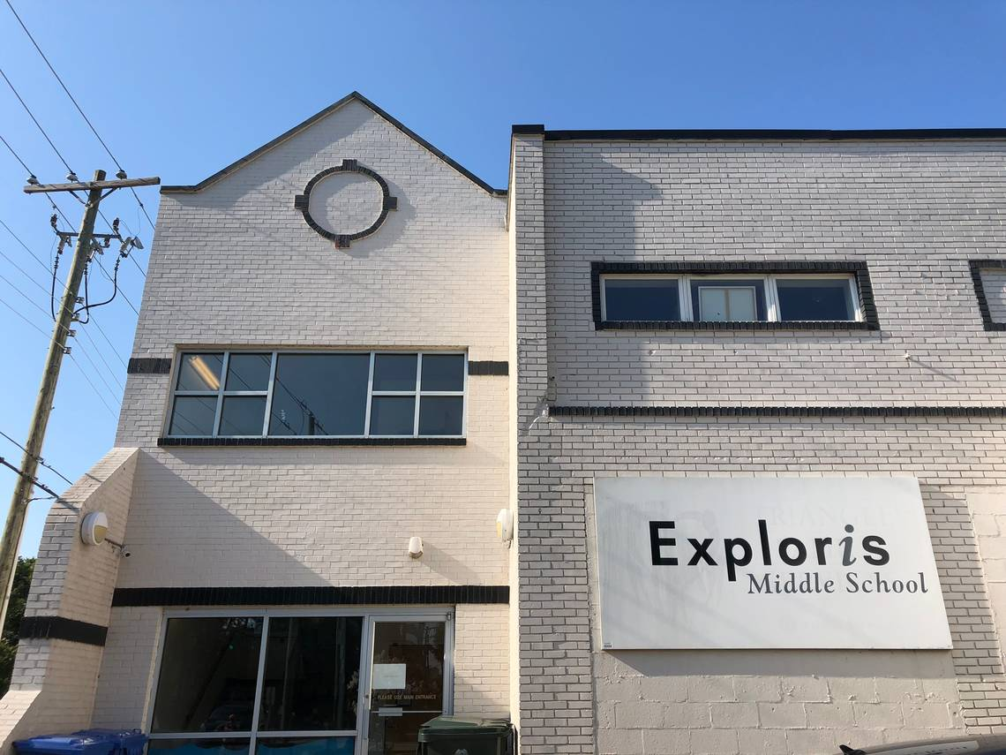
Exploris Middle School
The Exploris School is a diverse learning community that engages students in a challenging, relevant, relationship-based education.
Through experiential, project-based learning we empower students to foster a just and sustainable world.
Our educational program is built around four core pillars: Global Education, Project-Based Learning, Co-Teaching, and Responsive Classroom.
Students learn through hands-on activities, service learning, field experiences, and competency-based grading that allows all students the opportunity to grow and master skills.
Charter schools are public schools operated by private nonprofit boards. The primary funding sources for charter schools are local, state, and federal tax dollars. The schools have open enrollment with no discrimination, no religious associations, and no tuition. In short, charter schools are public schools serving public students with public dollars for the public benefit.
I couldn’t find info about foreign languages offered. I took Spanish for 3 years.
Language classes are offered via Rosetta Stone? :-(
Call teachers by their first names

Slide 8
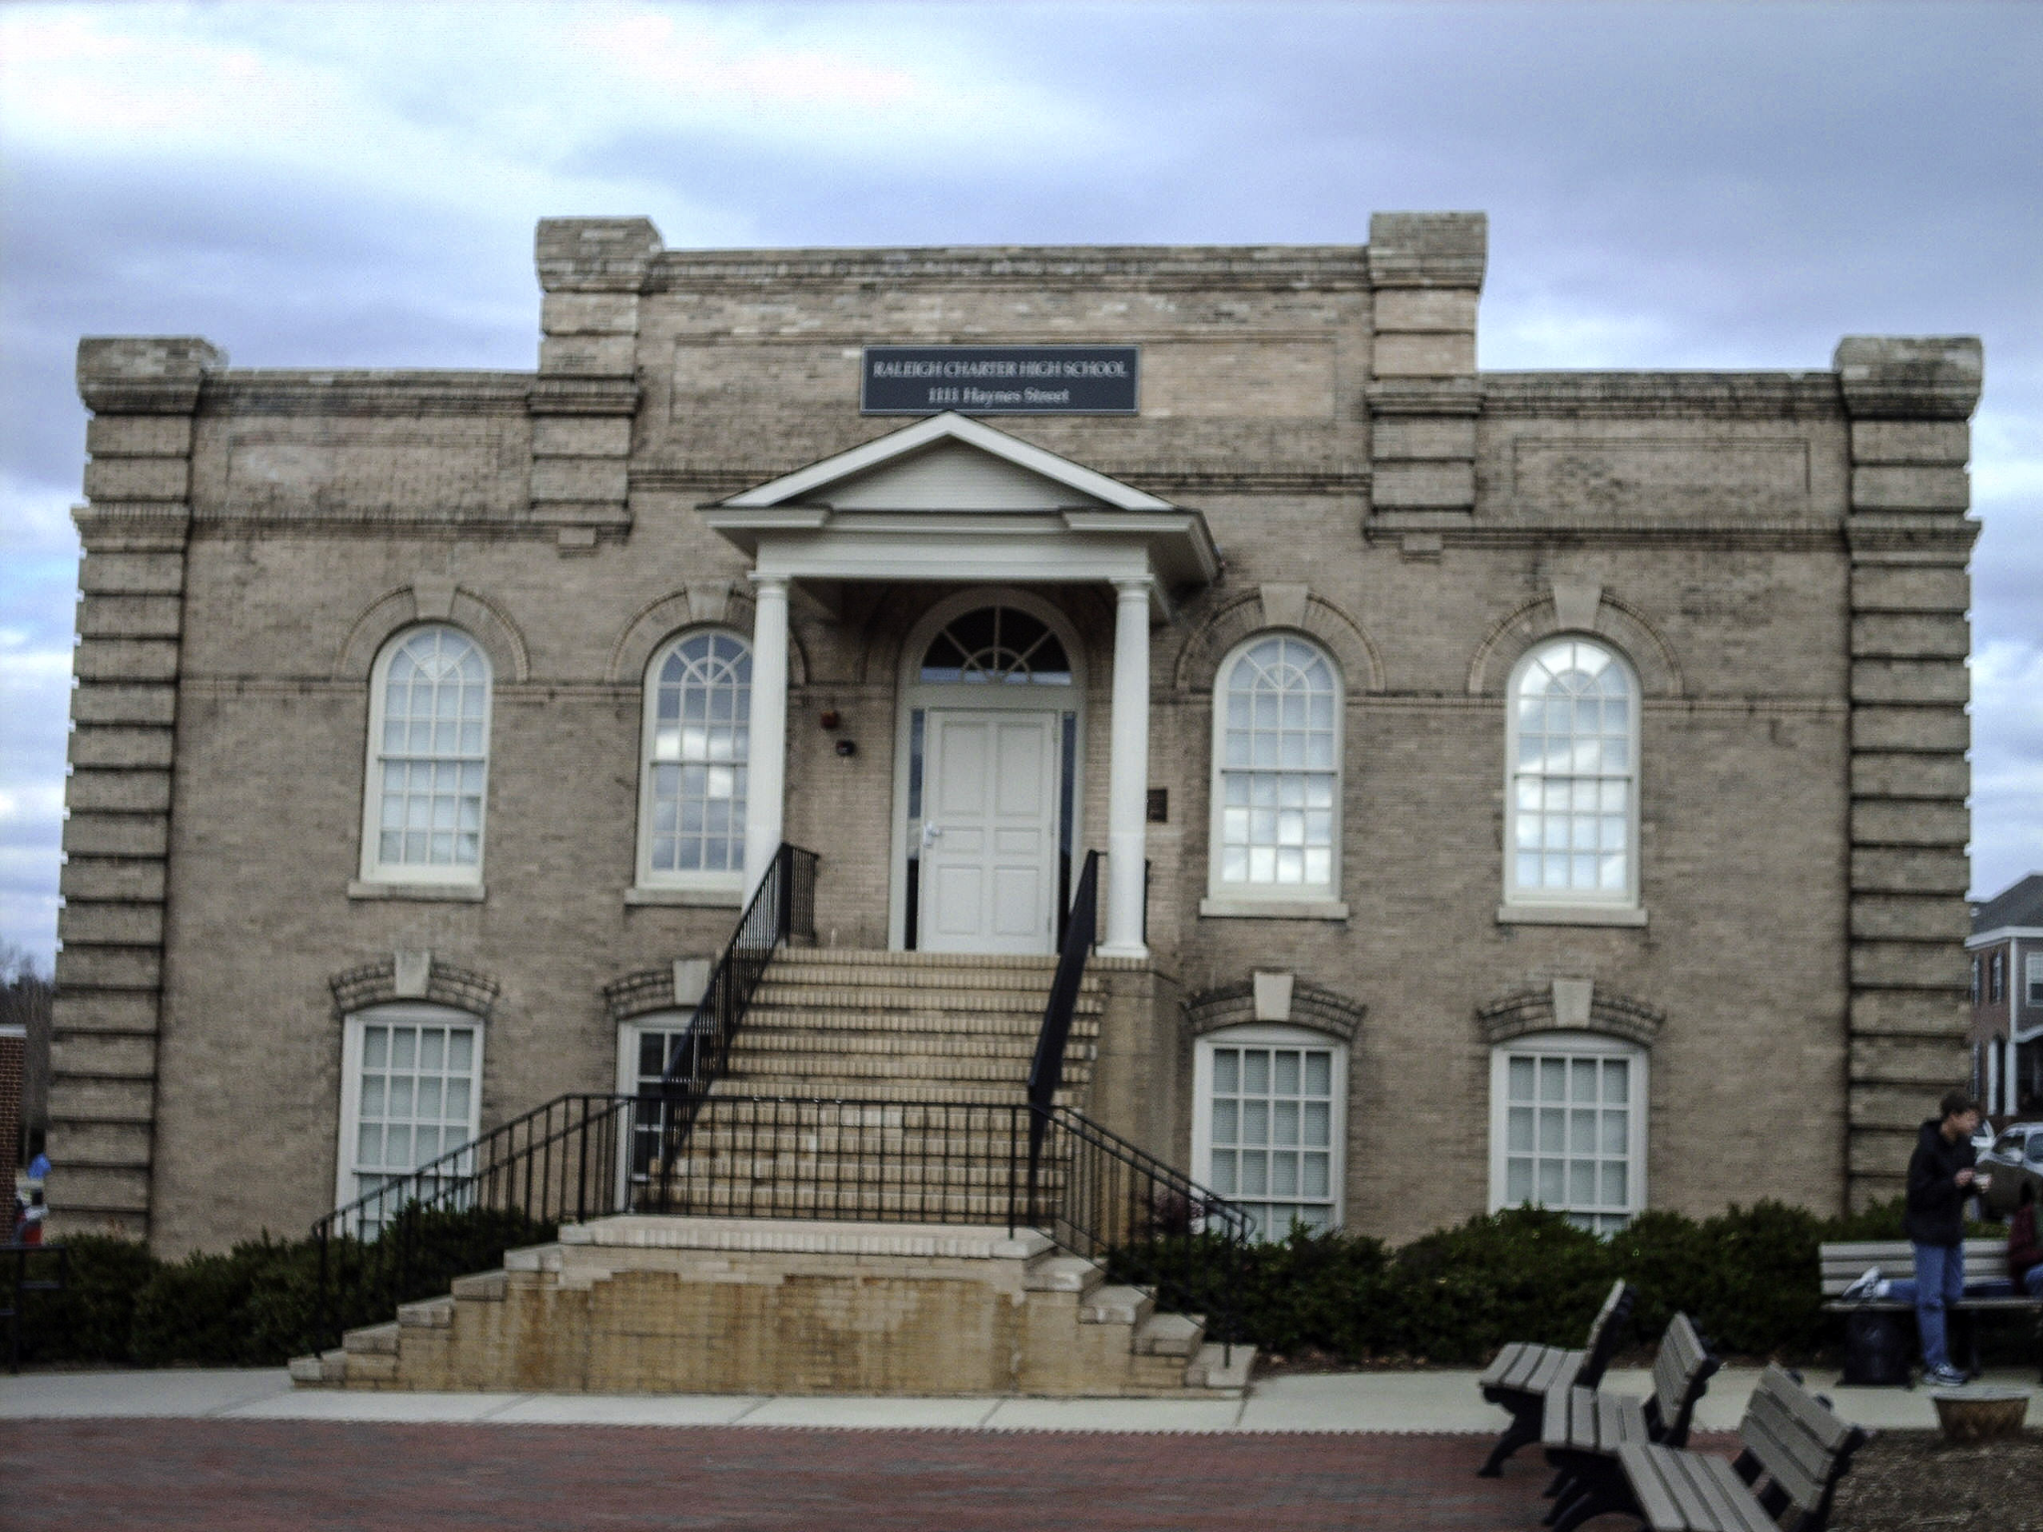
Raleigh Charter High School
Raleigh Charter High School challenges college-bound students in a creative and supportive atmosphere to become knowledgeable, thoughtful, contributing citizens. Our students learn to be citizens in a challenging academic setting.
The majority of our courses are Honors, Enriched Honors, and Advanced Placement. Students who have solid study habits will find this level of curriculum to be appropriate. Since we assign homework every evening (30 minutes per night in most courses and 30-45 minutes per night in Advanced Placement courses), students who possess the discipline to complete homework every evening and to arrive prepared for each class the following day will do well at RCHS.
Was rated 6th best public high school in the country when I was a student!
Common assignments: worksheets, lab reports, tests, writing 3 - 5 page essays, one essay in US History was 15+ pages

Slide 9
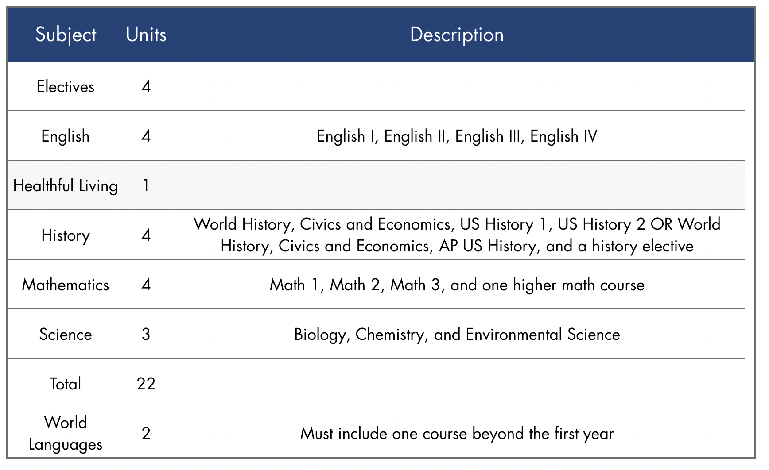

Raleigh Charter High School

Slide 10

Kalamazoo College
Here’s my transcript (all of the classes that I took). Do you have any questions about what these things mean? How do you think the school would describe itself? https://www.kzoo.edu/about/

Slide 11
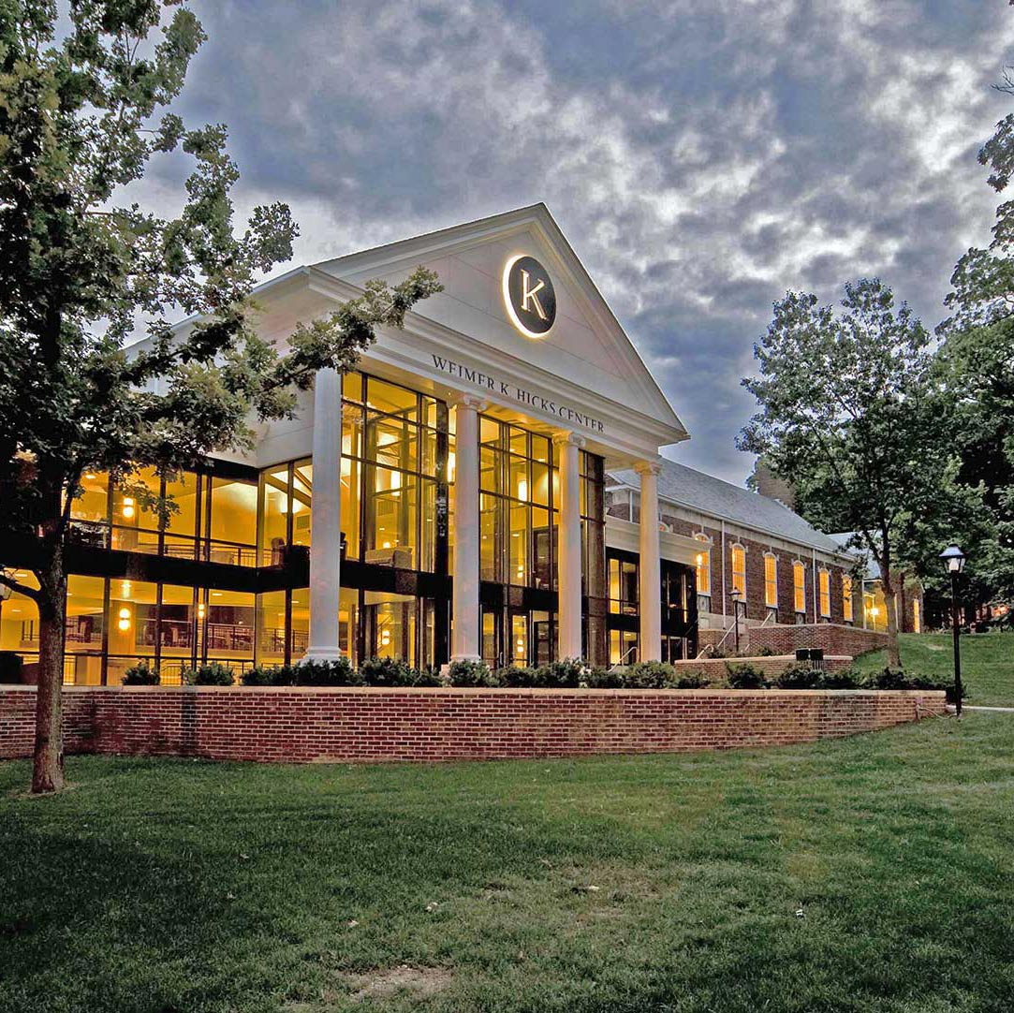
Kalamazoo College
Small liberal arts college in Michigan, 1,369 students from 37 states and 28 countries
Annual tuition, fees, room and board for 2022-23: $67,752. National average: $35,551 (educationdata.org)
Study abroad is very common
Senior project is required. It’s usually a big paper, but you can do other things too (like planting a garden).
Typical grade breakdown in class might be something like:
  20% participation/attendance
  40% midterm/final exams
  (10% x 4) 3 - 5 page essays

Slide 12
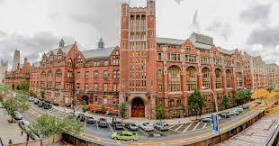
Teachers College, Columbia University
https://www.tc.columbia.edu/arts-and-humanities/applied-linguistics-tesol/degrees--requirements/tesol-ma/
Largest graduate school of education in the US (5,299 students)
Example grade breakdown in Language Assessment class:
  Assignments 1 and 2 (3 pages max, each) (10%)
  Midterm Paper (Part 1 of your final paper) (20%): The introduction, research questions, literature reviews, test design, & the draft of the test.
  Final Project (Part 2 of your final paper) & Presentation (65%): Revision of the midterm, test administration, test analyses & conclusions.
  Participation: Active participation in class discussions is expected. (5%)
Typical homework assignments: read 1 - 2 academic articles and/or 1 - 2 book chapters and be ready to discuss in class

Slide 13

College Admissions
Things that are considered with your application:
Grades from high school
References from 2 teachers
One or more essays
List of extracurricular activities (clubs, sports, etc)
SAT score (optional)
Interviews (optional)
Race/ethnicity/background

Slide 14
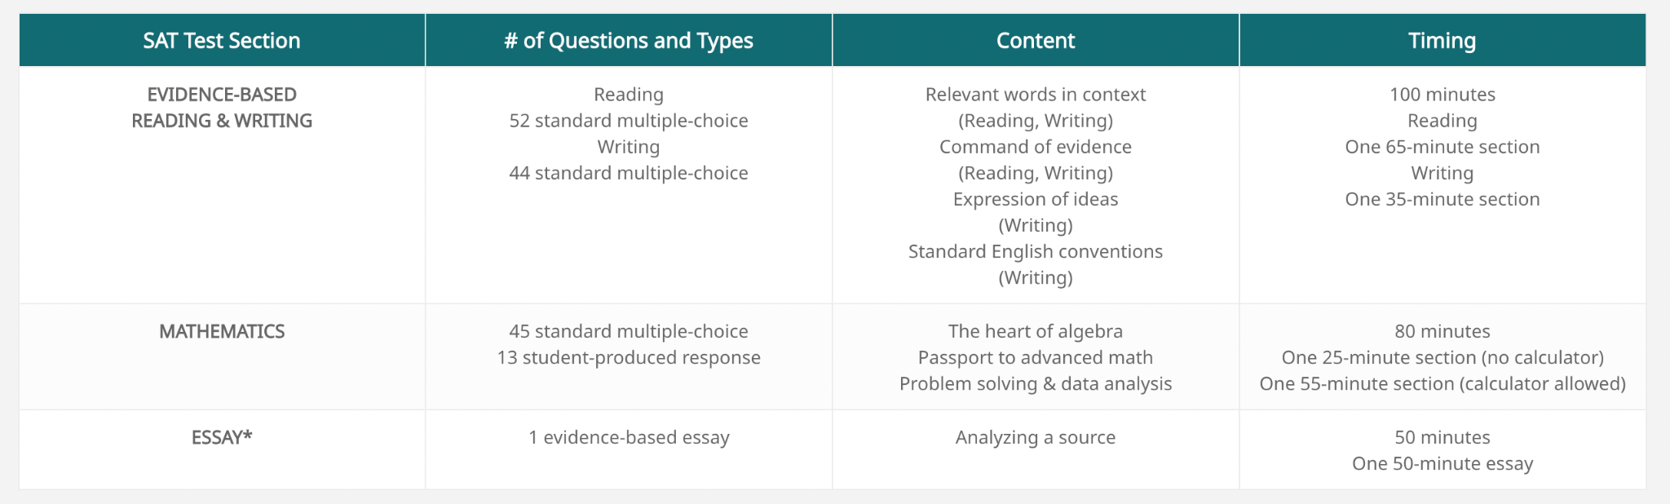
SAT
The SAT is a 3 hour 50 minute exam (including an optional essay which takes 50 minutes), consisting of five sections: Reading, Writing, Math (with calculator), and Math (no calculator).
https://www.latutors123.com/tutoring-resources/sat/format-dates/#:~:text=The%20SAT%20is%20a%203,and%20Math%20(no%20calculator).&text=The%20SAT%20is%20a%20paper,select%20dates%20throughout%20the%20year.

Slide 15
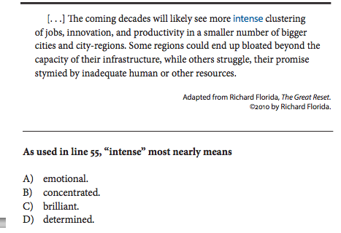
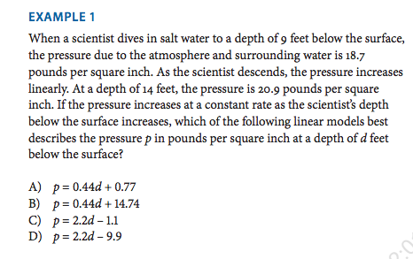
SAT

Slide 16
Design a college admissions process
What’s the college admissions process like in your country?
How is it the same/different than the process in USA?
Which do you think is more fair? Why?
In groups, design a college admissions process
Will you require…
  tests?
  Interviews?
  Essays?
  Extracurricular activities?
How much weight will you put on each criteria?

Slide 17
Do you know what these words mean in the context of education in the US? Here are the answers!
Charter– “publicly funded independent school established by teachers, parents, or community groups under the terms of a charter with a local or national authority.”
Magnet– “a school designed to attract pupils from various areas or groups, especially one offering specialist tuition in a particular subject alongside the standard curriculum.”
Liberal arts college–small 4-year school focused on undergraduate studies
SAT–Scholastic Aptitude Test. Big test that many college-bound HS students take
GPA–Grade Point Average. 0 - 4 scale to show your grades
AP–Advanced Placement. College-level courses you can take in High School
Definitions from Oxford Languages

Slide 18
KWL
https://tinyurl.com/kwlaosk

Slide 19

Conversation Club!
Fridays 9:30 - 11
BUT we might find an additional time
Fill out the form if you’re interested
https://tinyurl.com/convoNA

