Slide 1
USA Education System
AOŠK
Edwin Harris
14 March 2023
University of Ljubljana
Faculty of Education

Slide 2
Today’s plan
Review from last session
Watch videos from language classrooms in the US
Discuss strategies learned

Slide 3
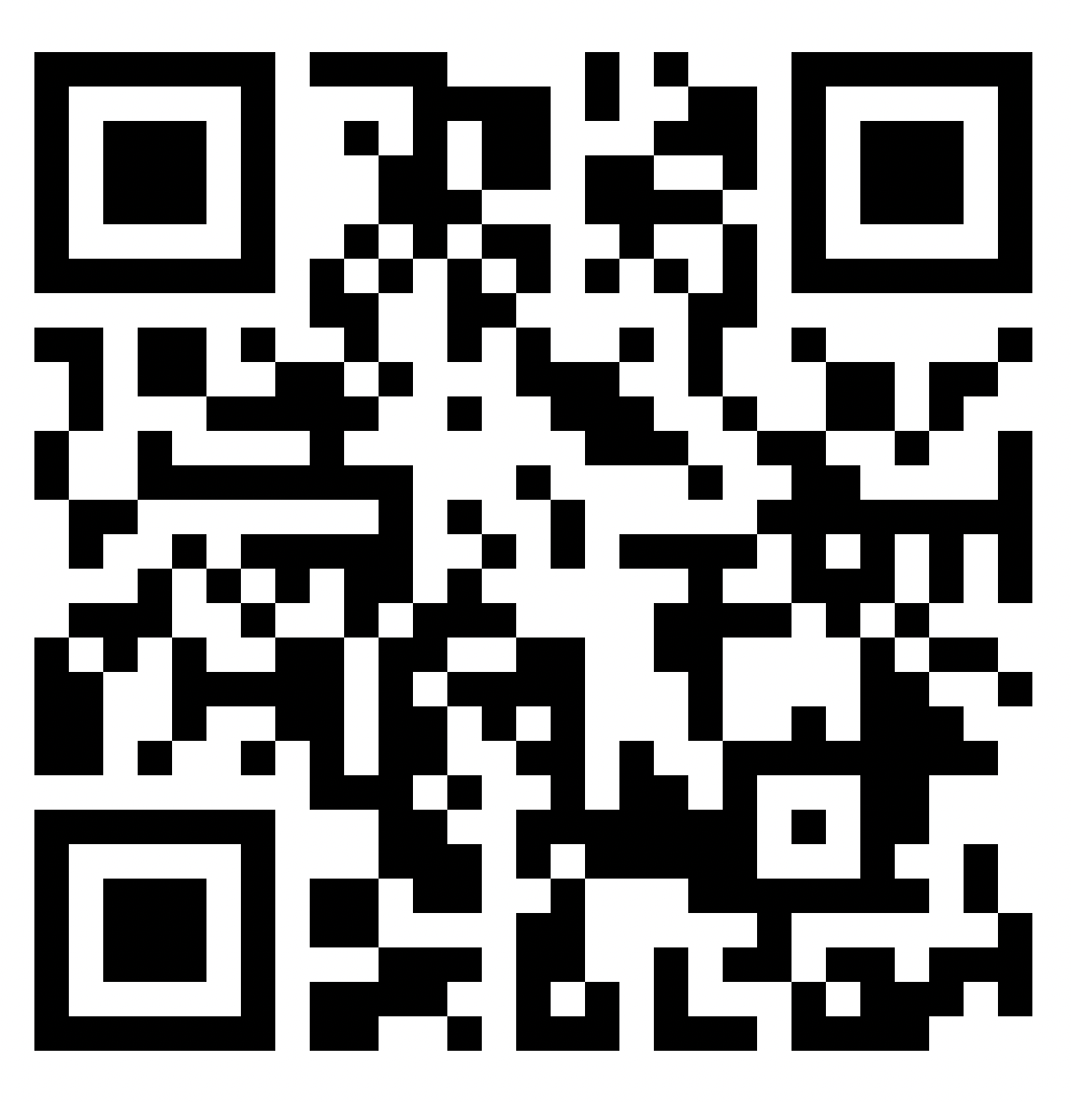
KWL
https://tinyurl.com/kwlaosk

Slide 4
Do you know what these words mean in the context of education in the US? Write down your guesses
Charter
Magnet
Liberal arts college
SAT
GPA
K-12
AP
ENL
ESL
ESOL
EAL
ELA
Community college

Slide 5
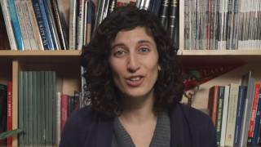
Teaching Bilinguals (Even if You Aren’t One)
Get into 8 groups

Slide 6
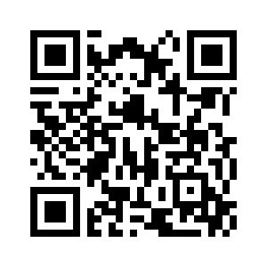
Answer these questions about the classroom in your video
Who? Who are the teachers? Who are the students?
What? What are the learning strategies that they use?
Where? Where is this school?
Any other notes?
https://tinyurl.com/aoskvids

Slide 7
Do you know what these words mean in the context of education in the US? Here are the answers!
Charter– “publicly funded independent school established by teachers, parents, or community groups under the terms of a charter with a local or national authority.”
Magnet– “a school designed to attract pupils from various areas or groups, especially one offering specialist tuition in a particular subject alongside the standard curriculum.”
Liberal arts college–small 4-year school focused on undergraduate studies
SAT–Scholastic Aptitude Test. Big test that many college-bound HS students take
GPA–Grade Point Average. 0 - 4 scale to show your grades
AP–Advanced Placement. College-level courses you can take in High School
Definitions from Oxford Languages

Slide 8
Do you know what these words mean in the context of education in the US? Here are the answers!
K-12–Kindergarten through 12th grade. Primary and secondary schools with students aged 5 - 18.
ENL–English as a New Language
ESL–English as a Second Language
ESOL–English for Speakers of Other Languages
EAL–English as an Additional Language
ELA–English Language Arts
Community college–two-year post-secondary schools that offer certificates, diplomas, vocational education, and Associates Degrees

Slide 9
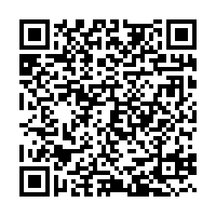
Conversation Club!
Fridays 9:30 - 11
BUT we might find an additional time
Fill out the form if you’re interested
https://tinyurl.com/convoNA

