Slide 1
USA Education System
AOŠK
Edwin Harris
(with big thanks to Garry Fourman)
28 March 2023
University of Ljubljana
Faculty of Education

Slide 2

"I pledge allegiance to the Flag of the United States of America, and to the Republic for which it stands, one nation under God, indivisible, with liberty and justice for all."
Required in 47 states! But it may be easy to opt out in many of these states.

Slide 3
Today’s plan
Review quiz from last session
Answering some of your questions
Learn about decision-making in USA schools
Role-play a school board meeting
Time-use activity

Slide 4
Warm-up Quiz
KAHOOT
Notes:
https://tinyurl.com/aoskquiz. eah2194@tc.columbia.edu easy password

Slide 5
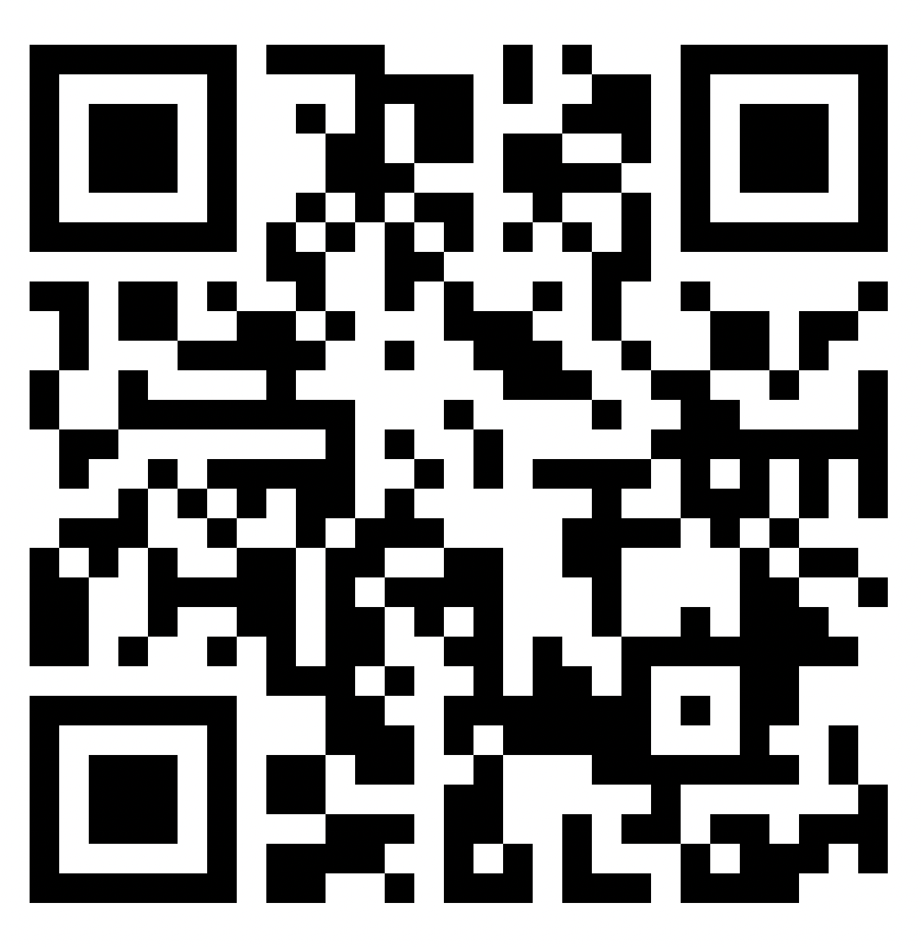
KWL
https://tinyurl.com/kwlaosk

Slide 6

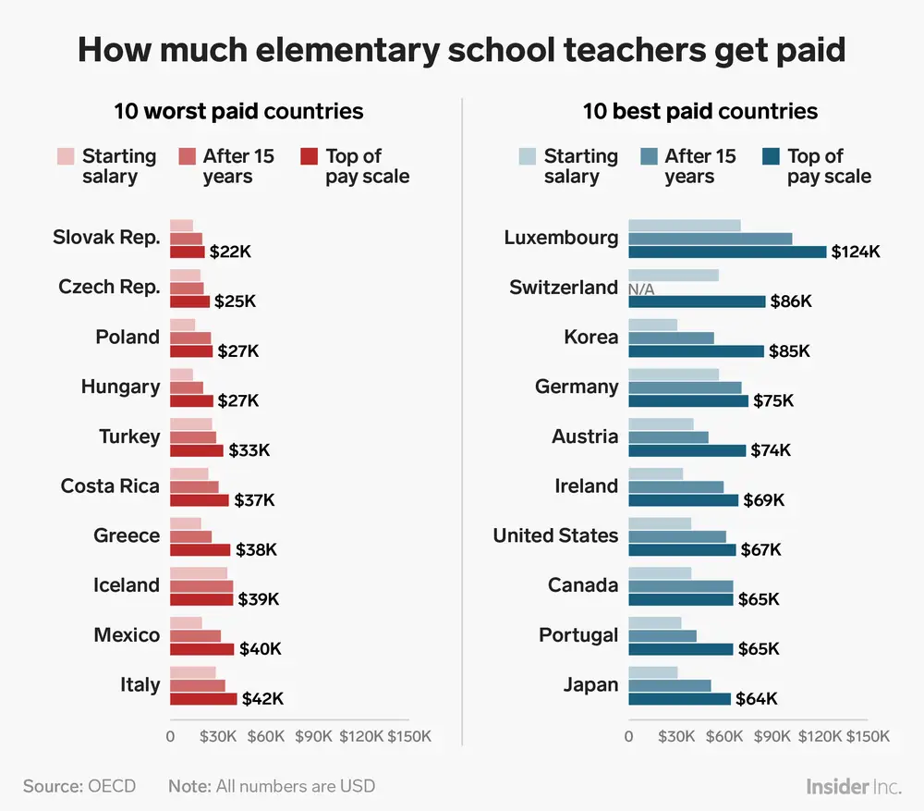

Some answers for your questions

Slide 7
Educational funding
The federal government only contributes about 8% of funding for schools
A lot of school funding comes from local property taxes (inequality)
School decisions are made at the state and local level

Slide 8
School boards
Usually 5-9 members who are elected or appointed
They make decisions with input from families, teachers, schools, students, and the general public
Collectively in charge of $600 billion, and 50 million students
School board duties:
  Decide the curriculum and textbooks
  Hire and evaluate a superintendent
  Approve and manage budgets
  Make a school calendar
  Other policies to address relevant issues
Adapted from: https://xqsuperschool.org/rethinktogether/demystifying-school-boards-what-do-school-boards-do/

Slide 9
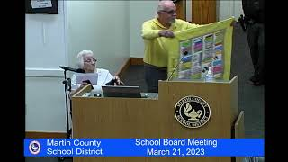

Slide 10


Slide 11
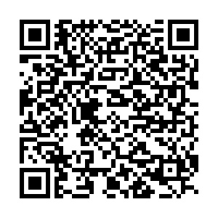
Curriculum
STEM: Science, Technology, Engineering and Mathematics
Vocational: prepares students to work in a trade/craft, as a technician or other support roles for many professions
Fine Arts: Learning painting, sculpture, creative writing, music performance, theater, photography, video production
Liberal Arts: history, language, philosophy, literature, focus on general knowledge rather than specific
Athletics: focus on physical fitness, team sports, leadership
From Garry Fourman
Notes:
Advocate for group: Each group gets unlimited funding: How would you use this money to promote your area/interest in your local school. Come up with one or two projects or ways.

Slide 12
Role playing Activity
Step I
You are a member of an advocacy group. Discuss why your area is important to children’s education, to their futures, and to the future of society. Create a list!
Step II
You are a member of a school board and an advocate for a specific curriculum. You have to select which programs your schools will offer and how the funding is to be distributed. You must eliminate at least one of the five programs.
Step III
The Superintendent does not vote; however, if the board cannot agree, s/he makes the final decision and reports the group’s results to the rest of the class.
From Garry Fourman
Notes:
Three new groups are created. Each group represents a school board and has 1,000,000 to spend. Each student advocates for their previous special interest group. The boards choose one of their members to be the superintendent. As a school board, you need to decide how to distribute the funding, what programs to support or not. I speak with the superintendents. They do what the school board tells them to do and report the final decision to the class. They have two minutes to report which program was cut and show the percentage of how the money is to be divided among the four remaining groups.

Slide 13
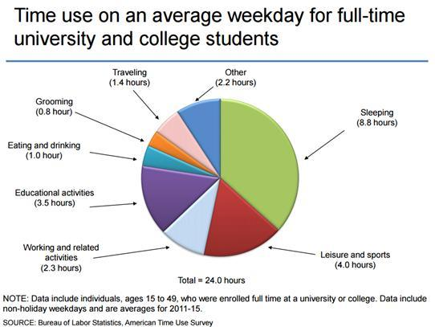
Time use activity
Make your own graph on a paper plate
Include the following categories (and more if they’re important):
  Sleeping
  Leisure and sports
  Work
  Education
  Eating and drinking
  Grooming
  Traveling
From Garry Fourman

Slide 14
KWL
https://tinyurl.com/kwlaosk

Slide 15
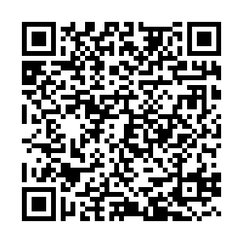
Conversation Club!
Fridays 9:30 - 11
BUT we might find an additional time
Fill out the form if you’re interested
https://tinyurl.com/convoNA

