Slide 1
CANADA

Slide 2
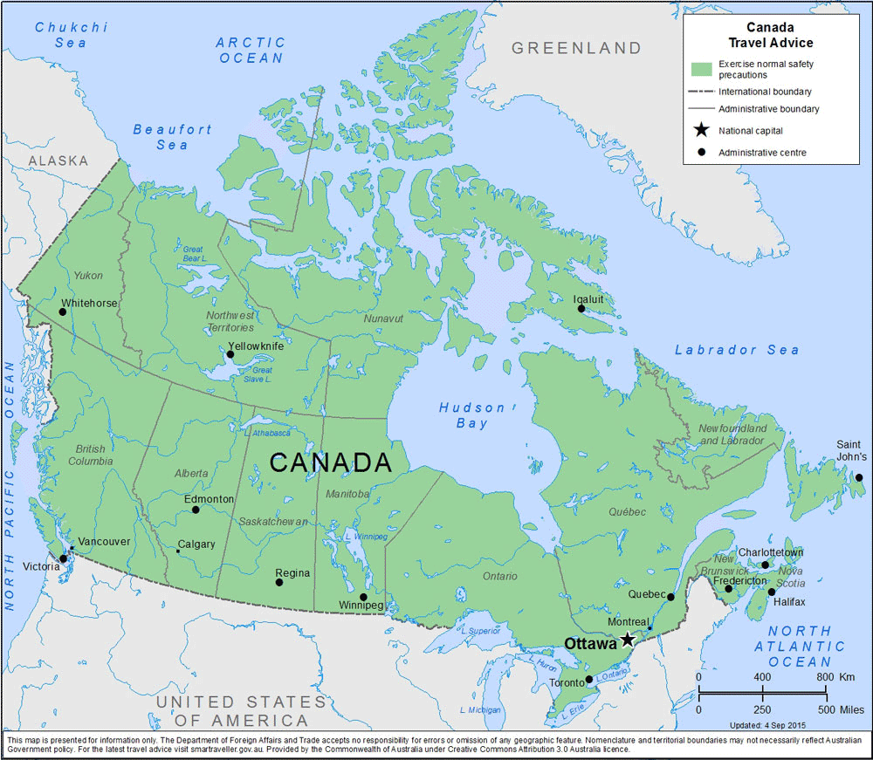

Slide 3
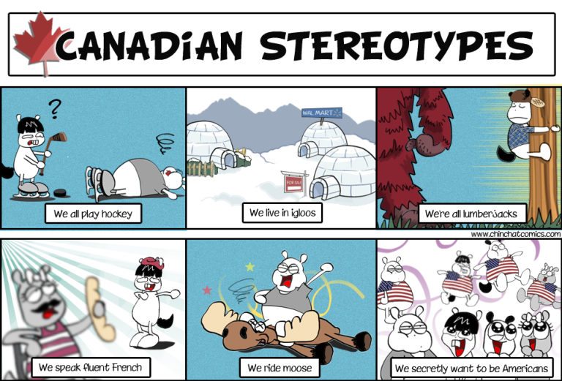
How to be a Canadian

Slide 4
GENERAL INFORMATION
AREA: 9,984,670 sq m
POPULATION TOTAL: 38,660,594 (4 people per sq km)
URBAN POPULATION: 81,3 %
FORM OF GOVERNMENT: a parliamentary democracy and a constitutional monarchy; Head of state: His Majesty King Charles III
POLITICAL DIVISION: Canada is a federation composed of ten provinces and three territories

Slide 5
GENERAL INFORMATION
CAPITAL CITY: Ottawa
LONGEST RIVER: MacKenzie, 4240 km
HIGHEST MOUNTAIN: Mount Logan, 5,959 m
LARGEST LAKE: Great Bear Lake, 31,328 sq m
CLIMATE: winters are generally cold, (average -10ºC) and summers in most areas are warm (average 21ºC), but temperatures can vary greatly depending on location

Slide 6
GENERAL INFORMATION
CLIMATE: the temperature in interior and Prairie provinces can fall as low as -40ºC in winter and some interior locations can exceed 40ºC in summer
OFFICIAL LANGUAGES: English 56%; French 21.4%
CURRENCY: Canadian Dollar (CAD)
HDI (HUMAN DEVELOPMENT INDEX) IN 2023: 0,936
  HDI is a composite statistic of life expectancy, education, and per capita income indicators, which are used to rank countries into four tiers of human development.

Slide 7
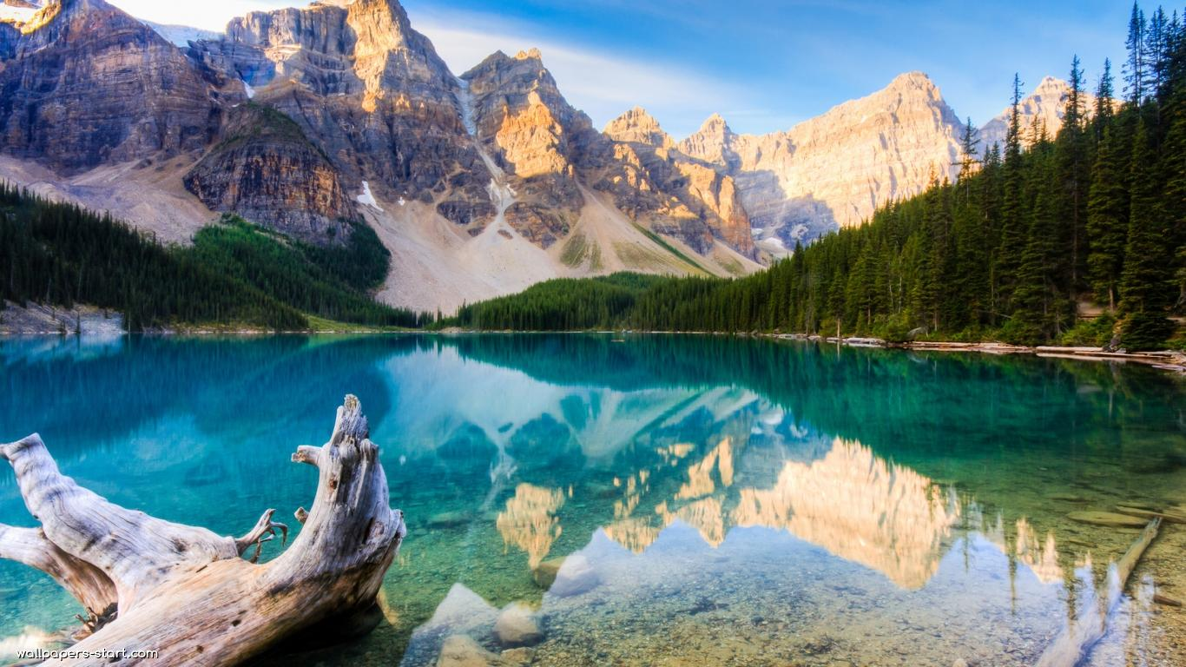
44 facts about Canada

Slide 8
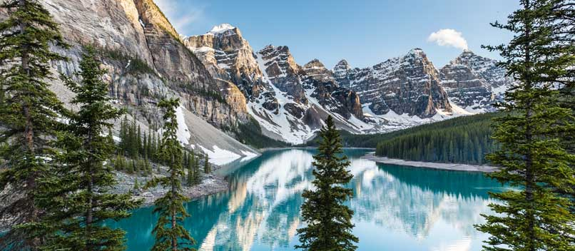
101 Facts About Canada
Top 10 reasons to move to Canada

Slide 9
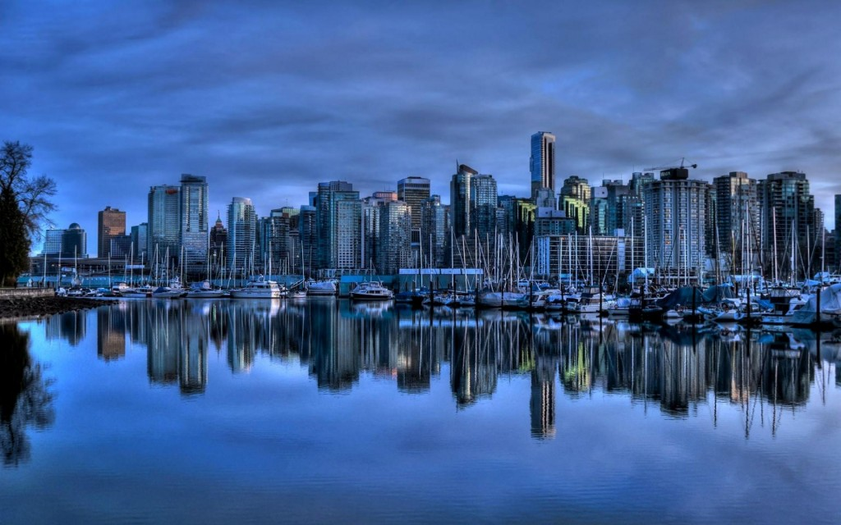
25 things you didn't know about Canada

Slide 10
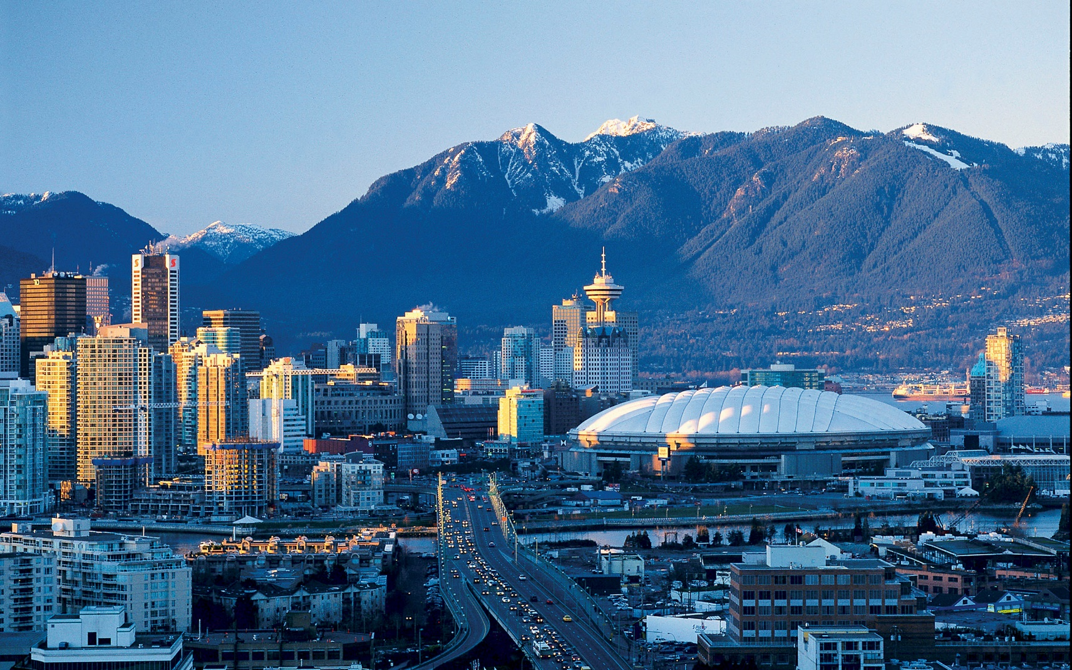
Canadian problems
Struggles of being Canadian

Slide 11
INTERESTING FACTS
http://www.hikebiketravel.com/18950/145-weird-fun-interesting-facts-canada/
https://www.buzzfeed.com/tanyachen/delightful-facts-about-canada?utm_term=.wdP34VB2j#.yxPvkBWDw
https://online.seterra.com/en/vgp/3050

