Slide 1
USA Education System
AOŠK
Edwin Harris
(with big thanks to Garry Fourman)
9 May 2023
University of Ljubljana
Faculty of Education

Slide 2
Today’s plan
Fun video about language education in USA
Review quiz from last session
Answering some of your questions
Learn about decision-making in USA schools
Role-play a school board meeting
Adult ESOL in New York City

Slide 3
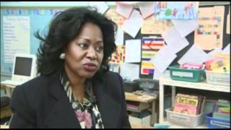

Slide 4
Answering your questions
How much money do teachers earn?
Is life in the U.S. expensive compared to Slovenia?
How do “gifted” classes work in primary/secondary school?

Slide 5
Warm-up Quiz
KAHOOT
Notes:
https://tinyurl.com/aoskquiz. eah2194@tc.columbia.edu easy password

Slide 6
Educational funding
The federal government only contributes about 8% of funding for schools
A lot of school funding comes from local property taxes (inequality)
School decisions are made at the state and local level

Slide 7
School boards
Usually 5-9 members who are elected or appointed
They make decisions with input from families, teachers, schools, students, and the general public
Collectively in charge of $600 billion, and 50 million students
School board duties:
  Decide the curriculum and textbooks
  Hire and evaluate a superintendent
  Approve and manage budgets
  Make a school calendar
  Other policies to address relevant issues
Adapted from: https://xqsuperschool.org/rethinktogether/demystifying-school-boards-what-do-school-boards-do/

Slide 8
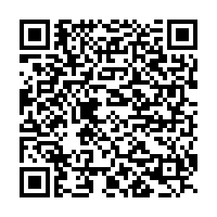
Curriculum
STEM: Science, Technology, Engineering and Mathematics
Vocational: prepares students to work in a trade/craft, as a technician or other support roles for many professions
Fine Arts: Learning painting, sculpture, creative writing, music performance, theater, photography, video production
Liberal Arts: history, language, philosophy, literature, focus on general knowledge rather than specific
Athletics: focus on physical fitness, team sports, leadership
From Garry Fourman
Notes:
Advocate for group: Each group gets unlimited funding: How would you use this money to promote your area/interest in your local school. Come up with one or two projects or ways.

Slide 9
Role playing Activity
Step I
You are a member of an advocacy group. Discuss why your area is important to children’s education, to their futures, and to the future of society. Create a list!
Step II
You are a member of a school board and an advocate for a specific curriculum. You have to select which programs your schools will offer and how the funding is to be distributed. You must eliminate at least one of the five programs.
Step III
The Superintendent does not vote; however, if the board cannot agree, s/he makes the final decision and reports the group’s results to the rest of the class.
From Garry Fourman
Notes:
Three new groups are created. Each group represents a school board and has 1,000,000 to spend. Each student advocates for their previous special interest group. The boards choose one of their members to be the superintendent. As a school board, you need to decide how to distribute the funding, what programs to support or not. I speak with the superintendents. They do what the school board tells them to do and report the final decision to the class. They have two minutes to report which program was cut and show the percentage of how the money is to be divided among the four remaining groups.

Slide 10
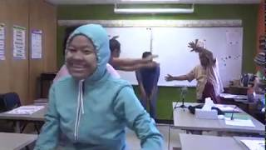
Adult ESOL in the USA
How is this similar to environments you’ve taught or learned in?
How is it different?
What do you notice about the students?
  Age
  Country of origin
  English level
Would you like to teach/work in an environment like this? Why/why not?

Slide 11

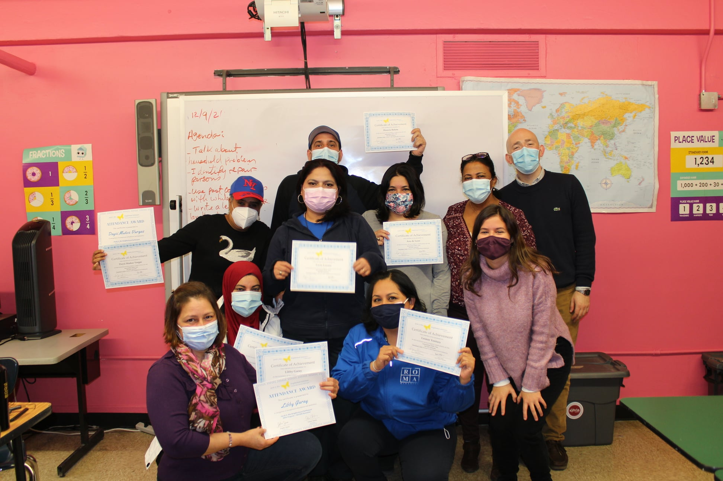
Adult ESOL in the USA
Do you notice anything unique about these fliers?
How might the classes be different/similar to environments you’ve taught or learned in?
Jacob A Riis Neighborhood Settlement Winter 2023 Class Advertisements

Slide 12

Adult ESOL in NYC
How many NYers lack high school education, English language proficiency, or both?
How many countries and languages are represented in students enrolled in literacy education at community-based orgs (CBOs)?
What is their age range?
What percentage of students live in poverty?
What are some common curriculum items?
What is the recommended cost per slot according to this report?
Investing in Quality - Literacy Assistance Center, December 2017

Slide 13
Adult ESOL in NYC
How many NYers lack high school education, English language proficiency, or both? 2.2 million
How many countries and languages are represented in students enrolled in literacy education at community-based orgs (CBOs)? 115+ countries, 70+ languages
What is their age range? 17-70, but the majority are 18-44
What percentage of students live in poverty? 90+%
What are some common curriculum items? Cultures, community resources, contemporary issues, civic engagement, health, money, parent engagement, employee skills, workers/immigrant rights
What is the recommended cost per slot according to this report? $7,400 per 400 hours (compared to $15,621 per public school student)

Slide 14
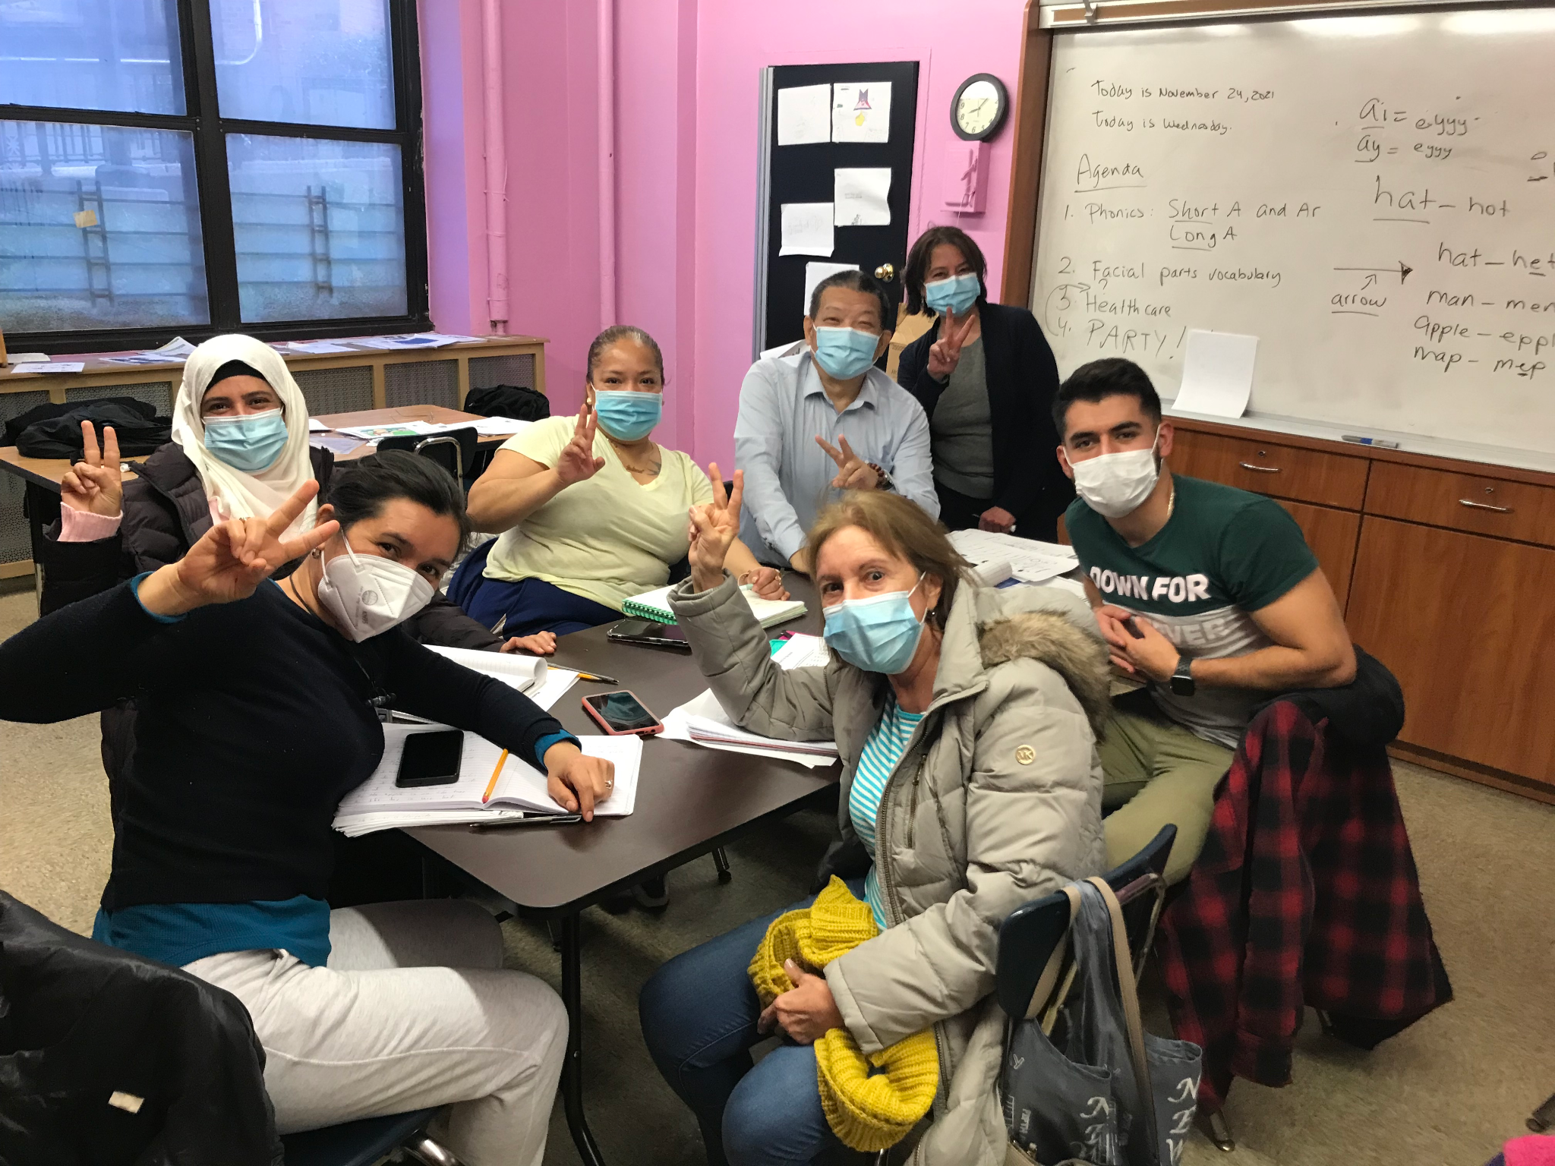

Adult ESOL in NYC
ADVANTAGES: CHALLENGES:
Motivated students
Motivated staff, volunteers, etc.
Diversity of student population
Language education is key for social integration
Free education!
Students have other priorities
Some students have limited formal education
Student attrition
Low funding
Rigid bureaucratic standards
Lack of appropriate resources

Slide 15
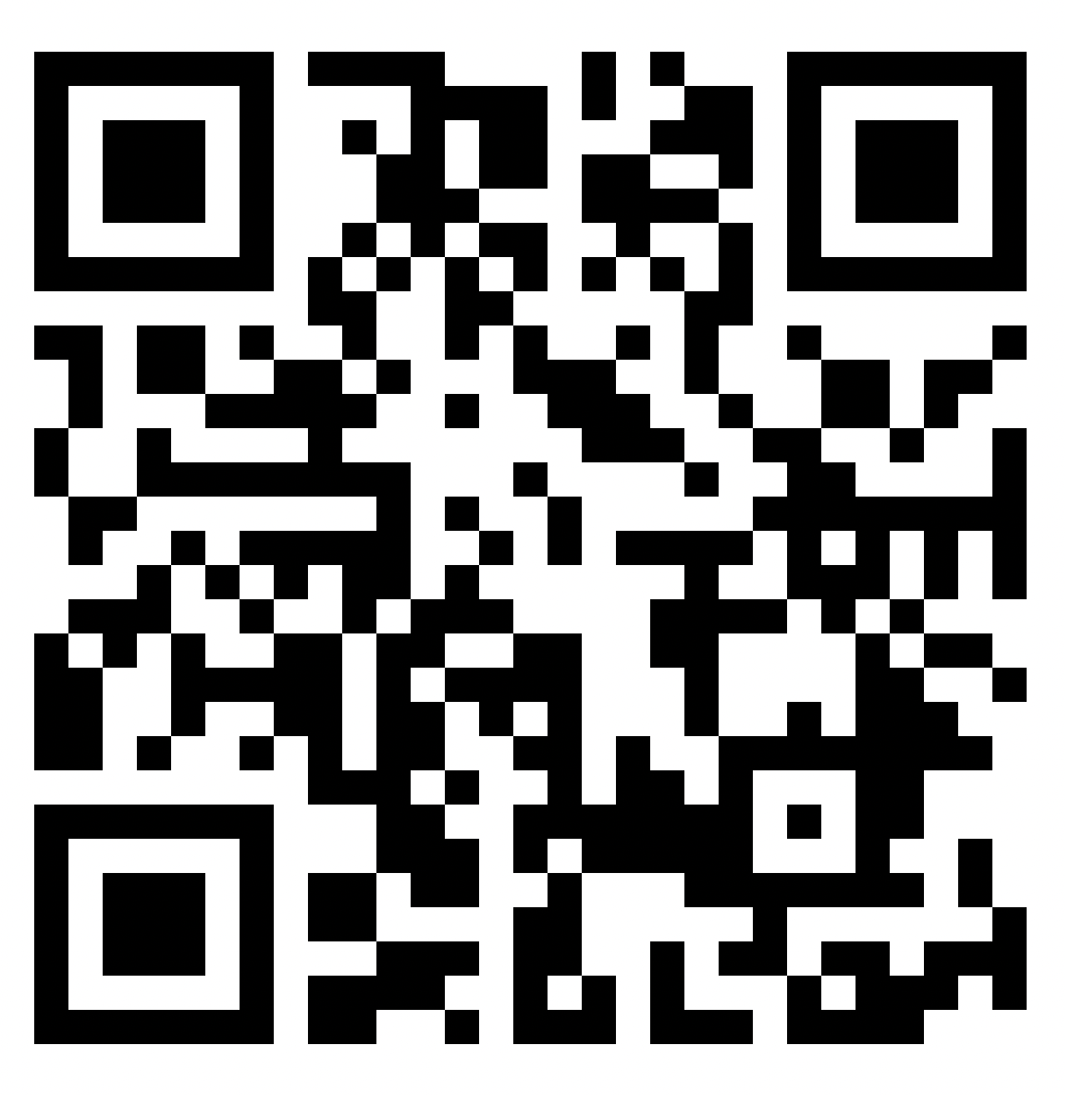
KWL
https://tinyurl.com/kwlaosk

Slide 16
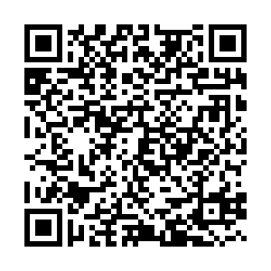
Conversation Club!
Fridays 9:30 - 11
Fill out the form if you’re interested
https://tinyurl.com/convoNA

Slide 17

Submit an article for publication!

Slide 18

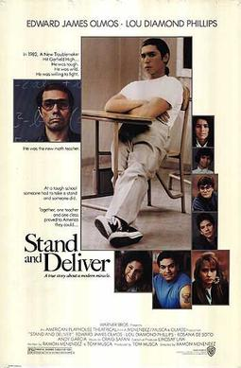


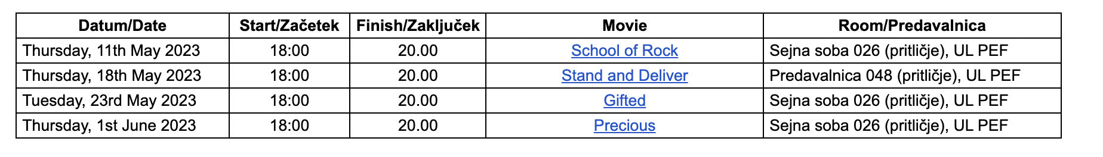
Movie nights!

