Slide 1
USA Education System
AOŠK
Edwin Harris
23 May 2023
University of Ljubljana
Faculty of Education

Slide 2
Today’s plan
Review quiz from last session
Read a report about Adult ESOL in New York City
Watch a video of an Adult ESOL class
Role-play as an Adult ESOL professional

Slide 3
Warm-up Quiz
KAHOOT
Notes:
https://tinyurl.com/aoskquiz. eah2194@tc.columbia.edu easy password

Slide 4
Adult ESOL in NYC
How many NYers lack high school education, English language proficiency, or both? 2.2 million
How many countries and languages are represented in students enrolled in literacy education at community-based orgs (CBOs)? 115+ countries, 70+ languages
What is their age range? 17-70, but the majority are 18-44
What percentage of students live in poverty? 90+%
What are some common curriculum items? Cultures, community resources, contemporary issues, civic engagement, health, money, parent engagement, employee skills, workers/immigrant rights
What is the recommended cost per slot according to this report? $7,400 per 400 hours (compared to $15,621 per public school student)

Slide 5

Adult ESOL in NYC
Scan the report alone (5 minutes)
Share 1-3 interesting facts with your group (5 minutes)
Share as a class
Investing in Quality - Literacy Assistance Center, December 2017

Slide 6
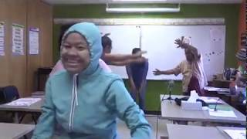
Adult ESOL in the USA
How is this similar to environments you’ve taught or learned in?
How is it different?
What do you notice about the students?
  Age
  Country of origin
  English level
Would you like to teach/work in an environment like this? Why/why not?

Slide 7


Adult ESOL in NYC
BENEFITS: CHALLENGES:
Motivated students
Motivated staff, volunteers, etc.
Diversity of student population
Language education is key for social integration
Free education!
Students have other priorities
Some students have limited formal education
Student attrition
Low funding
Rigid bureaucratic standards
Lack of appropriate resources

Slide 8
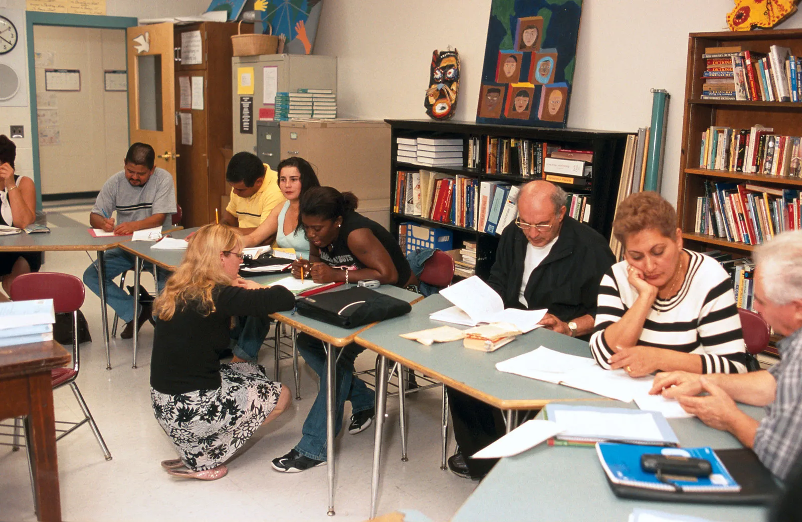
What would you do…
Discuss one scenario with your group. Fill out the sheet. I’ll assign the groups.
Scenario 1
Scenario 2
Scenario 3
Scenario 4
Scenario 5
Scenario 6

Slide 9

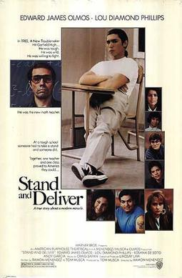


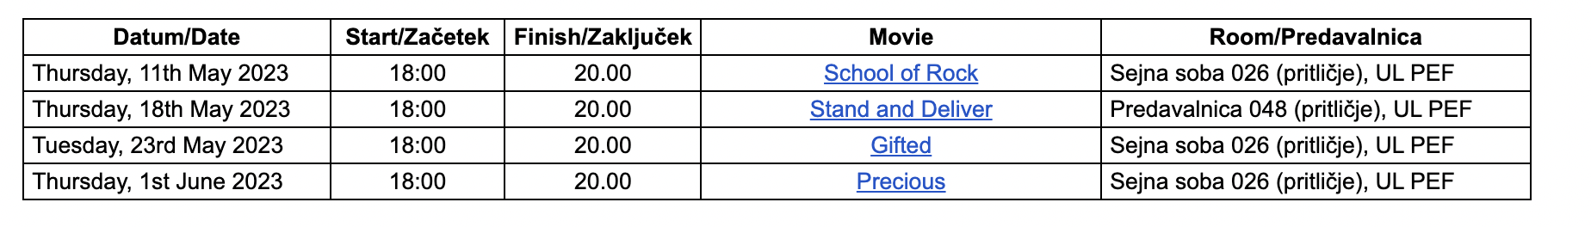
Movie nights!

Slide 10

KWL
https://tinyurl.com/kwlaosk

