Slide 1
Evaluating and creating materials and tasks for CLIL classrooms
Karmen Pižorn

Slide 2
FACTORS INFLUENCING MATERIALS
and
TASK EVALUATION
and
DESIGN

Slide 3
Shortage of ready-made resources?
https://www.teachingenglish.org.uk/professional-development/teachers/knowing-subject/c/clil
https://www.teachingenglish.org.uk/professional-development/teachers/knowing-subject/articles/clil-lesson-framework
https://www.onestopenglish.com/children/clil
https://www.clilmedia.com/five-of-the-best-clil-resources-online/
https://www.sciencewithme.com/#materials
https://landau.app/learn?gclid=EAIaIQobChMI5be1vaSc_wIVQvGyCh1weQtzEAAYASAAEgLjEPD_BwE
https://www.tigtagworld.com/clil
https://www.onestopenglish.com/teenagers/clil/teaching-tools
When seeking for materials, you must have the underpinning curricular goals in mind

Slide 4
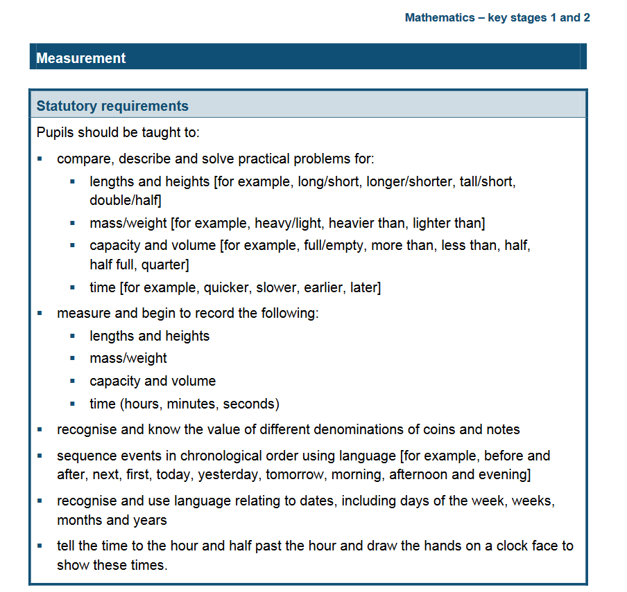
https://assets.publishing.service.gov.uk/government/uploads/system/uploads/attachment_data/file/335158/PRIMARY_national_curriculum_-_Mathematics_220714.pdf

Slide 5


Slide 6


Slide 7
The danger for CLIL: conventional EFL approach to materials development could focus attention ONLY on linguistic, rather than BOTH content and linguistic, aspects of courses.

Slide 8
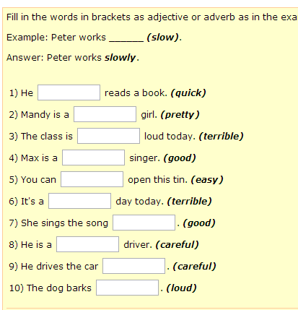

Slide 9
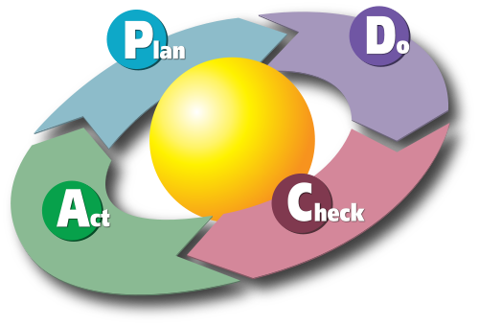
Materials design should be subject to a continuous review process, as use will always determine how appropriate the materials are for different contexts and groups of learners.

Slide 10

In CLIL classroom and in CLIL planning we need to focus equally on HOW the students MEET the content subject (input) and WHAT THE Y DO while learning (HOW they PROCESS the input).
INPUT
Mathematics

Slide 11
The design process involves:
what is needed to meet content-subject concepts (materials)
the task design
steers how this material is processed and how understanding is expressed (the output).

Slide 12
CLIL materials designer consider:
The target content
The language
Student and teacher roles
Affective factors (feelings, anxiety, motivation)
Cognitive factors
Culture

Slide 13


Student and teacher roles
More student-centred approaches
Students regularly acknowledge that CLIL courses are difficult, esp. at the beginning.
Successful CLIL courses include a great amount of paired work, group work and cooperative learning techniques
jigsaw tasks

Slide 14
Science units often focus on investigations, because they require students to talk, compare and contrast, discuss and draw conclusions – initially orally and then in written formats.
The importance of designing multi-stage and multi-layered tasks which enhance the active role of the student

Slide 15


Affective factors:
Motivation and anxiety

Slide 16
Motivation
a key theme for language learning
can stem from integrative or instrumental origins, or an interest in the subject area, or as a response to a challenge
When you do geography in French it’s harder because you have to concentrate more, but then you learn it better.

Slide 17
INTEGRATIVE MOTIVATION is linked to a desire to have contact with the culture and speakers of a country which uses the target language. It is a more INTRINSIC form of motivation.
INSTRUMENTAL motivation is linked to a success framework – for example, passing an examination to please a parent or gaining a better paid job. This is a more EXTRINSIC form of motivation.

Slide 18
How to maintain and protect motivation through classroom practice?
to encourage positive retrospective self-evaluation: creating TASKS which support this process is essential
More collaborative tasks
More formative assessment
Personal potential
FIXED mode : DEVELOPMENTAL mode
I cannot do anything to alter my capabilities.
I can work towards self-improvement.

Slide 19
A duble-subject effect of CLIL
Some learners who have a more negative attitude towards either the content subject or the language may have greater motivation towards the other subject and through this may improve their attitude towards the less-liked subject.

Slide 20


ENGLISH

Slide 21
ANXIETY
once language anxiety has evolved into a lasting trait it can have pervasive effects on language learning and language performance
is related to classroom climate and/or to the instructional conditions
Speaking tasks may cause more anxiety than reading tasks

Slide 22
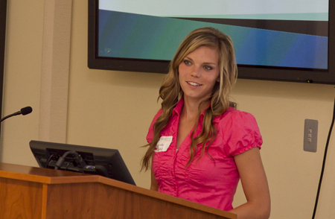
ANXIETY
occurs at INPUT processing
and OUTPUT stages of
language learning
worry about the speed of delivery
the presence of new vocabulary
the need to speak in front of others

Slide 23
To cultivate a positive classroom climate
Avoid social comparison, even in its subtle forms.
Promote cooperation instead of competition.
Help learners to accept the fact that they will make mistakes as part of the learning process.
Make test and assessment completely ‘transparent’ and involve students in the negotiation of the final mark.

Slide 24
FOCAL ATTENTION
PERIPHERAL ATTENTION
INCIDENTAL LEARNING
INTENTIONAL LEARNING
These learners set goals for themselves, monitor their progress toward those goals, understand and seek out the conditions in which they learn best, and actively make connections and meaning
The way young children focus on communication but learn first-language grammar rules as a ‘by-product’.

Slide 25
CLIL
Language learning as part of CLIL results from a more peripheral attentional focus – where the main focus is on the content and not in a language learning objective per se.

Slide 26
Tasks design
When we select or design materials, we need to visualize HOW in terms of language they (materials) present the essential content in a MANAGEABLE way.
Tasks accompany stimulus materials
Are the tasks formulated around REAL PURPOSES, such as comparisons, decisions and conclusions.
KEY language is repeated – but by using it for the real purposes and not just for the sake of repetition.

Slide 27
COMPREHENSIBLE INPUT
Comprehensible input is crucial to language acquisition and so to the development of language competence.
Using a whole range of linked stimuli while also activating prior knowledge to maximize comprehension
Review language: is it over-familiar and untaxing or whether it contains new linguistic items but still remains accessible
UNTAXING: not difficult, and not needing a lot of physical or mental effort

Slide 28
Input and output
We need to look NOT just at the content, accessibility and comprehensibility of the INPUT materials, but also at the TASK DESIGN. The nature of the task will determine how students make sense of the materials and how they express that understanding.

Slide 29
EVALUATING, ASSEMBLING AND MODIFYING MATERIALS

Slide 30
CLIL teachers must allow the subject content to emerge in the same way as it usually would despite the role of the other language.
CLIL teachers should follow the methodology which is appropriate for a certain subject.
Pre-teaching of specific language in ‘language teacher mode’ is often NOT best practice.
4C model – not appropriate only for CLIL but for everyday practice

Slide 31
Meeting input
In normally structured classrooms, learners meet the lesson content through hearing or seeing some kind of text and they may be receptive or active whilst doing this.

Slide 32
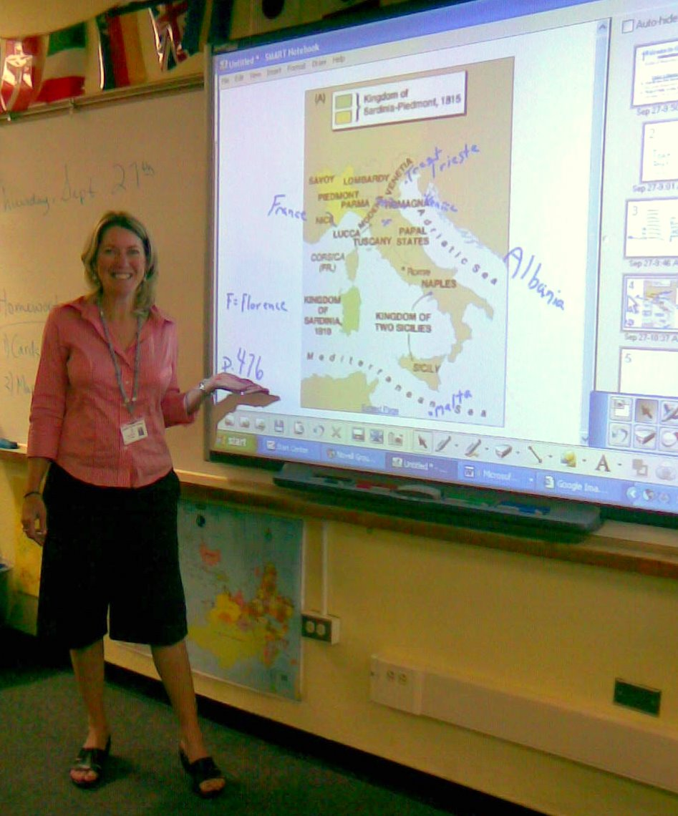




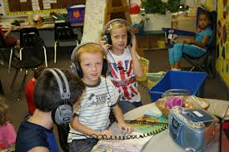
Types of texts

Slide 33
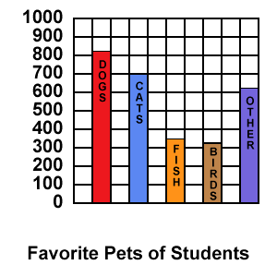
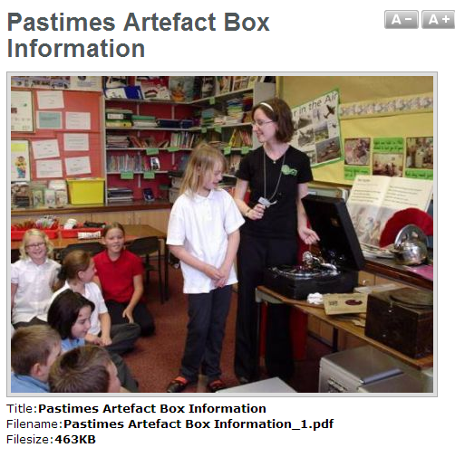
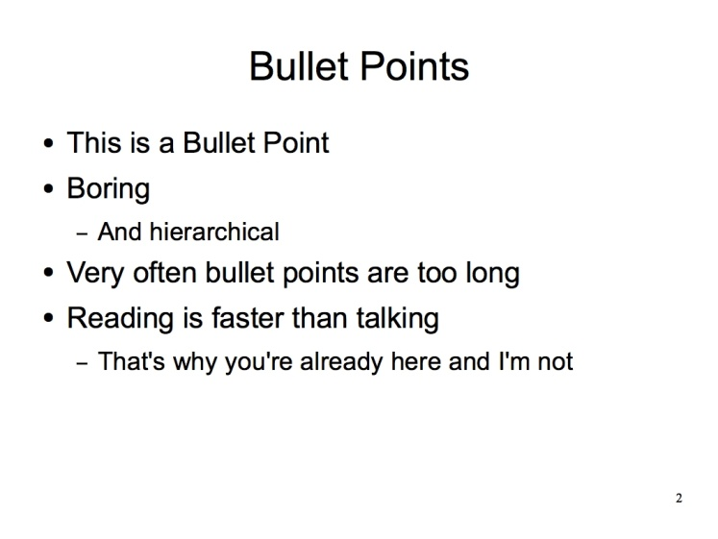
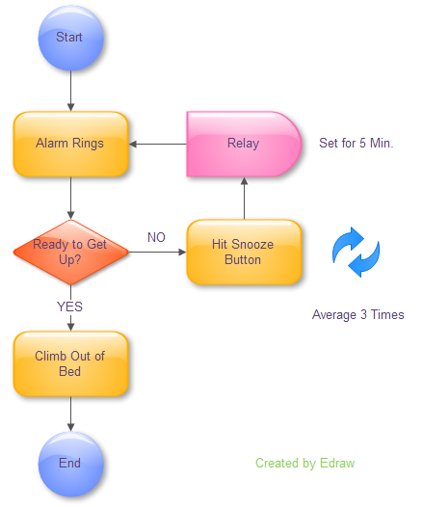

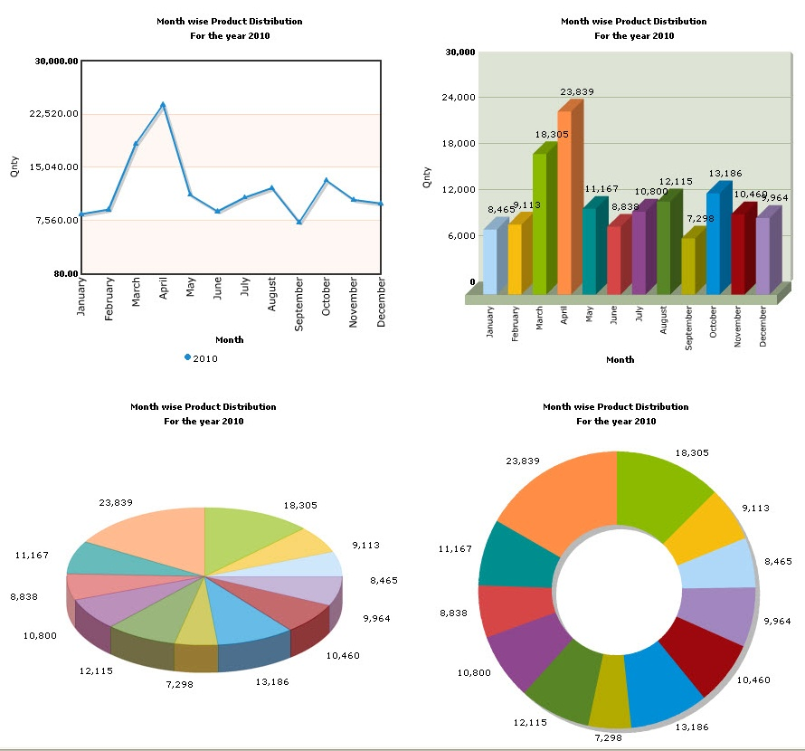
Types of texts
FLIPCHART

Slide 34
http://www.businessenglishonskype.hu/index.php/business-skills

Slide 35
How to begin a teaching unit concerning the use of materials
Start with visuals/real objects and brainstorm existing knowledge
Start with an activity which raises awareness and sets questions
Start with a presentation which introduces concepts and language (think also about the respective role and importance of the texts in the presentation, and of the teacher talk which accompanies these).
Start with a linear text which introduces the ideas.
Start with a set of questions.

Slide 36
EVALUATING TEXTS
the focus of the ‘message’ (Is it the content you want?)
The clarity of the ‘message’ (is it expressed in an accessible way?)
The mix of textual styles for presentation (does it have visuals, tables, diagrams, graphics as well as text which can be heard or read, including bulleted and continuous prose?)
The level of subject-specific specialist vocabulary (is it the right amount and are they the right words?)

Slide 37
EVALUATING TEXTS
The level of general vocabulary (are there complex words which are not necessary?)
The level of grammatical/syntactical complexity (are the phrases and sentences too complicated and/or is the use of grammar more complex than is needed?)
The clarity of the thread of thinking (is this overt? Is inference or integration needed?)
OVERT: not hidden or secret

Slide 38
PHOTOSYNTHESIS

Slide 39
PHOTOSYNTHESIS
Science and Technology Education from FT Exploring.
http://www.ftexploring.com/photosyn/photosynth.html
Photosynthesis | Educational Video for Kids
https://www.youtube.com/watch?v=UPBMG5EYydo
https://www.ducksters.com/science/photosynthesis.php
https://www.ducksters.com/science/photosynthesis.php
Photosynthesis
https://www.youtube.com/watch?v=yHVhM-pLRXk
https://www.scienceforkidsclub.com/photosynthesis.html
Photosynthesis | The Dr. Binocs Show | Learn Videos For Kids
https://www.youtube.com/watch?v=D1Ymc311XS8&t=1s
  What to select?
  How to combine it?
  Which order to use it in?
  How to target different ability levels with different elements?
  Which sections of the text need modification?
https://www.coolkidfacts.com/photosynthesis-for-kids/

Slide 40
Less commonly taught topics
May be difficult to find materials
The texts may be at a higher level and in more complex continuous text format
A strong need for modifying the text (into bullet points opr tabular form)

Slide 41
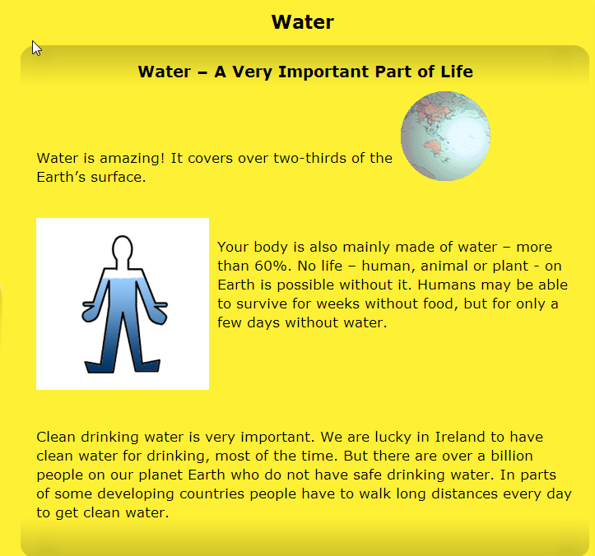
WATER
http://www.askaboutireland.ie/learning-zone/primary-students/3rd-+-4th-class/science/science-full-story/water-a-very-important-pa/

Slide 42
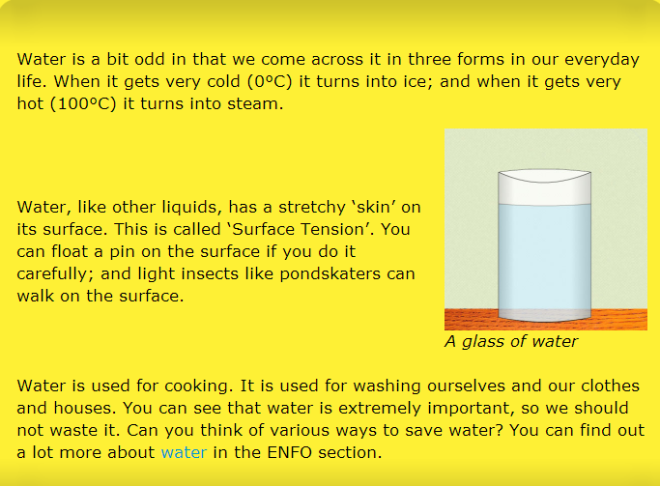
http://www.askaboutireland.ie/learning-zone/primary-students/3rd-+-4th-class/science/science-full-story/water-a-very-important-pa/

Slide 43
How much new content material can we introduce in a lesson?
New content
New language

Slide 44
NEW CONTENT
Planning Circle
3b. Input during the extension learning stage
3a. Input during the main learning stage
NEW LANGUAGE
FAMILIAR LANGAUGE
1. Warm-up brainstorimng activity
2. Main introductory stage
FAMILIAR CONTENT

Slide 45
Content | Language | Inside the circle | Outside the circle
Familiar | Familiar | 1. Settles and acclimatizes learners. | No cognitive challenge: danger that CLIL is seen as only re-learning old content in another language.
Familiar | New | 2. Establishes departure point and introduces specialist language. | Danger that language becomes a barrier, although the content is already known.
New | Familiar | 3a. The language remains accessible as new concepts | Danger that new content is ‘dumbed down’, as over-simple language cannot do justice to new material.
New | New | 3b. The language becomes more complex as the new material is consolidated and subject confidence grows. | Cognitive challenge too high: danger that CLIL is seen as impossible. Objectives may become over-focused on language.

Slide 46
Read this article
https://files.eric.ed.gov/fulltext/ED539729.pdf
Criteria for producing CLI learning material
Peeter Mehisto Encuentro 21, 2012, ISSN 1989-0796, pp. 15-33

