Slide 1


EXPERIENCE YOU
DESERVE
ALGOOS STUDY WORK AND TRAVEL

Slide 2






WHO ARE WE?
Partner to hundreds of schools and universities worldwide
Hotel consultants - only 4- and 5-star hotels and resorts

Slide 3
MUST KNOW
GENERAL INFORMATION
REQUIREMENTS:
Positive attitude
Min. 17 / 18 yo
Student status
Valid travel documents
EXPENSES:
Personal expenses
Program fee/deposit
DURATION:
Min. 3/4 months

Slide 4
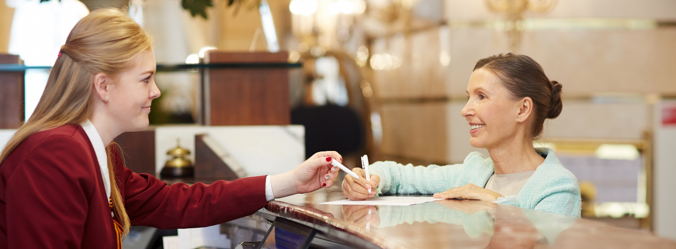

POSITIONS
Guest Relations
Front office
Animation
SPA
Food and Beverage
(restaurant & bar service)
Kitchen
Housekeeping
Technical Support
Maintenance
Marketing
Management
Administration
Accounting
Human Resources
PAID
UNPAID

Slide 5

DESTINATIONS & BENEFITS
Free meals
Free accommodation
Secured work position (8h/5-6days)
ERASMUS+ scholarship
MONTHLY SALARY :
Cyprus: 750 € – 850€ (+ TICKETS)
Greece: 550 € – 850€
Portugal: 250-400€
Spain: 250-750€
France: 557€-650€

Slide 6


1st Steps to your career
Register on www.algoos.com
Build your CV
or send to internships@algoos.com
Interview
Receive an offer
Sign the Agreement
(max. 7 days)

Slide 7
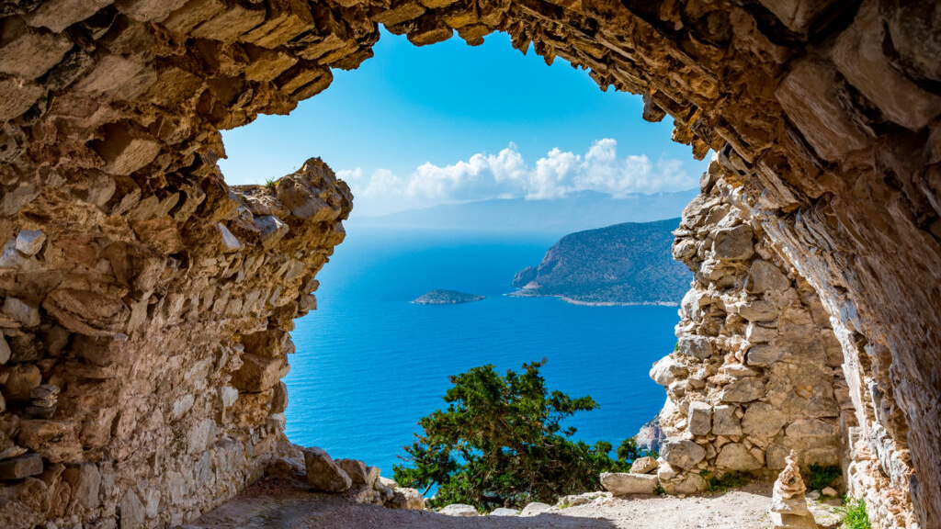
SEE YOU SOON
T: +30 22 41 888 018
E: internships@algoos.com
M: +30 6948324436
W: www.algoos.com

