Slide 1
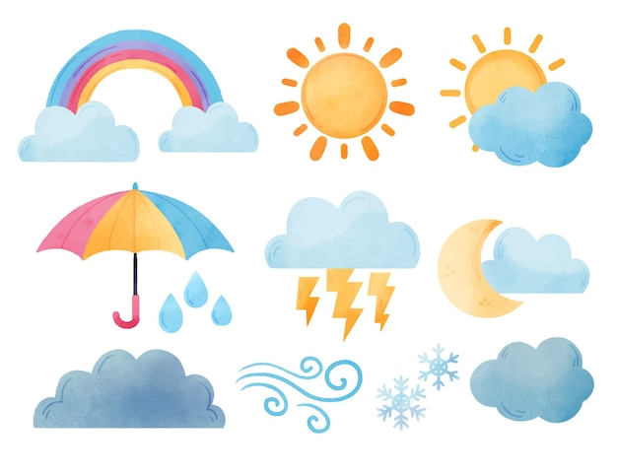
WEATHER

Slide 2

It's sunny.

Slide 3

It‘s cloudy.

Slide 4
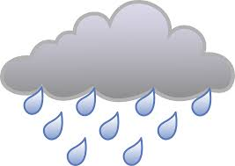
It‘s rainy.

Slide 5
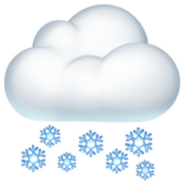
It‘s snowy.

Slide 6

It‘s windy.

Slide 7

It‘s foggy.

Slide 8

It‘s hot.

Slide 9

It‘s warm.

Slide 10
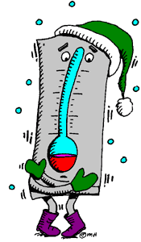
It‘s cold.

Slide 11
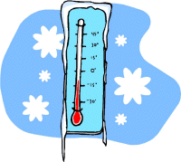
It‘s freezing.

