Slide 1
Dodatni letnik
Interno gradivo doc. dr. Konstanca Zalar
GLASBENA TEORIJA - 1
Ritmične vsebine
Notni zapis

Slide 2
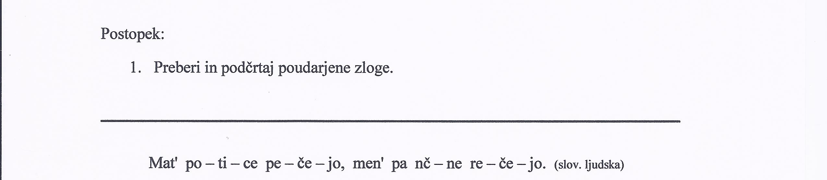


Slide 3
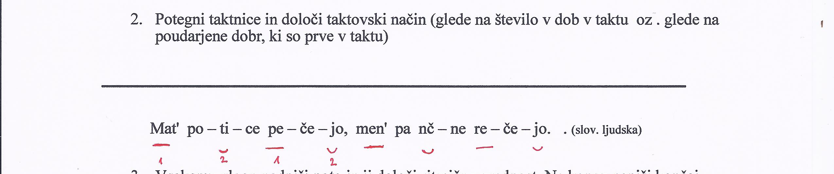
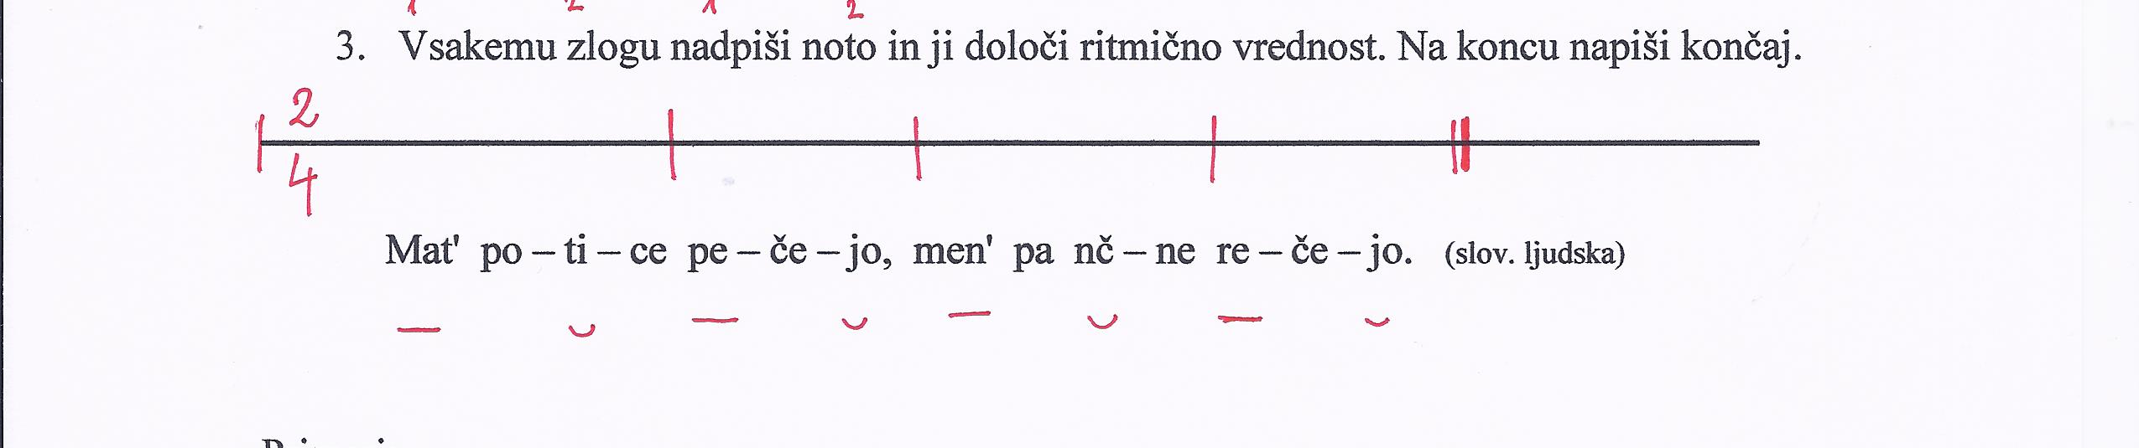

Slide 4
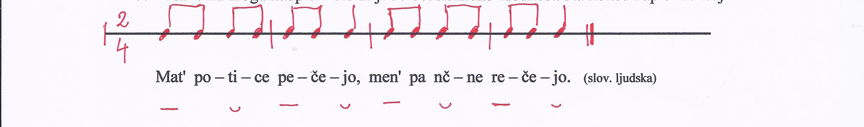

Slide 5

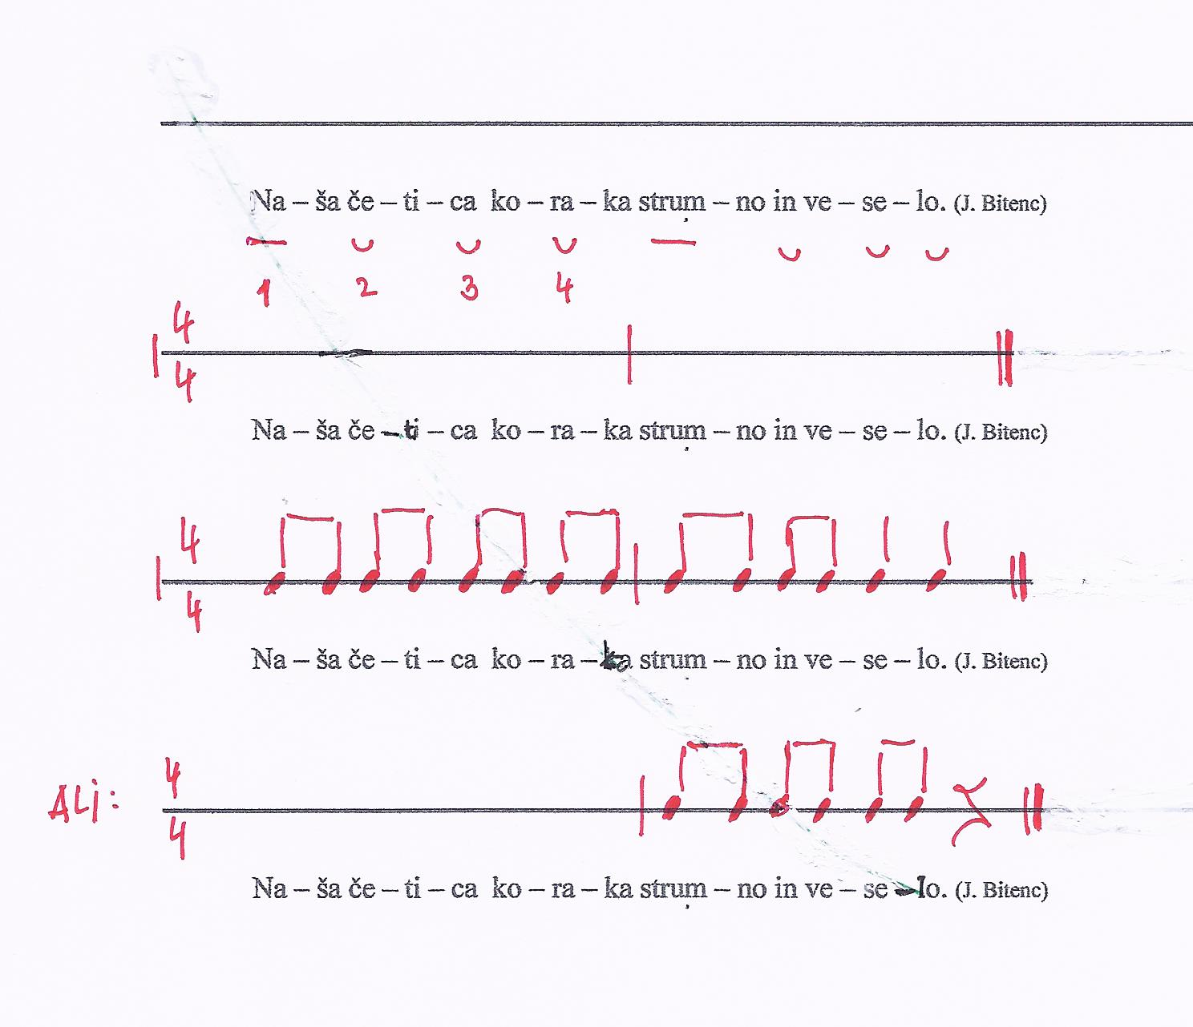

Slide 6
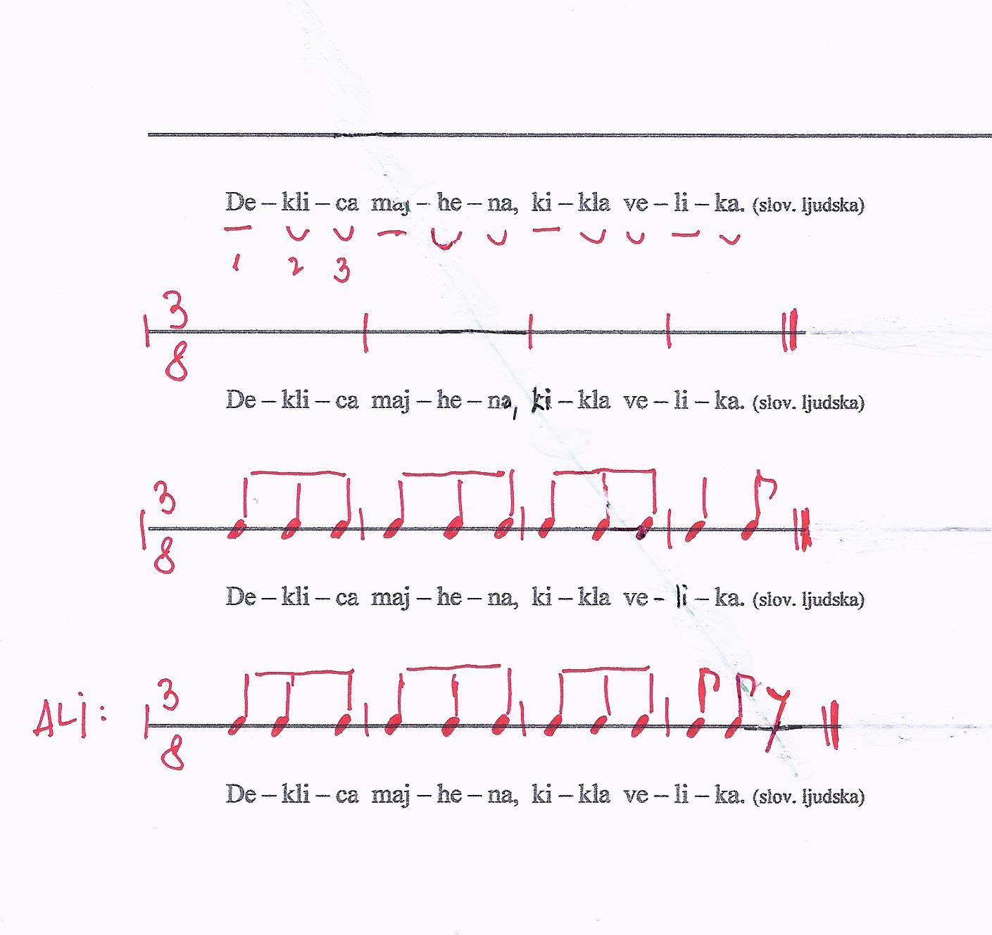

Slide 7
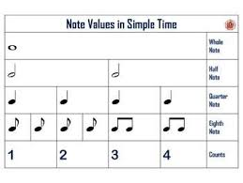
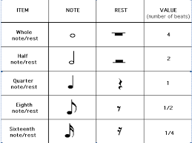
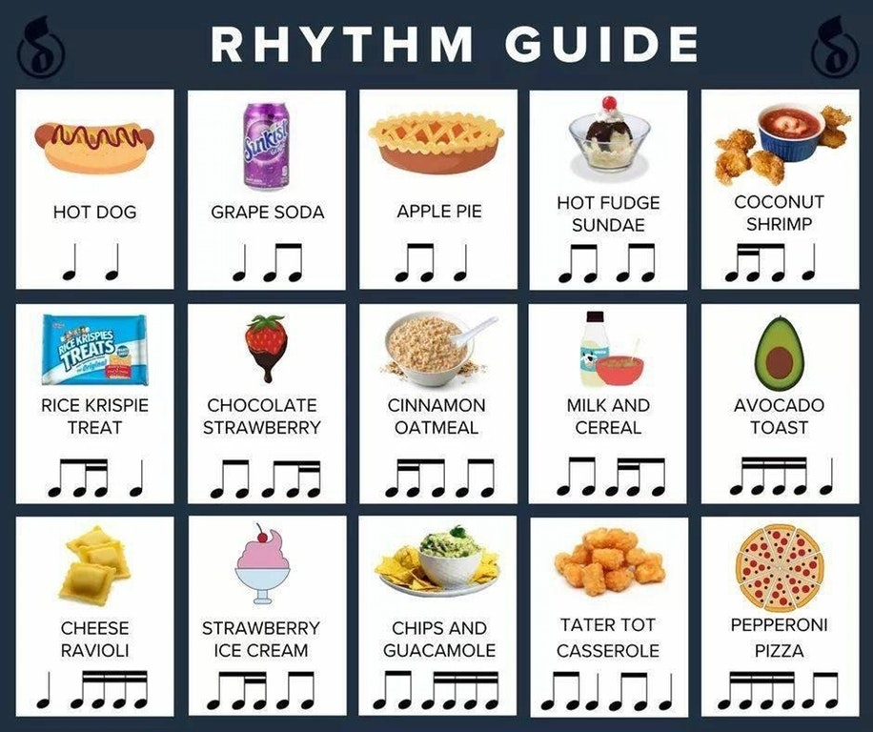
https://www.google.com/search?q=rhythm+notes&client=firefoxbd&channel=trow2&sxsrf=ALeKk039gMWuC5wj0A9QKSyY8SvCpidDzg:1586331554423&tbm=isch&source=iu&ictx=1&fir=boa32v4FE8M1mM%253A%252CqLXwDFZP4S_u2M%252C_&vet=1&usg=AI4_-kR0tLh_Yo_-3Kjs9zKt0EXdC0v6mg&sa=X&ved=2ahUKEwinlLDGqdjoAhUMC-wKHWtMBLcQ9QEwBXoECAUQJg#imgrc=175VOXUR53gR7M

Slide 8
Napiši note (C – c3):
_________________________________________________________________________________________________________________________________________________________________________________________________________________________________________________________________________________________________________________________________________________________________________________________________________________________________________________________________________________________________________________________________________________________________________________________________________________________________________________________________________________________________________________________________________________________________________________________________________________
_________________________________________________________________________________________________________________________________________________________________________________________________________________________________________________________________________________________________________________________________________________________________________________________________________________________________________________________________________________________________________________________________________________________________________________________________________________________________________________________________________________________________________________________________________________________________________________________________________________
____
____
C c2 c1 g1 f a2 E d h1 a1 e1
_________________________________________________________________________________________________________________________________________________________________________________________________________________________________________________________________________________________________________________________________________________________________________________________________________________________________________________________________________________________________________________________________________________________________________________________________________________________________________________________________________________________________________________________________________________________________________________________________________________
_________________________________________________________________________________________________________________________________________________________________________________________________________________________________________________________________________________________________________________________________________________________________________________________________________________________________________________________________________________________________________________________________________________________________________________________________________________________________________________________________________________________________________________________________________________________________________________________________________________
FIS as1 as2 fis1 b2 gis es1 eis1 cis2 dis1 es2

Slide 9
