Slide 1

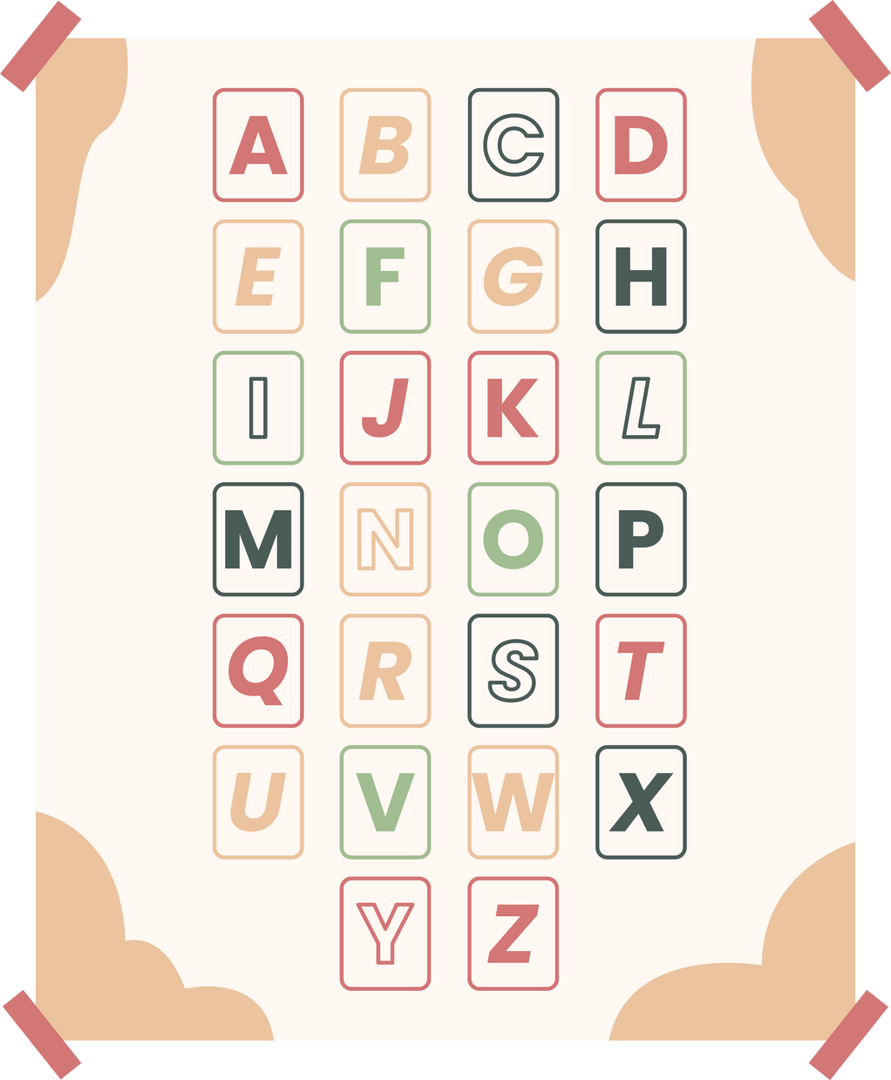



Past simple tense

Slide 2

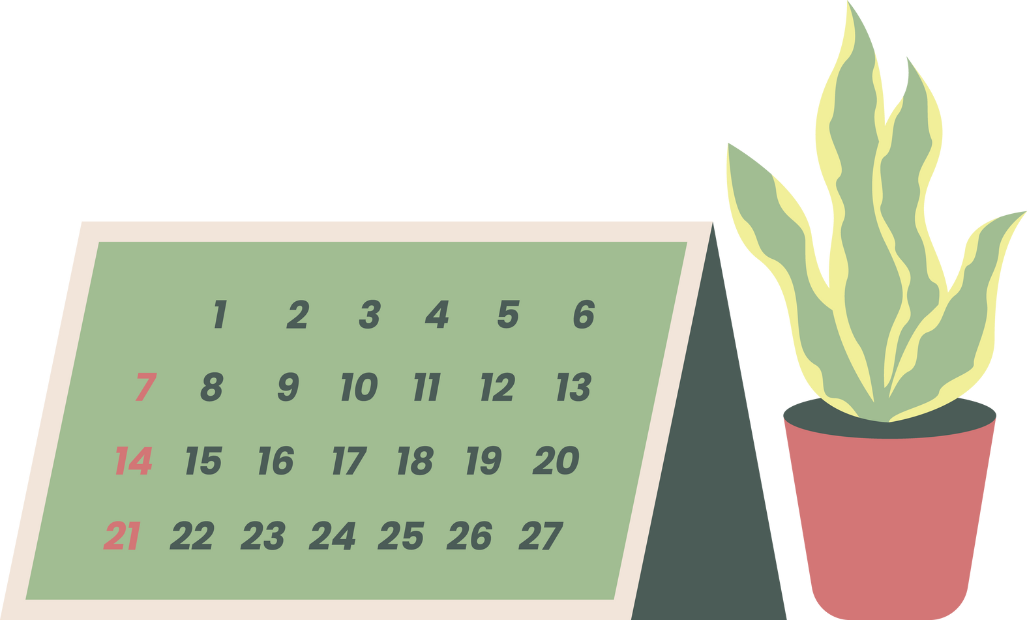

Past simple tense
  je pretekli čas, ki opisuje dogodke, ki so se zgodili v preteklosti

Slide 3
Primeri:
work- worked
play- played
start- started
love- loved
paint- painted
look- looked
cook- cooked
  tvorimo ga tako, da glagolu dodamo
končnico - ed

Slide 4
I played football.
I started school.

Slide 5


Časovni prislovi:
  yesterday
  days ago, years ago, months ago
  last year, last month

Slide 6
I played football yesterday.
I played football last year.
I played football two days ago.

Slide 7
Nikalna oblika
  stavek zanikamo z besedo didn’t, glagolu pa odvzazmemo -ed končnico
I didn’t play football yesterday.
I didn’t play football two days ago.

Slide 8
Pravilen zapis
  kratki glagoli- enozložni, ki se končajo na soglasnik, samoglasnik, soglasnik, se zadnji soglasnik podvoji
  stop- stopped
  če se glagol konča na -e, en e odpade
love- loved
live- lived
dance- danced
  če se glagol konča na soglasnik+ Y, se Y spremeni v I
  hurry- hurried

Slide 9

  beseda se konča na samoglasnik+ l, se l podvoji
  travel- travelled
  control- controlled

Slide 10
Vprašanja
  vprašanja tvorimo z besedo DID
YES/ NO QUESTIONS:
Did you play tennis yesterday?
  did+oseba+glagol brez -ed končnice+ ...
WH- QUESTIONS:
What did you play yesterday?
  wh- word+ did+ oseba+ glagol brez -ed končnice+ ...

Slide 11
GLAGOL TO BE
  glagol to be ima oblike: was/were
I was here.
You were here.
She was here.
He was here.
They were here.
We were here.

