Slide 1

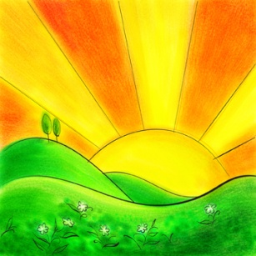

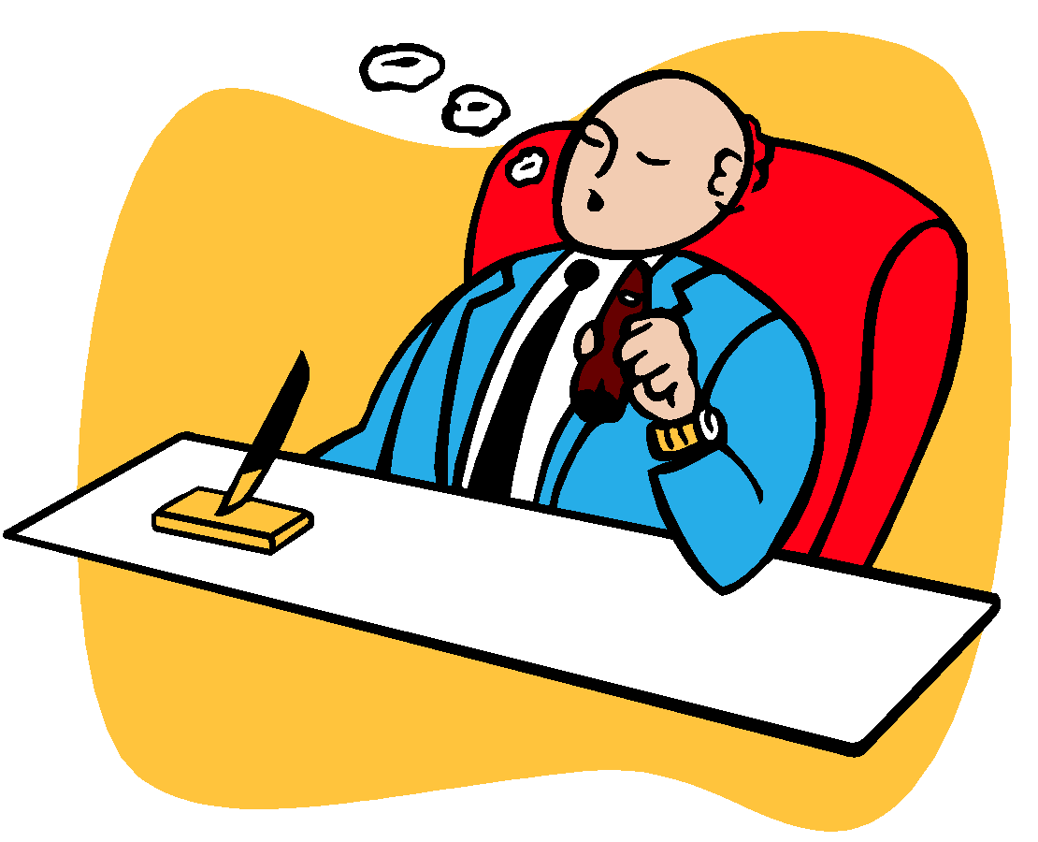
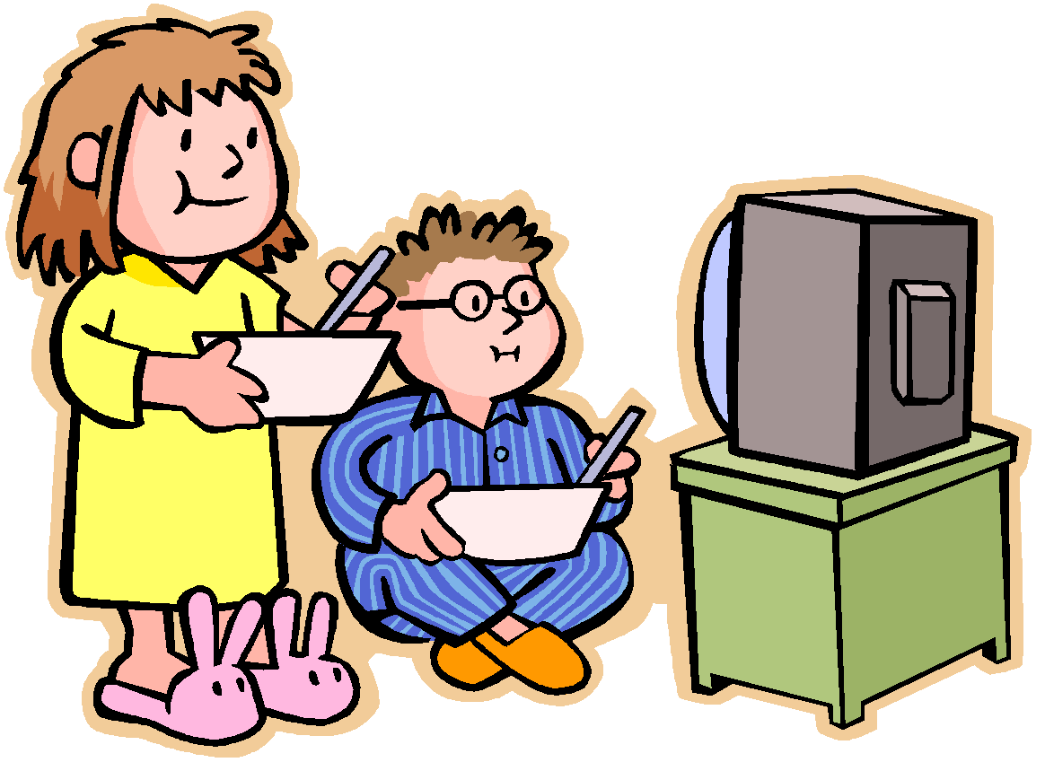
Present simple tense
Navadni sedanji čas

Slide 2
Za dejanja, ki se ponavljajo
The man goes to the shop every day.
Za navade
He drinks coffee and watches TV.
Za splošne resnice, dejstva
It‘s year 2025.
RABA

Slide 3
OBLIKA
TRDILNA OBLIKA:
OSEBEK + GLAGOL (-s/-es*)
They like pizza.
He likes pizza.
POZOR!!!
Glagoli BE, HAVE GOT, CAN!
NIKALNA OBLIKA:
OSEBEK + POMOŽNI GLAGOL (don‘t/doesn‘t*) + GLAGOL
They don‘t like pizza. DON‘T=DO NOT (I, you, we, they)
He doesn‘t like pizza. DOESN‘T=DOES NOT (he, she, it)
VPRAŠALNA OBLIKA:
POMOŽNI GLAGOL (do/does*) + OSEBEK + GLAGOL
Do they like pizza? (I, you, we, they)
Does he like pizza? (he, she, it)
* - samo za 3. osebo ednine (he, she, it)

Slide 4
OBLIKA
VPRAŠALNA OBLIKA Z WH-vprašalnicami:
who (kdo)
why (zakaj)
where (kje)
when (kdaj)
Who do you like?
Where does he live?
Who are you? (glagol biti)
wh-vprašalnica + do/does + osebek + glagol
oz. wh-vprašalnica + glagol biti + osebek

Slide 5
PRAVOPIS
Glagol se konča na –ch, -sh, -ss/s, o, ali -x
dodamo –ES
gledati: watch + ES => watches
končati: finish + ES => finishes
zamujati: miss + ES => misses
mešati: mix + ES => mixes
iti: go + ES => goes
Glagol se konča na samoglasnik
(a, e, i, o, u) + –y:
-y ostane, dodamo –S.
play + S => plays
Glagol se konča na soglasnik + -y:
-y se spremeni v –I, dodamo –ES
fry + ES => fries

Slide 6
ČASOVNA DOLOČILA-How often do you…?
always, usually, often, sometimes, rarely, never James and Jodie usually eat chicken.
James and Jodie are always hungry.
Ta določila postavljamo pred glagol oziroma za glagol biti (am, is, are).
every day/month/year…;
once a week, twice a month, three times a year
James and Jodie eat chicken once a week.
James and Jodie eat chicken every Tuesday.
Ta določila postavljamo na koncu stavka.

