Slide 1
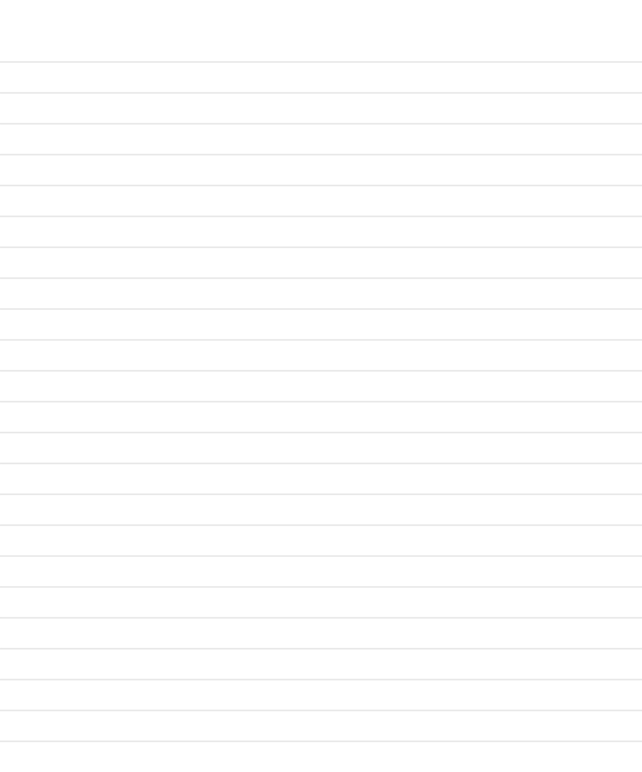

Articles-
a/an, the
ČLENI

Slide 2

A in AN sta nedoločna člena.
THE je določni člen.

Slide 3


a/an
  a in an uporabljamo, ko o nečem govorimo prvič
There is an old market in town.

Slide 4

the
  za izražanje položaja:
in the middle, on the left, at the top
  ko obstaja samo en:
the south west of England
  s presežniki:
the best, the nearest, the most interesting
  z imeni držav z Republic, Kingdom ali State ali državami v množini:
the Unites States, The Dominican Republic, the Nederlands
  z imeni rek:
the river Thames, the Nile
  z imeni posameznih zgradb:
the Eiffel Tower, the National Gallery

Slide 5

a or the?
‘A’ uporabljamo, ko o nečem govorimo prvič. Če o tem govorimo ponovno, uporabljamo ‘the’.
Ex: Let’s have a hamburger. The hamburger was very good.

Slide 6


No article- /
  z imeni ulic:
Oxford Street, Broadway
  z imeni ljudi:
queen Elizabeth, Miss Novak
  z imeni držav:
France, Austria
  z imeni mest
London, Ljubljana, Mumbai

Slide 7

Let’s practice!

Slide 8
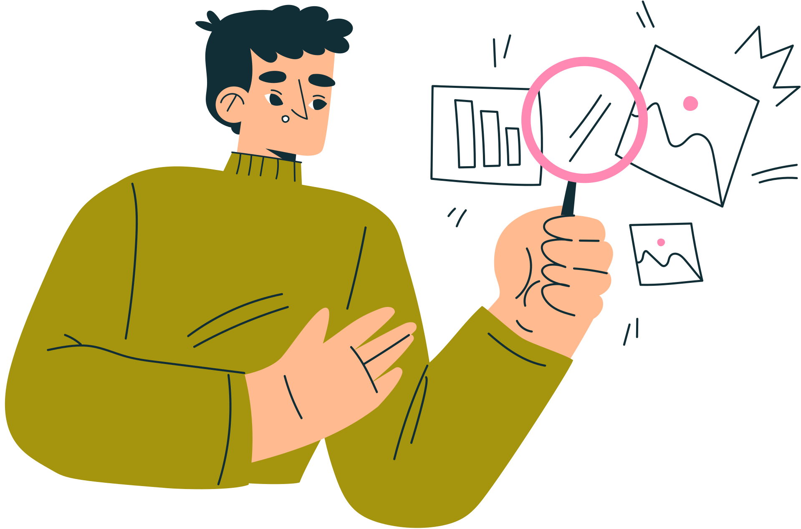
  My brother is ________ architect in ________ London.
  ________ Mississippi River flows through ________ United States.
  We visited ________ Republic of Slovenia last summer.
  She was elected ________ President of the company.
  ________ Mount Everest is the highest mountain in ________ world.
  They live in ________ Ohio, near ________ Lake Erie.
  ________ Danube flows through many European capitals, including ________ Vienna.
  He is ________ honest man who works as ________ director.
  We are planning a trip to ________ Netherlands and then to ________ France.
  ________ Nile is longer than ________ Thames.

Slide 9


Rešitve z razlagami:
an (poklic), / (mesto) – My brother is an architect in / London.
The (reka), the (ime države s "States") – The Mississippi River flows through the United States.
the (beseda "Republic") – We visited the Republic of Slovenia last summer.
/ (položaj/funkcija, ki jo zaseda le ena oseba hkrati) – She was elected / President of the company.
/ (posamezna gora), the (edinstvena stvar) – / Mount Everest is the highest mountain in the world.
/ (zvezna država), / (jezero brez besede "of") – They live in / Ohio, near / Lake Erie.
The (reka), / (mesto) – The Danube flows through many European capitals, including / Vienna.
an (beseda se začne na samoglasniški zvok "o"), a (poklic) – He is an honest man who works as a director.
the (množinsko ime države), / (običajno ime države) – We are planning a trip to the Netherlands and then to / France.
The (reka), the (reka) – The Nile is longer than the Thames.

Slide 10
Great job!

Slide 11
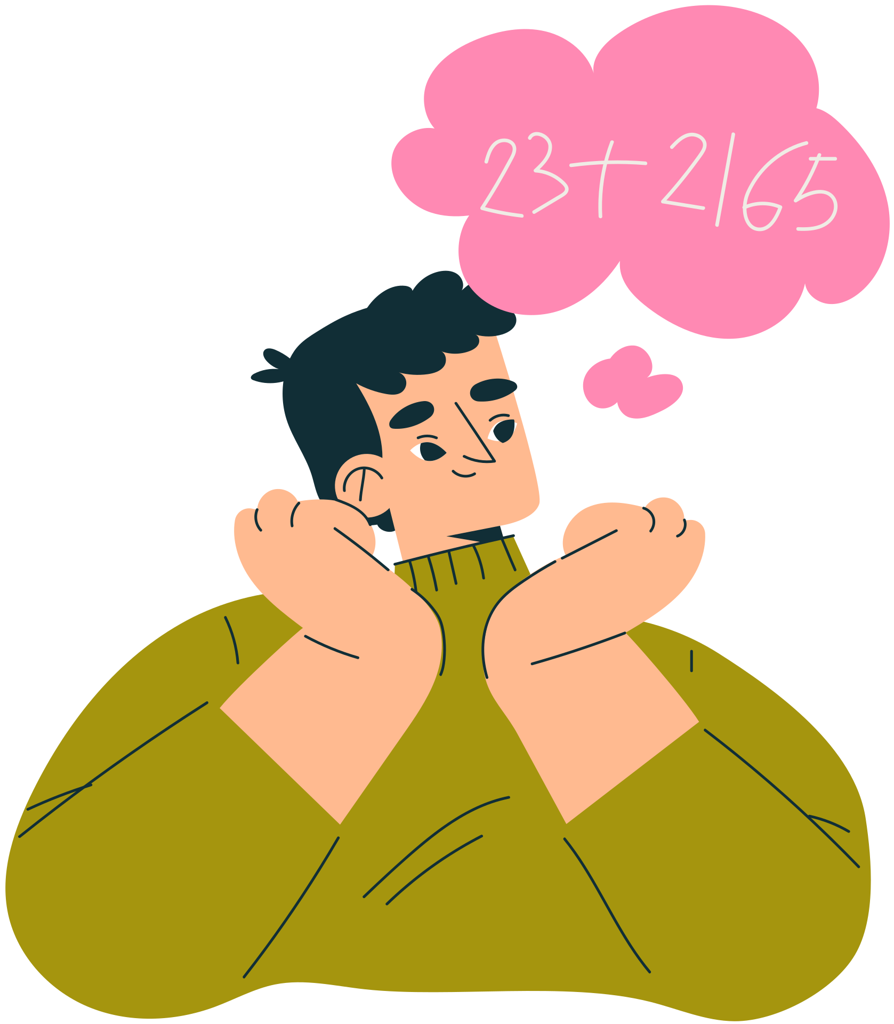







Teacher Resources Page

