Slide 1

SKRITE SLIKE
POKLICI

Slide 2

pilot
SHOW

Slide 3
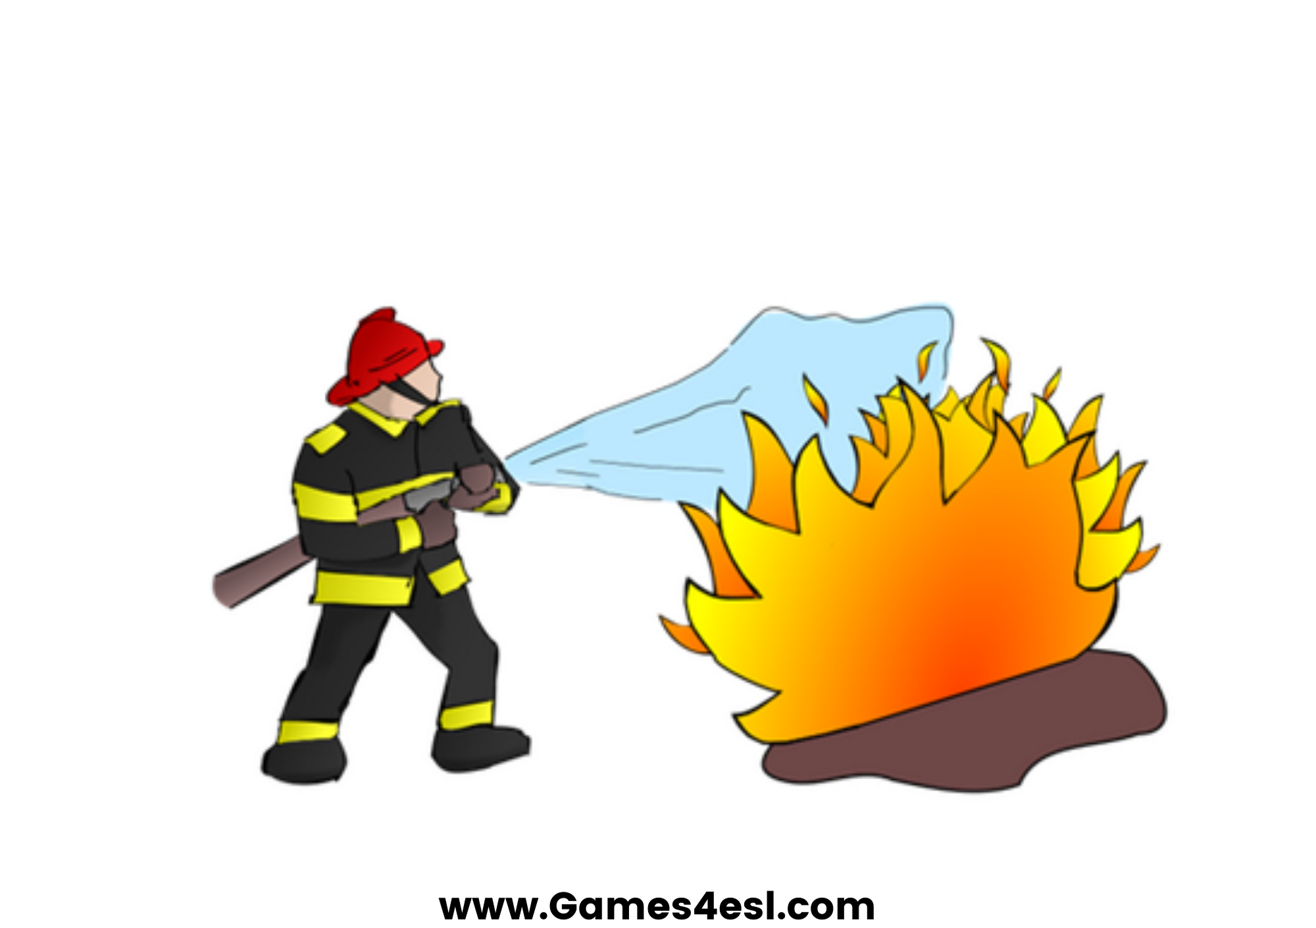
firefighter
SHOW

Slide 4

chef
SHOW

Slide 5

police officer
SHOW

Slide 6

nurse
SHOW

Slide 7

post man
SHOW

Slide 8

teacher
SHOW

Slide 9

doctor
SHOW

Slide 10
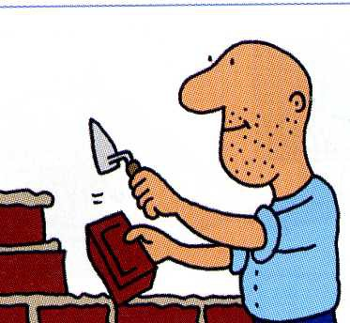
builder
SHOW

Slide 11

soldier
SHOW

Slide 12

farmer
SHOW

Slide 13

vet
SHOW

Slide 14
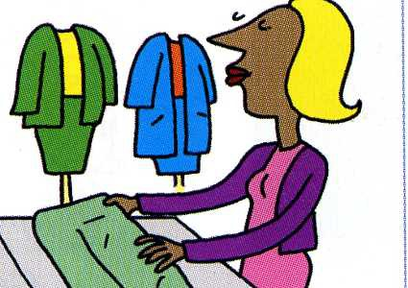
shop assistant
SHOW

Slide 15
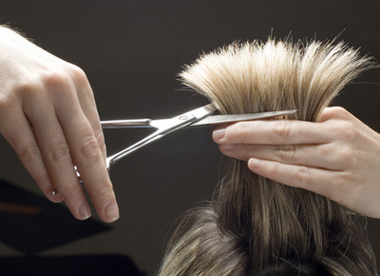
hairdresser
SHOW

Slide 16

librarian
SHOW

Slide 17

dentist
SHOW

Slide 18

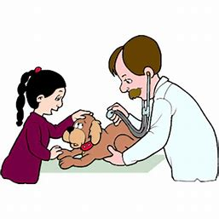


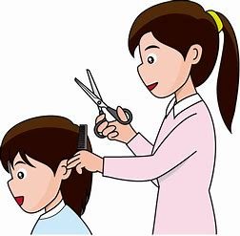

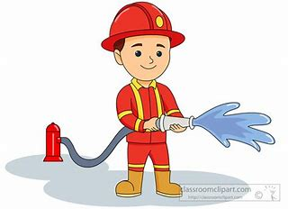

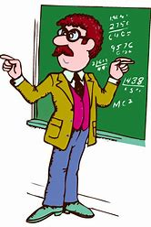




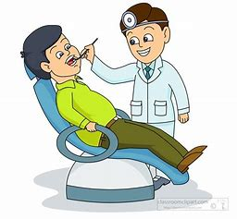

ARE YOU A …..?

Slide 19
PREPIŠI V ZVEZEK IN DOPOLNI S POKLICI. POKLICE TUDI NARIŠI.
JOBS
MY MUM IS A ……
MY DAD IS A ……….
WHEN I GROW UP, I WANT TO BE …….

