Slide 1
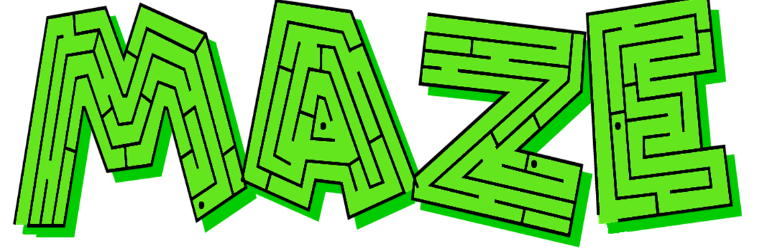

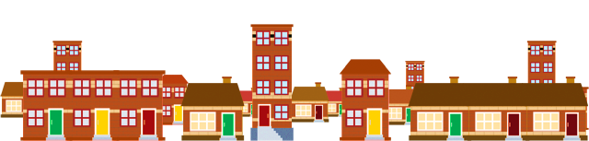

PLACES AROUND TOWN

Slide 2


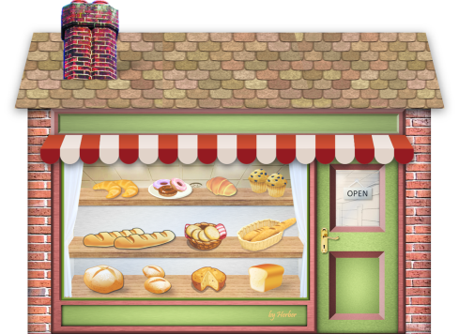
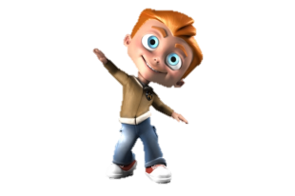
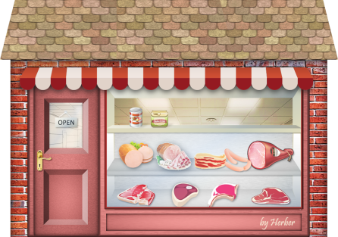
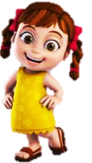
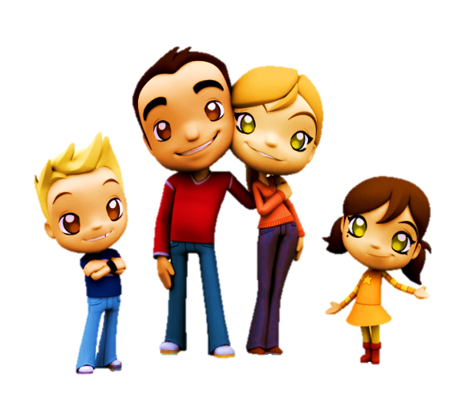
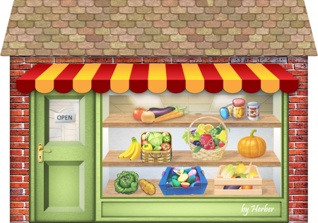
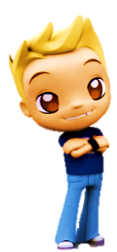
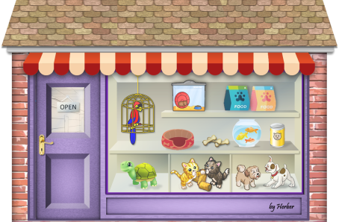
Who goes to the pet shop?
1/10
BOB
LIZ
ANN
PET SHOP
TOM
Click on the right kid
NEXT

Slide 3
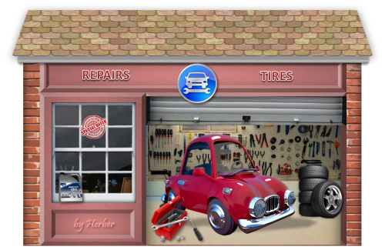
Who goes to the greengrocer’s?
2/10
BOB
LIZ
GREENGROCER’S
ANN
TOM
Click on the right kid
NEXT

Slide 4
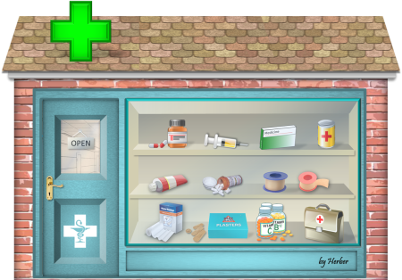

Who goes to the butcher’s?
3/10
BOB
BUTCHER’S
LIZ
ANN
TOM
Click on the right kid
NEXT

Slide 5
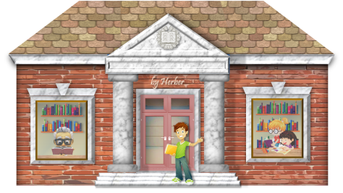

Who goes to the bakery?
4/10
BAKERY
BOB
LIZ
ANN
TOM
Click on the right kid
NEXT

Slide 6
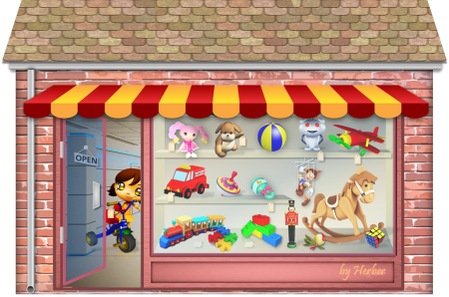
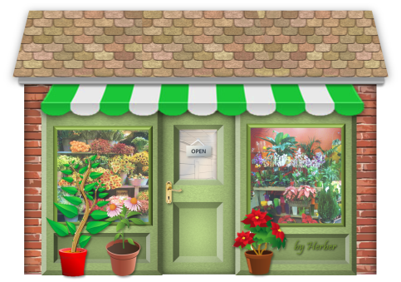
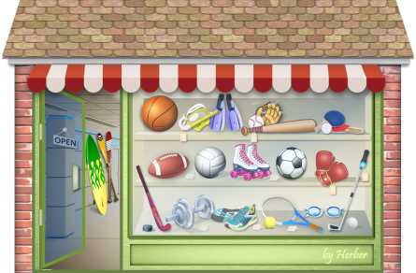
Who goes to the florist?
5/10
TOM
FLORIST
LIZ
ANN
BOB
Click on the right kid
NEXT

Slide 7
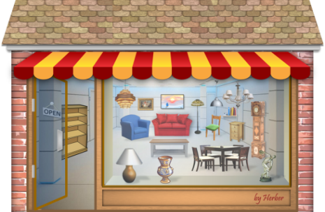
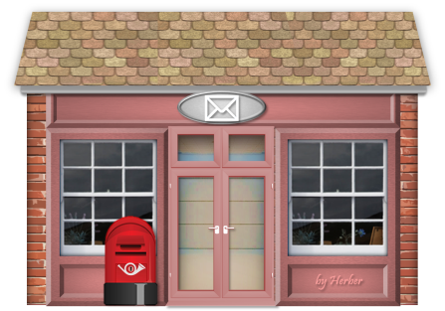
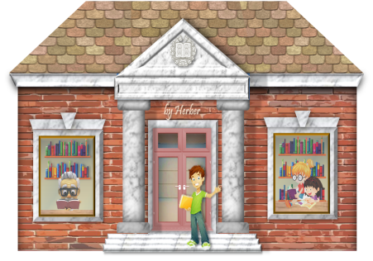

Who goes to the library?
6/10
BOB
LIZ
LIBRARY
ANN
TOM
Click on the right kid
NEXT

Slide 8
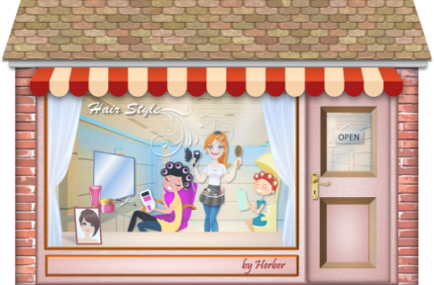
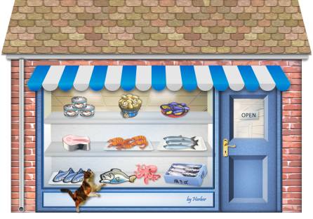
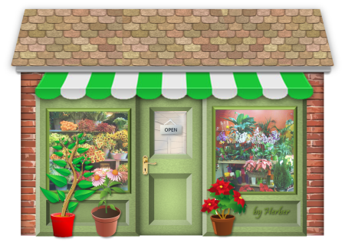
Who goes to the fishmonger’s?
7/10
BOB
FISHMONGER’S
LIZ
ANN
TOM
Click on the right kid
NEXT

Slide 9

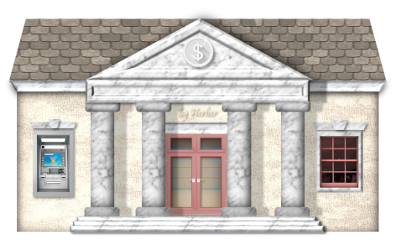
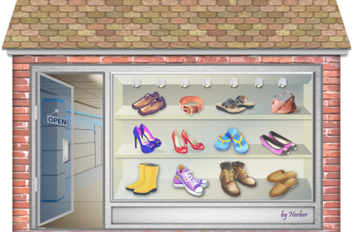
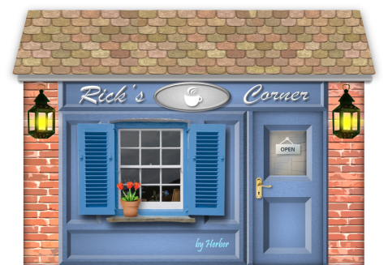
Who goes to the church?
8/10
CHURCH
BOB
LIZ
ANN
TOM
Click on the right kid
NEXT

Slide 10
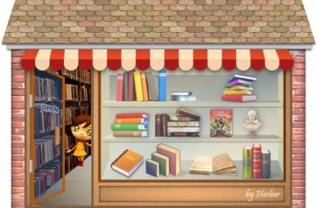
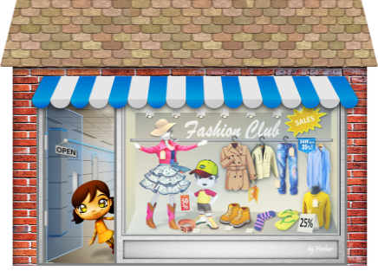

Who goes to the hairdresser’s?
9/10
BOB
LIZ
ANN
HAIRDRESSER’S
TOM
Click on the right kid
NEXT

Slide 11

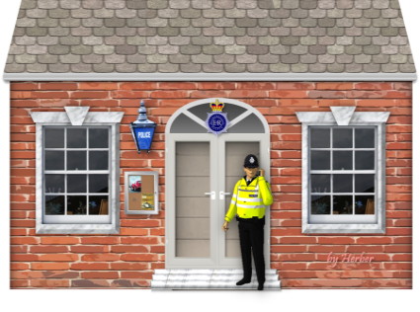
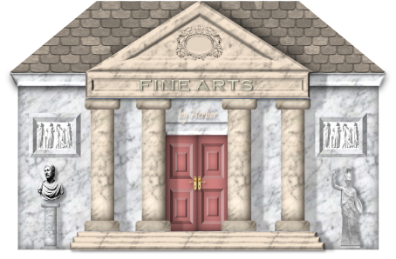
Who goes to the garage?
10/10
GARAGE
BOB
LIZ
ANN
TOM
Click on the right kid
EXIT

