Slide 1
Unusual jobs

Slide 2


Male or female jobs?

Slide 3



Slide 4
What do they do:
GUM BUSTER
Dice inspector
PROFESSIONAL WHISTLER
Lion tamer

Slide 5
CHICKEN SEXER
HOT WALKER
FACE FEELER
PROFESSIONAL CUDDLER

Slide 6



Slide 7
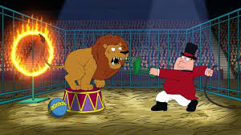
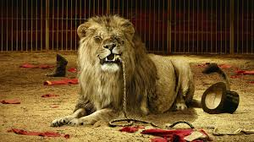

Slide 8
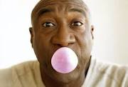


Slide 9
