Slide 1
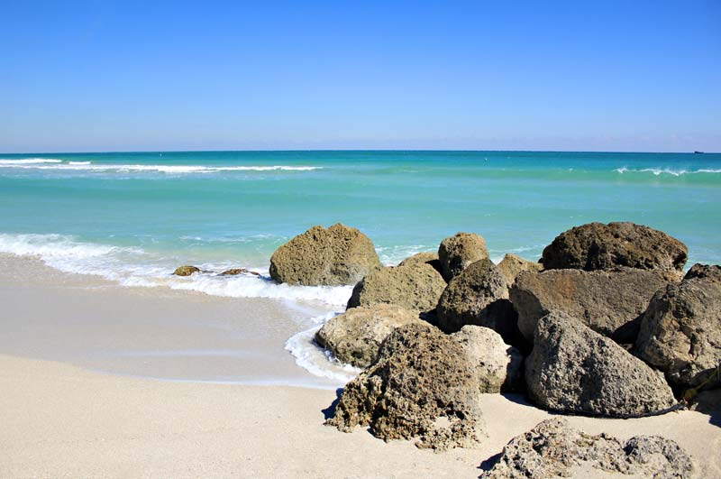
Travel & Tourism

Slide 2
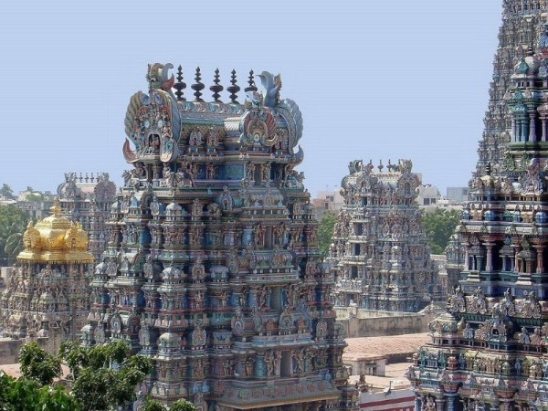
If money was no object, where would you travel to and why?
Would you go alone or with someone else?

Slide 3
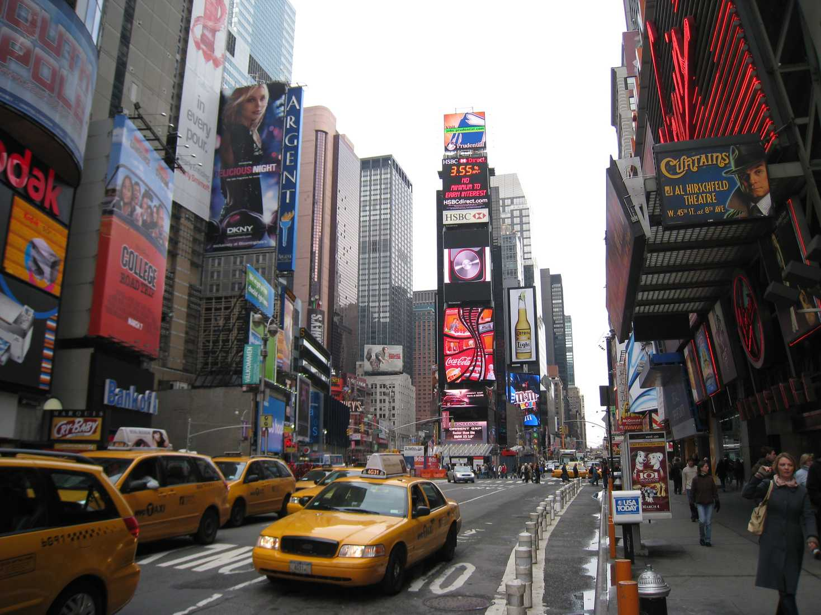
Destination
A city of your choice
The coast of…
Lake…
The ______________ mountains / hills
Far flung places
An exotic destination
Tourist hot spots
Off the beaten track

Slide 4
Reason
Attractions
Adventure
For relaxation
Travelling broadens the mind.

Slide 5
Accommodation
At a campsite
At a guest house
In a hotel
In a B&B
In a caravan
With a family

Slide 6
Length of stay
For a long weekend
For a week
For a fortnight
For a month…

Slide 7
Activities
Sightseeing
Sunbathing
Snorkelling
Climbing
Fishing
Clubbing
Hiking
Swimming
Sailing
Camping
skiing

Slide 8
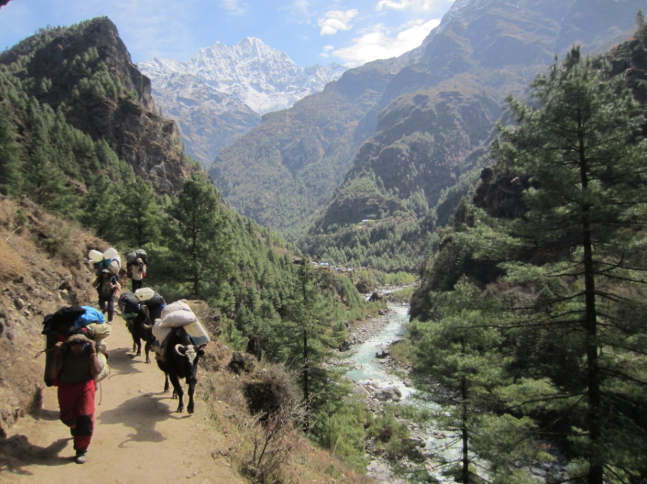
Before you leave
How would you prepare yourself before you left for a destination you have never been to?

Slide 9
Travel guides
Reccomendations
Government warnings
Political situation
Vaccinations
Accommodation
Transport options
Exchange rates
First aid kit
Appropriate clothing
Sports equipment
computer/ camera/phone
Books/travel guides
Food
presents

