Slide 1
THE ROAD NOt TAKEN
By: Robert Frost
© Luka Hauko

Slide 2
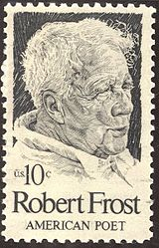
AUTHOR:
ROBERT FROST
San Francisco, California (1874)
Grew up in a city → move into a farm → back to the field of education
sailed to England → WWI back to USA → Pencil Pines in Florida
English teacher
Pulitzer Prize for Poetry
Congressional Gold Medal

Slide 3
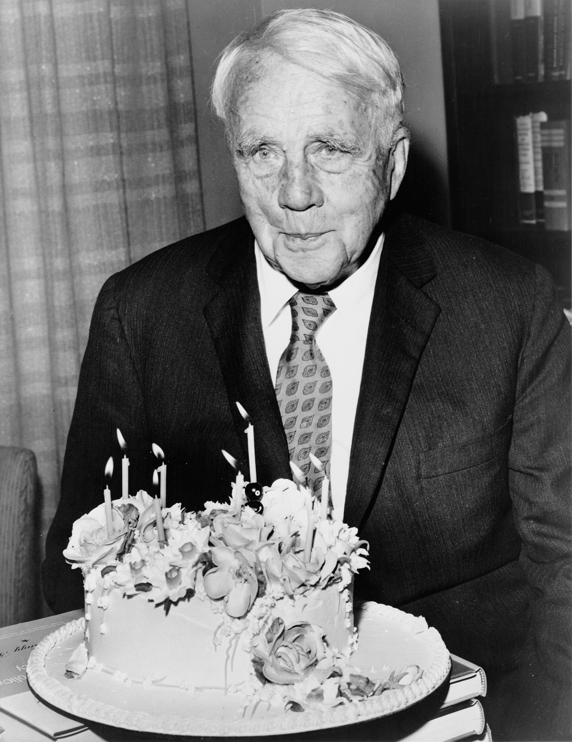
PERSONAL LIFE
Plagued by grief and loss:
Death of his Father – tuberculosis (11).
Death of his Mother - cancer (26).
Younger Sis spends 9 years in mental hospital then dies.
Suffered from depression.

Slide 4
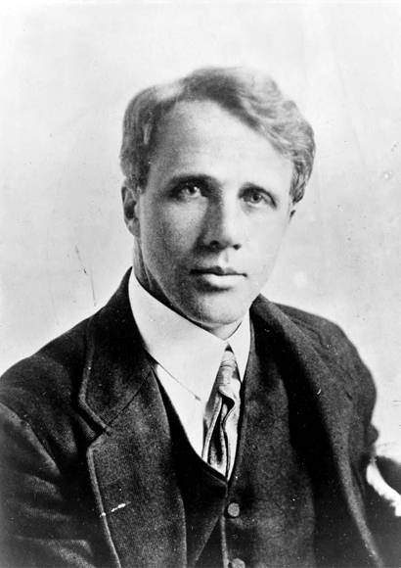
Work and life and all of that
“Greatest of the American poets of this century.”
Many criticized his traditional style.
“No other living poet has written so well
about the actions of ordinary men.”
Critical views on Frost's poetry have changed over the years.
(as has his public image).

Slide 5
The road not taken
ROBERT FROST
Two roads diverged in a yellow wood,
And sorry I could not travel both
And be one traveler, long I stood
And looked down one as far as I could
To where it bent in the undergrowth;
Then took the other, as just as fair,
And having perhaps the better claim,
Because it was grassy and wanted wear;
Though as for that the passing there
Had worn them really about the same,
And both that morning equally lay
In leaves no step had trodden black.
Oh, I kept the first for another day!
Yet knowing how way leads on to way,
I doubted if I should ever come back.
I shall be telling this with a sigh
Somewhere ages and ages hence:
Two roads diverged in a wood, and I—
I took the one less traveled by,
And that has made all the difference.

Slide 6
Feelings?

Slide 7
Main theme
Impossible to see the ways of life-altering decisions.
It is impossible to say whether taking the other road would have been better or worse: all one can say is that it would have been different.
Life dilemmas → you are required to make a decision.
Not stated if it was the right road. But the place he ends up, for better or worse, was the result of his decision.

Slide 8
It is not about taking the road less travelled. One should make decisions with confidence.
Pondering about the different life one may have lived had they done something differently is central to "The Road Not Taken.
Meditative tone. Weighing the pros and cons.
Take one path or the other, black or white - go ahead, do it.
Primarily makes use of metaphor. (life – road)

Slide 9
Four stanzas, each five lines in length.
A traditional rhyme scheme of ABAAB.
Yellow wood = something in-between, unsure of itself.
A game of chance. But you will never know about the other way.
Poem written to highlight a trait of, and poke fun at, his friend Edward Thomas.

Slide 10
“Poetry is emotion, passion, love, grief - everything that is human.”

