Slide 1
crime

Slide 2
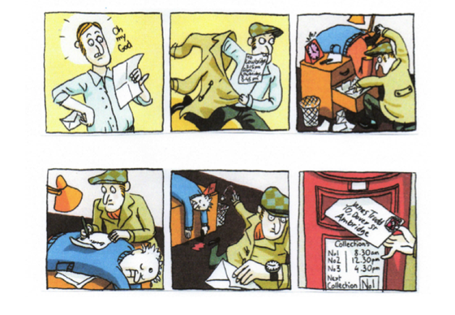

Slide 3
Jerry Robert is a famous detective. He does a very good job and he has a great reputation. We will follow him during a case.
One morning around eleven o’clock, Jerry Robert had received a letter indicating him a problem somewhere in town: a new crime scene.
http://englishatgm.eklablog.com/my-own-detective-story-a114708980

Slide 4
vocabulary
https://www.engvid.com/english-resource/vocabulary-crime-criminals/
WRITE DOWN THE NAME OF THE CRIMINAL
abduction | taking someone away by force, demanding money for their safe return | /
assassination | killing a famous person or public figure | assassin
bigamy | marrying someone when you are already married to another person | bigamist
bribery | giving money or granting favors to influence another person’s decisions or behavior | briber

