Slide 1
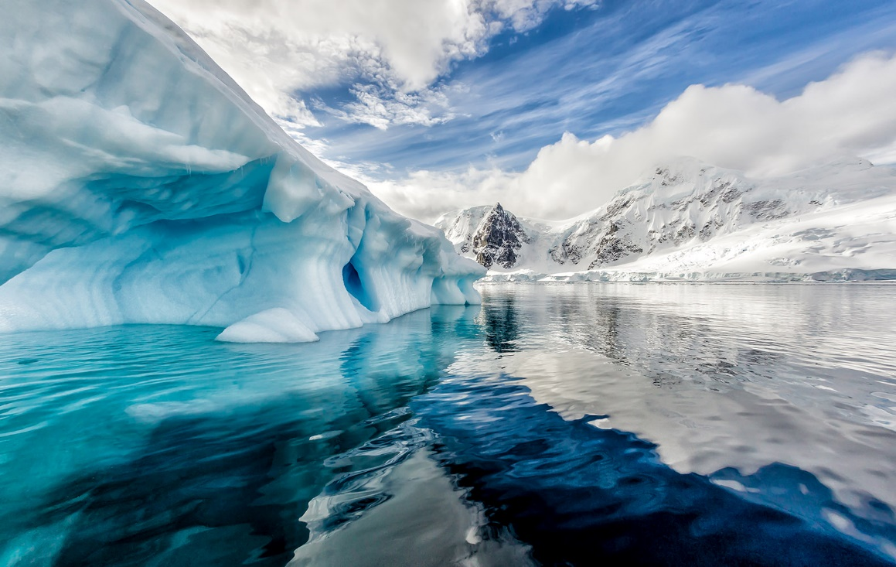
ANTARCTICA

Slide 2
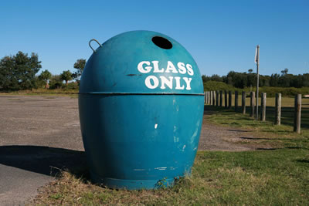
BOTTLE BANKS

Slide 3
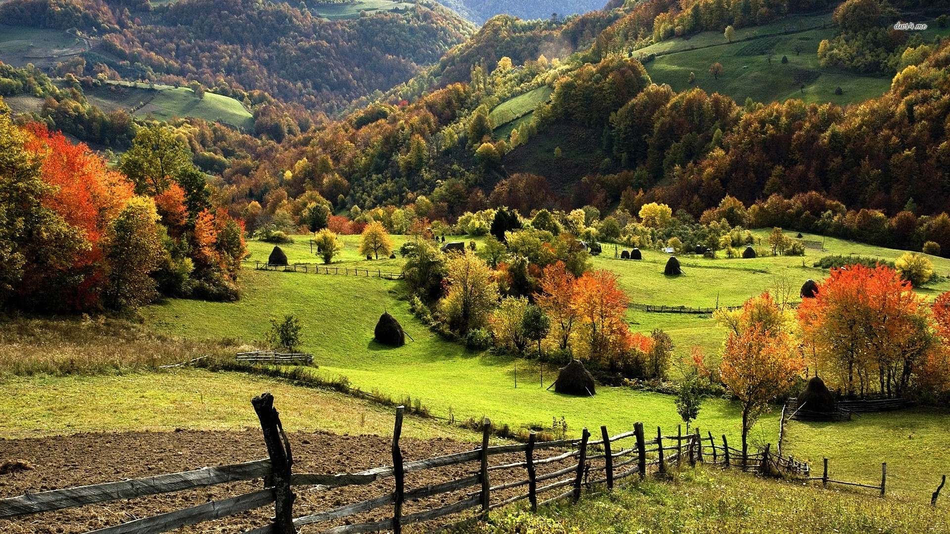
COUNTRYSIDE

Slide 4
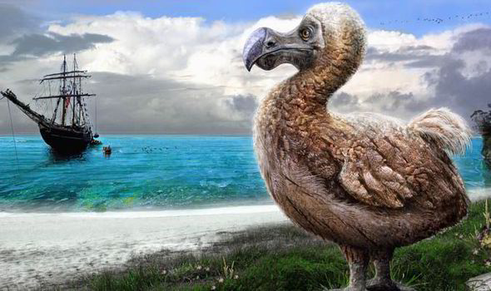
DODOS

Slide 5
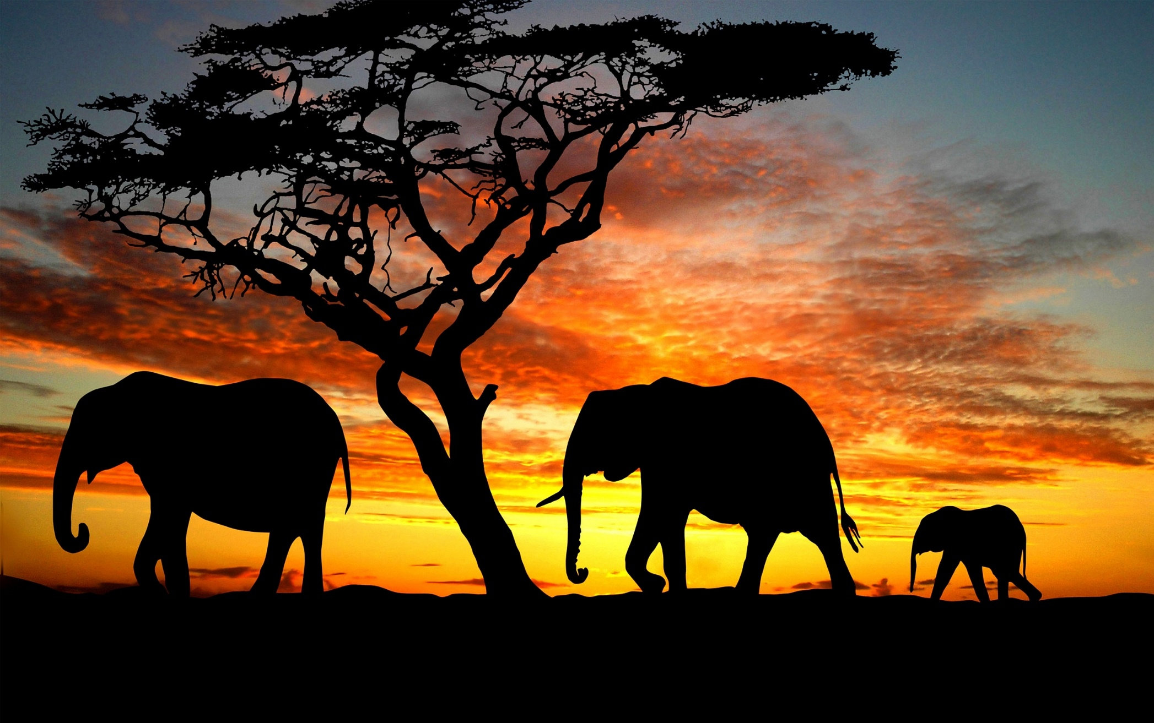
ELEPHANTS

Slide 6


FRIENDS OF THE EARTH

Slide 7
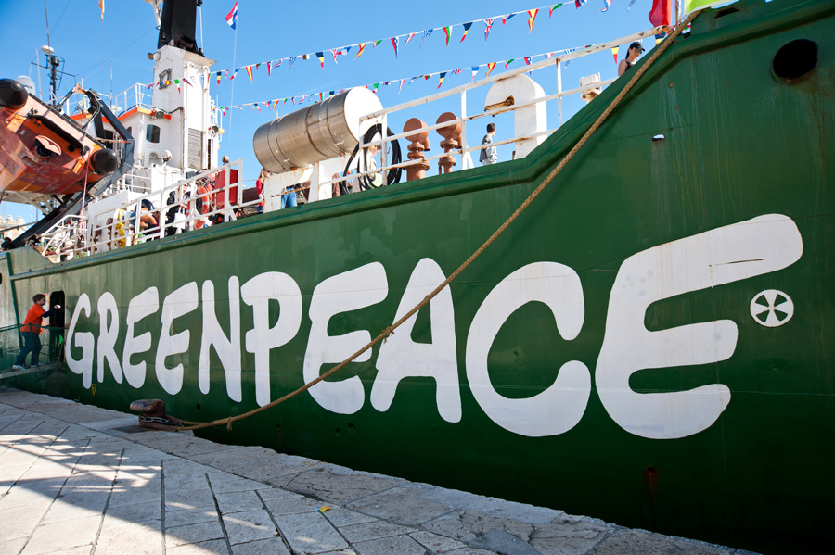
GREENPEACE

Slide 8
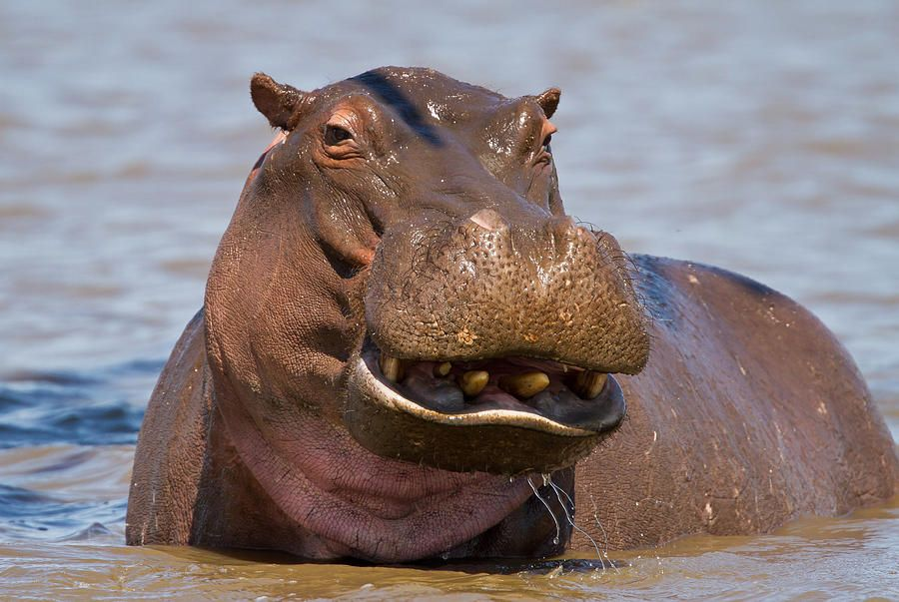
HIPPOPOTAMUS

Slide 9
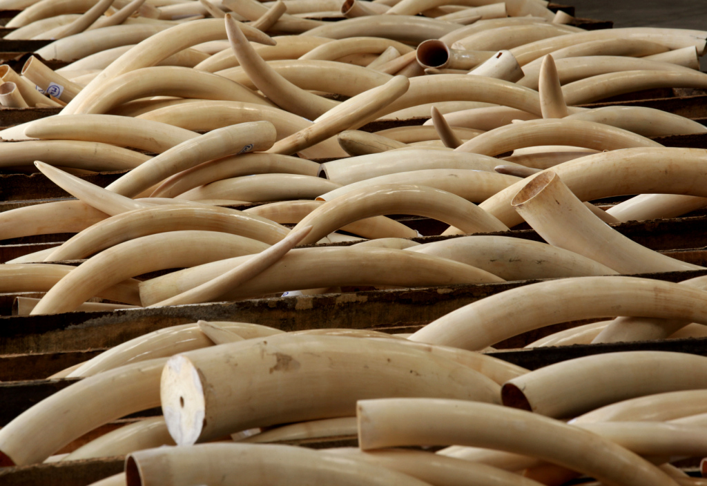
IVORY

Slide 10
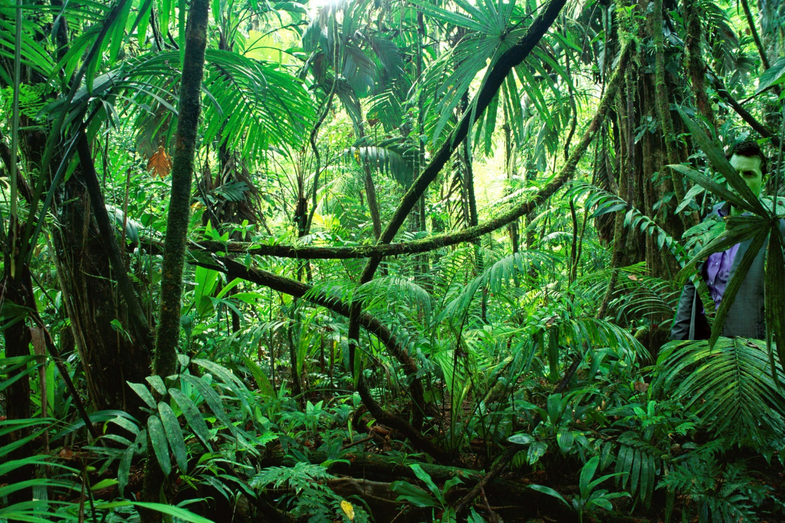
THE JUNGLE

Slide 11
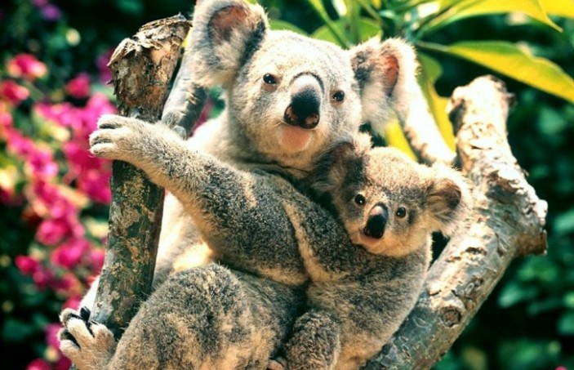
KOALAS

Slide 12
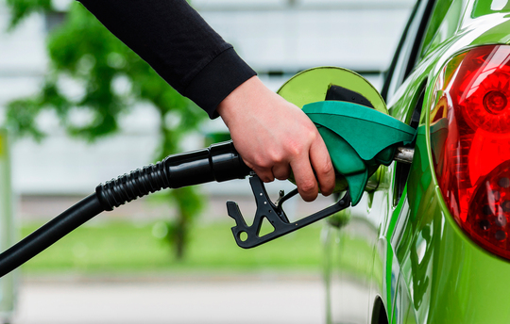
LEAD-FREE PETROL

Slide 13
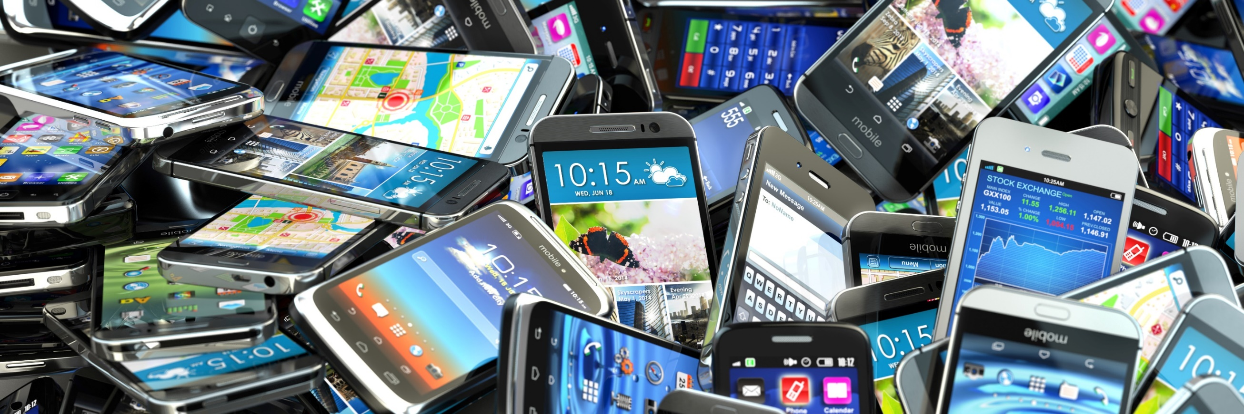
MOBILE PHONES

Slide 14
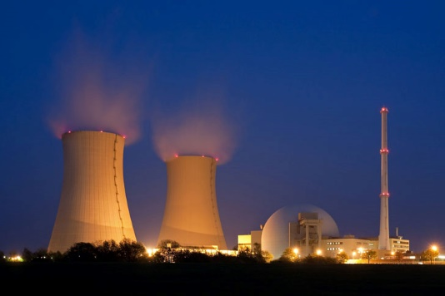
NUCLEAR POWER STATIONS

Slide 15
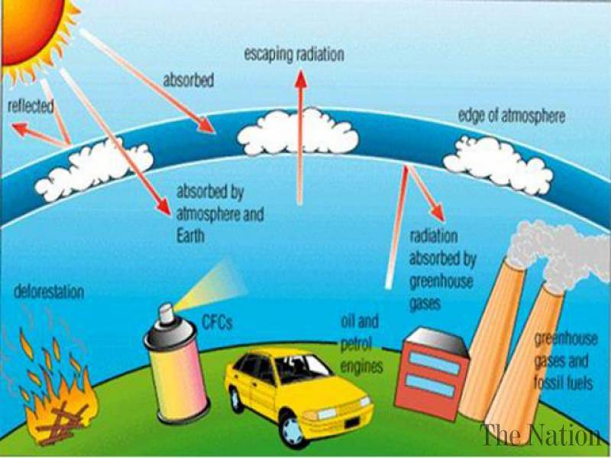
OZONE LAYER

Slide 16
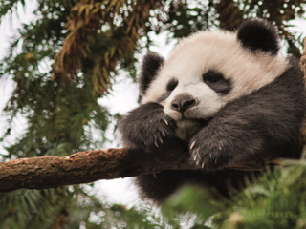
PANDAS

Slide 17
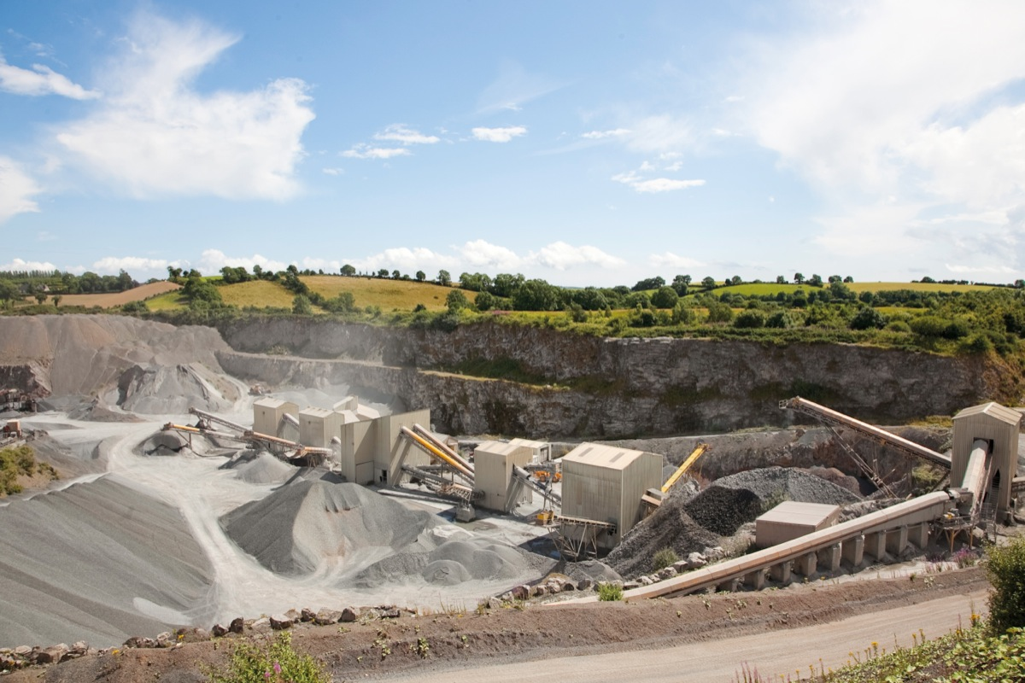
QUARRIES

Slide 18
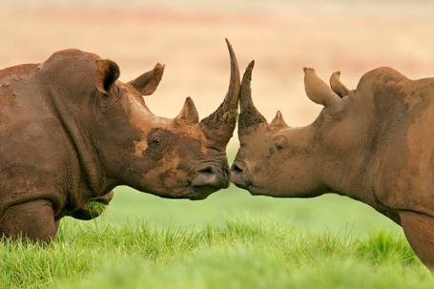
RHINOS

Slide 19
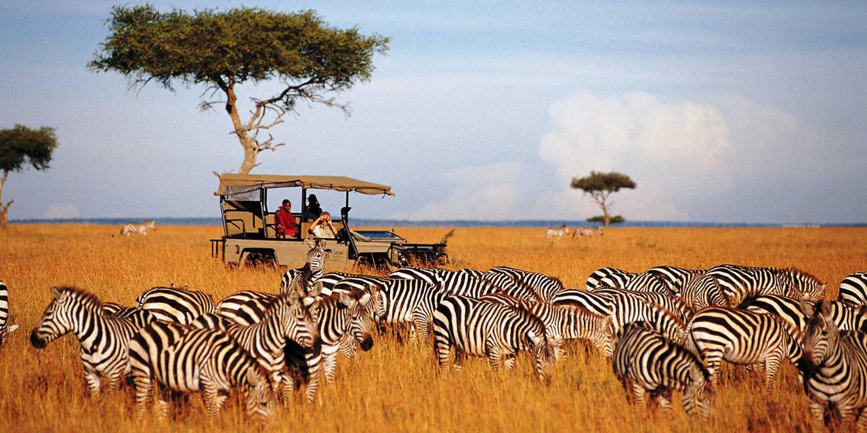
SAFARI

Slide 20
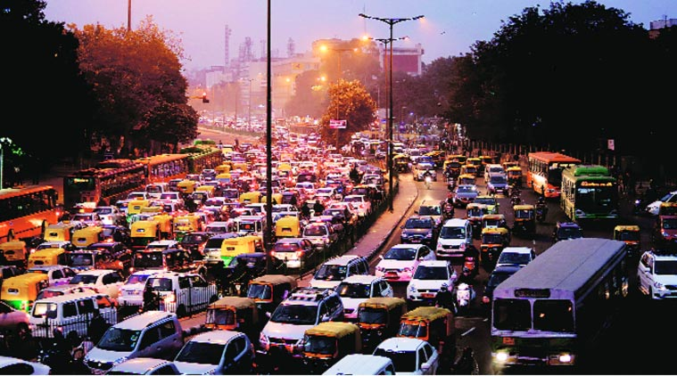
TRAFFIC

Slide 21
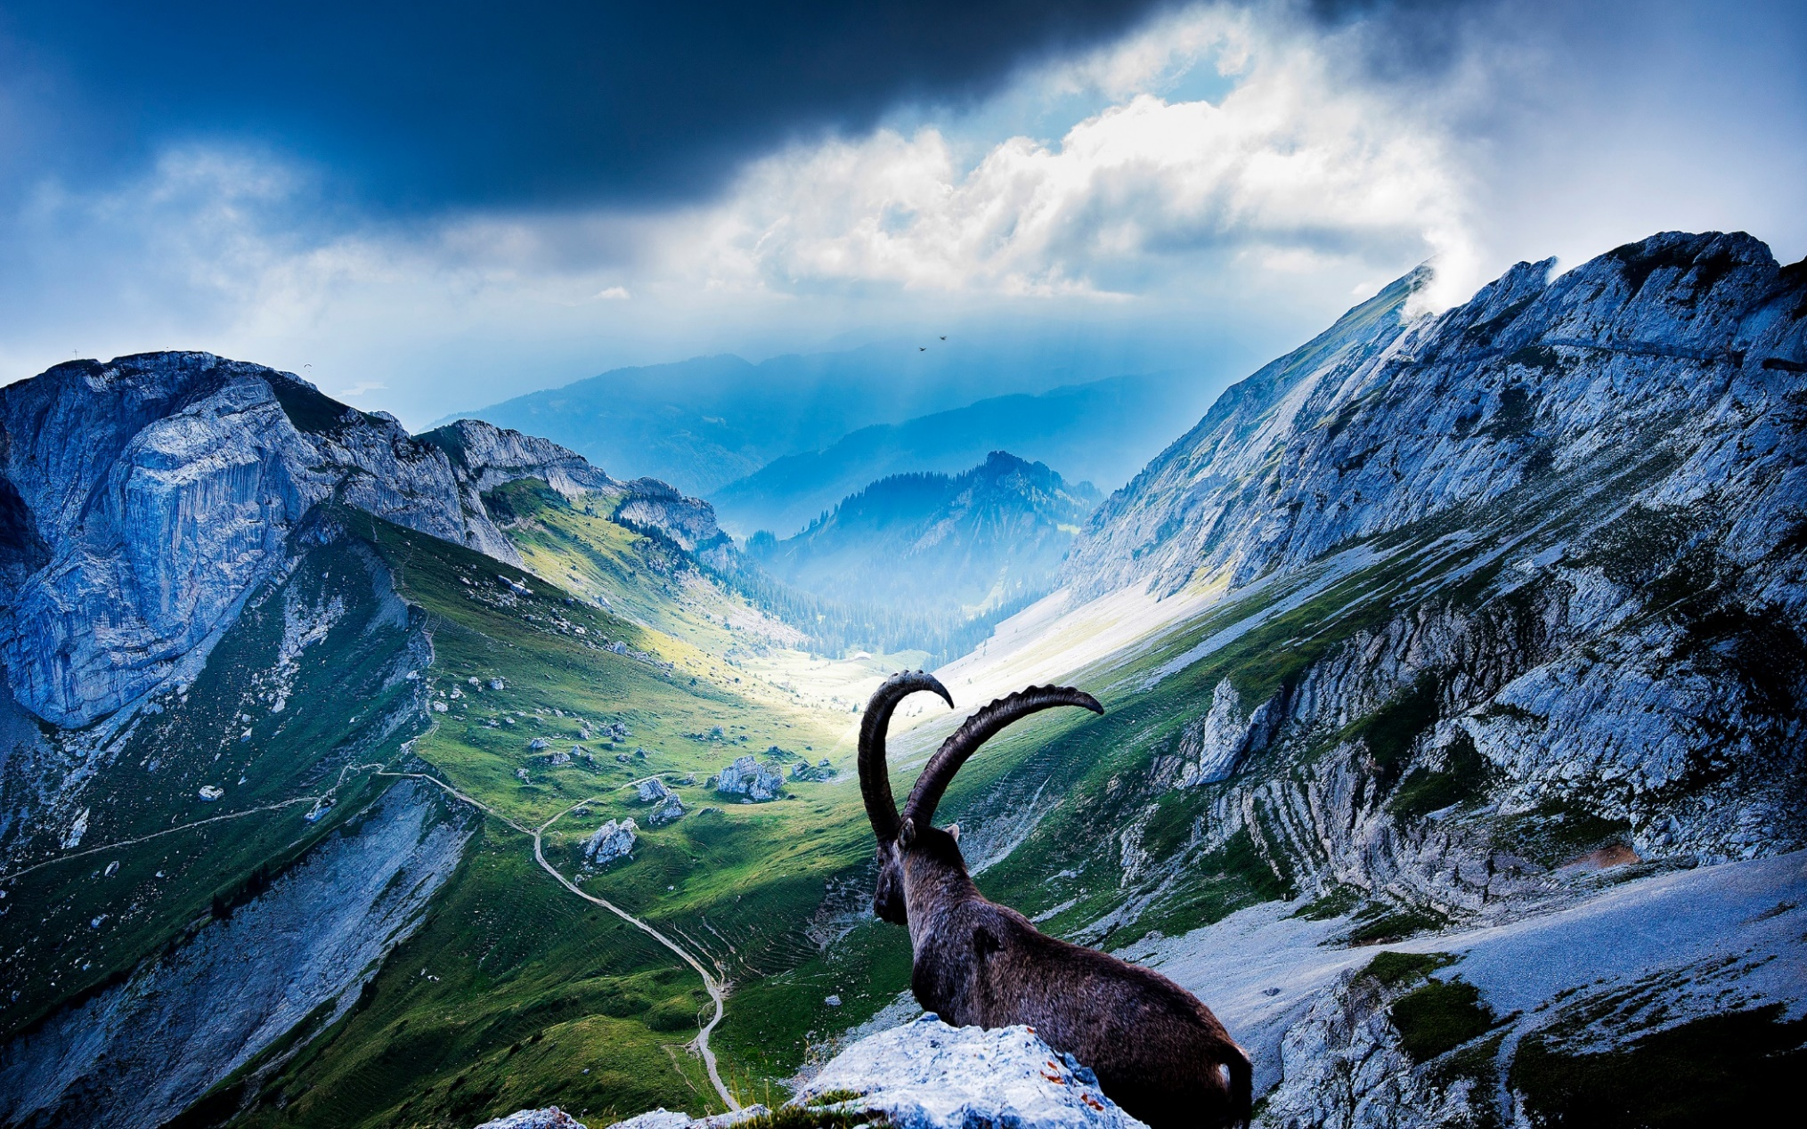
UNSPOILED NATURE

Slide 22

VEGETARIANISM

Slide 23
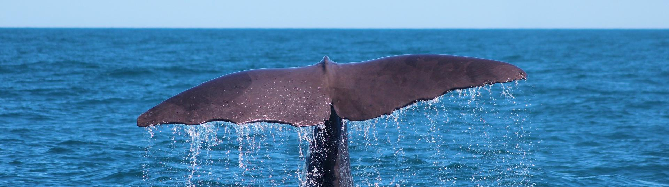
WHALES

Slide 24

EXTRA INFORMATION

Slide 25

YOU

Slide 26
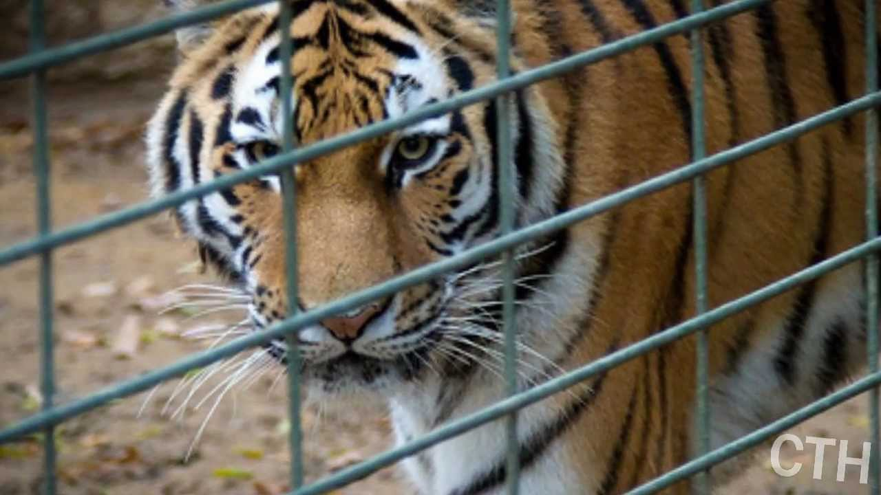
ZOOS

