Slide 1
Film and literature -GENRE

Slide 2
aRTS
Visual arts (drawing, painting, photography, architecture, sculpture)
Literary arts (fiction, nonfiction, drama, poetry)
Performing arts (music, film, theatre, dance)
Gastronomy
Video games?
criticism

Slide 3

How to define the genre
The study of genre is not an exact science.
Some texts may belong in more than one genre.
For example: Romeo and Juliet is a drama, a tragedy, and an Elizabethan play.

Slide 4
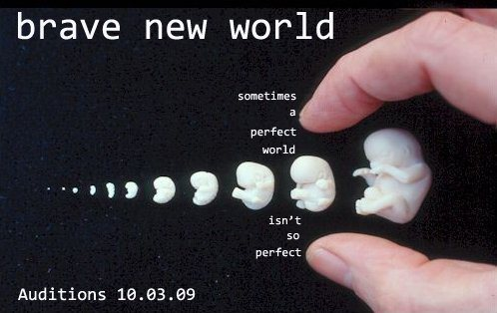
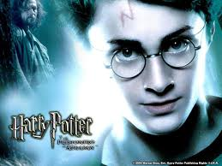
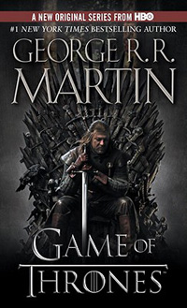

Fiction
stories that come from the author’s imagination
  Historical Fiction: based on a person or event from history.
  Science Fiction: dealing with aliens, the distant future, or advanced technology.
  Fantasy: containing monsters, magic, or other supernatural elements.
  Realistic Fiction: a story that could have happened, but didn’t.

Slide 5
Nonfiction:
writing that is true or factual
  Informational Writing: provides information on a topic (MATURA)
  Persuasive Writing: attempts to influence the reader (MATURA)
  Autobiography: the story of one’s life told by oneself.
  Biography: the story of one’s life told by another.

Slide 6

Drama
  writing that is meant to be acted on a stage (a play)
  Comedy: has a happy ending.
  Tragedy: ends in death and sadness.

Slide 7
Poetry: writing that is concerned with the beauty of language
Seznam za višjo raven:
Williams Shakespeare – sonnet 130
W.b. Yeats – the lake isle of innesfree
Robert Frost: the road not taken
Maya Angelou: Phenomenal Woman
John McCrane: The Flanders fields

Slide 8
Folklore
stories handed down through speech from generation to generation.
  Fairy Tale: a story with magic, monsters, and/or talking animals (like fiction / fantasy, but part of the oral tradition).
  Fable: a very short story that has a moral or life lesson; usually has talking animals as main characters.
  Myth: has gods or goddesses and often accounts for how something came to be.
  Legend: an exaggerated story about something that may have been real at one time.
  Tall Tale: stories set in the Wild West; the main character’s strengths, skills, or size have been exaggerated and the tone is funny.

Slide 9
SOURCES
http://www.ereadingworksheets.com/genre/ (maj, 2016)
http://www.ric.si/mma/Izbor%20umetnostnih%20besedil%20ANG%202017/2015100612192696/ (may, 2016)
https://en.wikipedia.org/wiki/The_arts (may, 2015)

