Slide 1
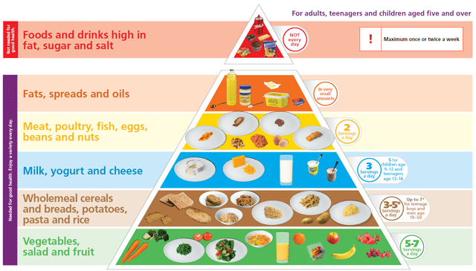
FOOD

Slide 2
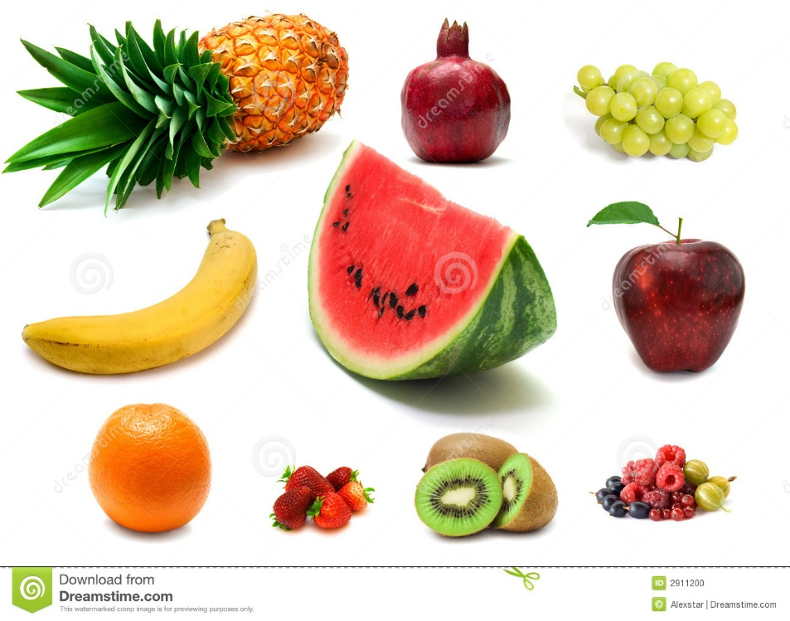
FRUIT

Slide 3
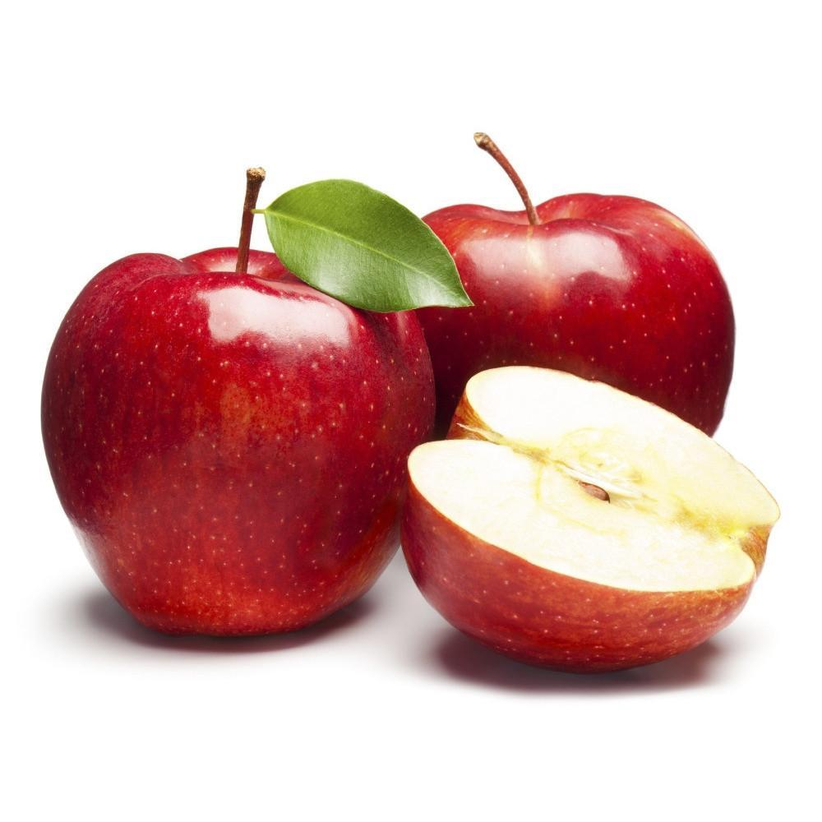

Slide 4
APPLES

Slide 5
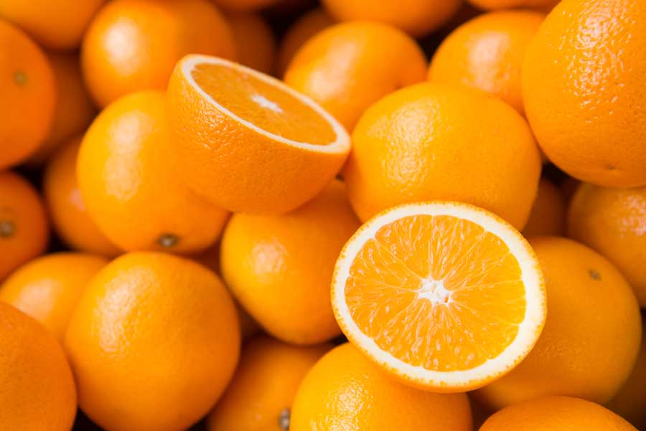

Slide 6
ORANGES

Slide 7
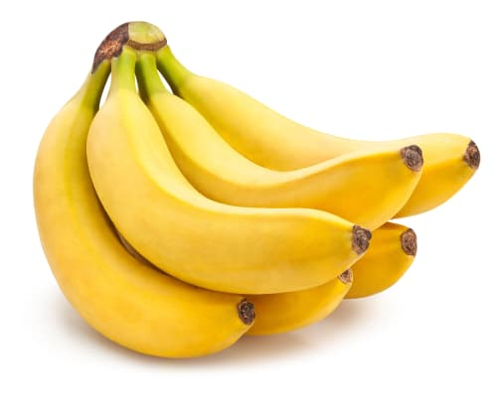

Slide 8
BANANAS

Slide 9


Slide 10
STRAWBERRIES

Slide 11
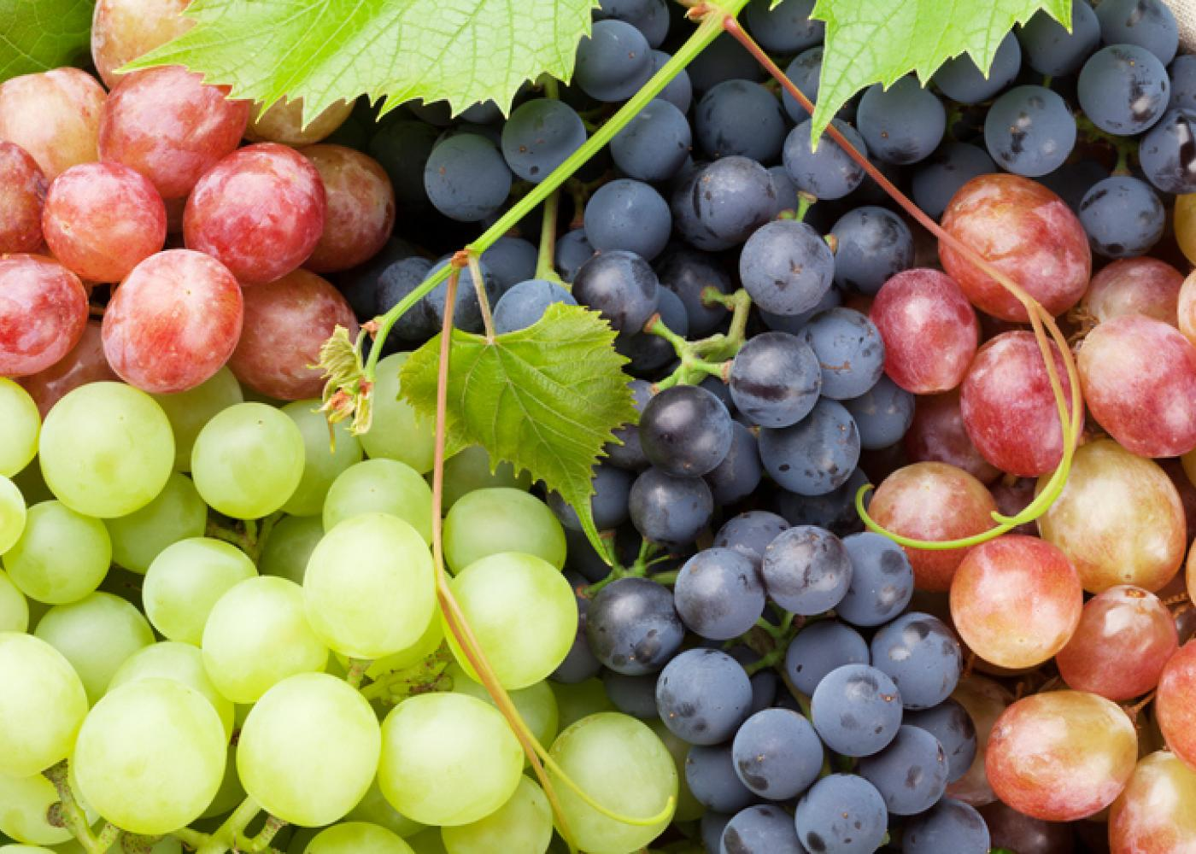

Slide 12
GRAPES

Slide 13
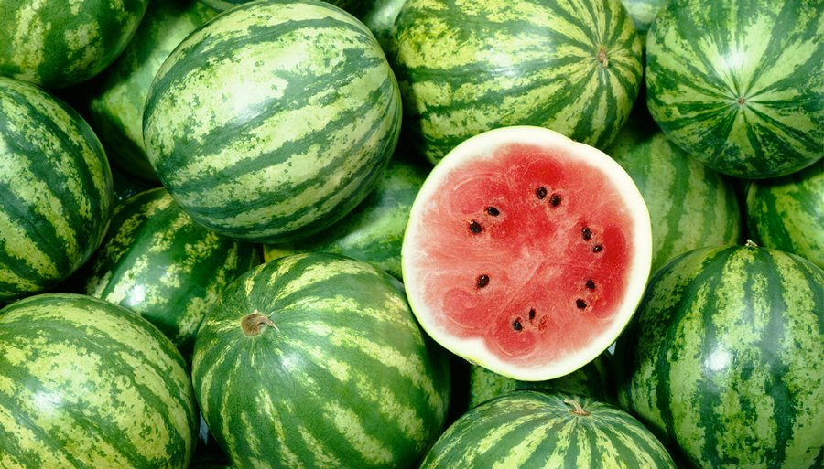

Slide 14
WATERMELONS

Slide 15
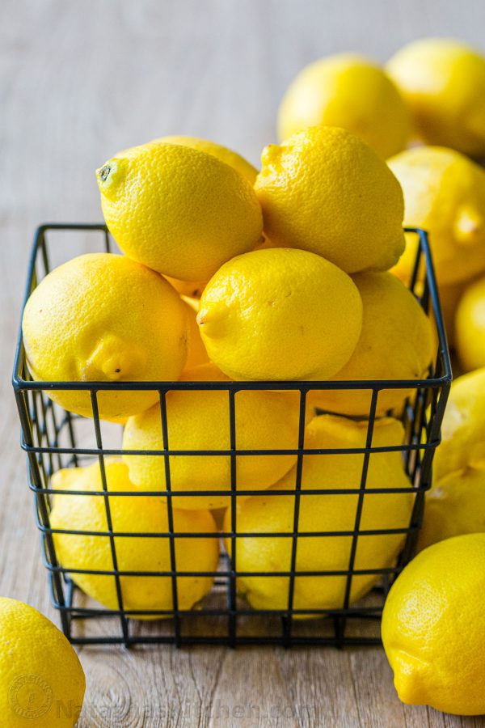

Slide 16
LEMONS

Slide 17
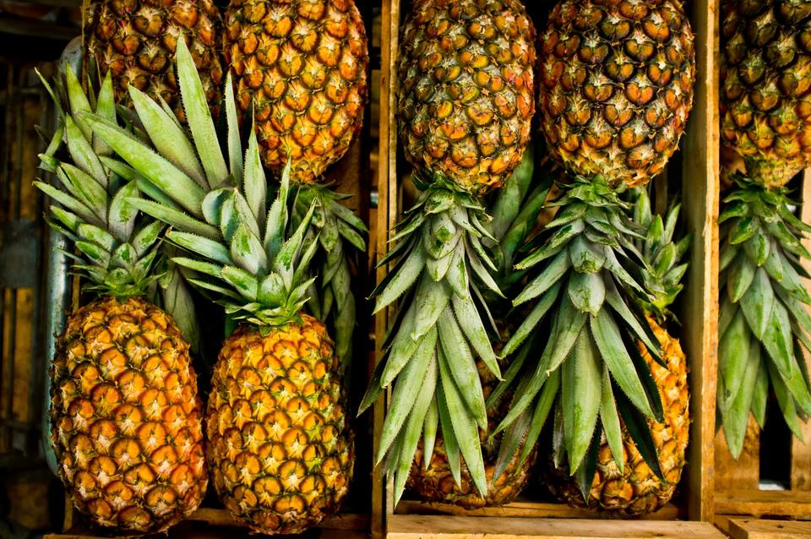

Slide 18
PINEAPPLES

Slide 19
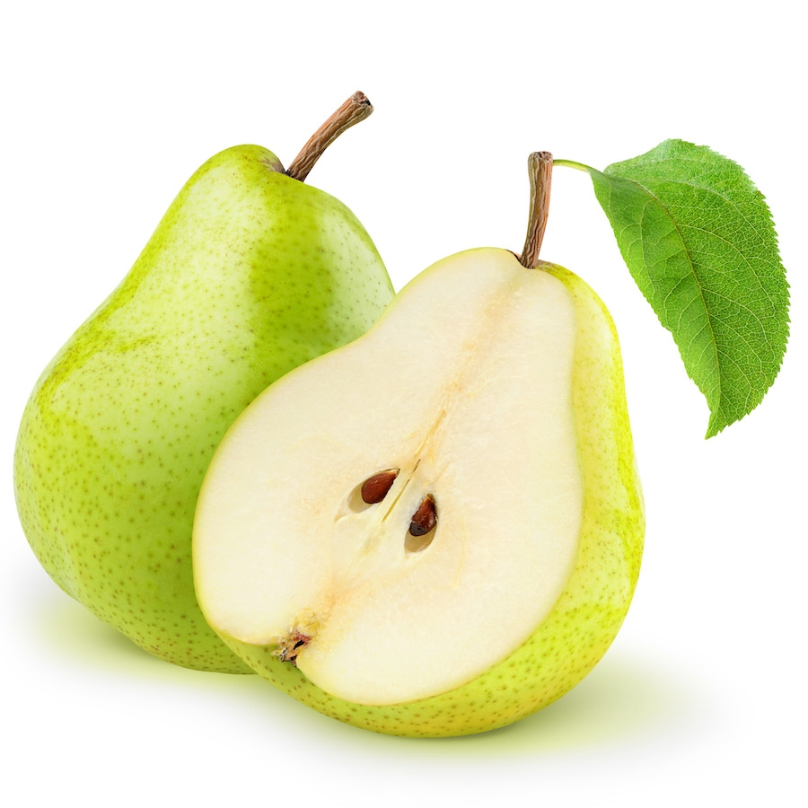

Slide 20
PEARS

Slide 21
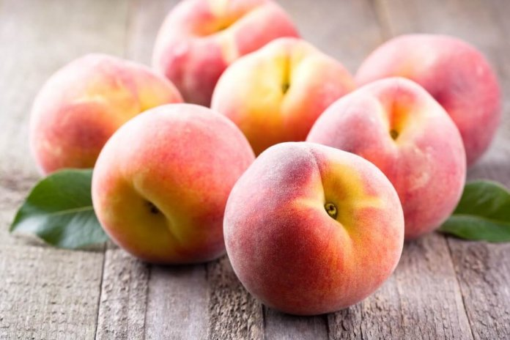

Slide 22
PEACHES

Slide 23


Slide 24
CHERRIES

Slide 25
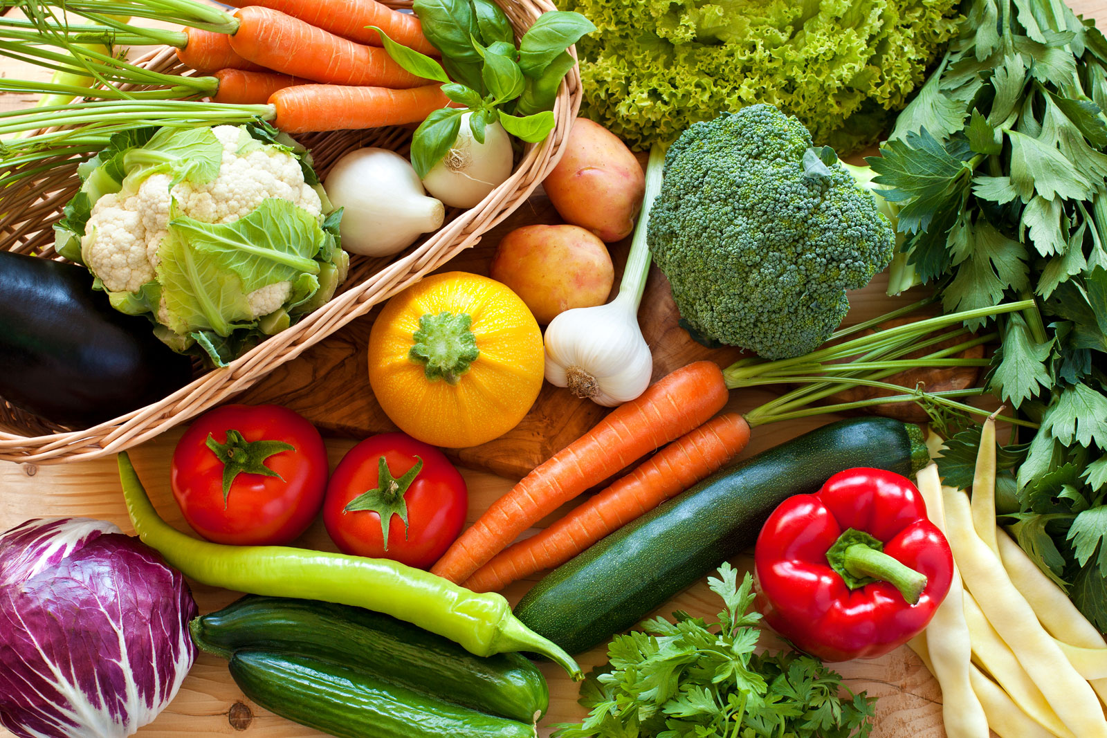
VEGETABLES

Slide 26
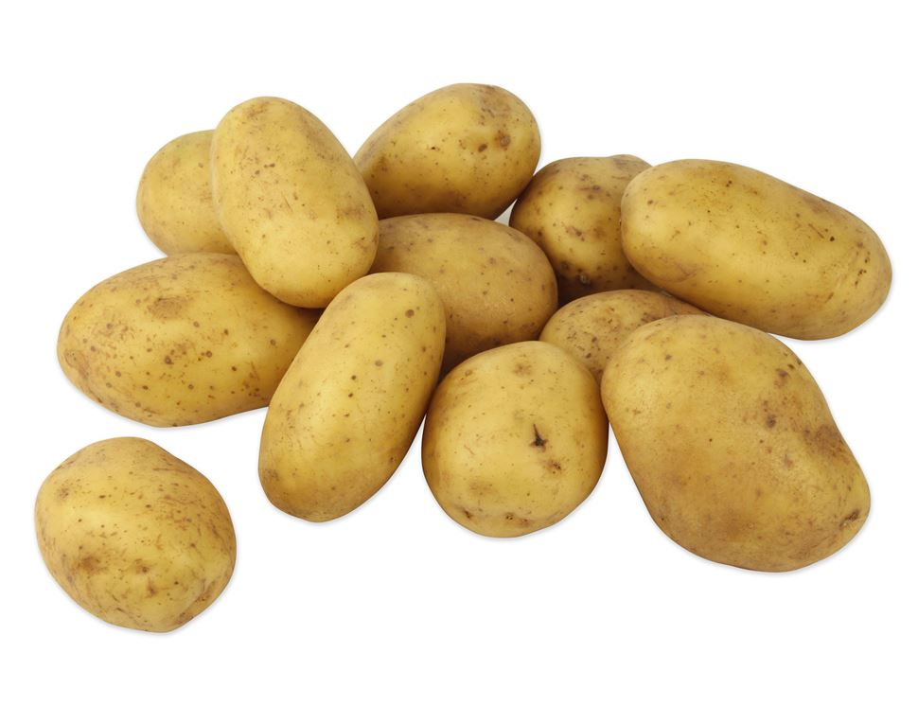

Slide 27
POTATOES

Slide 28
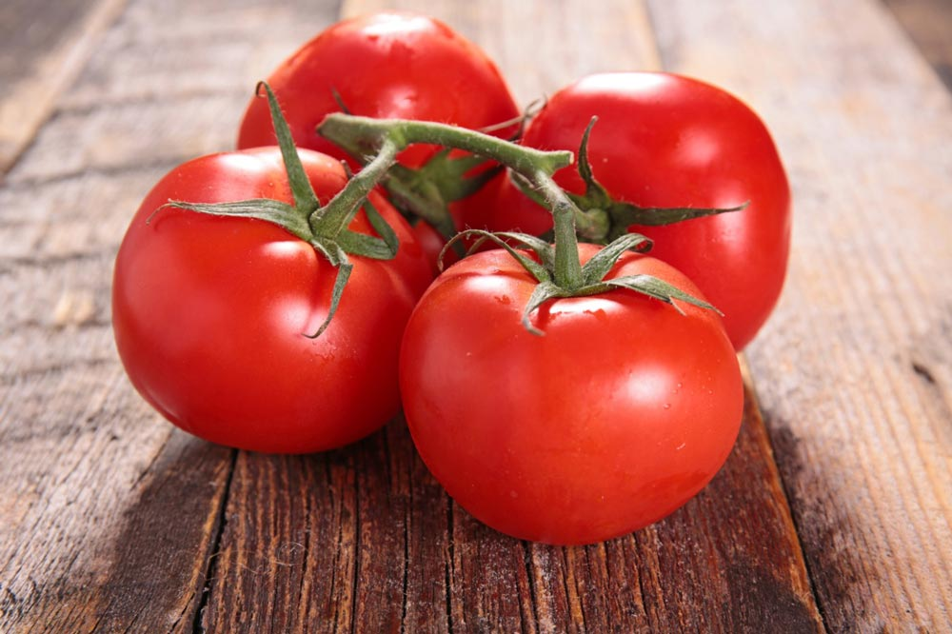

Slide 29
TOMATOES

Slide 30
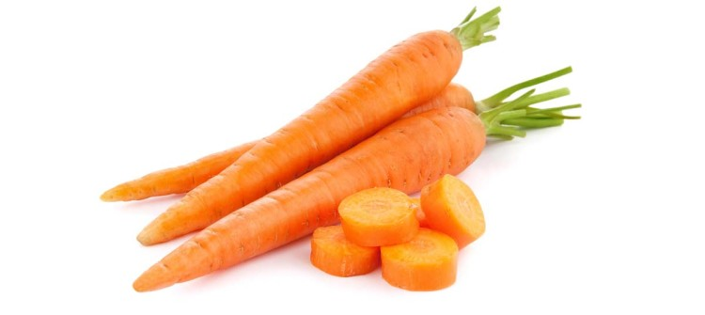

Slide 31
CARROTS

Slide 32
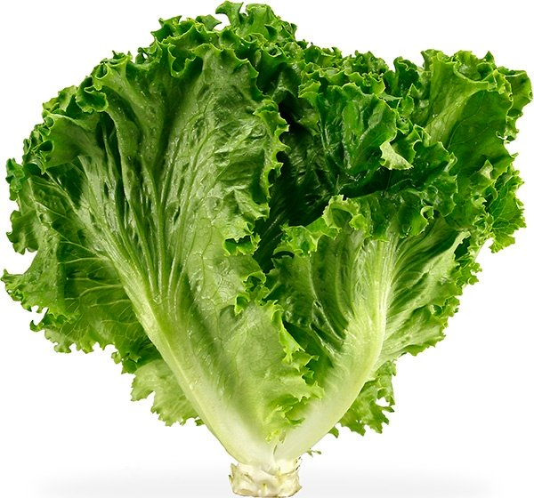

Slide 33
LETTUCE

Slide 34
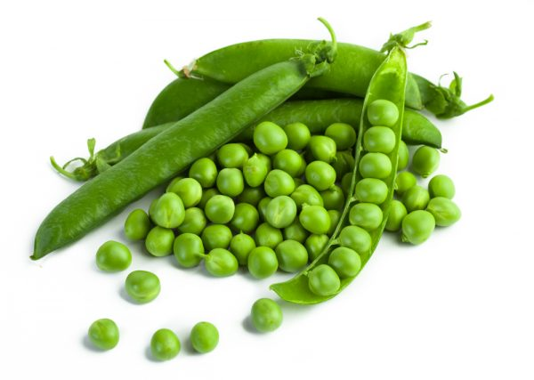

Slide 35
PEAS

Slide 36
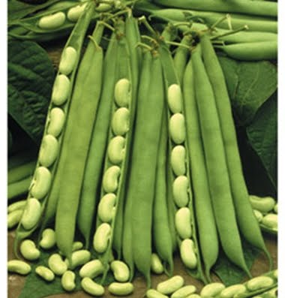
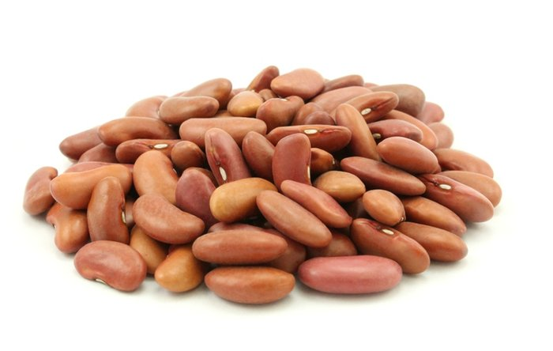

Slide 37
BEANS

Slide 38
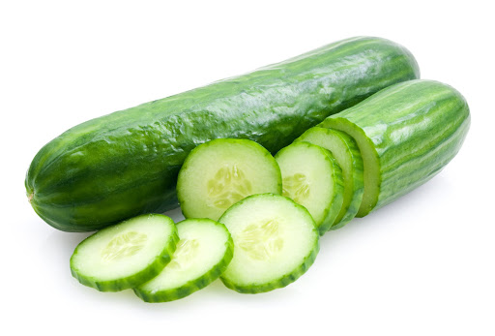

Slide 39
CUCUMBERS

Slide 40
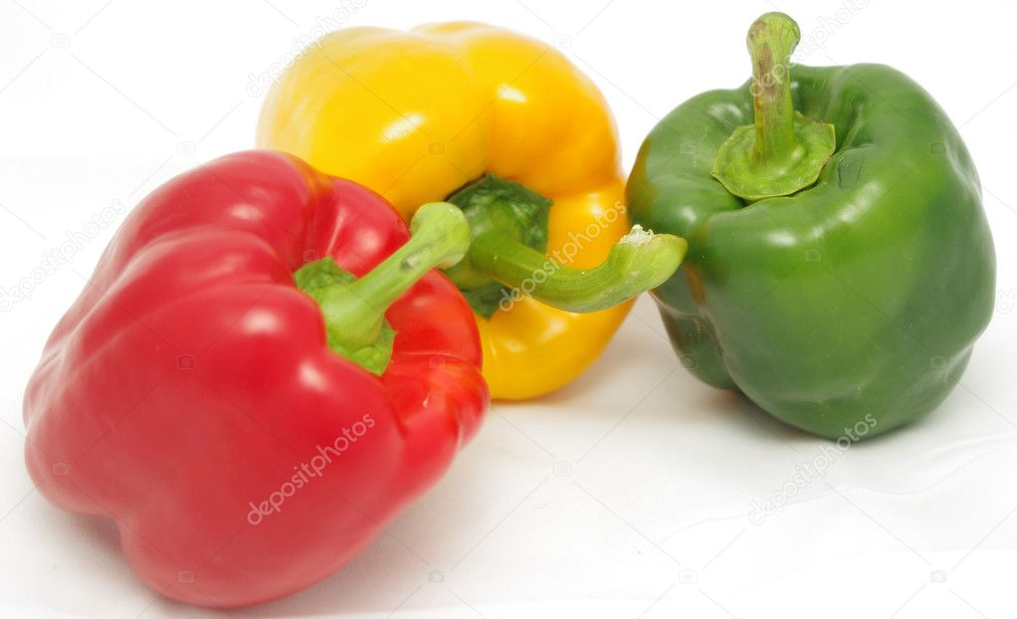

Slide 41
PEPPERS

Slide 42
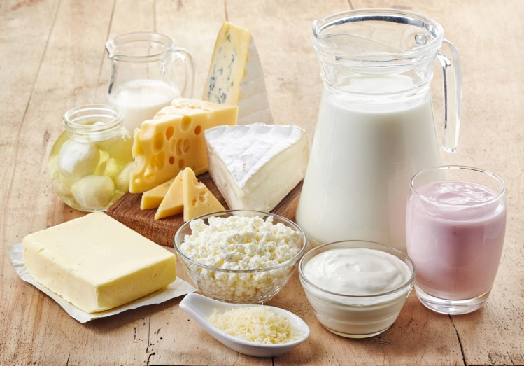
DAIRY PRODUCTS

Slide 43
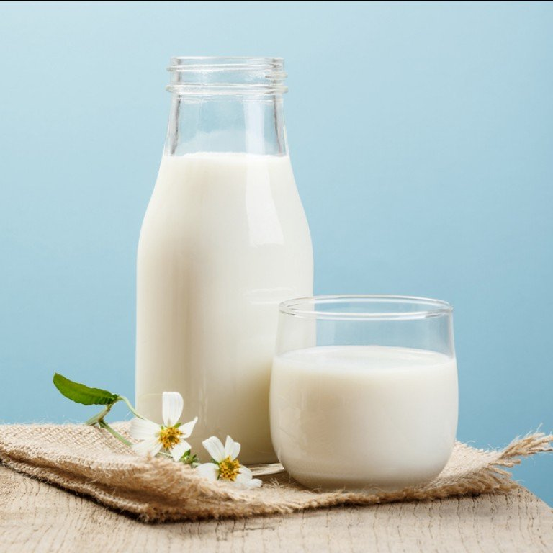

Slide 44
MILK

Slide 45
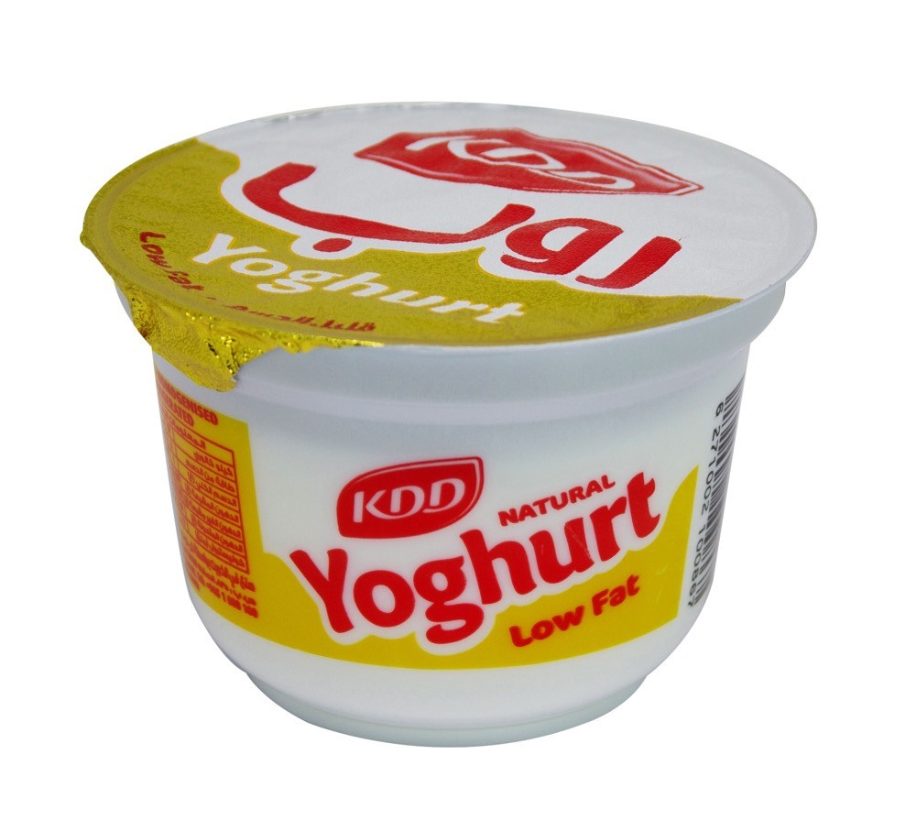

Slide 46
YOGHURT

Slide 47
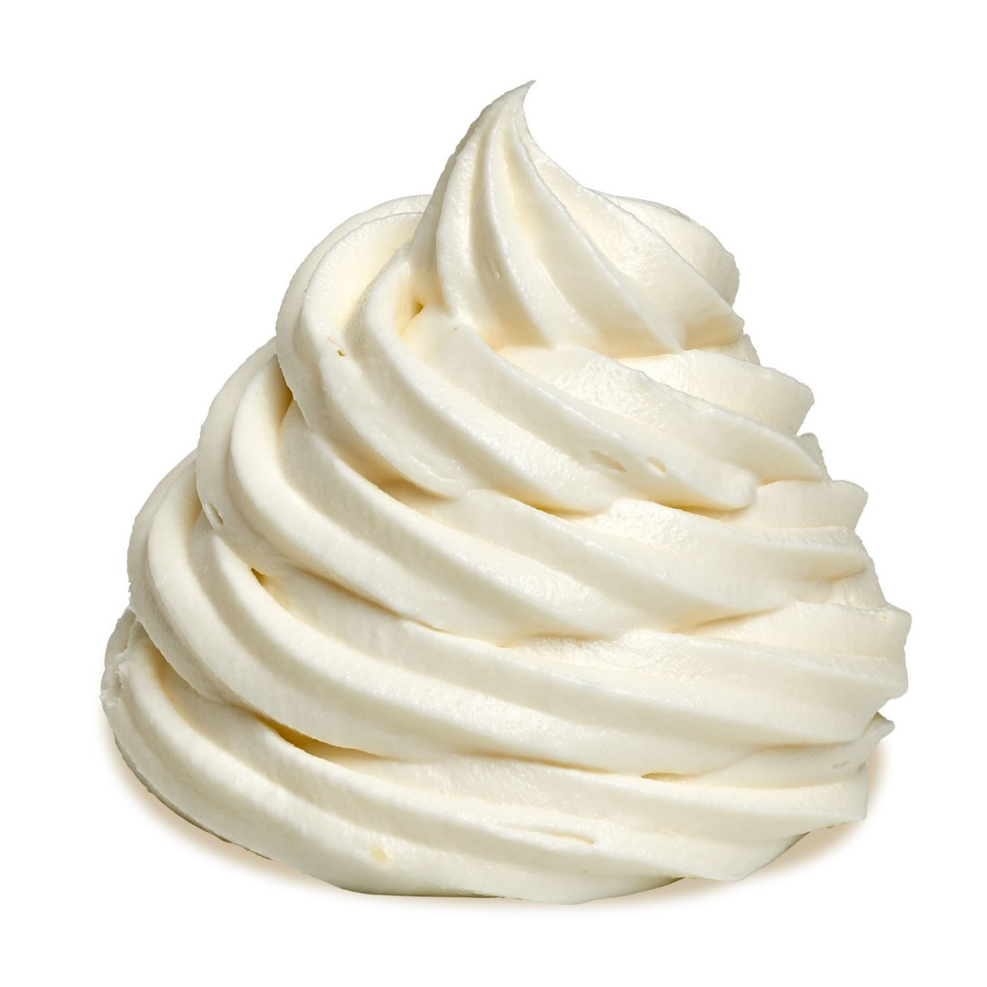

Slide 48
CREAM

Slide 49
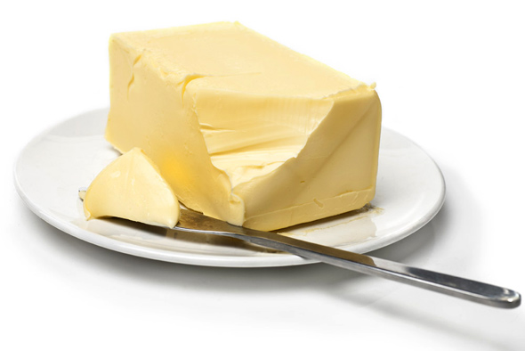

Slide 50
BUTTER

Slide 51
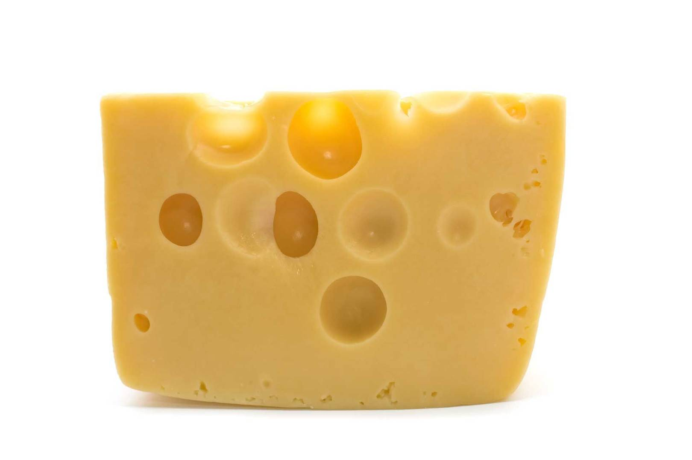

Slide 52
CHEESE

Slide 53


Slide 54
ICE CREAM

Slide 55
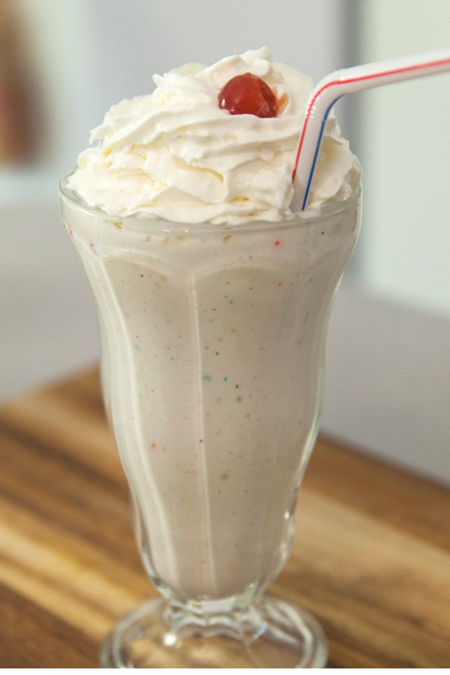

Slide 56
MILKSHAKE

Slide 57
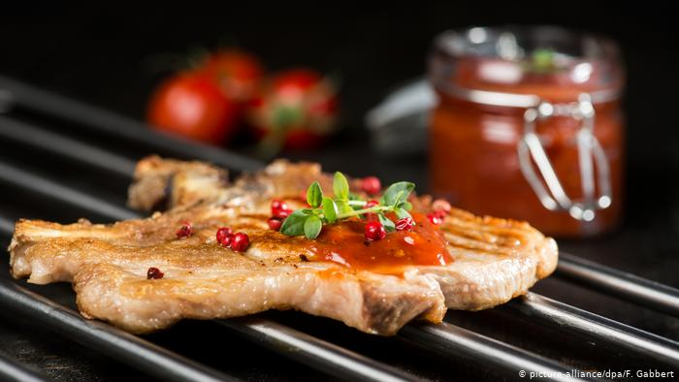
MEAT

Slide 58
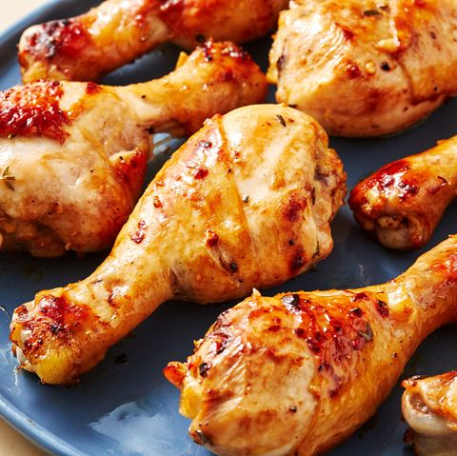

Slide 59
CHICKEN

Slide 60
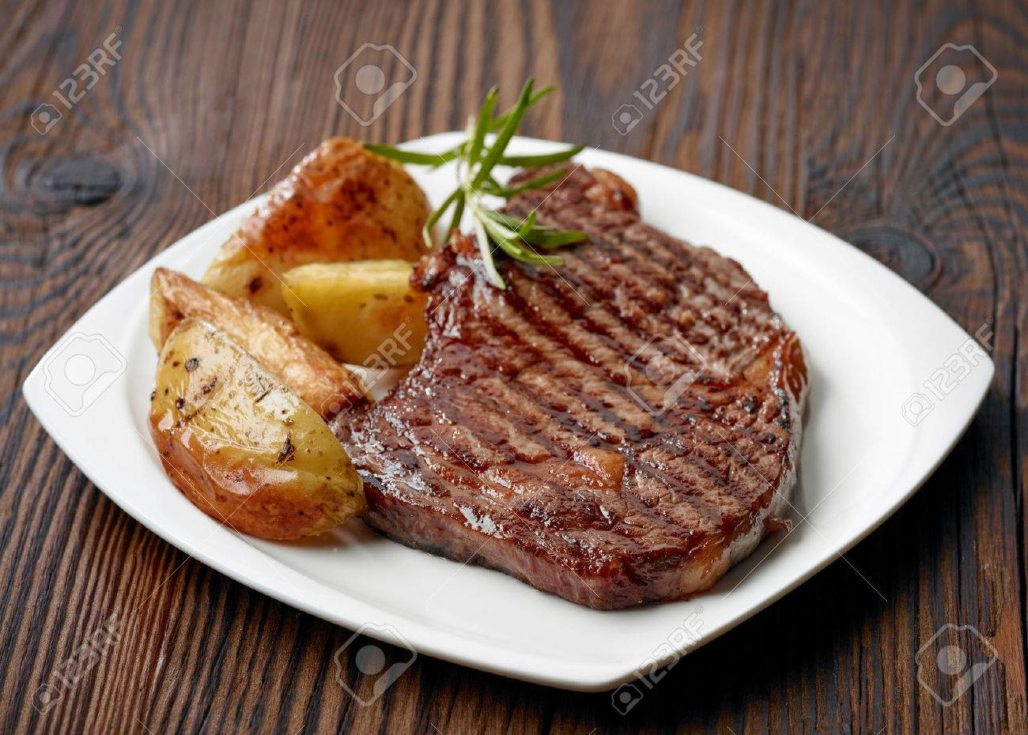

Slide 61
BEEF STEAK

Slide 62
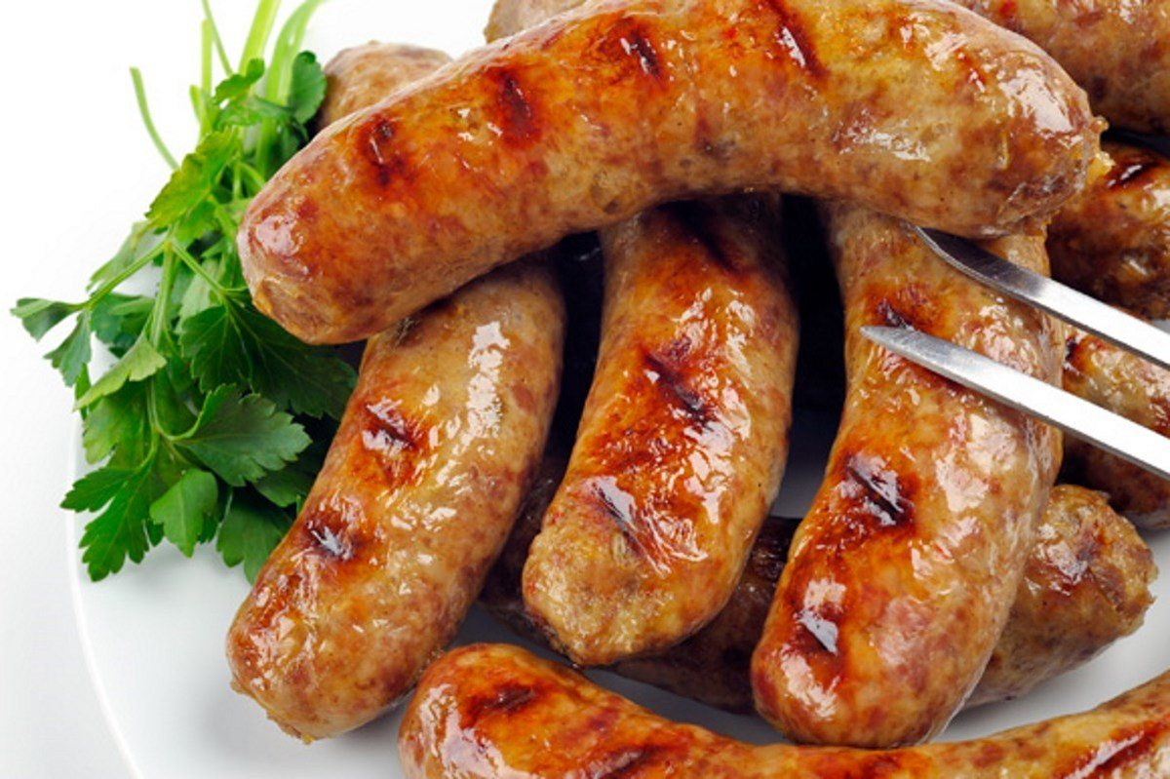

Slide 63
SAUSAGES

Slide 64
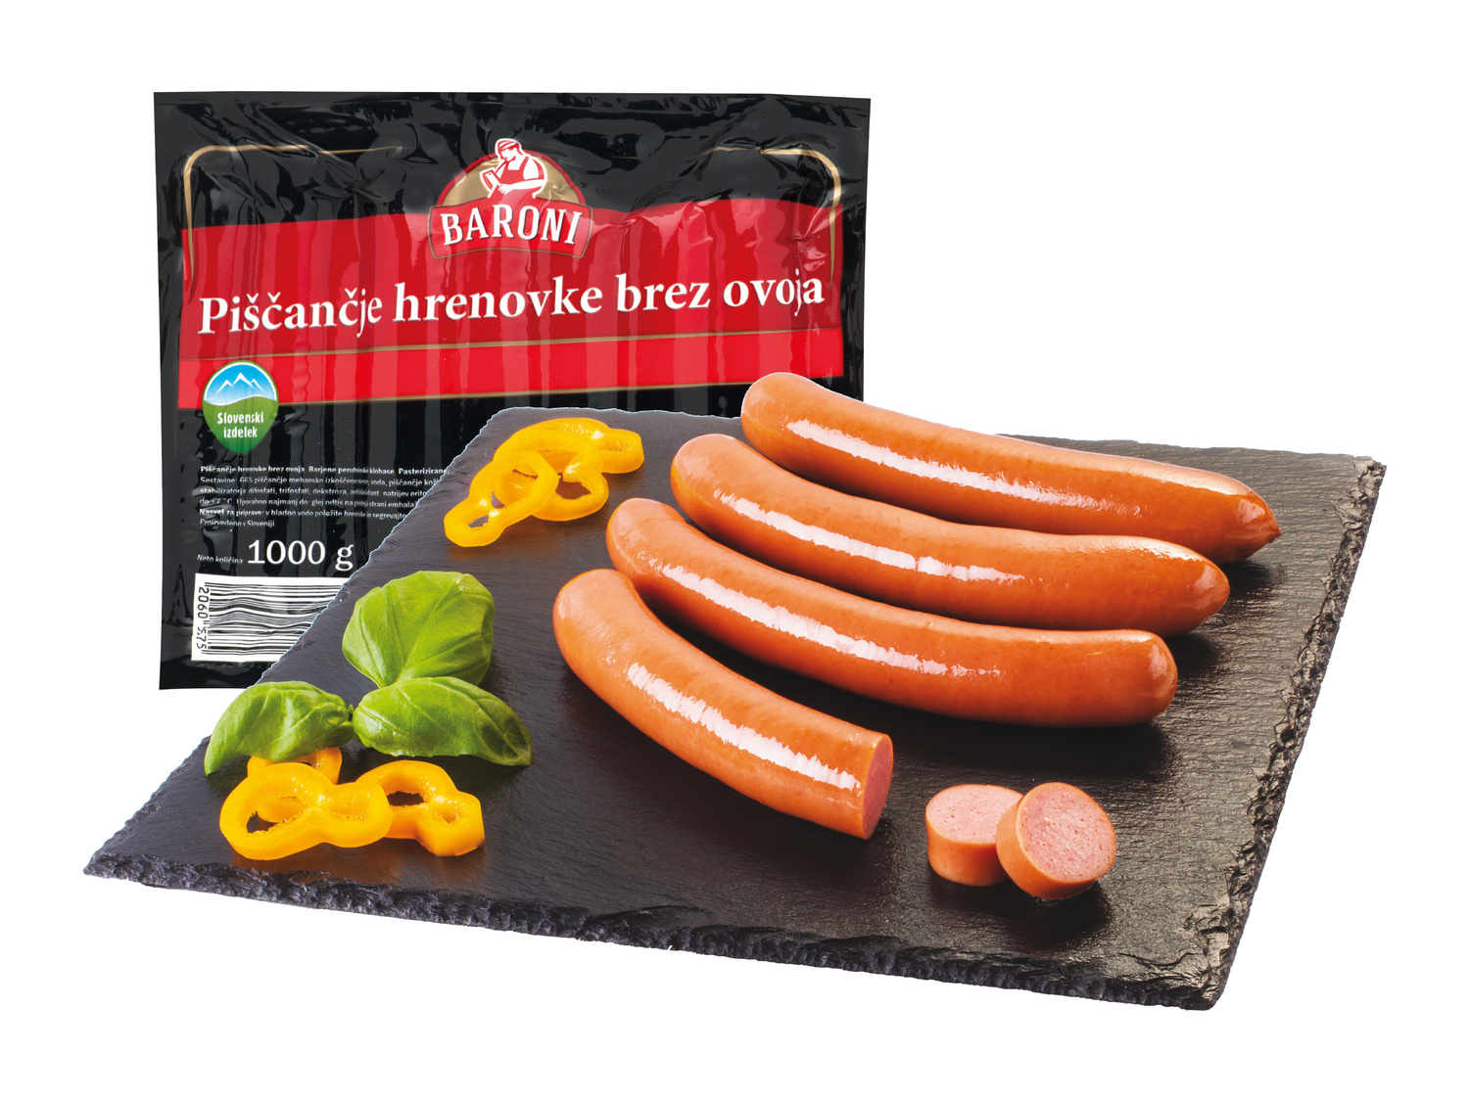

Slide 65
FRANKFURTERS

Slide 66
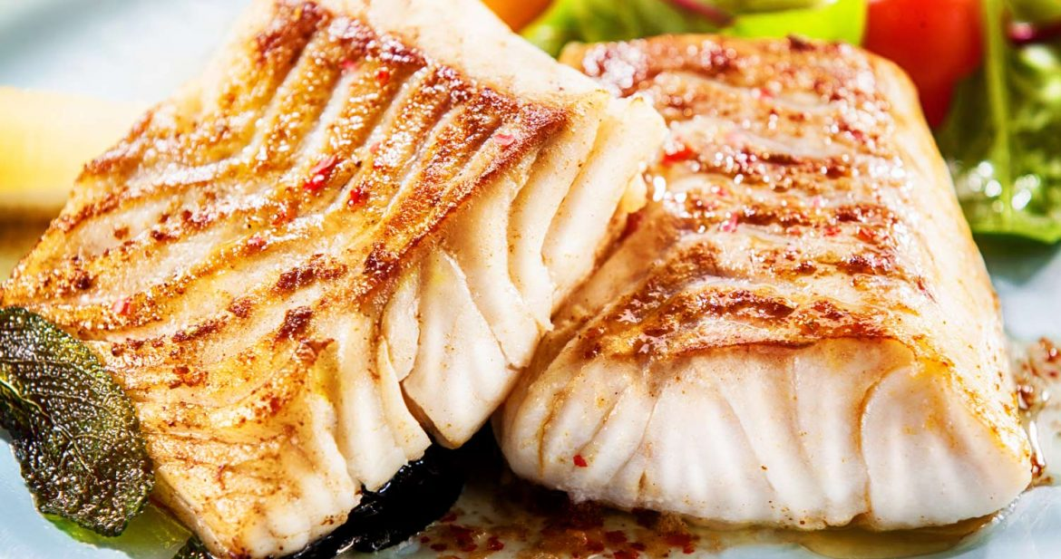

Slide 67
FISH

Slide 68
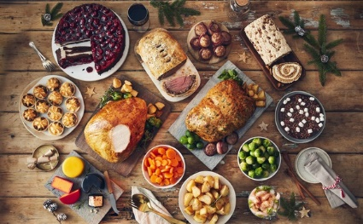
OTHER FOOD

Slide 69


Slide 70
SOUP

Slide 71
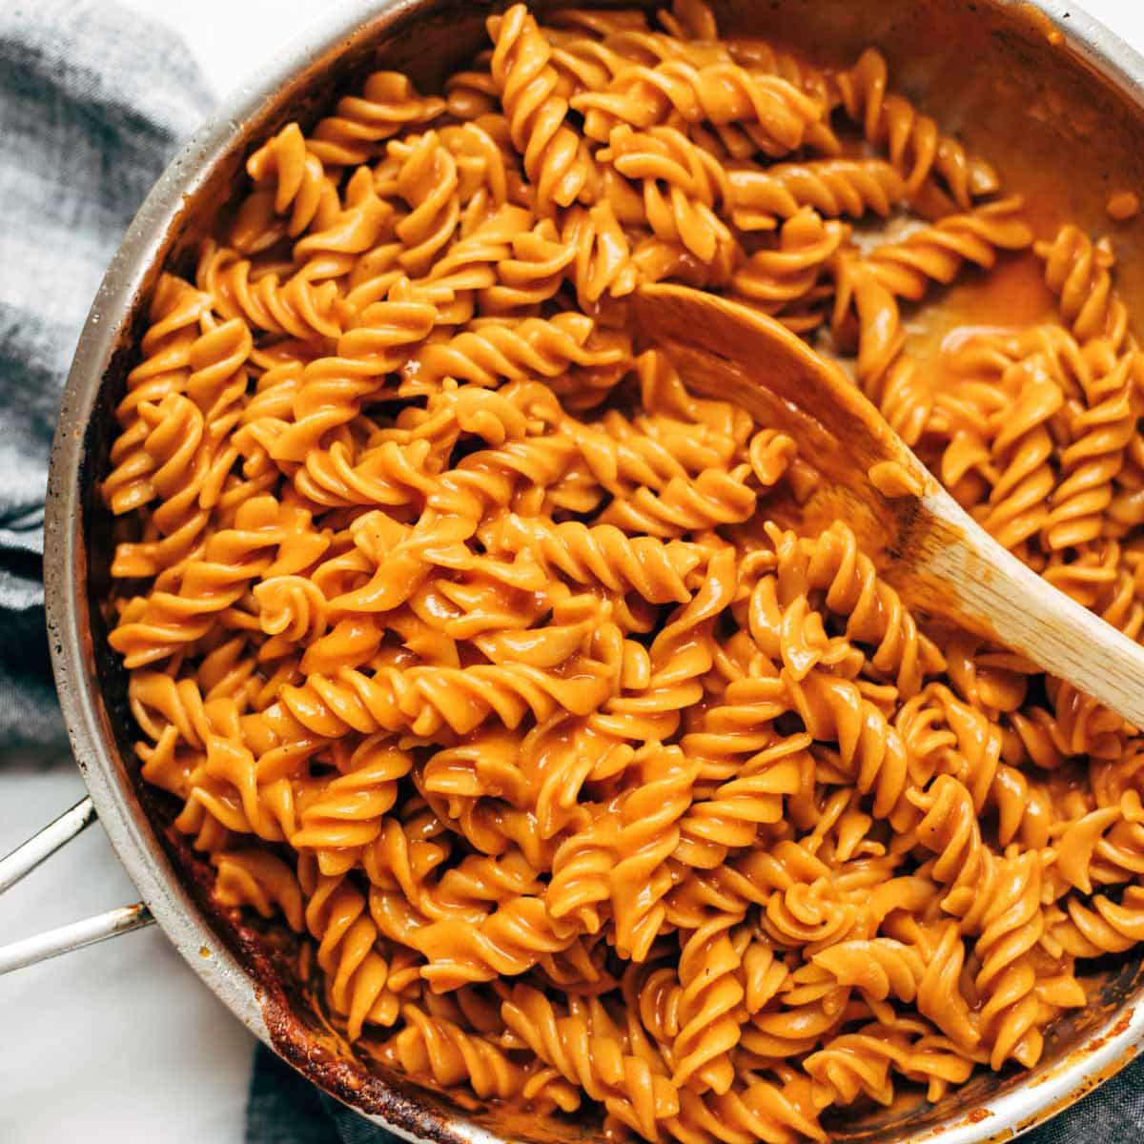

Slide 72
PASTA

Slide 73
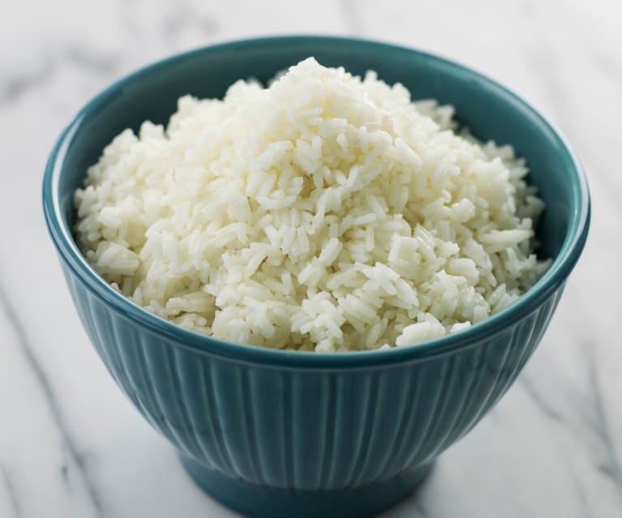

Slide 74
RICE

Slide 75
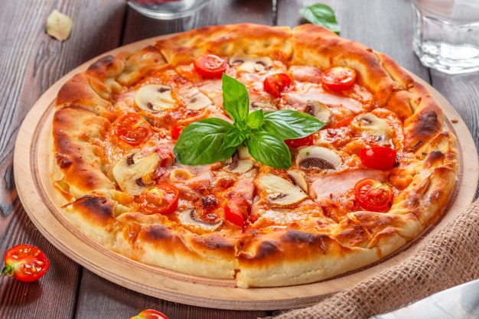

Slide 76
PIZZA

Slide 77
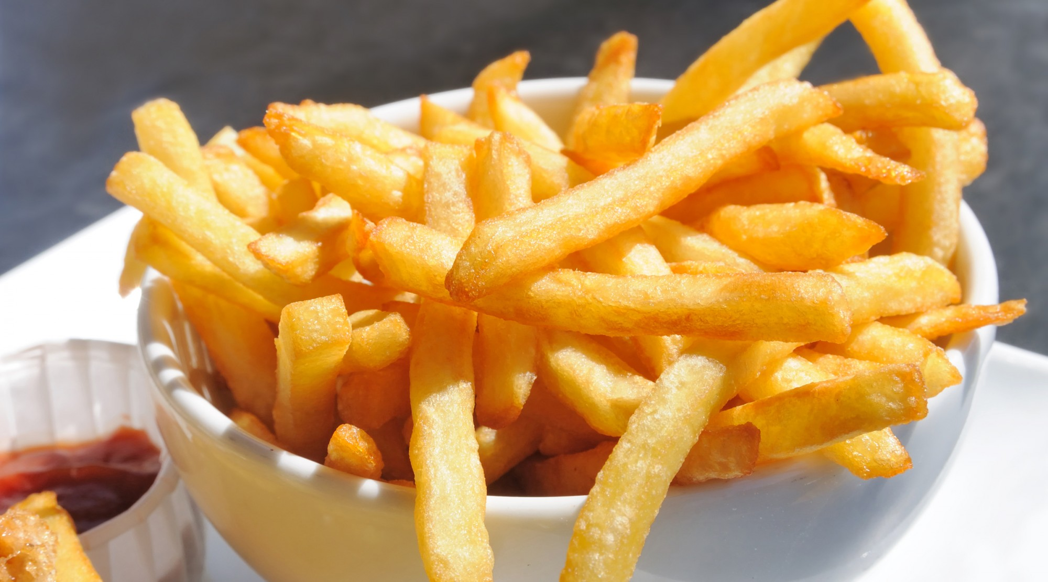

Slide 78
FRIES

Slide 79
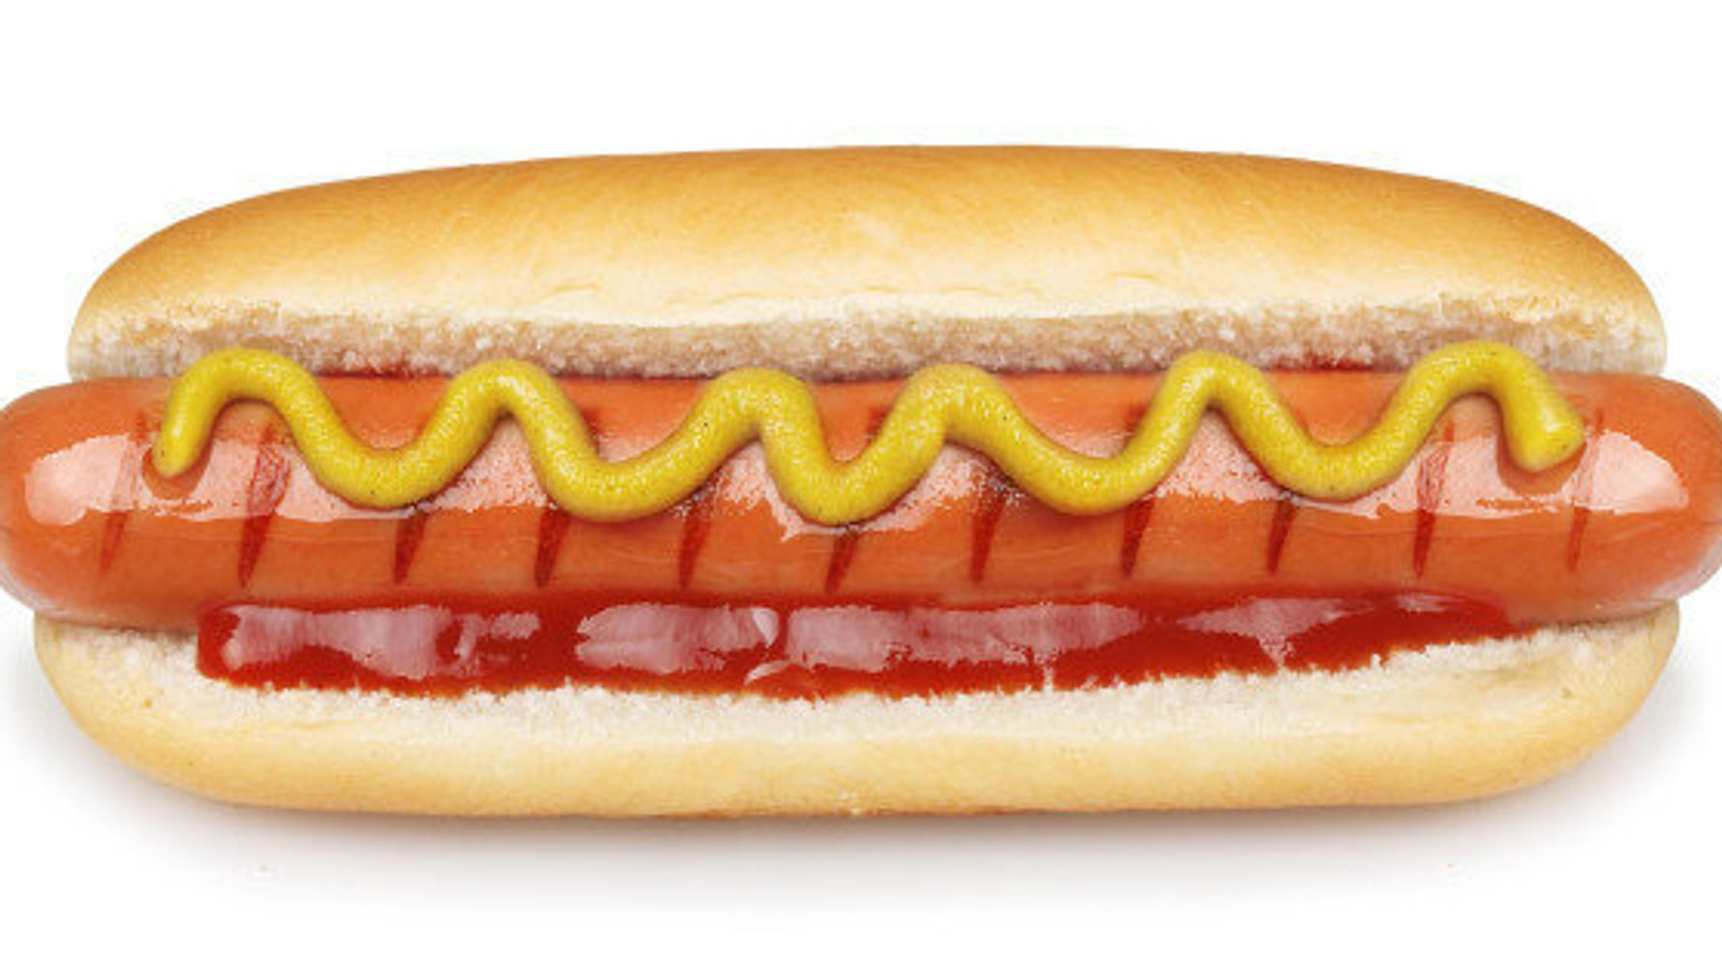

Slide 80
HOT DOG

Slide 81
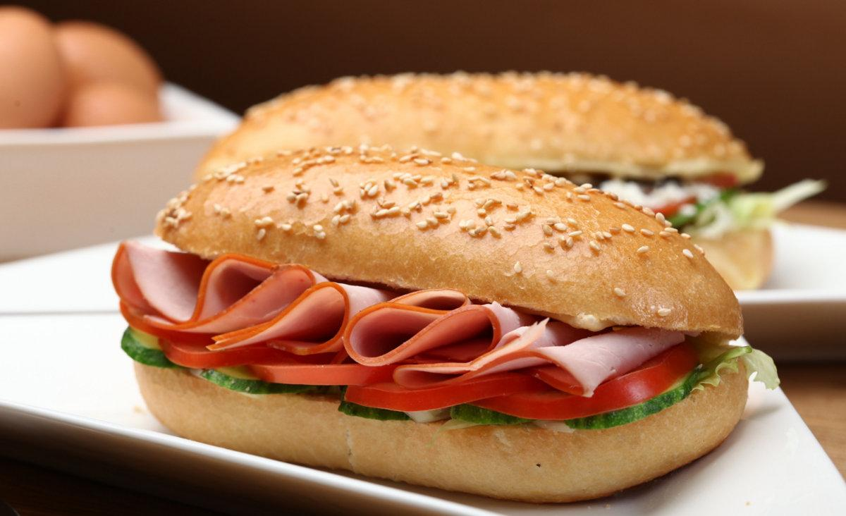

Slide 82
SANDWICH

Slide 83
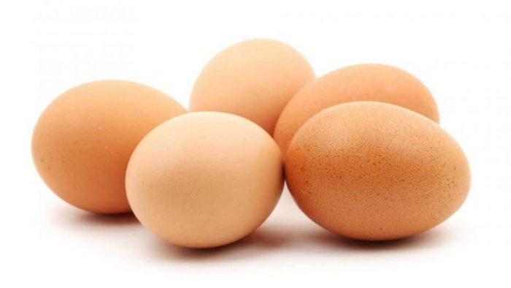

Slide 84
EGGS

Slide 85
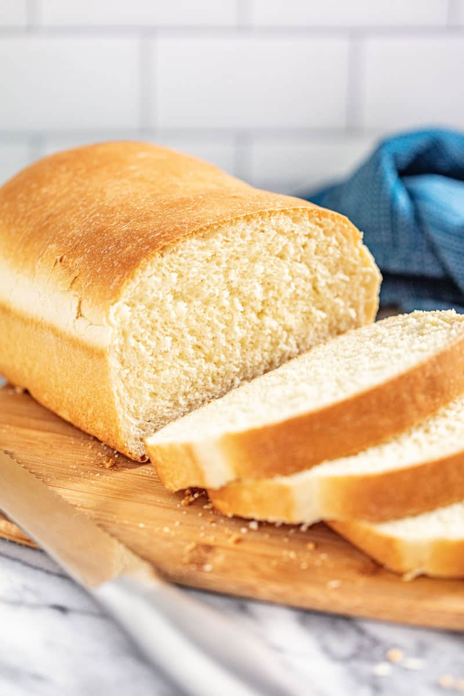

Slide 86
BREAD

Slide 87
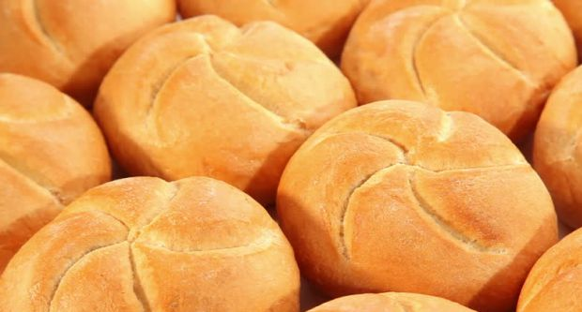

Slide 88
BREAD ROLLS

Slide 89
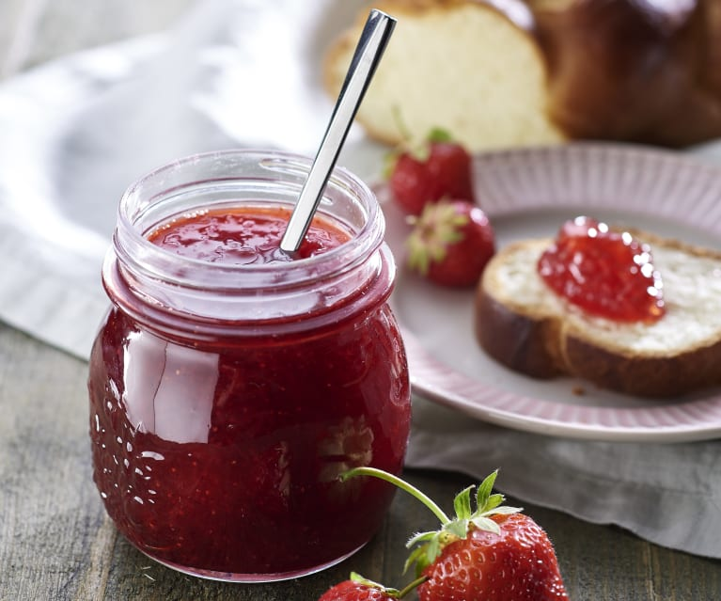

Slide 90
JAM

Slide 91


Slide 92
HONEY

Slide 93
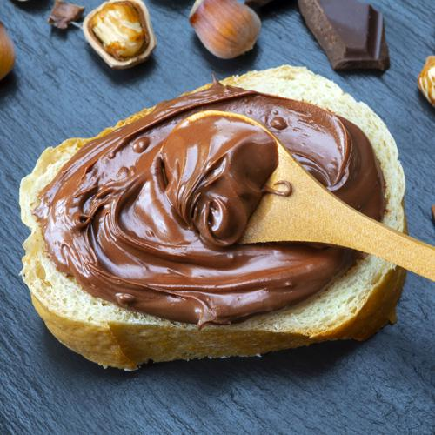

Slide 94
CHOCOLATE SPREAD

Slide 95
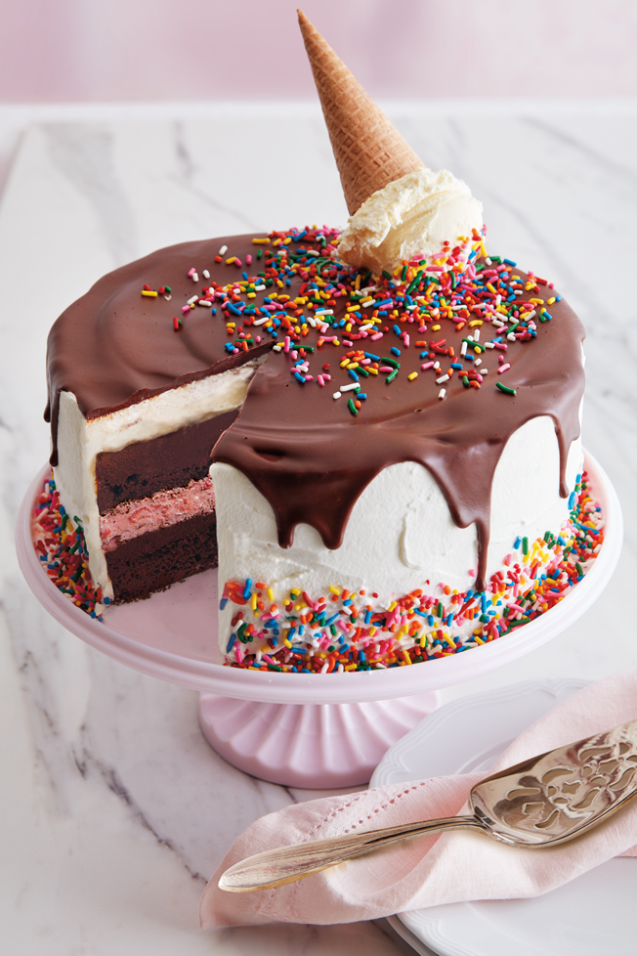

Slide 96
CAKE

Slide 97
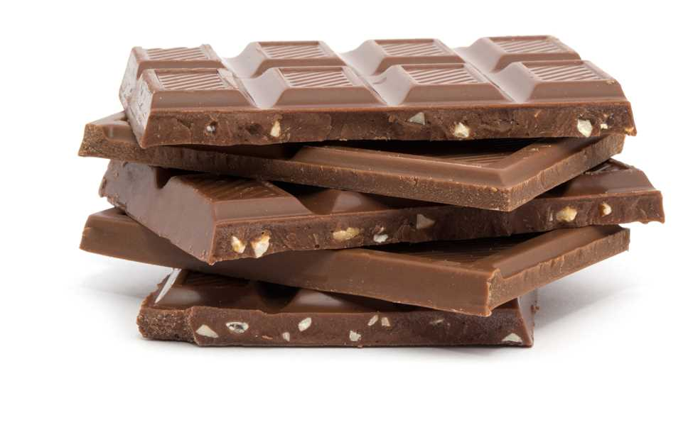

Slide 98
CHOCOLATE

Slide 99
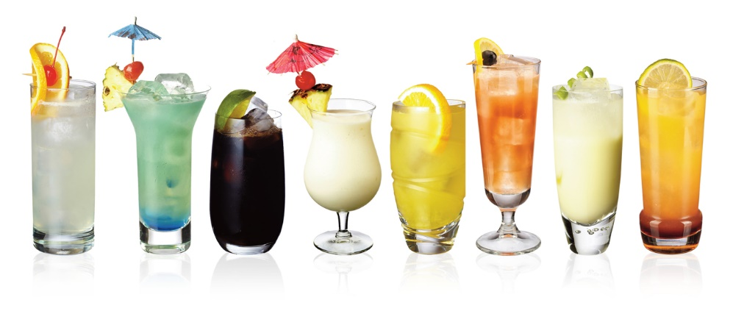
DRINKS

Slide 100


Slide 101
WATER

Slide 102
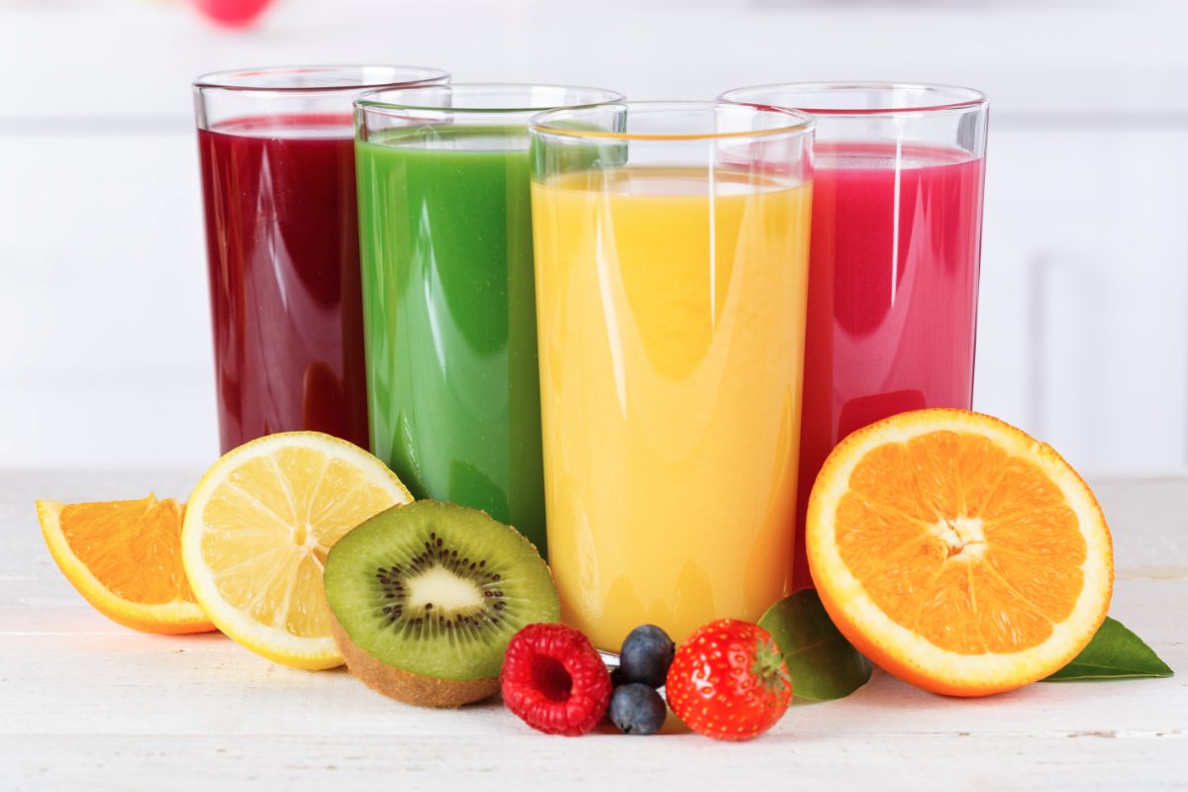

Slide 103
JUICE

Slide 104


Slide 105
SODA

Slide 106


Slide 107
TEA

Slide 108


Slide 109
HOT COCOA
HOT CHOCOLATE

Slide 110


Slide 111
COFFEE

