Slide 1
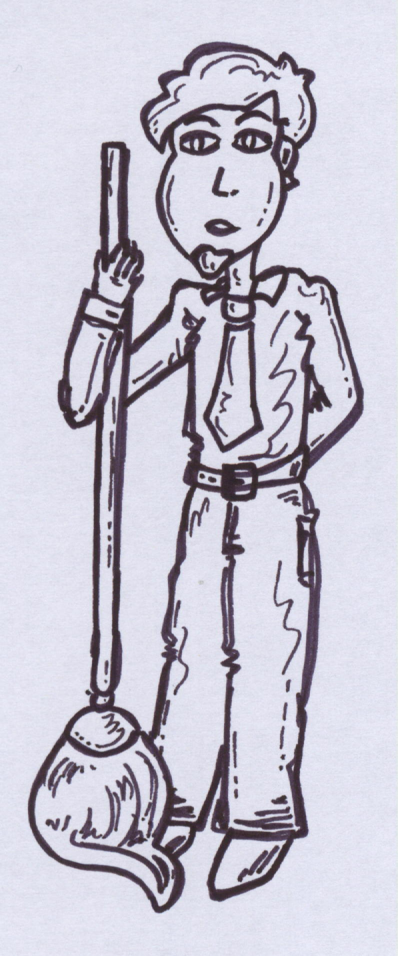
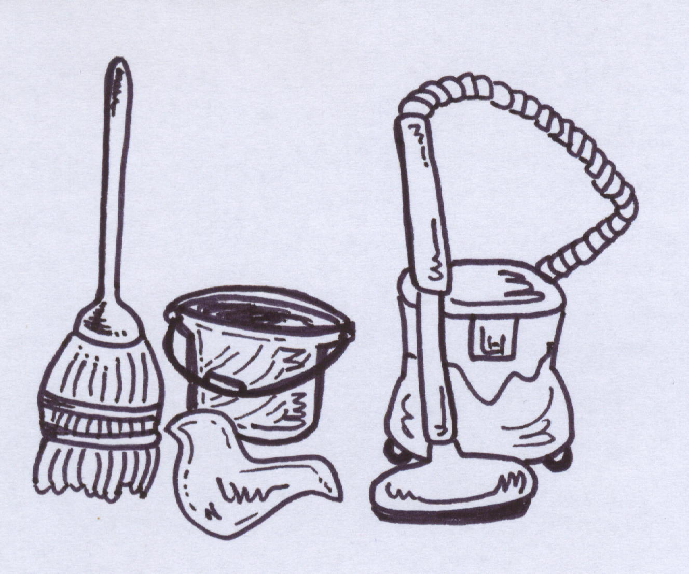
CLEANING
- a story about Mr Nelson -
by TLN

Slide 2
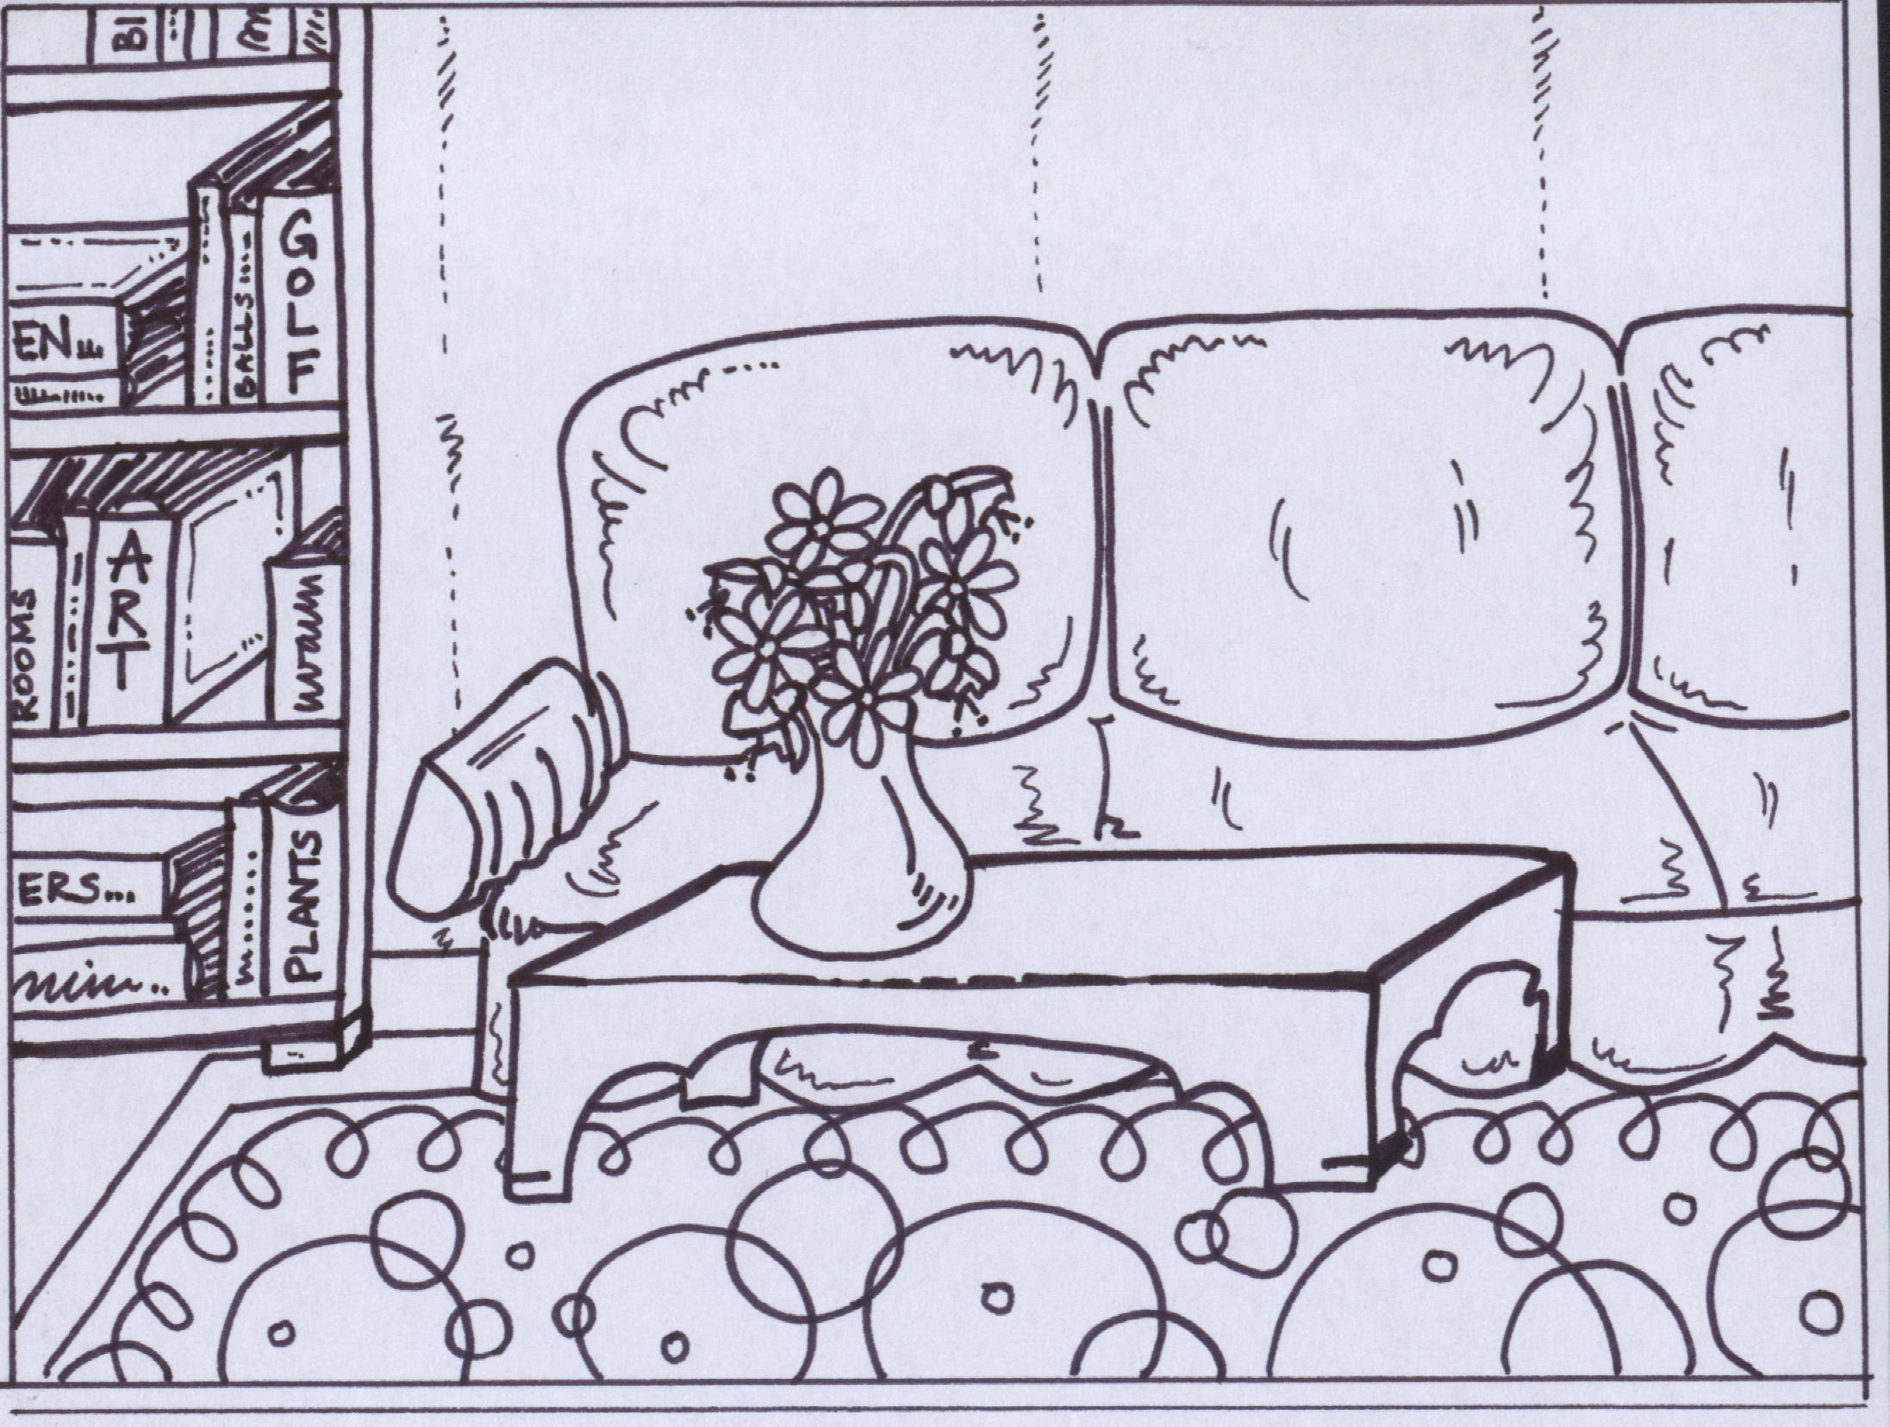
Mr. Nelson likes his home. He lives in a small village in a very small house at the end of the village. He cleans his home every day.
He starts cleaning his home in the sitting room. He cleans the big Persian rug. He cleans the dust on his brown table. He puts the books on the shelves in his bookcase. He puts some flowers in the vase and then he sits on his sofa for a moment to relax – to relax and have a look at his beautiful and clean sitting room. Everything is clean. Everything is in its place. Everything is perfect.

Slide 3
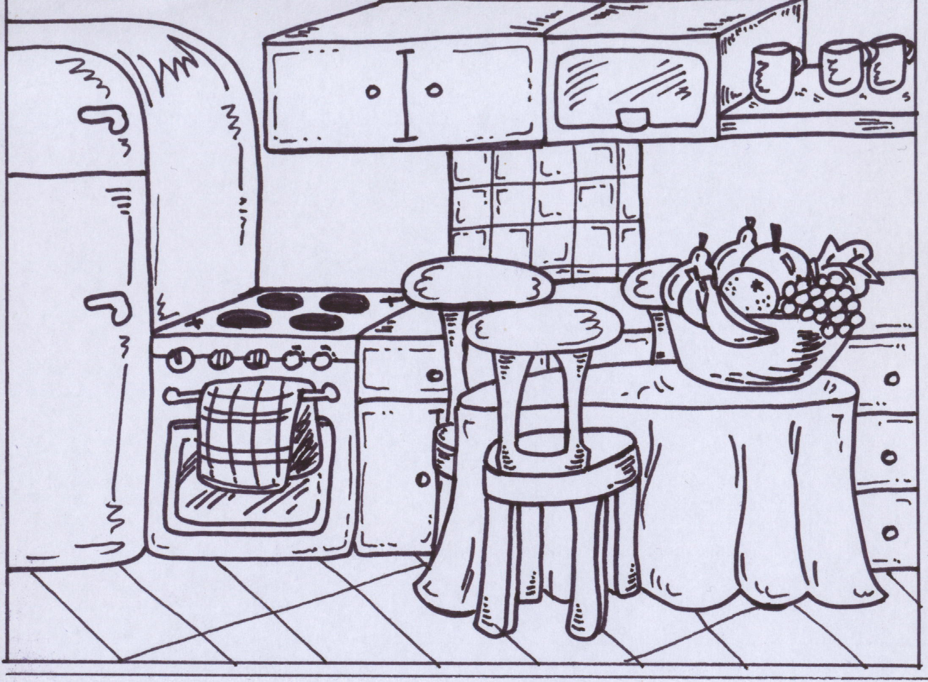
Then he goes in the kitchen. He puts pots and pans in the cupboards. He cleans the cooker. He puts the three chairs on the dining table and then he vacuums under the table. When the vacuuming is finished, he puts the three chairs around the table and puts a bowl of fruit on the dining table. He stops and looks at his kitchen.
Everything is clean. Everything is in its place. Everything is perfect.

Slide 4
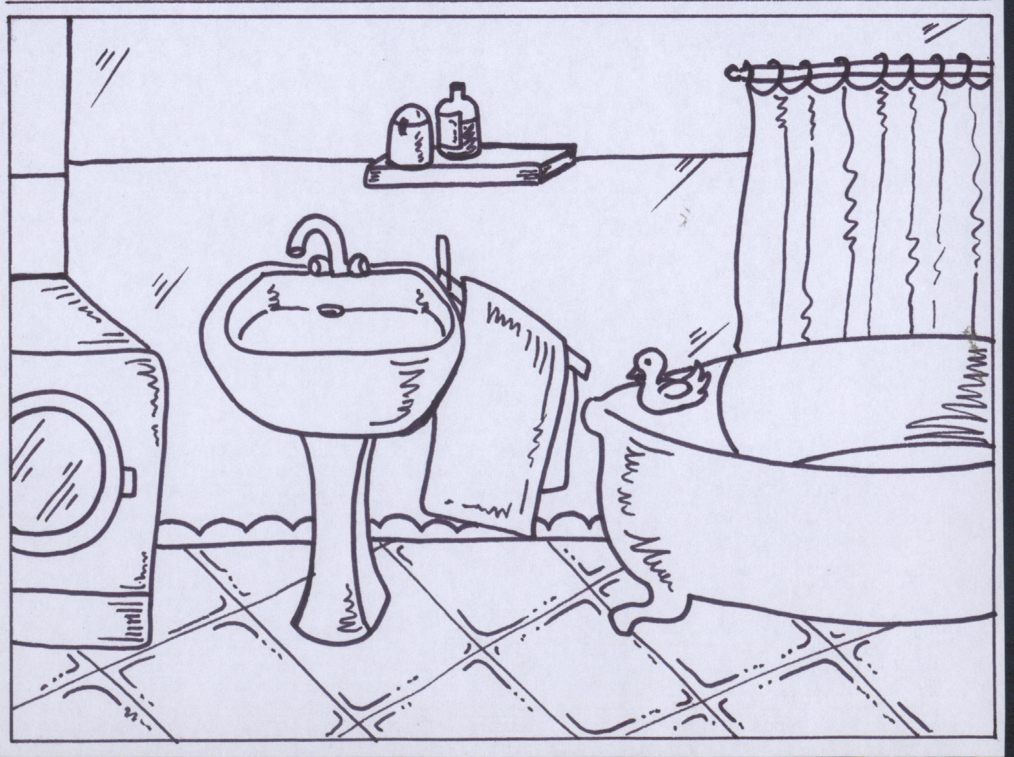
The bathroom is next. He cleans the floor. He puts the clothes in the washing machine and changes the towels. He puts the rubber duck on the bath. He puts the small rug in front of the bath. Then he has a look at his clean and tidy bathroom.
Everything is clean. Everything is in its place. Everything is perfect.

Slide 5
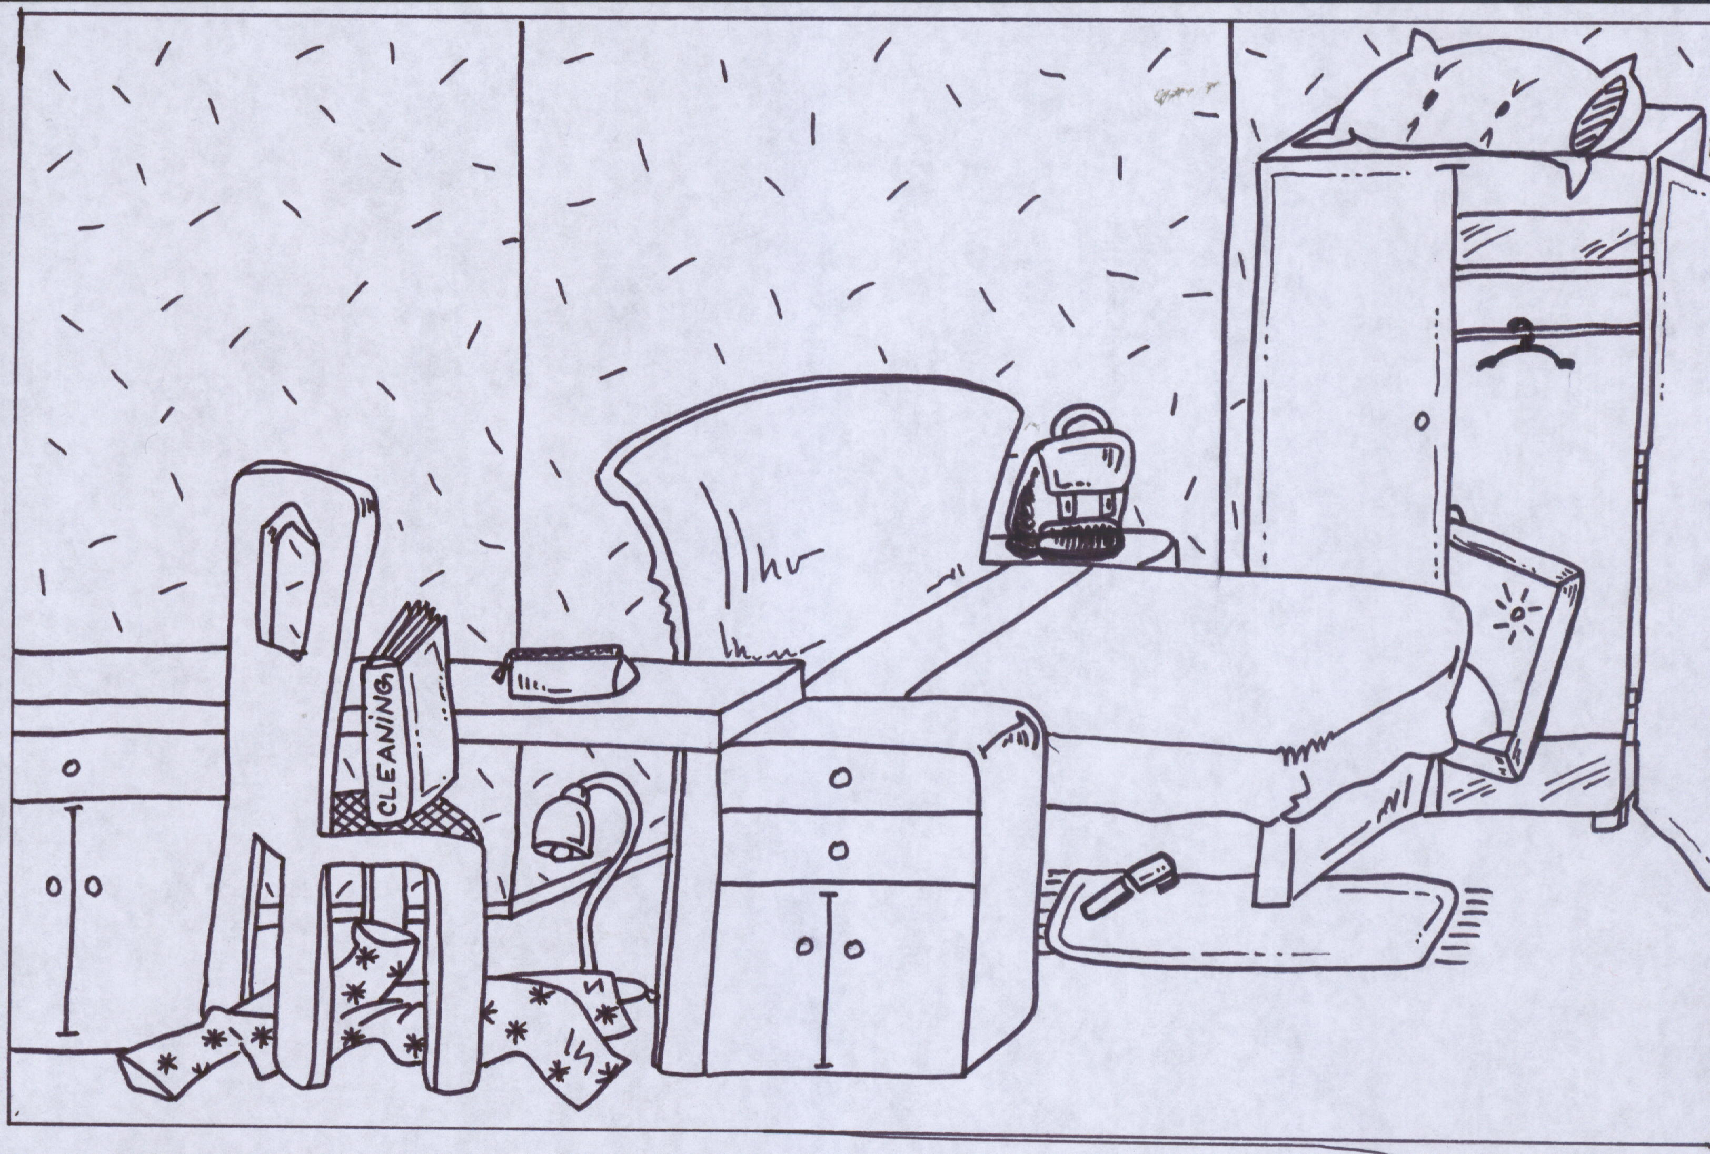
When he comes to his bedroom, he starts his work by picking things up. There is a pen under the bed. He picks it up and puts it on the table. But that’s not all. Look at this room. It’s a mess! Things are not where they should be. Oh, dear. There is a bag on the cupboard. There is a lamp under the table. The pillow is on the wardrobe. Mr. Nelson’s favourite book is on the chair. His pyjamas are under the chair. Oh, and there is a painting in the wardrobe.

Slide 6
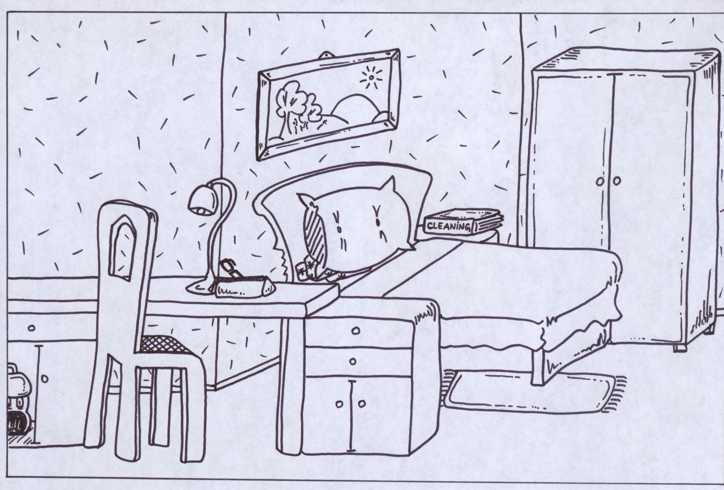
Let’s help Mr. Nelson. Let’s tell him where things are.
Where is the pen?
“The pen is in the pencil-case on the table.”
Where is the bag?
“The bag is in the cupboard under the table.”
Where is the lamp?
“The lamp is on the table.”
Where is the painting?
“The painting is on the wall. His bed is under the painting.”
Where is his pillow?
“The pillow is on the bed.”
Where is his favourite book?
“The book is on the cupboard next to the bed.”
Where are his pyjamas?
“His pyjamas are under the pillow on the bed.”

Slide 7
That’s that. Everything is in its place, now.
Mr. Nelson cleans the dust on the table, wardrobe, chair, cupboards and bed. He vacuums the rug. Then he sits on the chair for a moment to rest – to rest and have a look at his lovely and clean bedroom. Everything is clean. Everything is in its place. Everything is perfect.

Slide 8
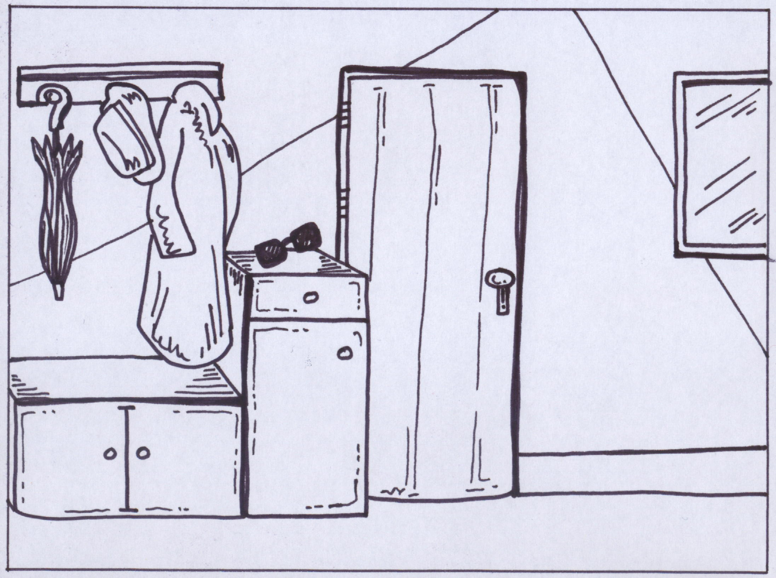
Now, it’s time to clean the hall, too. He cleans the dust. There are three hooks above the cupboards. He puts his umbrella on the first hook. He puts his hat on second hook and his coat on the third hook. He puts his shoes in the cupboard. He puts his sunglasses on the cupboard. He cleans the floor. He cleans the windows and the doors, too. When he finishes his work, he cleans the brooms, the cloth and the vacuum cleaner.

Slide 9
What does Mr. Nelson clean every day?
“His home. His whole house.”
Which rooms are clean, now?
“All the rooms – the sitting room, the kitchen, the bathroom, the bedroom and the hall.”
Which room was a mess?
“His bedroom was really messy. It’s clean now. Everything is clean. Everything is in its place. Everything is perfect.”
Mr. Nelson likes cleaning. He likes his home clean and tidy.

Slide 10
TEST YOUR MEMORY
Look at PICTURE A and PICTURE B. Find and describe 7 DIFFERENCES.
A B

