Slide 1
MY BEDROOM

Slide 2
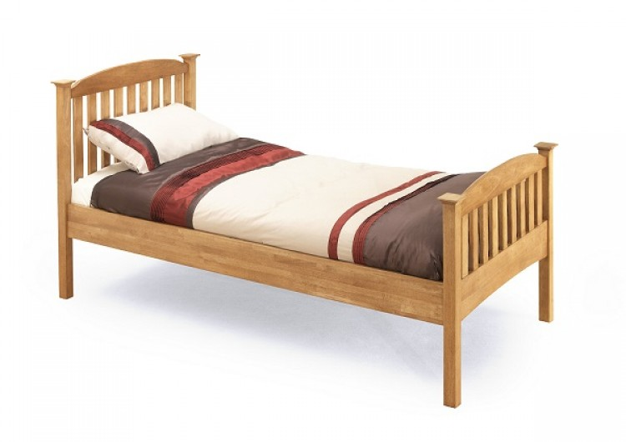

BED

Slide 3
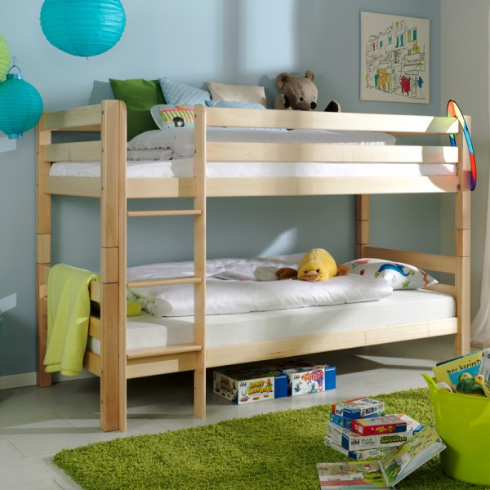
BUNK
BED

Slide 4
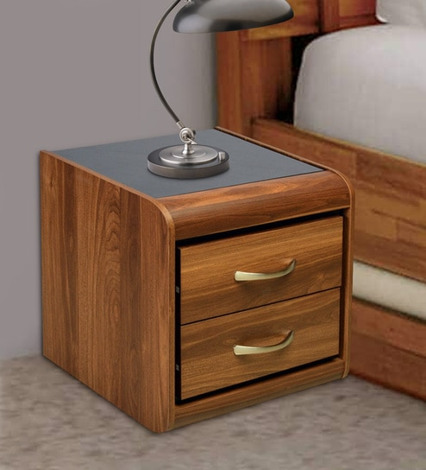
BEDSIDE
TABLE

Slide 5
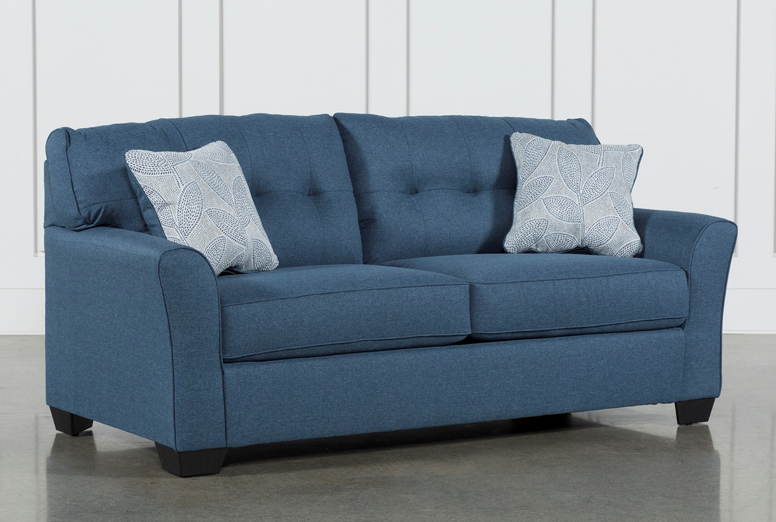
SOFA

Slide 6
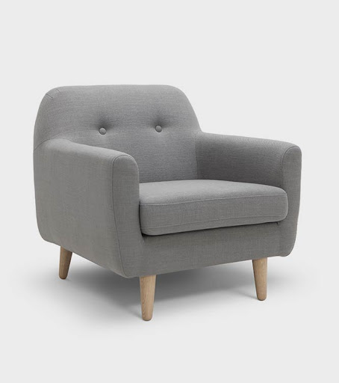
ARMCHAIR

Slide 7
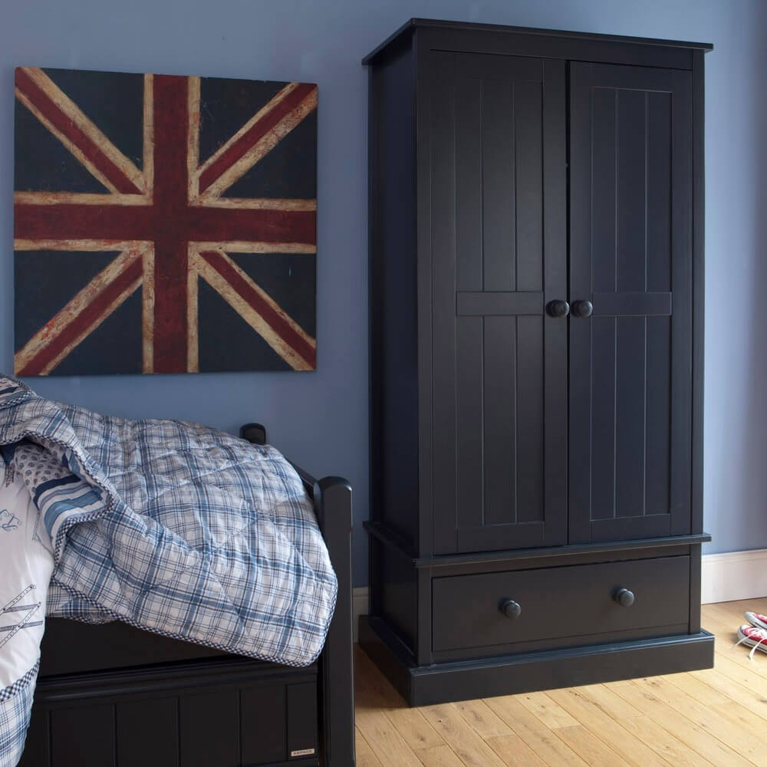
WARDROBE or
CLOSET

Slide 8
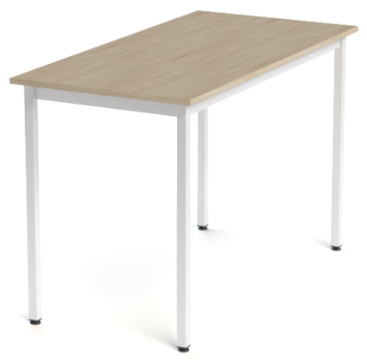
TABLE

Slide 9
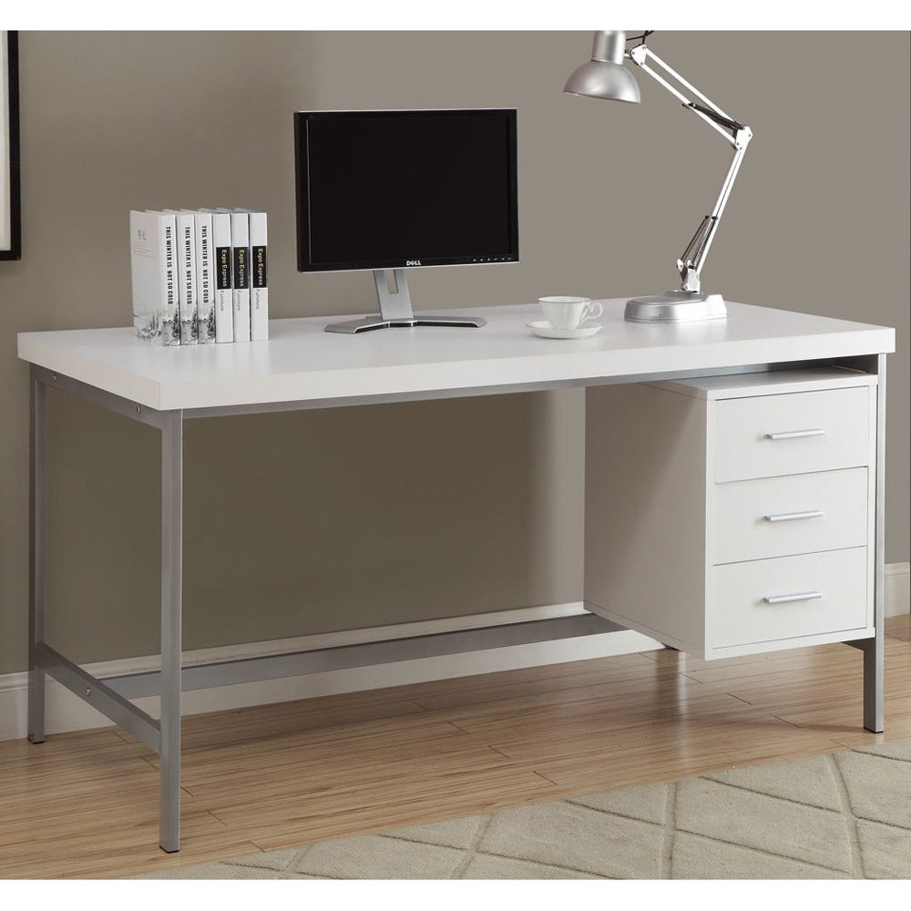
DESK

Slide 10
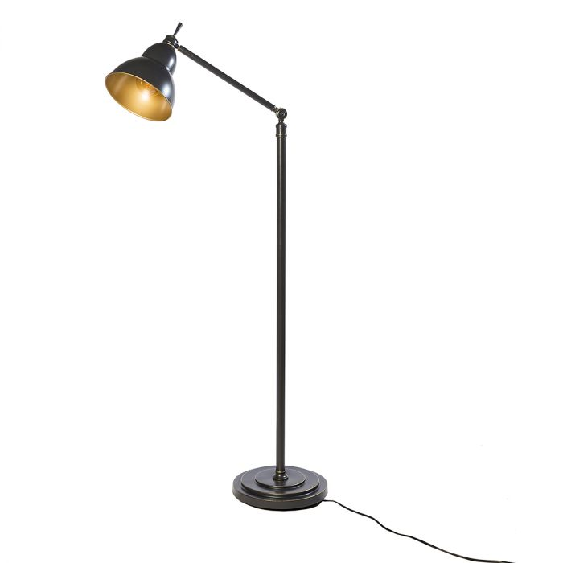
LAMP

Slide 11
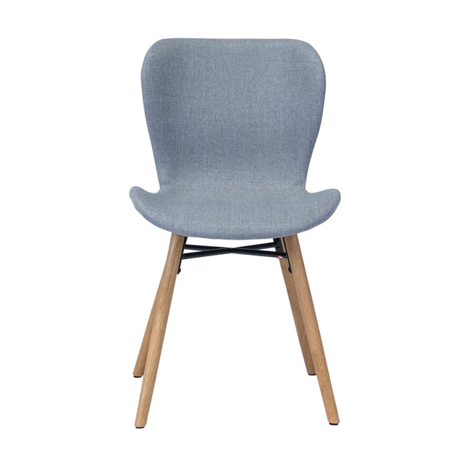
CHAIR

Slide 12
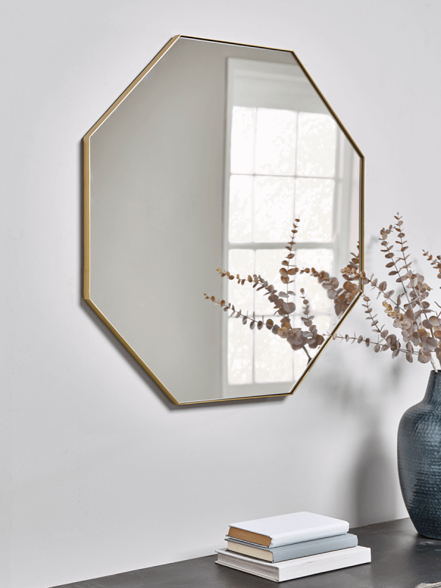
MIRROR

Slide 13
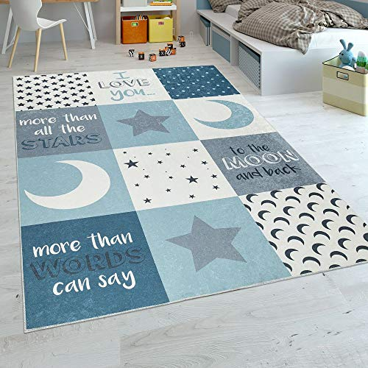
MAT or RUG

Slide 14
PLACES IN A HOUSE / FLAT

Slide 15
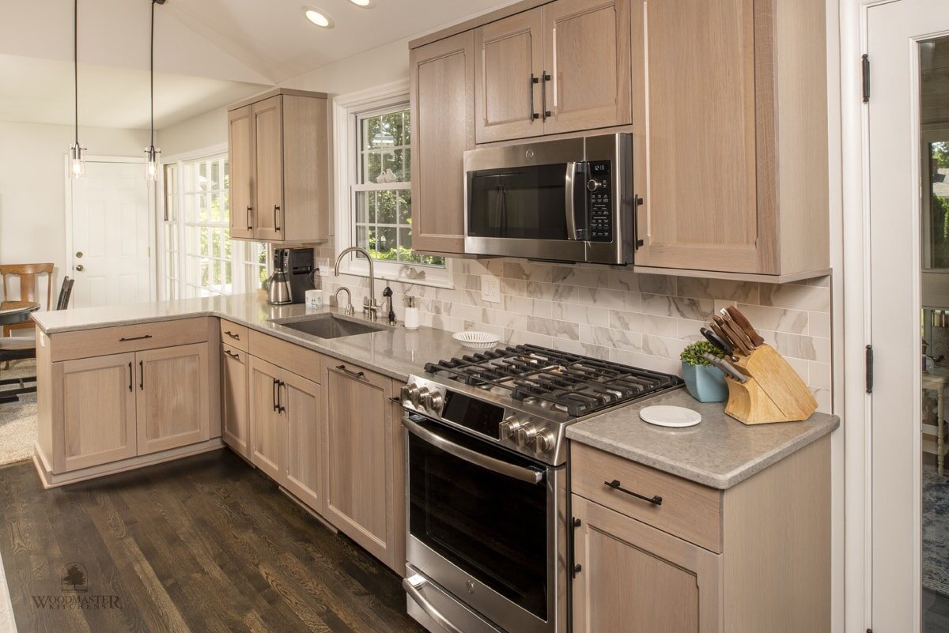

Slide 16
KITCHEN

Slide 17
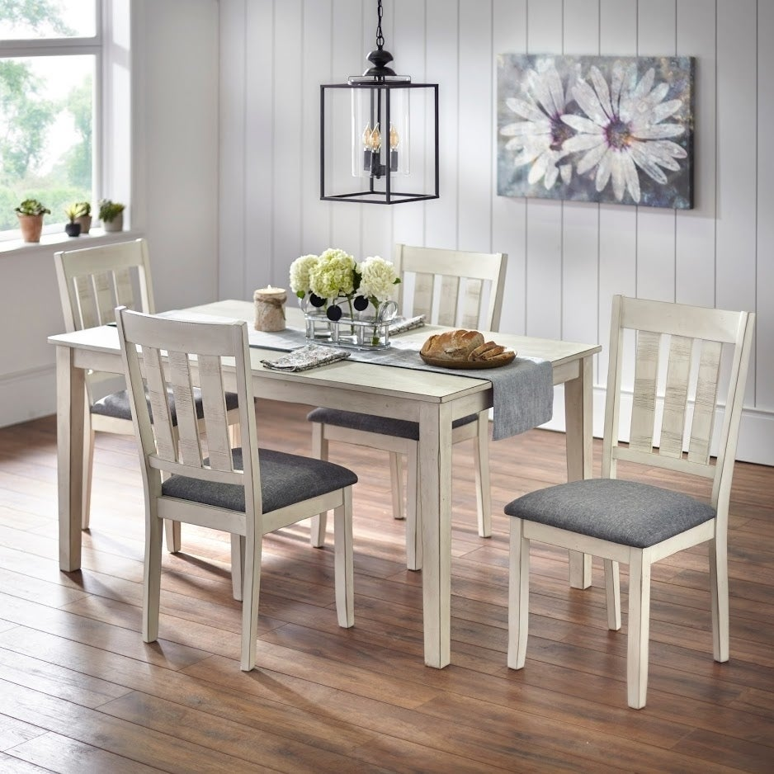

Slide 18
DINING ROOM

Slide 19
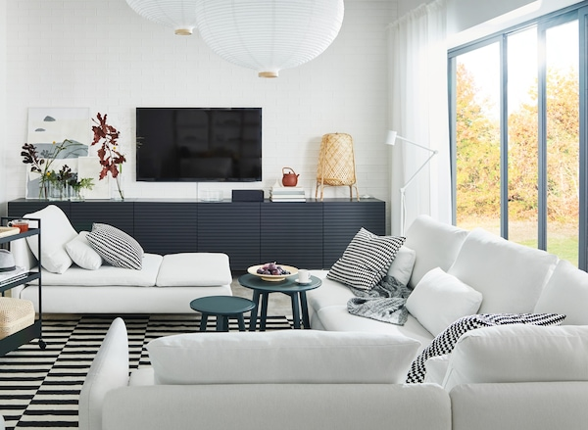

Slide 20
LIVING ROOM

Slide 21
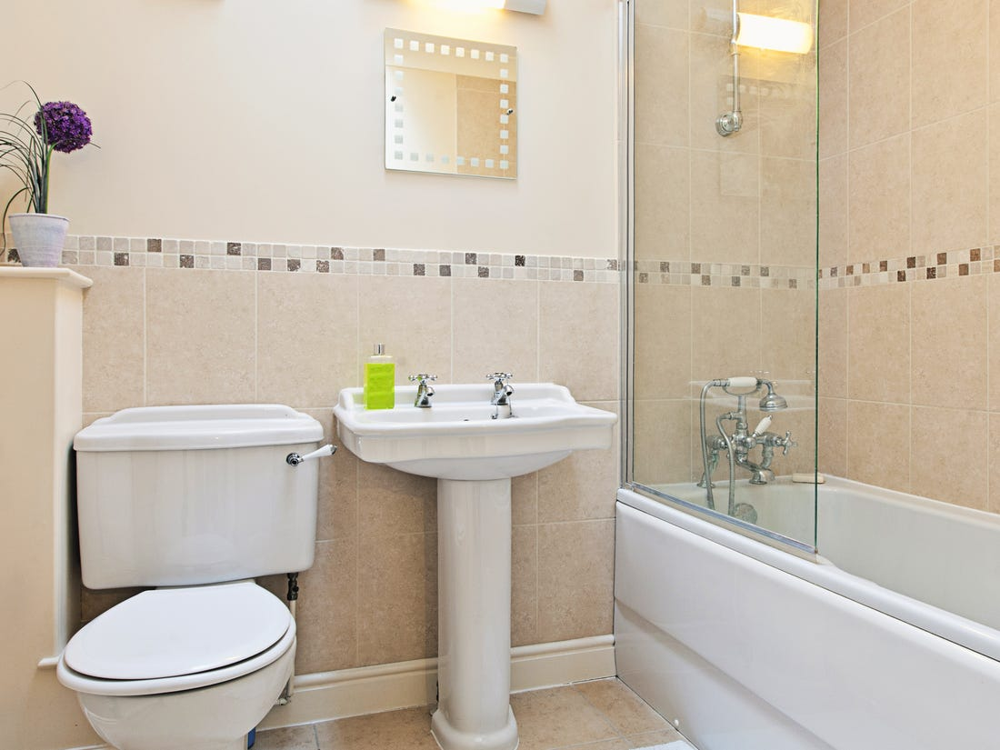

Slide 22
BATHROOM

Slide 23
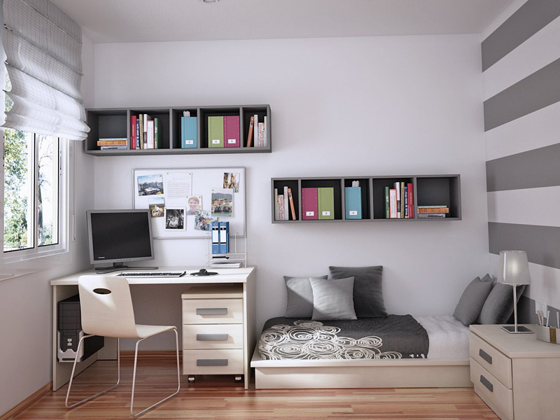

Slide 24
BEDROOM

Slide 25
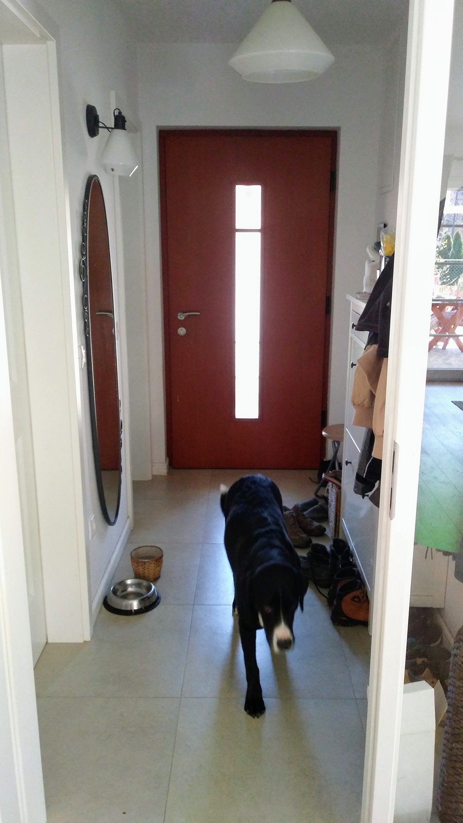

Slide 26
ENTRANCE HALL

Slide 27
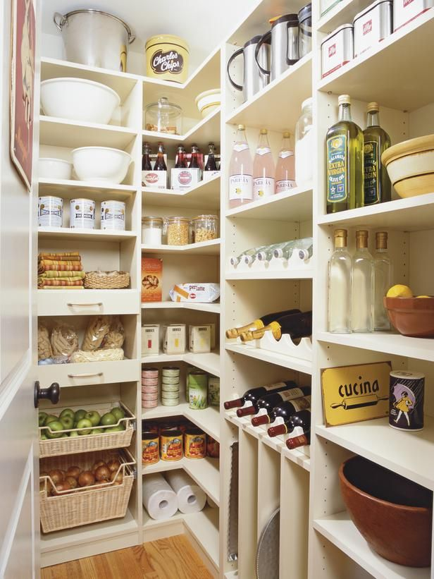

Slide 28
PANTRY

Slide 29
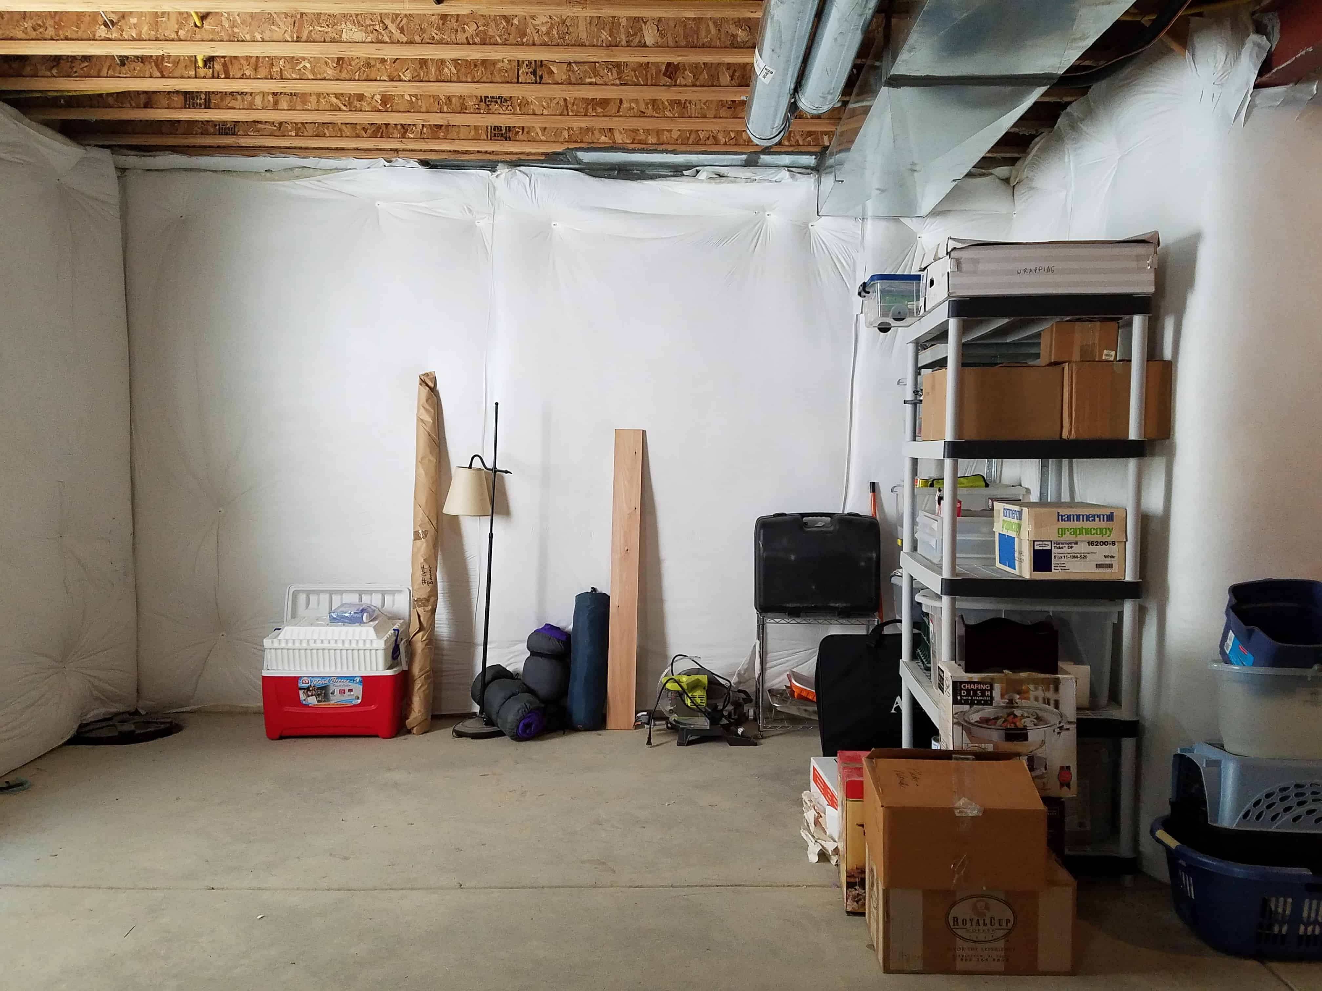

Slide 30
BASEMENT

Slide 31
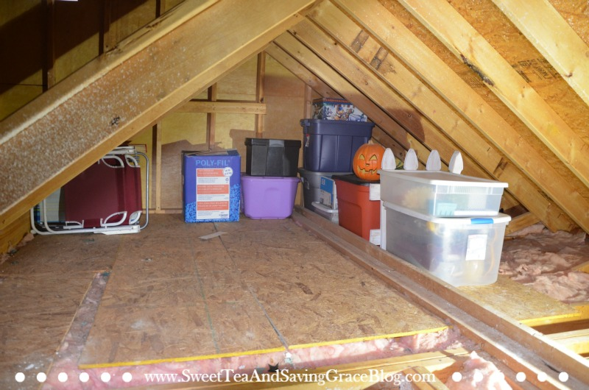

Slide 32
ATTIC

Slide 33


Slide 34
GARAGE

Slide 35
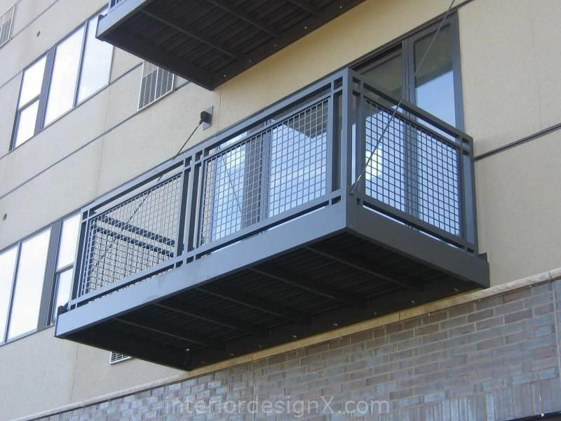

Slide 36
BALCONY

