Slide 1

Good morning, children! How are you today?
I‘m fine, thank you.
Let‘s start today by singing a song. You all know this song.
Click on the link below, sing and dance along.
(Klikni, zapoj in zapleši zraven.)
https://www.youtube.com/watch?v=XqZsoesa55w

Slide 2

Zdaj pa te čaka nekaj nalog …
YOU NEED YOUR BOOK, NOTEBOOK AND YOUR PENCIL CASE.

Slide 3
THE ENORMOUS CARROT
Open your book on page 72, exercise 22.
Copy the words in your notebook and translate them (prepiši besede v zvezek in jih prevedi).

Slide 4
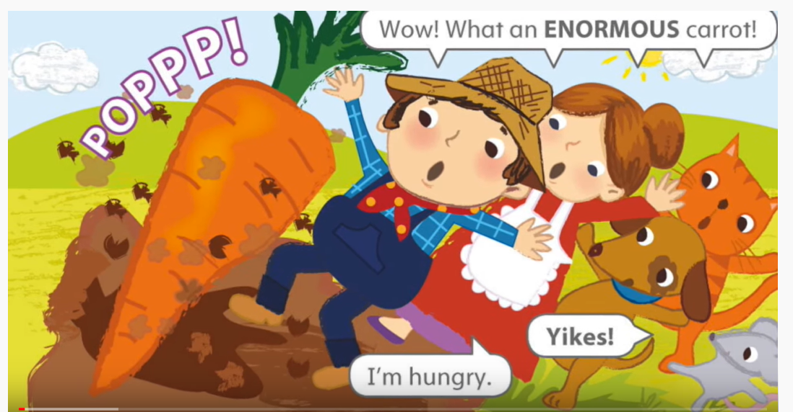
Oglej si zgodbo
The enormous carrot
https://www.youtube.com/watch?v=jS4HesLKxSc

Slide 5
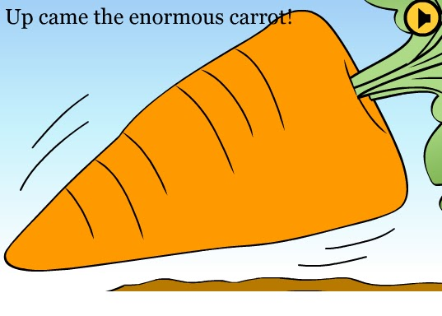
Time for practice ☺
(čas za vajo )
Klikni na The enormous carrot exercises in reši vaje.

Slide 6
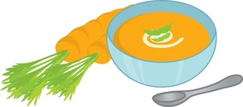
To je vse za danes. Če imaš doma korenček ali dva, prosi koga od odraslih in skupaj skuhajte korenčkovo juho.
Pa dober tek ☺

