Slide 1
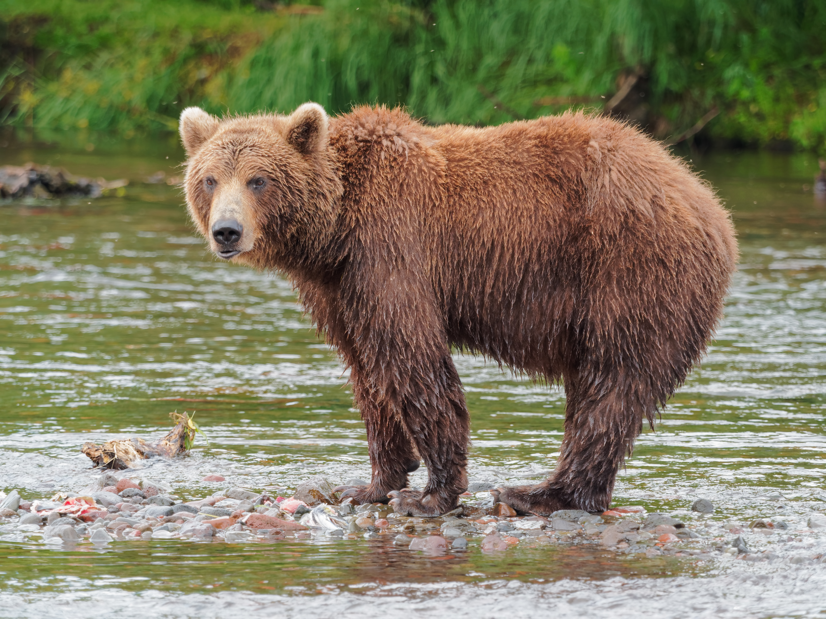
A BEAR https://www.youtube.com/watch?v=OejB2cVm4eA

Slide 2
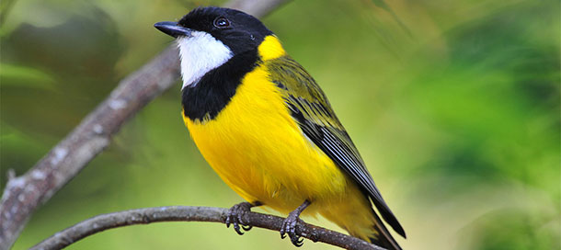
A BIRD https://www.youtube.com/watch?v=G8wzDKKp-bk

Slide 3
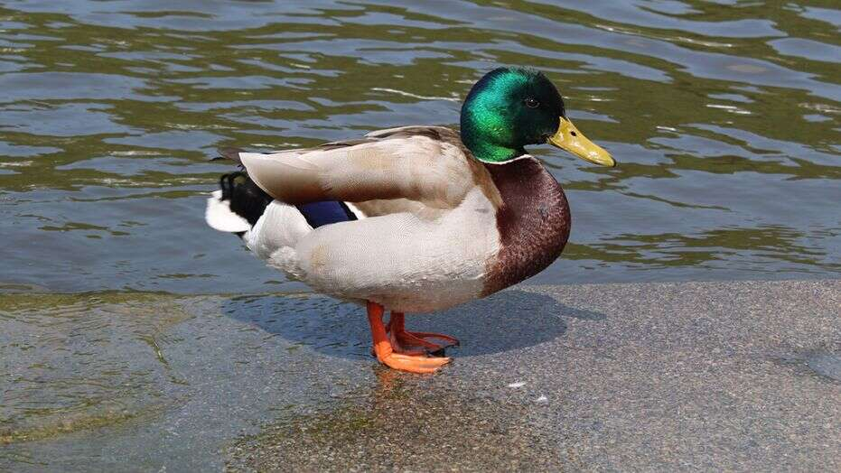
A DUCK https://www.youtube.com/watch?v=k_84jn8-cNM

Slide 4
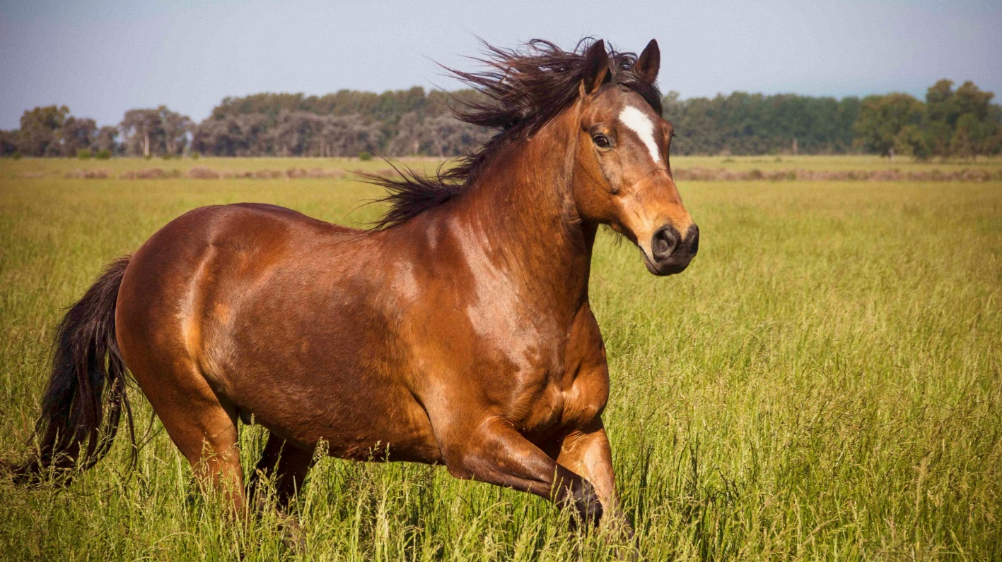
A HORSE https://www.youtube.com/watch?v=NzneAuRBamE

Slide 5
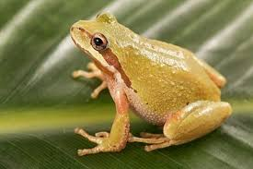
A FROG https://www.youtube.com/watch?v=t5wHrlvo0HI

Slide 6
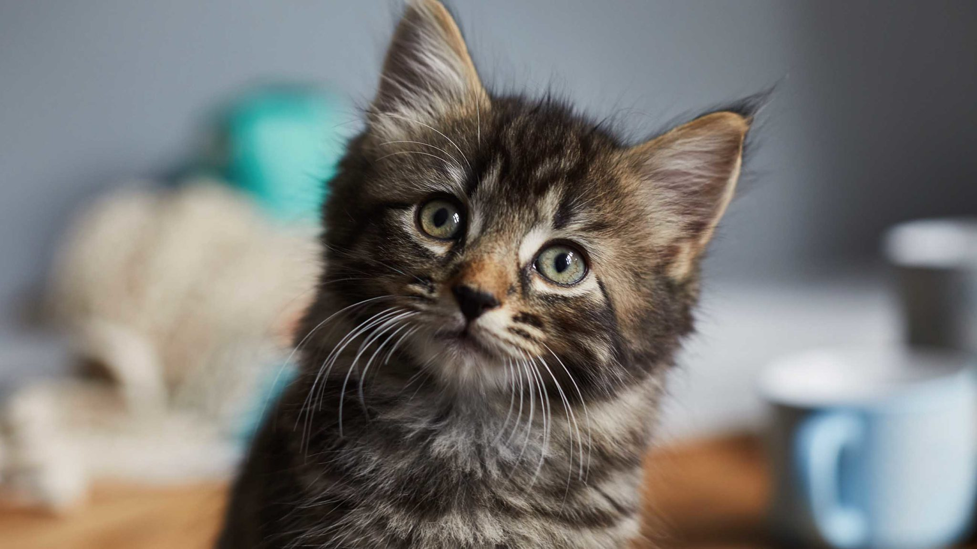
A CAT https://www.youtube.com/watch?v=IctwlBDPy-Y

Slide 7
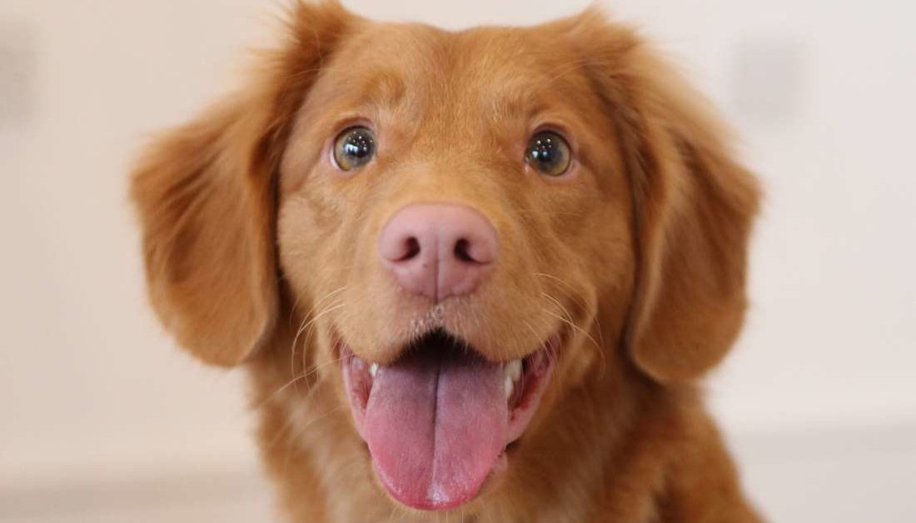
A DOG https://www.youtube.com/watch?v=hsK7C9waBcg

Slide 8
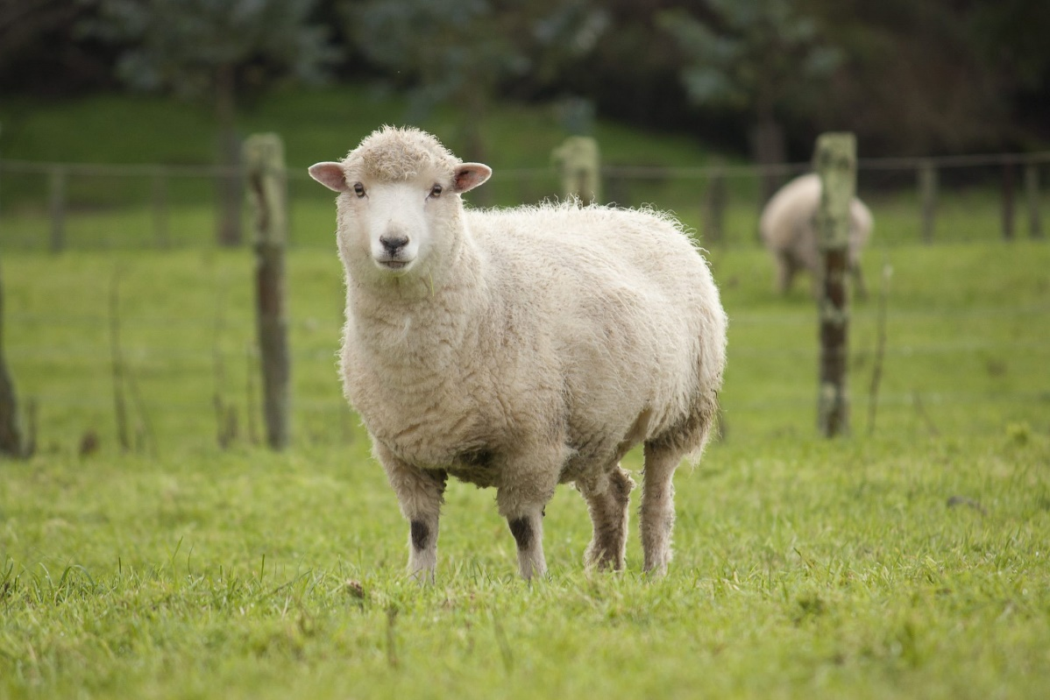
A SHEEP https://www.youtube.com/watch?v=_mihD3lTR6M

Slide 9
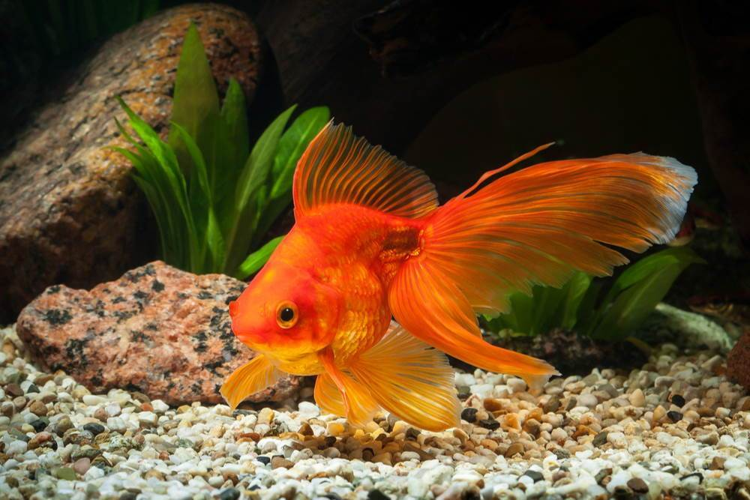
A GOLDFISH https://www.youtube.com/watch?v=1Iwg1vjZT6A

Slide 10
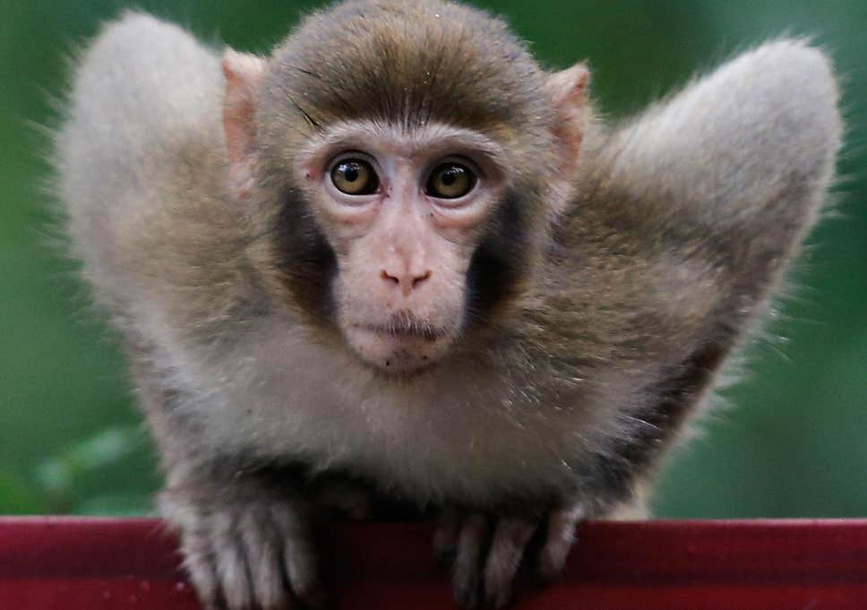
A MONKEY https://www.youtube.com/watch?v=oh_PaK3amas

