Slide 1
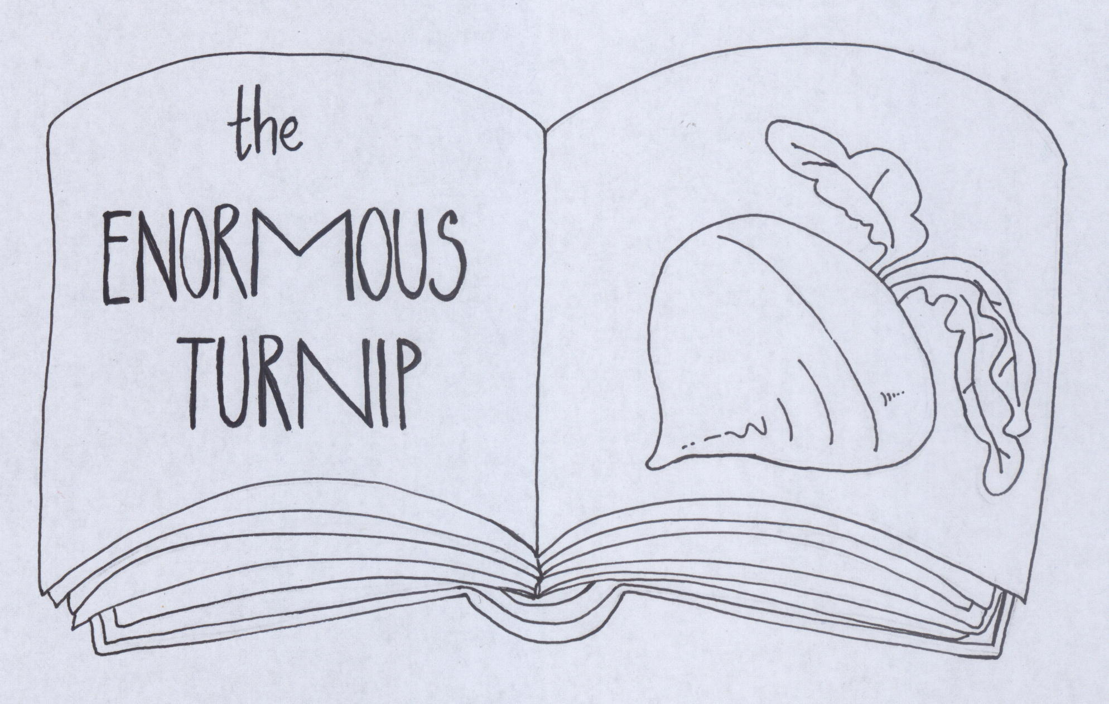
Alexei Tolstoy
Adapted by: ŠPELA HRIBAR MAGLIĆ & TJAŠA LEMUT NOVAK
Illustrated by: TJAŠA LEMUT NOVAK & ŠPELA HRIBAR MAGLIĆ

Slide 5
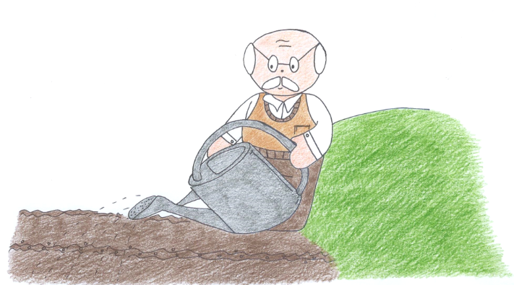
HE WATERS THE SEEDS.

Slide 15
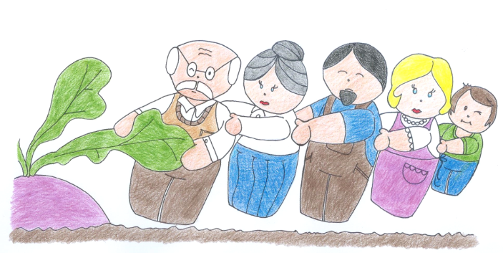
SO, MUM SAYS TO BROTHER: »COME AND PULL WITH US«.
GRANDPA, GRANDMA, DAD, MUM AND BROTHER PULL THE TURNIP TOGETHER. »HEAVE-HO, HEAVE-HO!« BUT THEY CANNOT PULL IT UP.

Slide 20
