Slide 1
WHAT‘S IN THE PICTURE?
(Kaj je na sliki?)

Slide 2
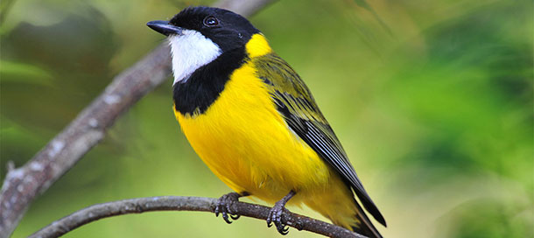
https://www.youtube.com/watch?v=G8wzDKKp-bk

Slide 3
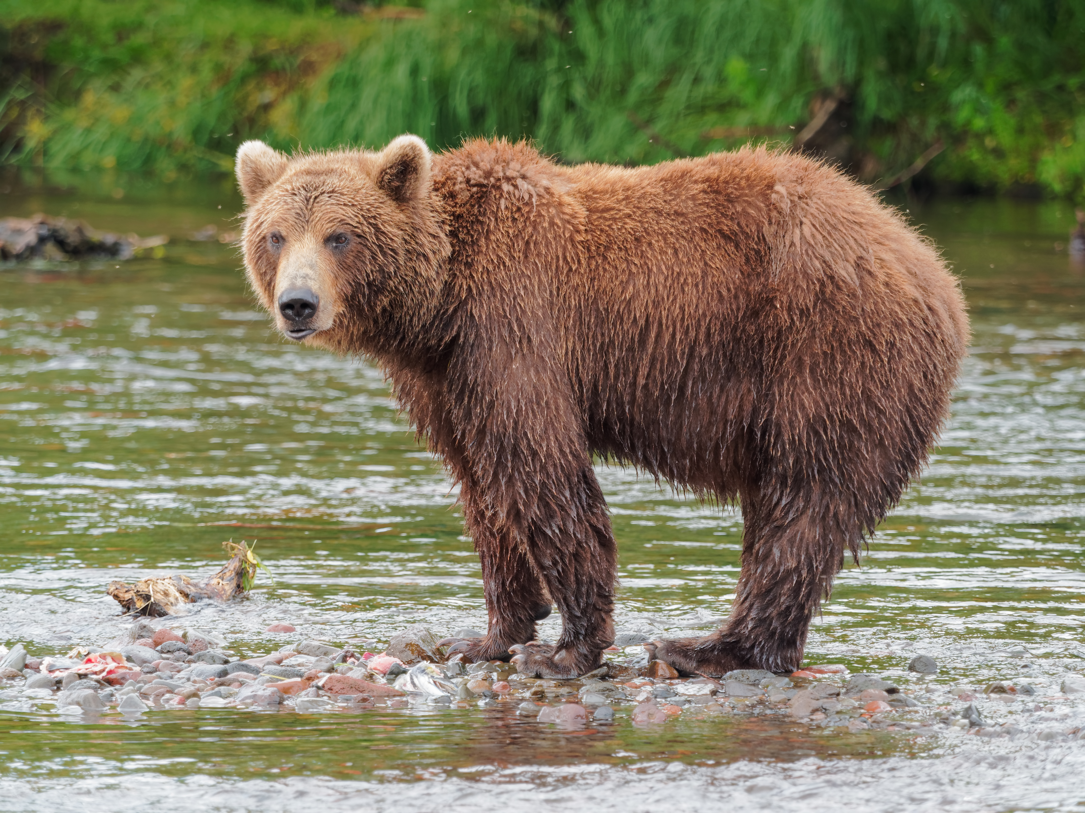
https://www.youtube.com/watch?v=OejB2cVm4eA

Slide 4

https://www.youtube.com/watch?v=IctwlBDPy-Y

Slide 5
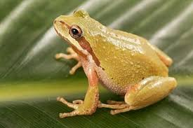
https://www.youtube.com/watch?v=t5wHrlvo0HI

Slide 6
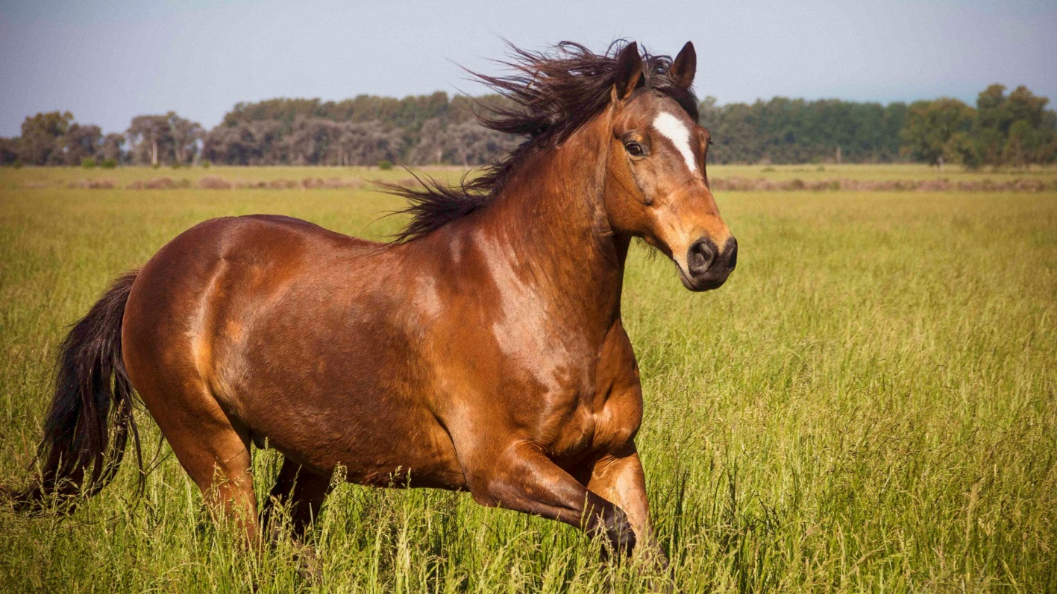
https://www.youtube.com/watch?v=NzneAuRBamE

Slide 7

https://www.youtube.com/watch?v=hsK7C9waBcg

Slide 8
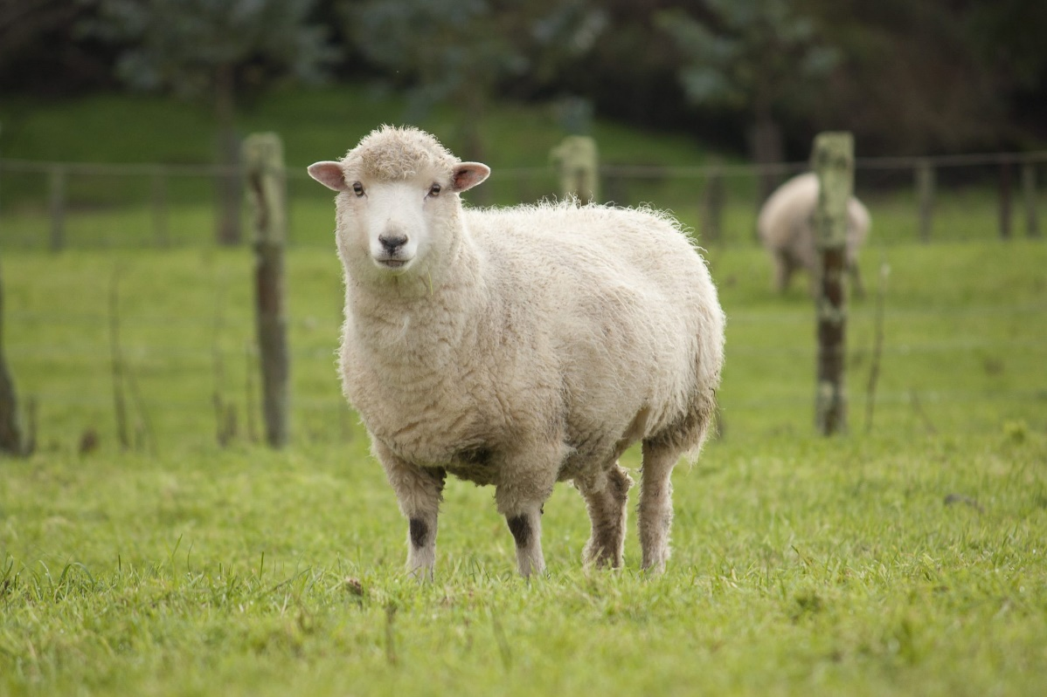
https://www.youtube.com/watch?v=_mihD3lTR6M

Slide 9
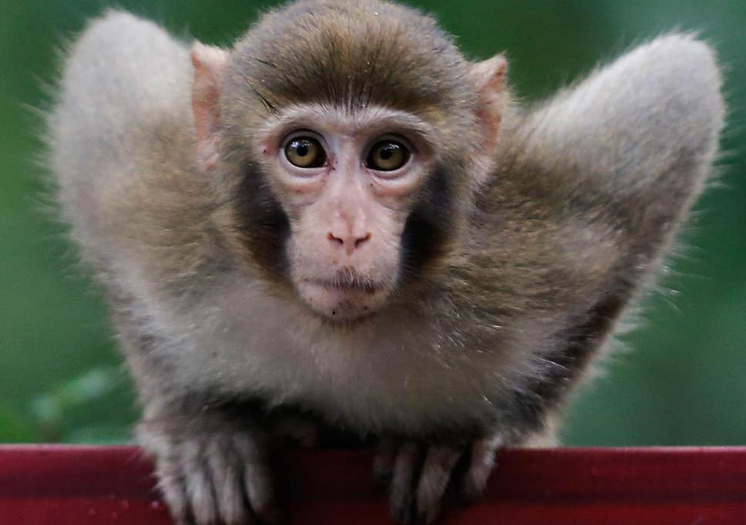
https://www.youtube.com/watch?v=oh_PaK3amas

Slide 10
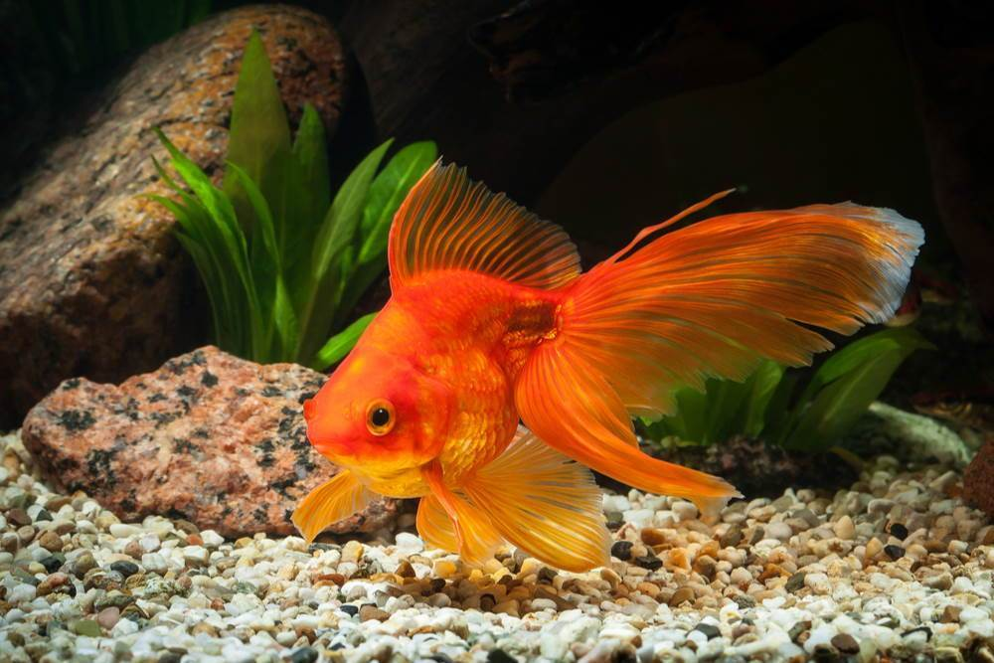
https://www.youtube.com/watch?v=1Iwg1vjZT6A

Slide 11
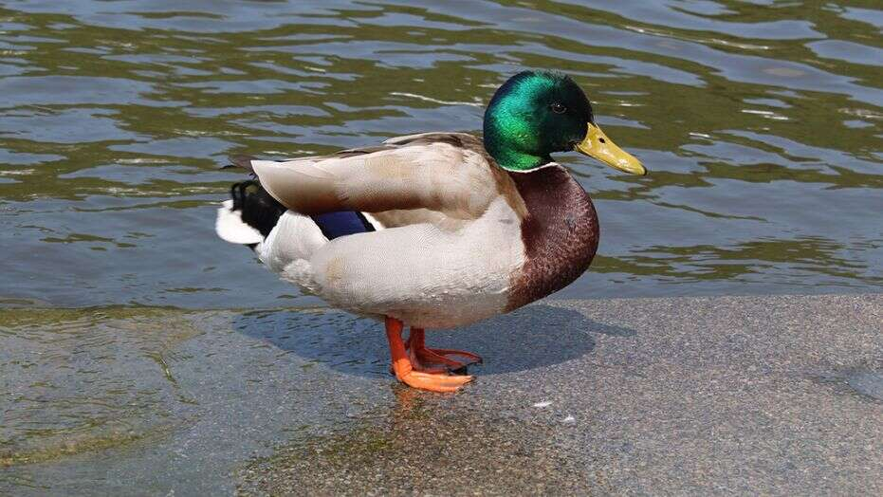
https://www.youtube.com/watch?v=k_84jn8-cNM

