Slide 1
ADJECTIVES IN –ed and –ing
PRIDEVNIKI NA –ED in –ING

Slide 2
ADJECTIVES ENDING IN -ED
… describe FEELINGS (= opisujejo OBČUTKE):
I am excied about the party at the weekend. (navdušen sem)
He‘s bored with his job. (zdolgočasen je)
She‘s not interested in cars. (se ne zanima)
They are tired working in the garden. (utrujeni so)
You are satisfied with your work. (zadovoljen si)

Slide 3
ADJECTIVES ENDING IN -ING
… describe the THING that causes that feeling in a person (=opisujejo stvari, ki povzročijo občutke pri ljudeh):
Have you seen the exciting new movie about the aliens? (razburljiv film)
He‘s job is boring. (dolgočasna služba)
The book is interesting. (zanimiva knjiga)
That work is tiring. (utrujajoče delo)
Your work is satisfying. (zadovoljujoče delo)

Slide 4
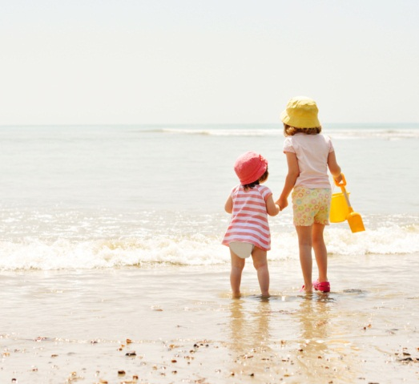
Compare (=primerjaj)
We had a relaxing holiday.
Good driving instructors have a relaxed manner.
That was a satisfying meal.
The airline has many satisfied customers.

Slide 5
Complete (=dopolni)
When we went to Disneyland we found it more ____________ (amuse) than our parents.
It can be very ___________ (irritate) when friends arrive late for a film.
You‘ll never get ___________ (bore) at night in Berlin beacuse the nightlife is wonderful.
The situation was very ___________ (embarras) for me and I felt uncomfortable.

