Slide 1
Brown bear, brown bear what do you see?
1. razred

Slide 2
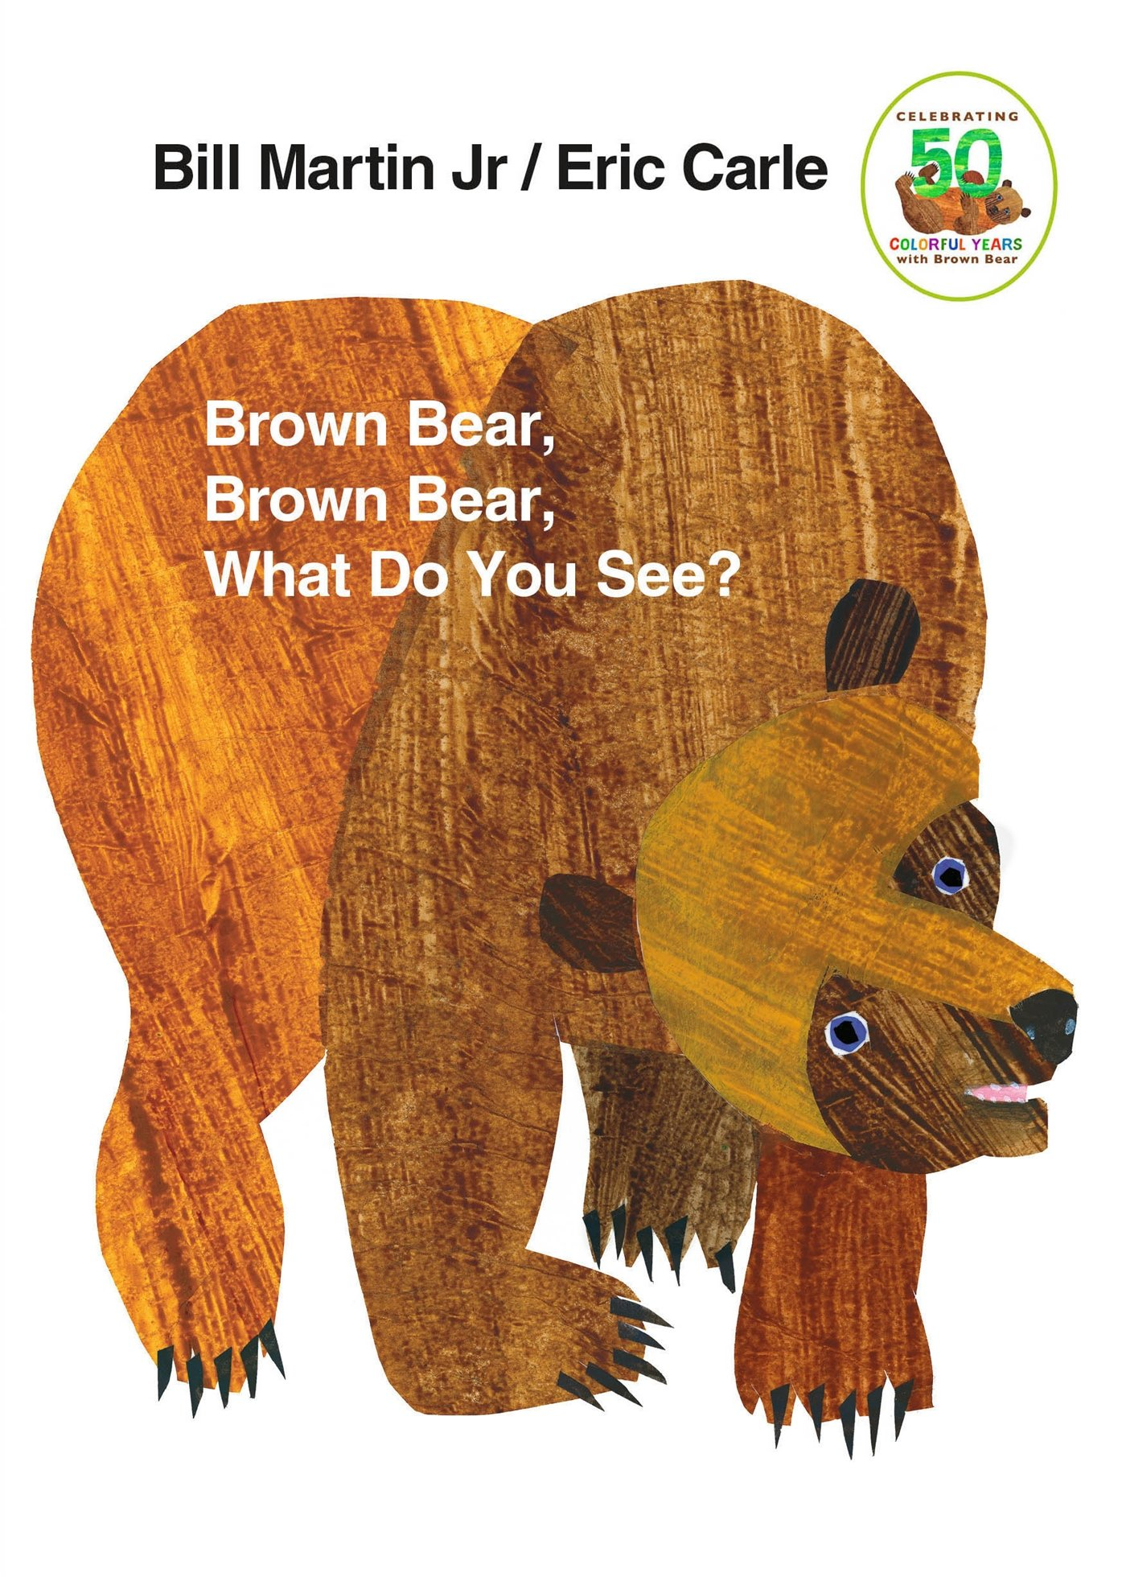
Brown bear, brown bear what do you see?
https://www.youtube.com/watch?v=HaDDsT9IAWc

Slide 3
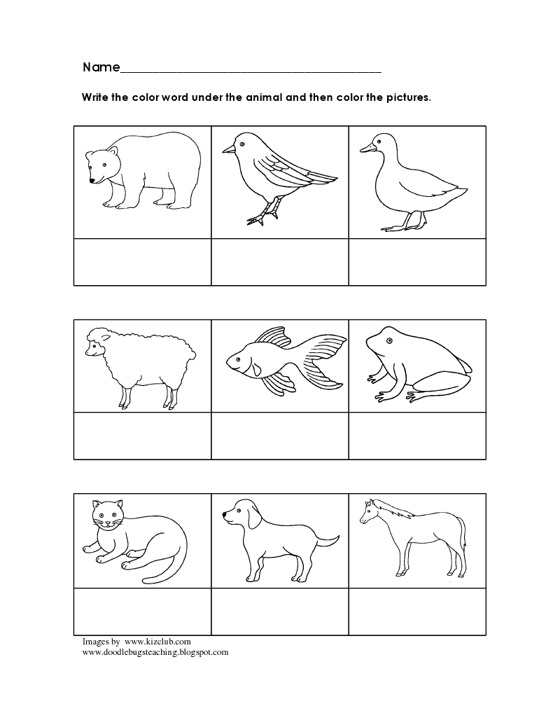

DO YOU REMEMBER THE COLOUR OF THE ANIMALS?

Slide 4
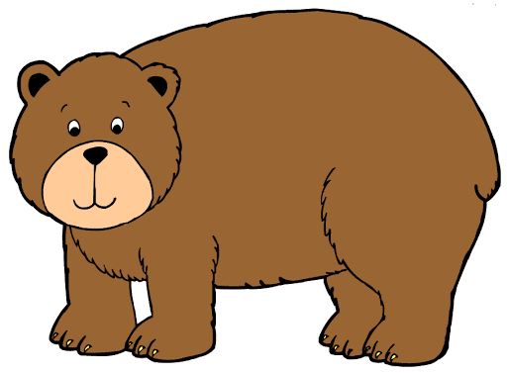
WHAT COLOUR IS THE BEAR?

Slide 5
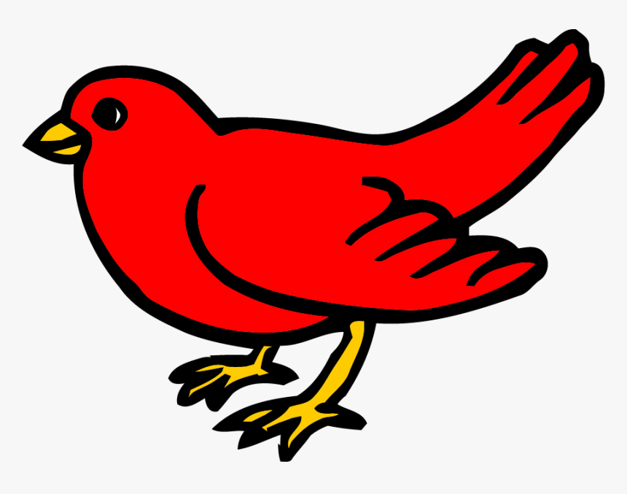
WHAT COLOUR IS THE BIRD?

Slide 6
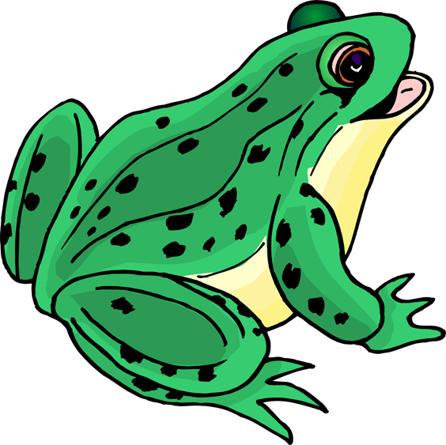
WHAT COLOUR IS THE FROG?

Slide 7
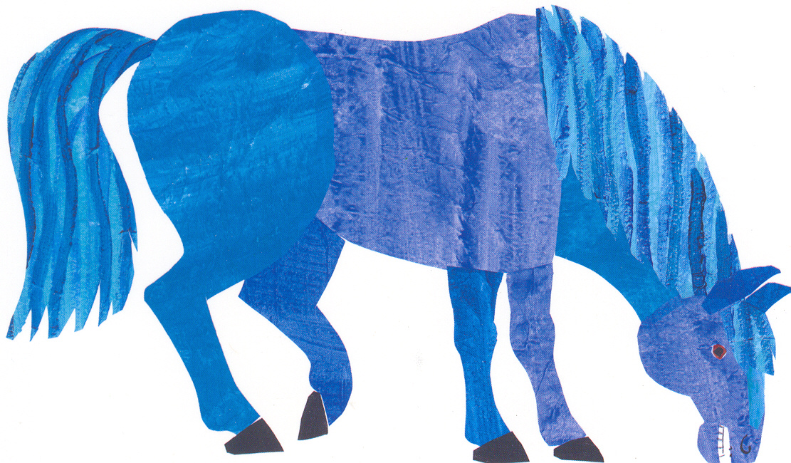
WHAT COLOUR IS THE HORSE?

Slide 8
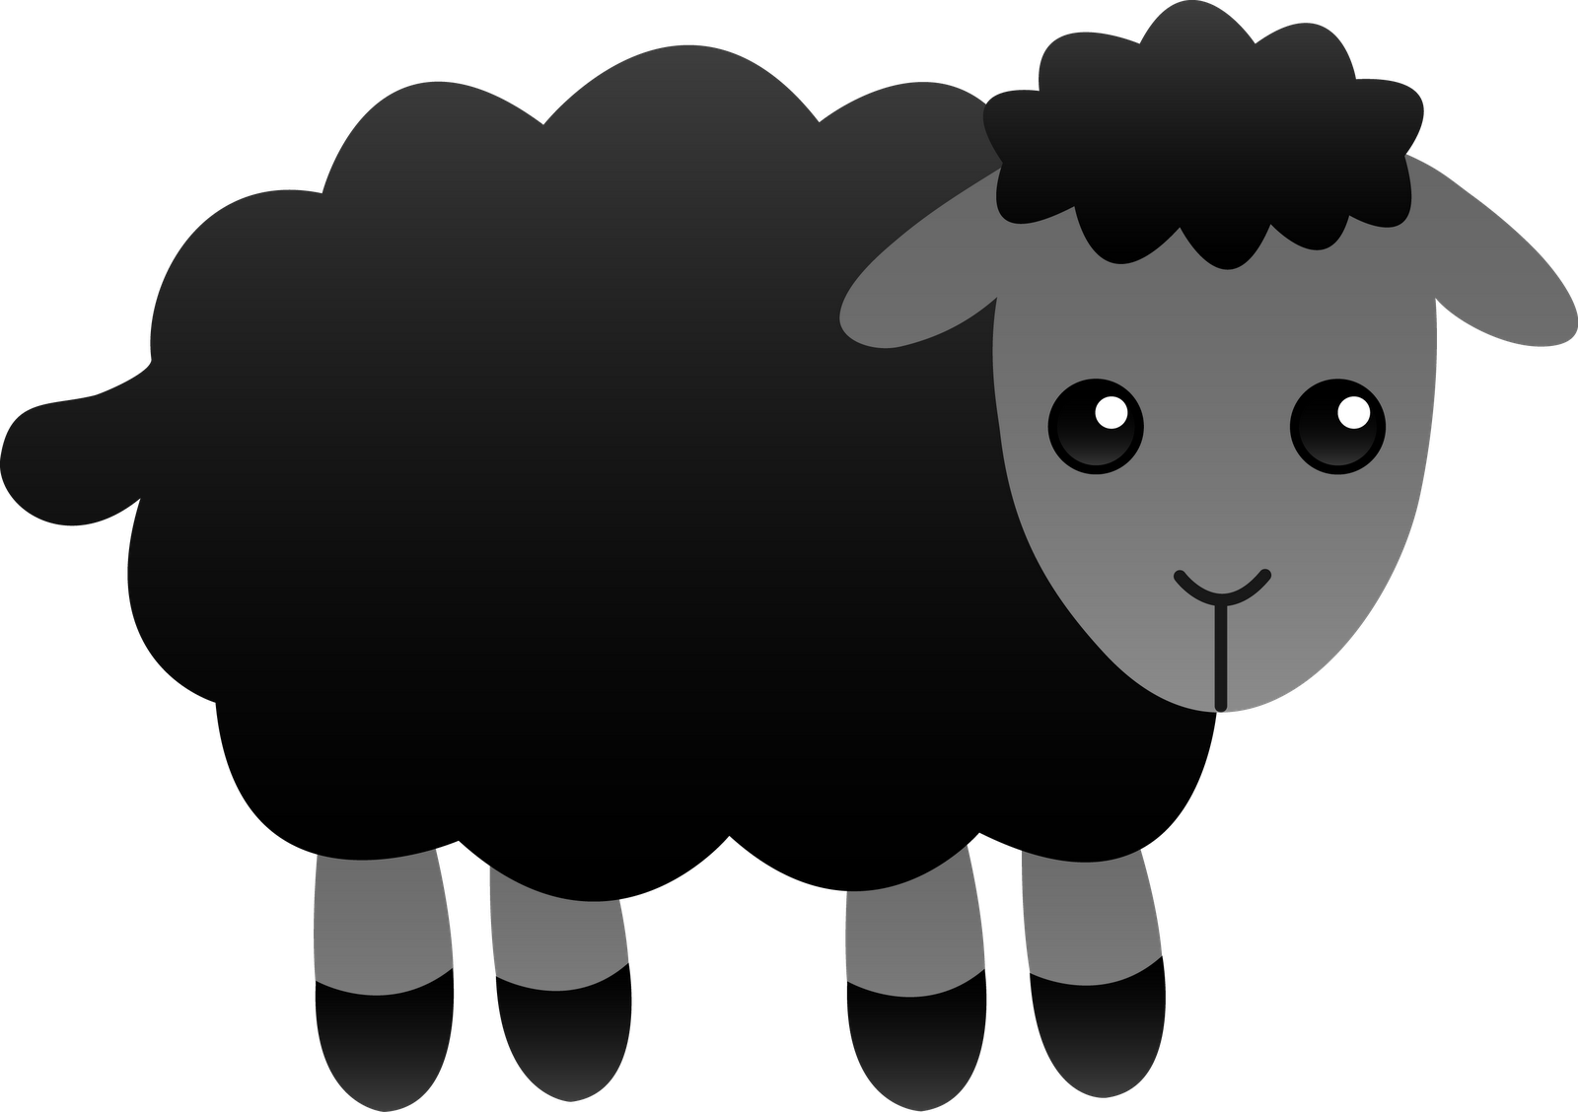
WHAT COLOUR IS THE SHEEP?

Slide 9
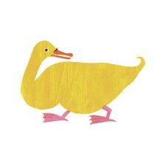
WHAT COLOUR IS THE DUCK?

Slide 10
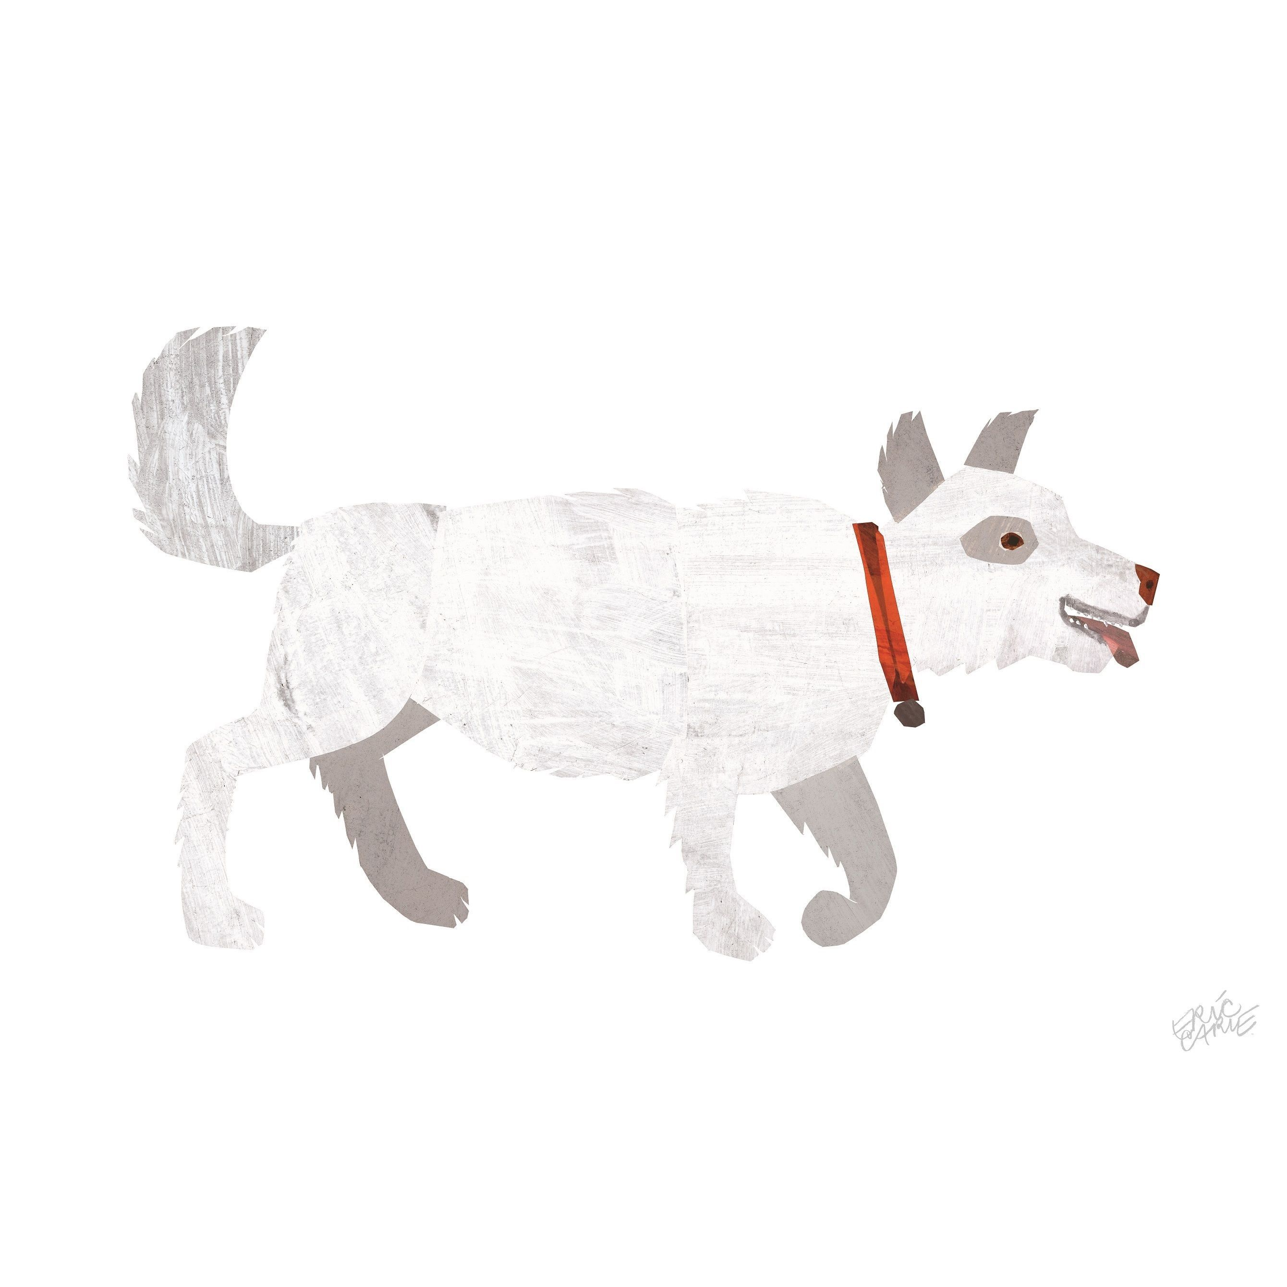
WHAT COLOUR IS THE DOG?

Slide 11
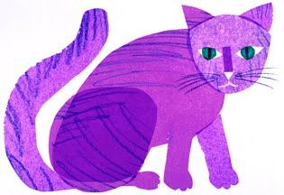
WHAT COLOUR IS THE CAT?

Slide 12
