Slide 1

Pozdravljeni, učenci!
Danes vas čaka zelo lepa zgodbica, ki jo je napisal znan škotski pisatelj Rod Campbell. Zgodbica ima naslov Dear Zoo in govori o dečku, ki si je močno želel žival.
Odločil se je, da bo pisal v živalski vrt …

Slide 2


Slide 3
Poiščite si kotiček, udobno se namestite in uživajte ob pravljici …
https://www.youtube.com/watch?v=rudDGRQ9QGA

Slide 4
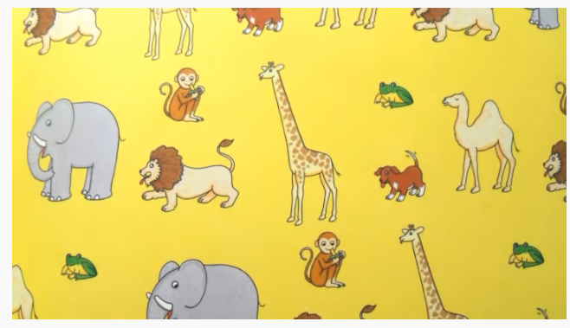
Dobro poglejte sliko…
Katere živali so na sliki?
Katera žival pa manjka?

Slide 5
REŠITEV:
NA SLIKI SO: A MONKEY, A GIRAFFE, AN ELEPHANT, A CAMEL, A PUPPY, A LION, A FROG
MANJKA: A SNAKE

Slide 6
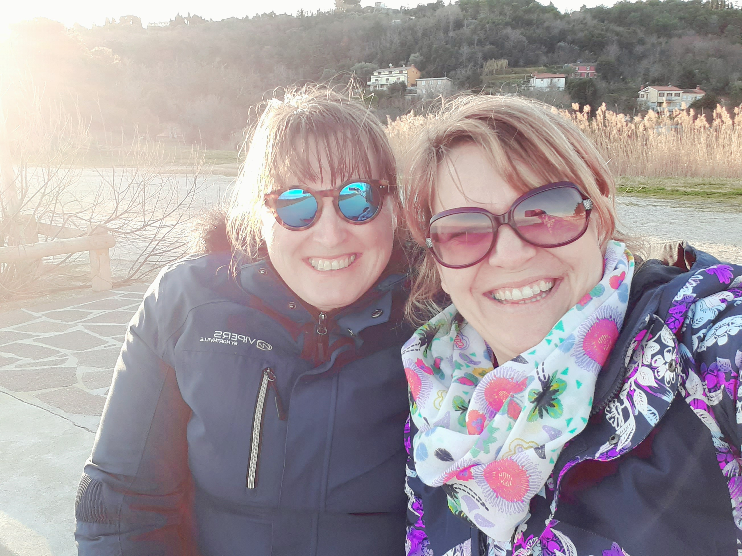
Otroci, tudi midve bi vam radi nekaj pokazali in povedali…

Slide 7
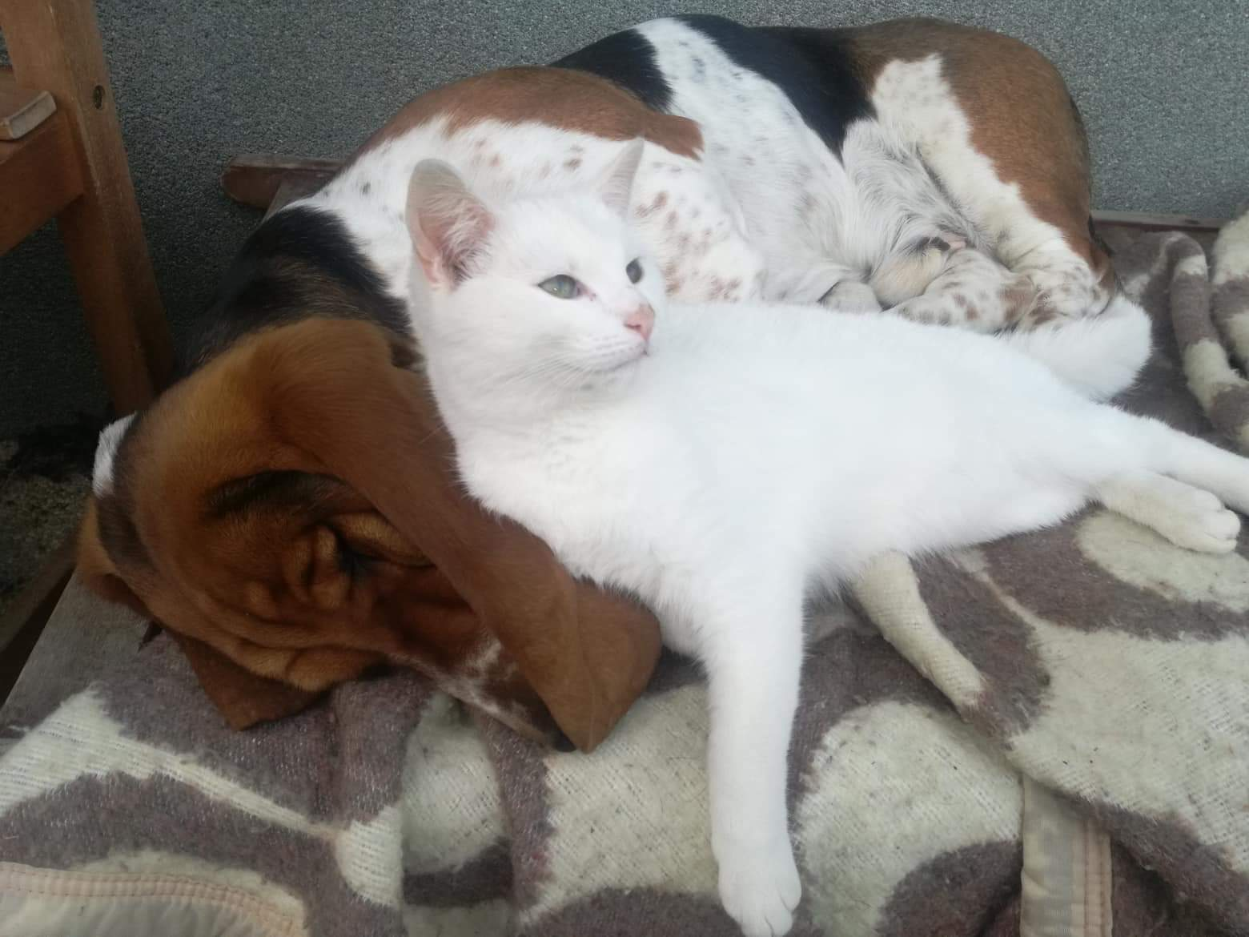
Hello children, this is Miss Potokar. I‘ve got a pet, too.
This is my dog. His name is Vinči. He is white, black and brown.
He is very friendly.
This is my cat. His name is Muri. He is white. He is very naughty.

Slide 8
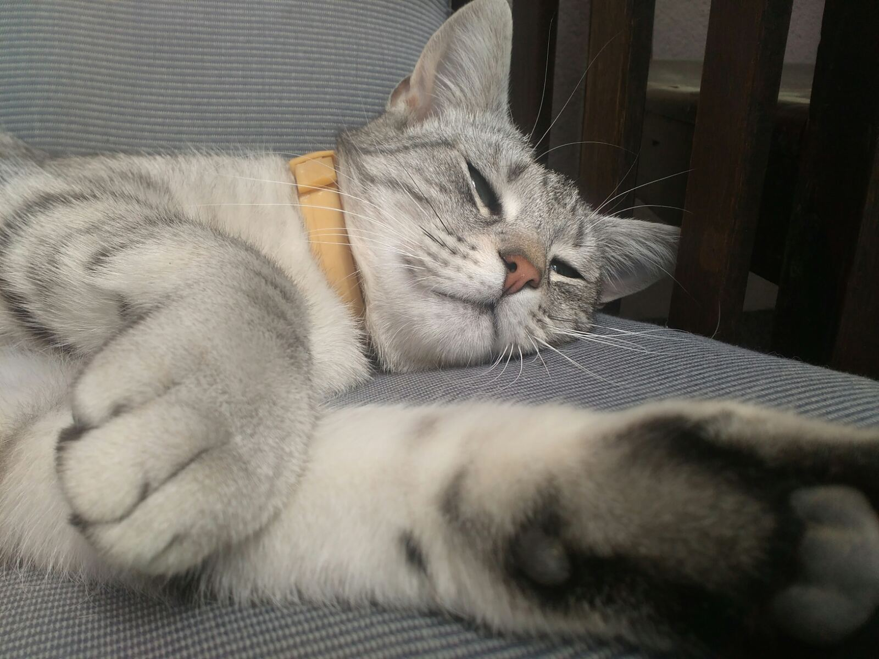
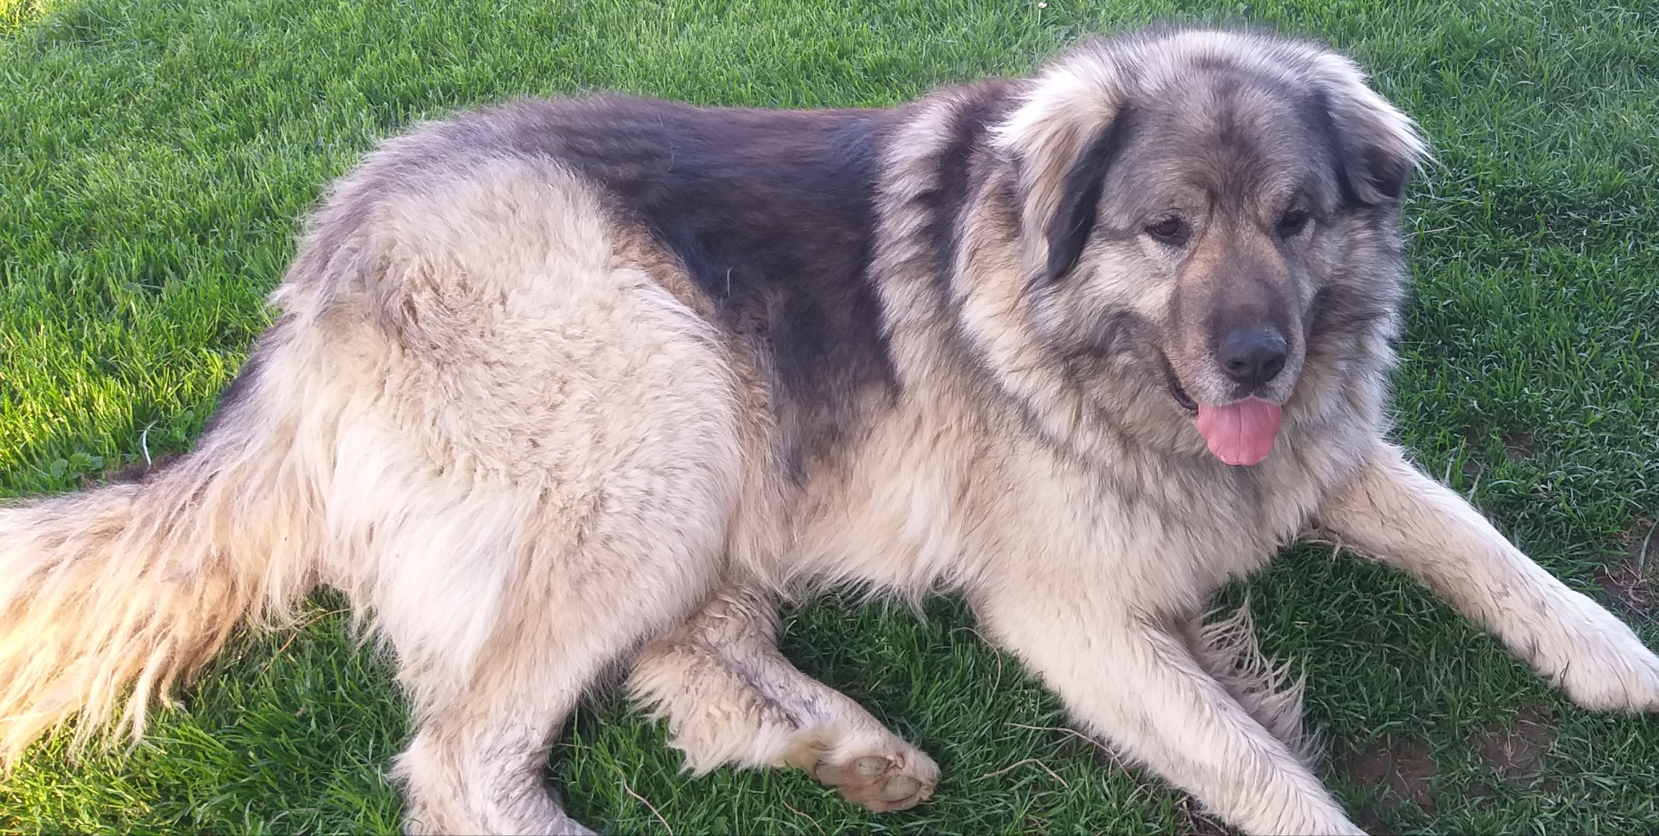
Hello children, this is Miss Rečnik. I‘ve got a pet, too.
This is my dog. Her name is Luna. She is a very big dog. She is very friendly.
This is my cat. Her name is Kepica. She is brown and white. She is very soft and she likes to cudle.

Slide 9
Kaj pa vi otroci?
A imate tudi vi doma kakšno živalco?
Je še nimate, pa si jo želite?
Pošljite nama fotografijo vašega ljubljenčka ali pa v zvezek narišite,
katero žival si želite.
Lepo bodite do naslednjega tedna.

