Slide 1
Pozdravljeni, učenci!
Danes vas čaka nekaj nalog povezanih z zgodbico Dear Zoo.

Slide 2
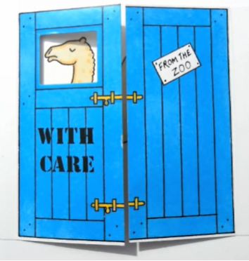
Which animal is in the blue crate?

Slide 3
Yes, it‘s a CAMEL.

Slide 4
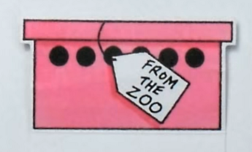
Which animal is in the pink box?

Slide 5
Yes, it‘s a FROG.

Slide 6
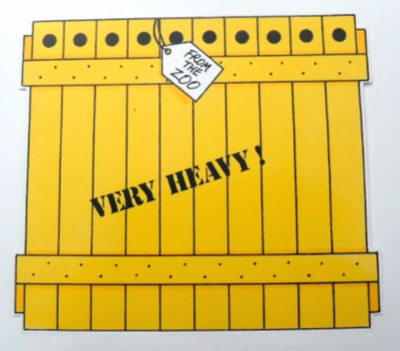
Which animal is in the yellow crate?

Slide 7
Yes, it‘s an ELEPHANT.

Slide 8
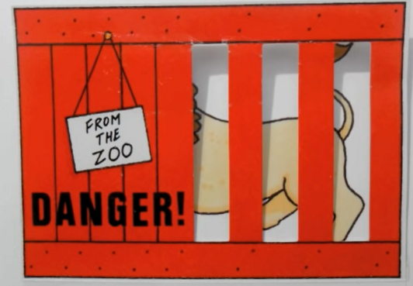
Which animal is in the red crate?

Slide 9
Yes, it‘s a LION.

Slide 10
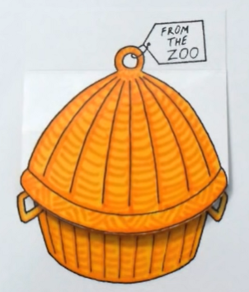
Which animal is in the orange and brown basket?

Slide 11
Yes, it‘s a SNAKE.

Slide 12
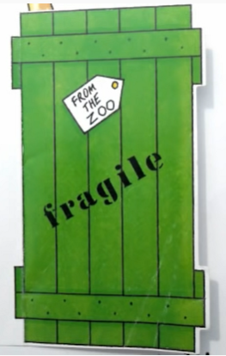
Which animal is in the green crate?

Slide 13
Yes, it‘s a GIRAFFE.

Slide 14
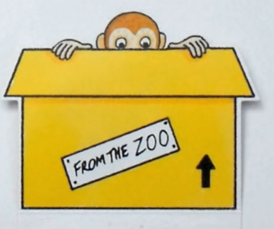
Which animal is in the yellow box?

Slide 15
Yes, it‘s a MONKEY.

Slide 16
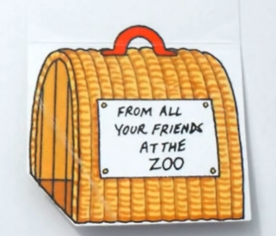
Which animal is in the yellow and brown basket?

Slide 17
Yes, it‘s a PUPPY.

Slide 18
Tako, to je za danes vse. Upam, da ti je šlo dobro in da si se imel lepo.

