Slide 1

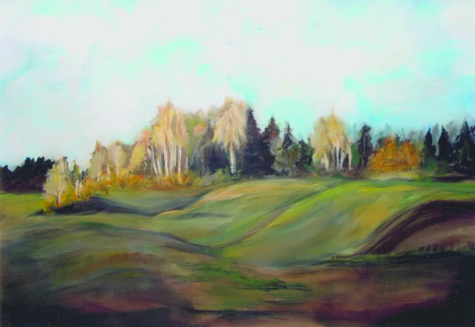
KRAJINA

Slide 2
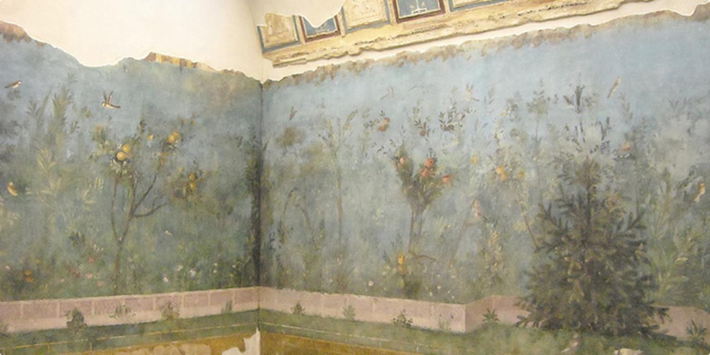
Vrtna pokrajina v Livijini vili

Slide 3
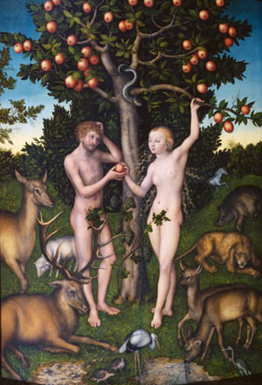
Lucas Cranach, Adam in Eva, 1526

Slide 4
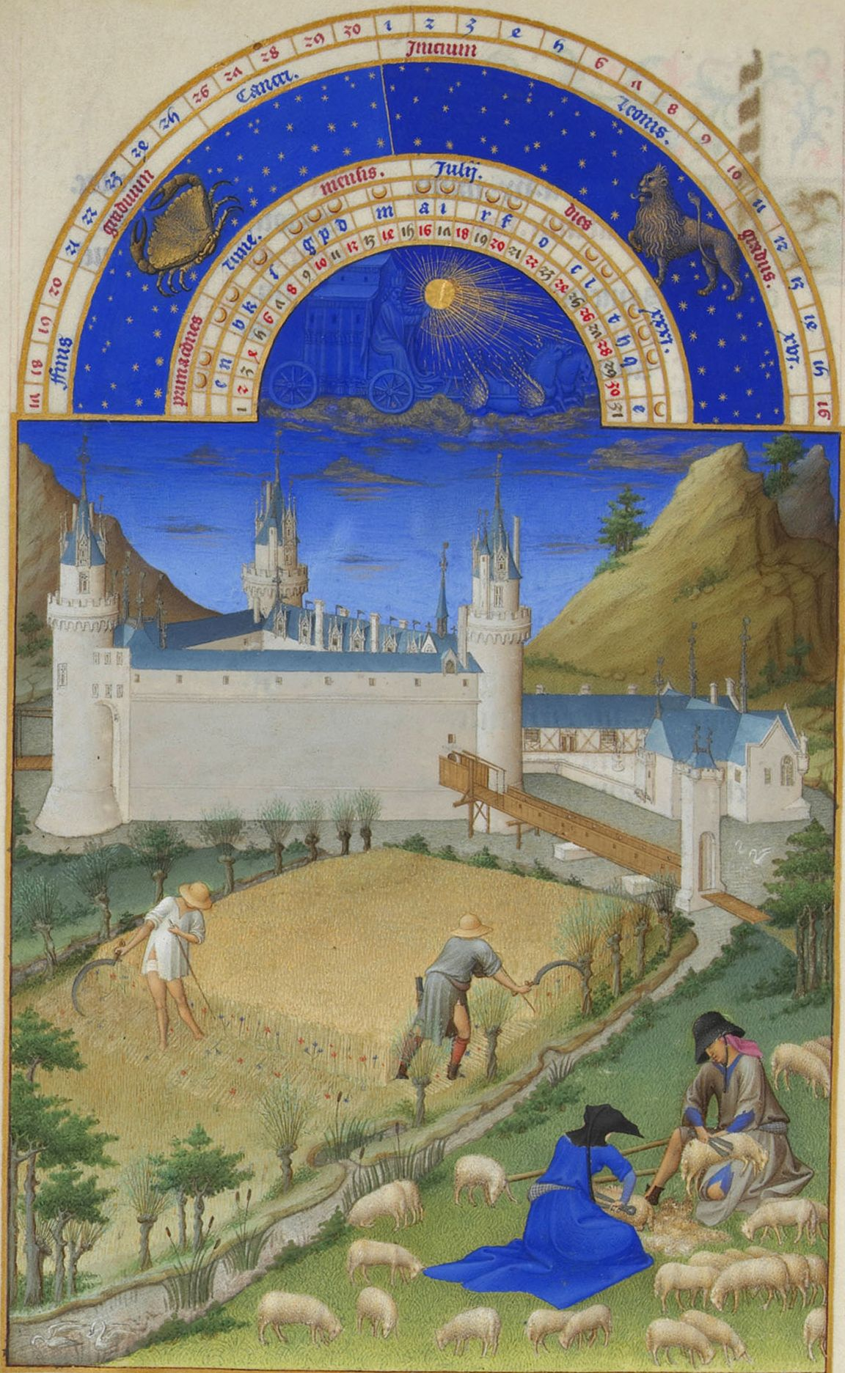
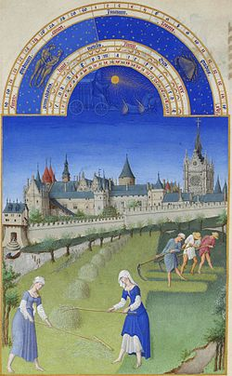

Bratje Limbourg (1412–1416)

Slide 5
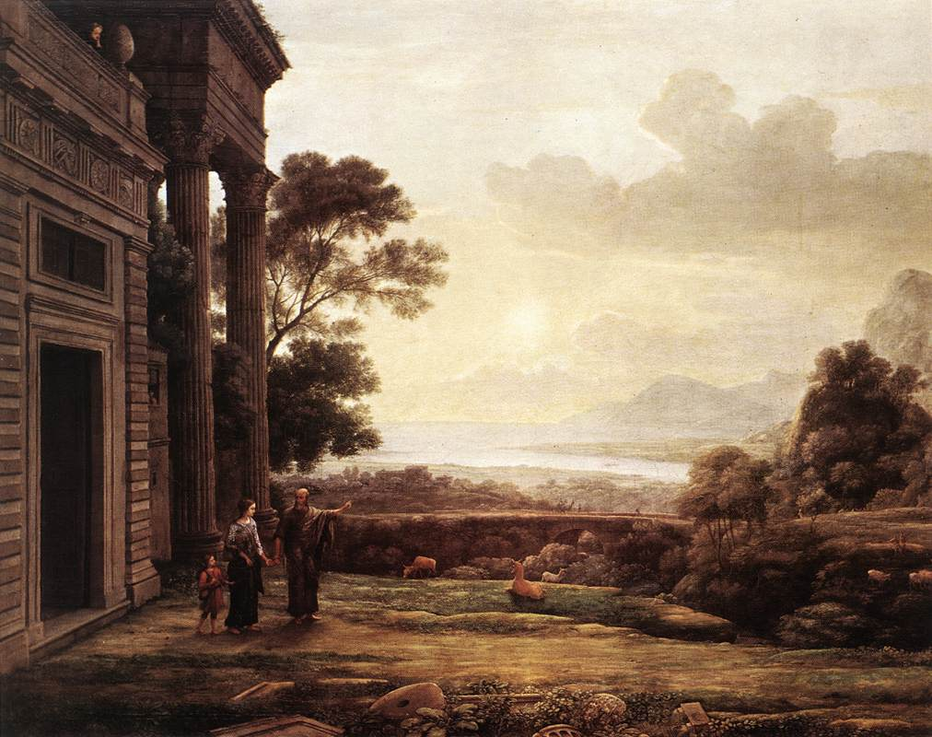
Claude Lorrain: Abraham odslovi Hagaro.

Slide 6
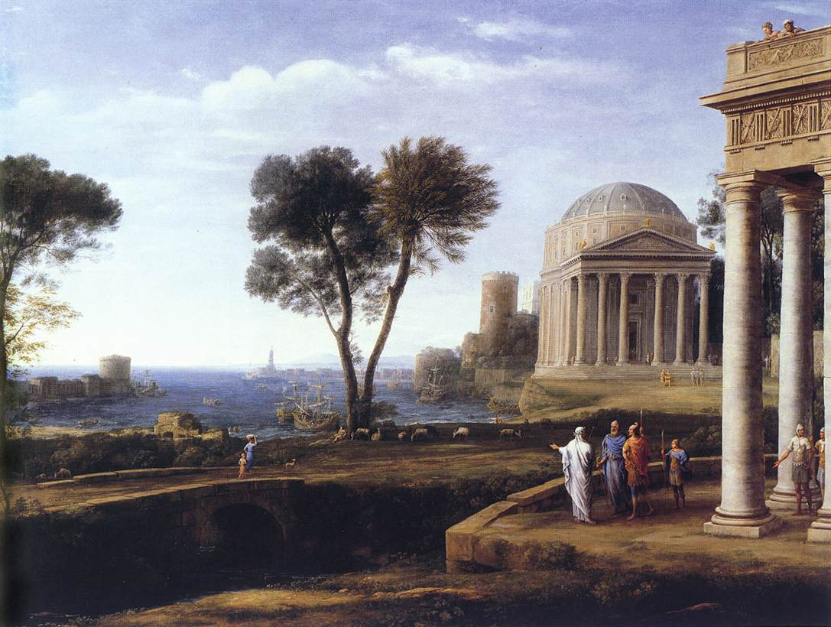

Slide 7
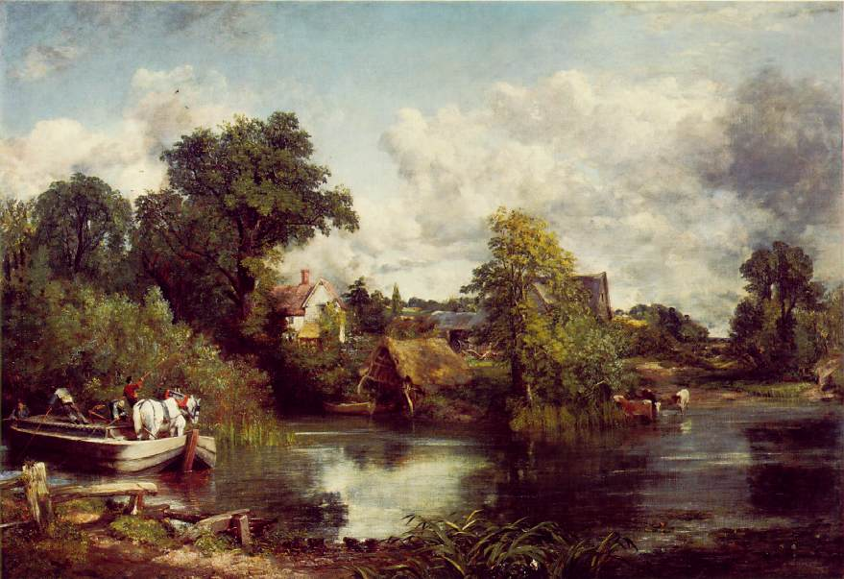
John Constable, Bel konj (19. st.)

