Slide 1
BODY PARTS

Slide 2


Slide 3
HEAD

Slide 4
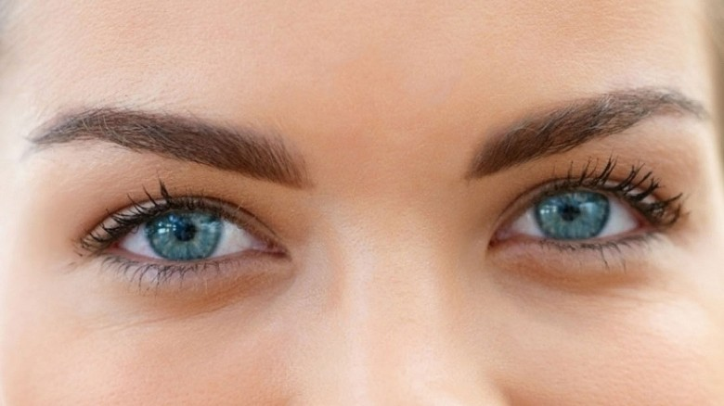

Slide 5
EYES

Slide 7
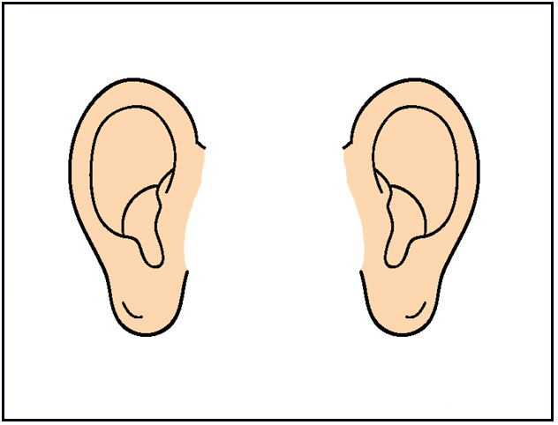

Slide 8
EARS

Slide 9
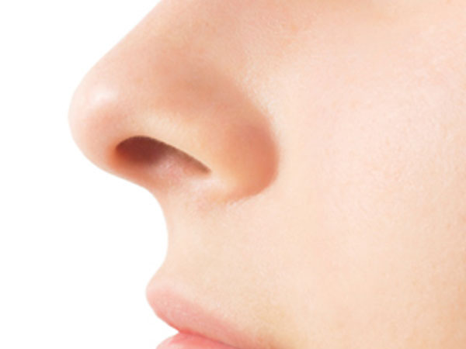

Slide 10
NOSE

Slide 11


Slide 12
CHEEKS

Slide 13


Slide 14
CHIN

Slide 15
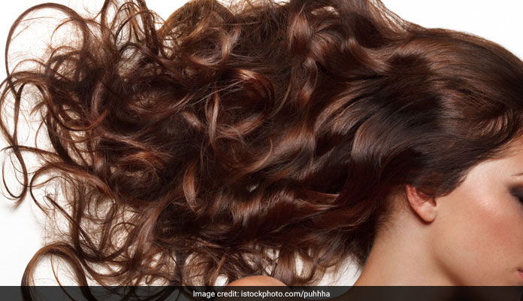

Slide 16
HAIR

Slide 17
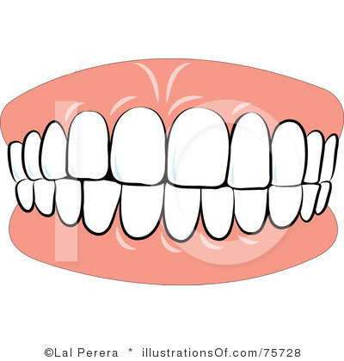

Slide 18
TEETH

Slide 19


Slide 20
MOUTH
TONGUE

Slide 21
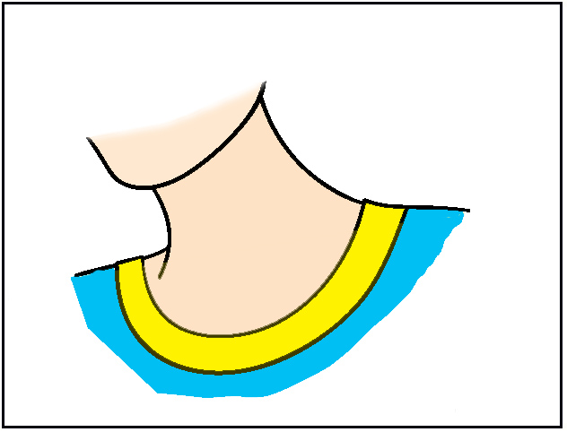

Slide 22
NECK

Slide 23


Slide 24
SHOULDERS

Slide 25


Slide 26
ARM

Slide 27
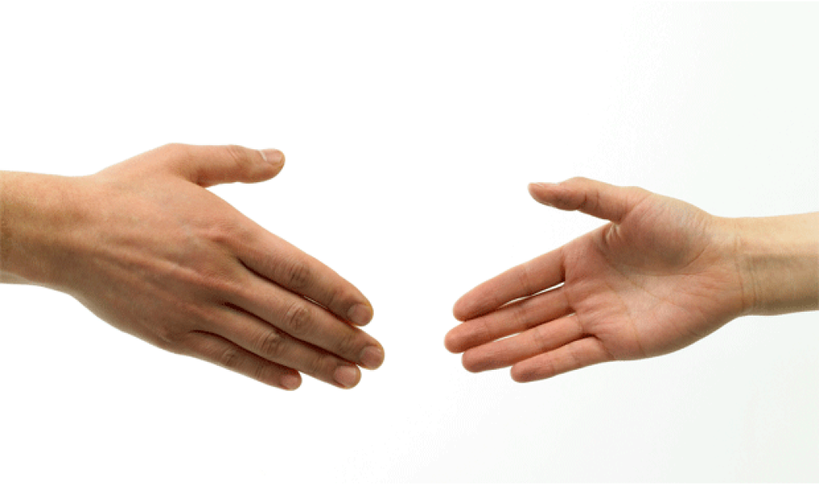

Slide 28
HANDS

Slide 29
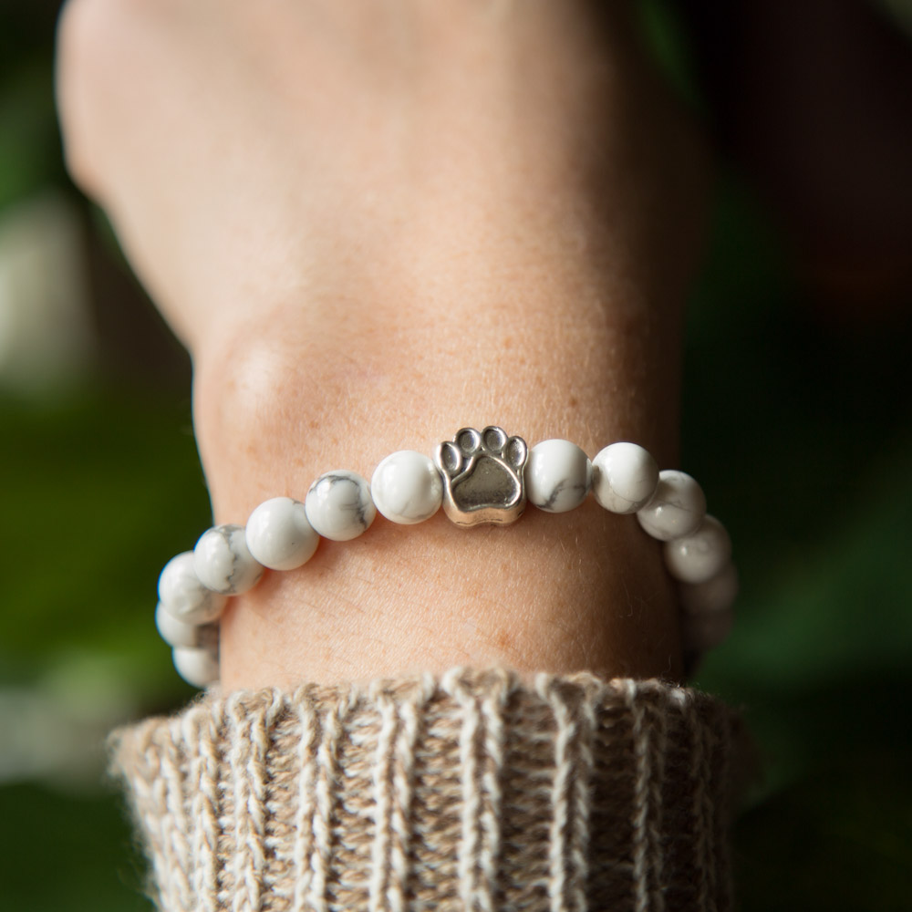

Slide 30
WRIST

Slide 31
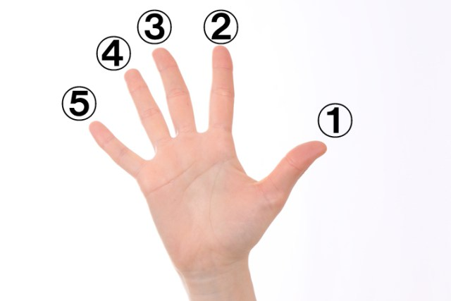

Slide 32
FINGERS

Slide 33
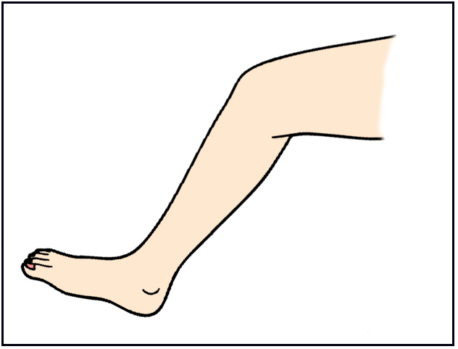

Slide 34
LEG

Slide 35
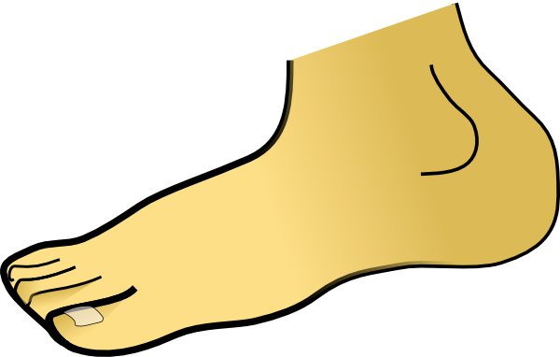

Slide 36
FOOT

Slide 37


Slide 38
FEET

Slide 39
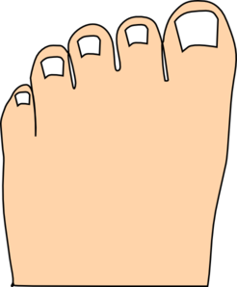

Slide 40
TOES

Slide 41
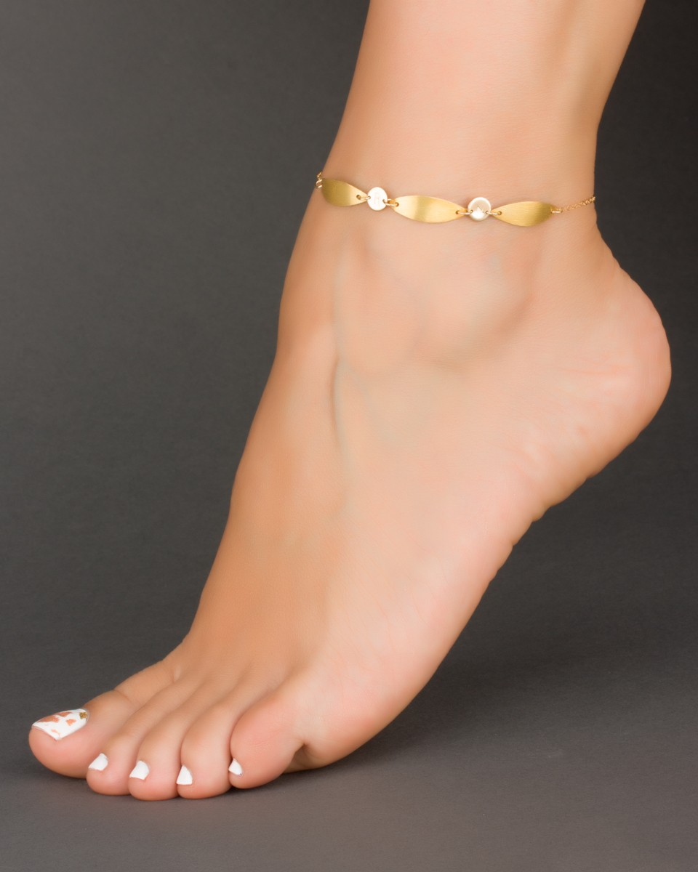

Slide 42
ANKLE

Slide 43


Slide 44
CHEST

Slide 45
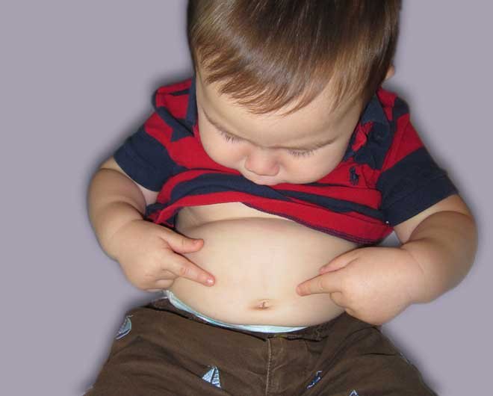

Slide 46
STOMACH
BELLY

Slide 47


Slide 48
BACK

Slide 49
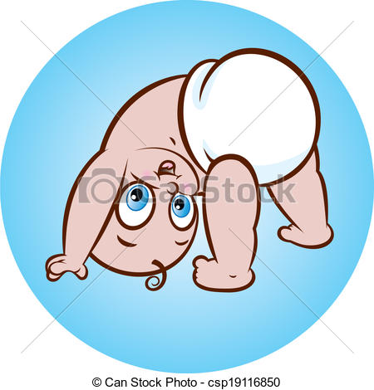

Slide 50
BACKSIDE

