Slide 1
PLACES IN A TOWN OR VILLAGE

Slide 2
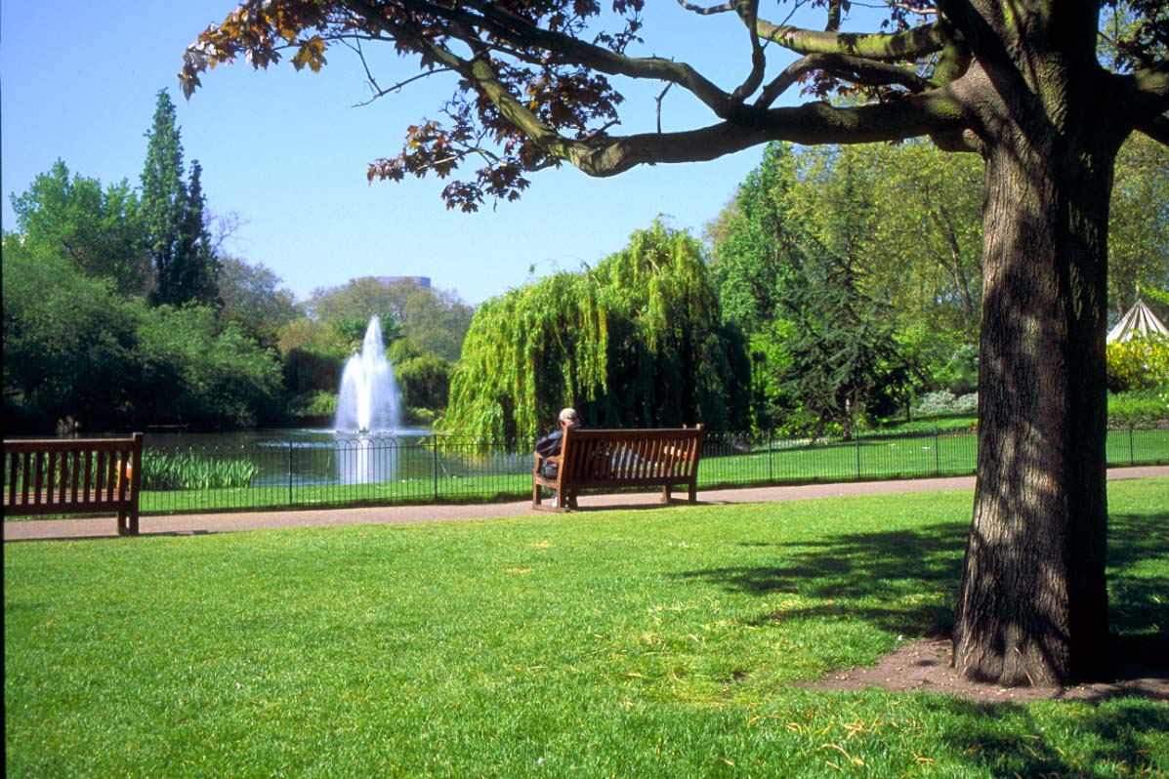

Slide 3
A PARK

Slide 4
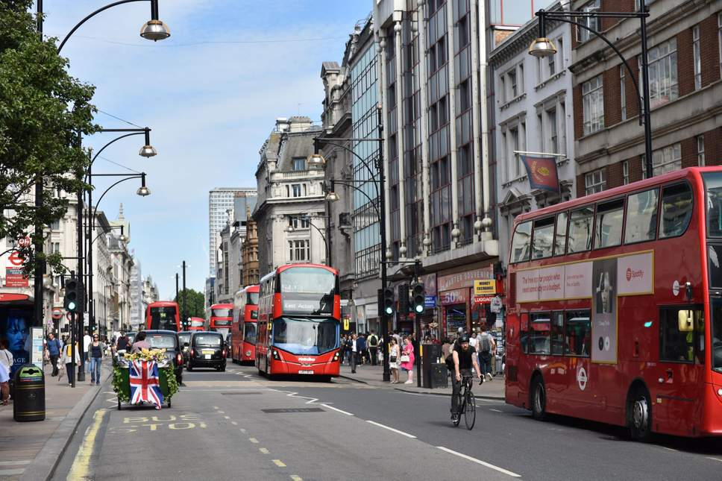

Slide 5
A STREET

Slide 6
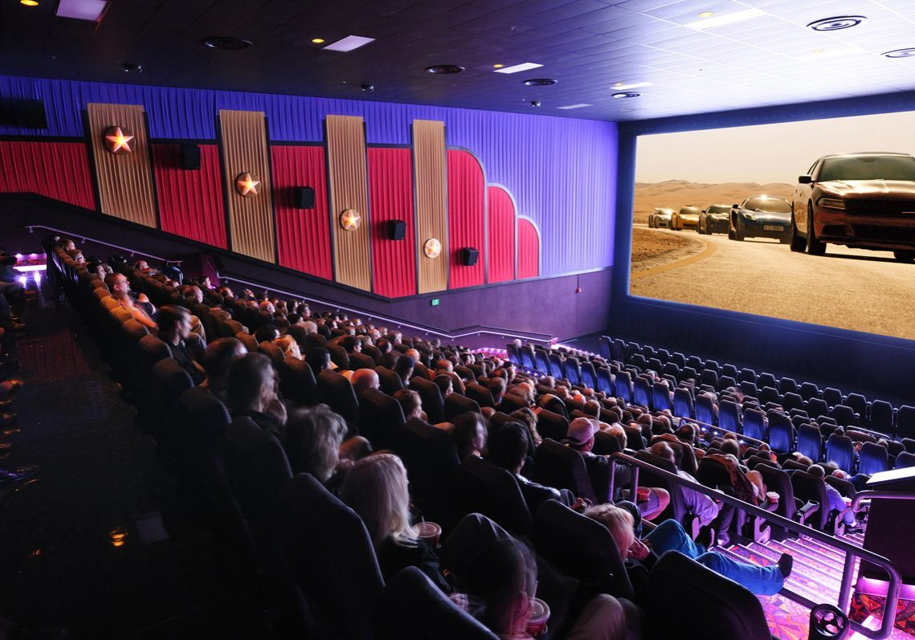

Slide 7
A CINEMA

Slide 8
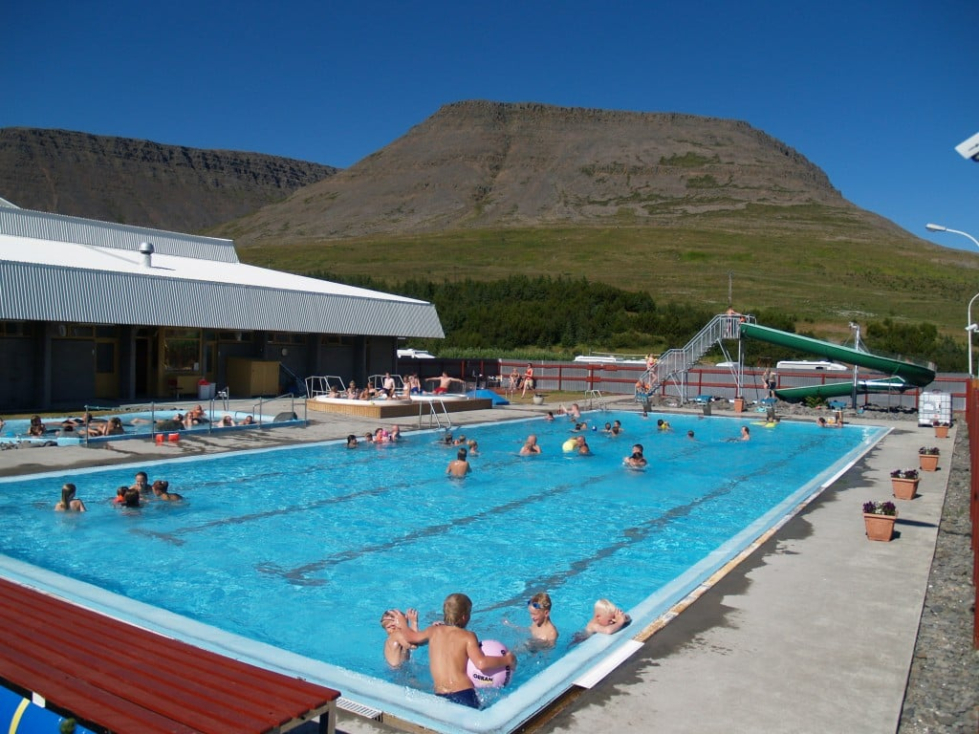

Slide 9
A SWIMMING POOL

Slide 10
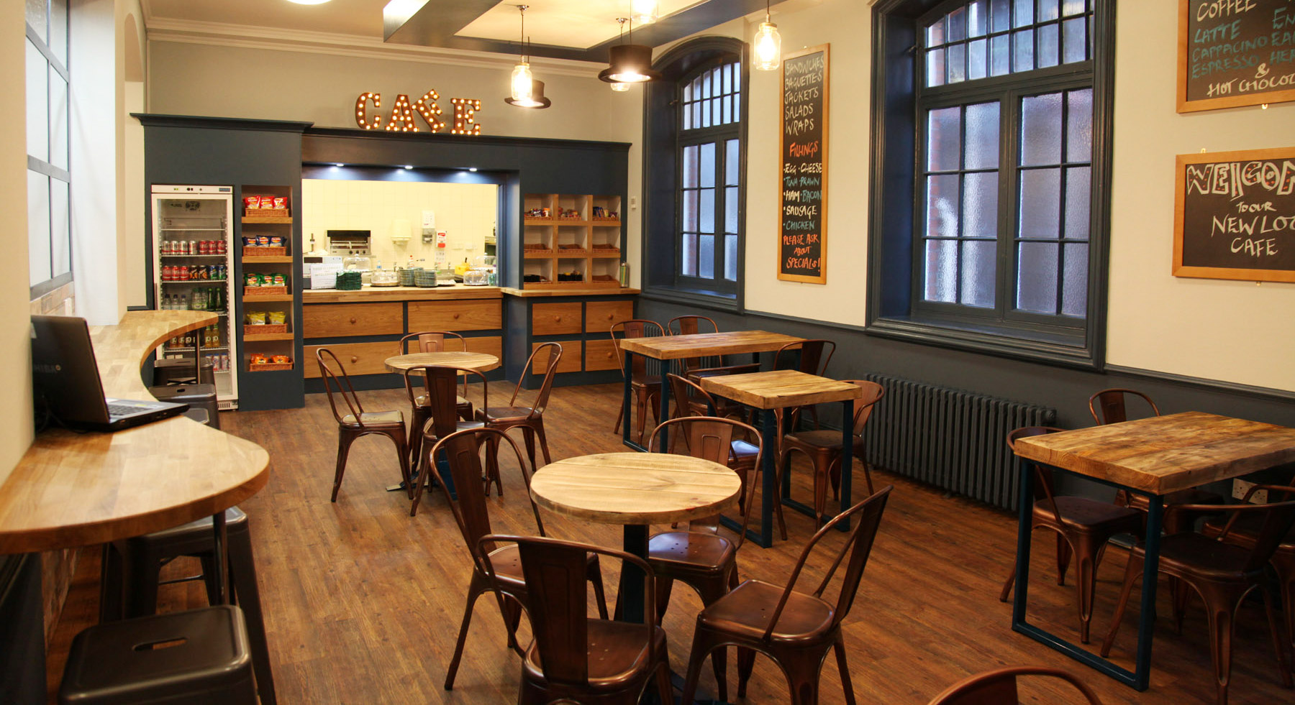

Slide 11
A CAFE

Slide 12
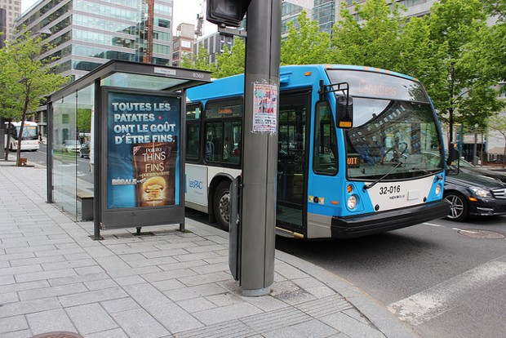

Slide 13
A BUS STOP

Slide 14
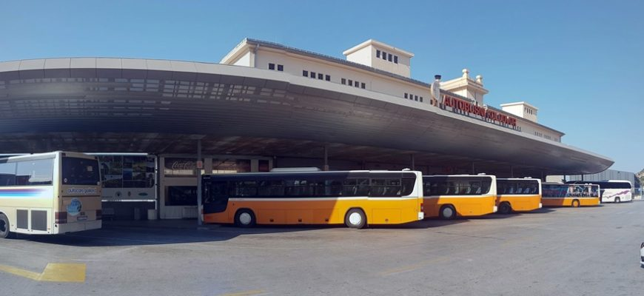

Slide 15
A BUS STATION

Slide 16
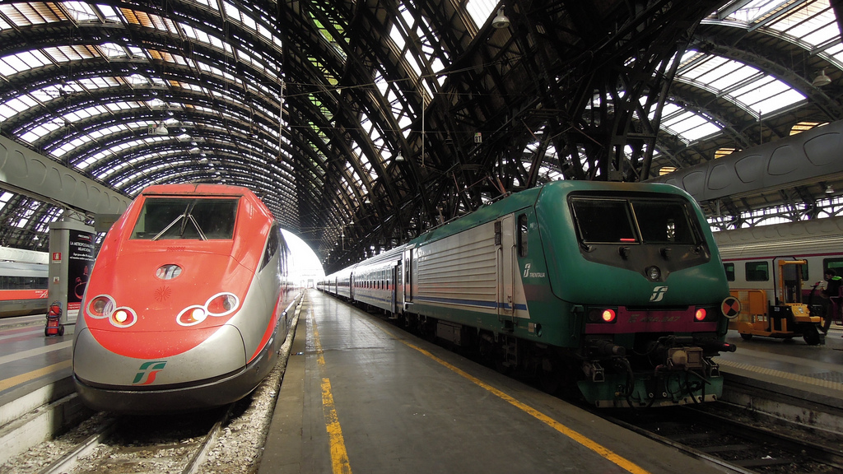

Slide 17
A TRAIN STATION

Slide 18
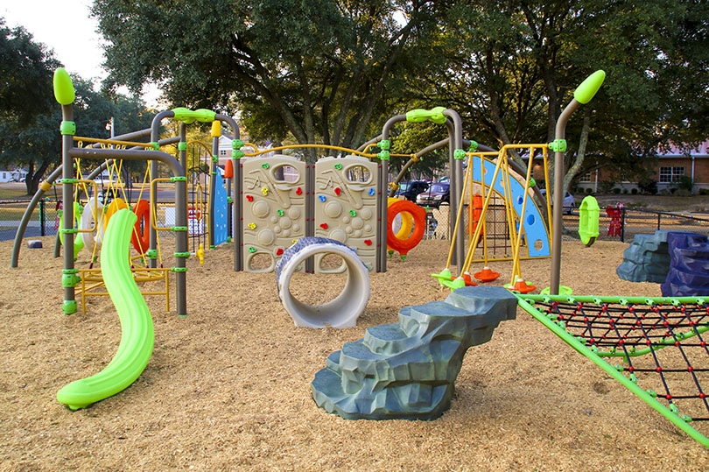

Slide 19
A PLAYGROUND

Slide 20
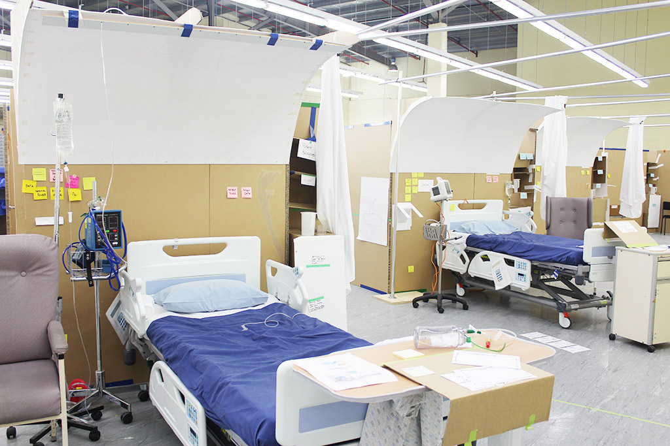

Slide 21
A HOSPITAL

Slide 22
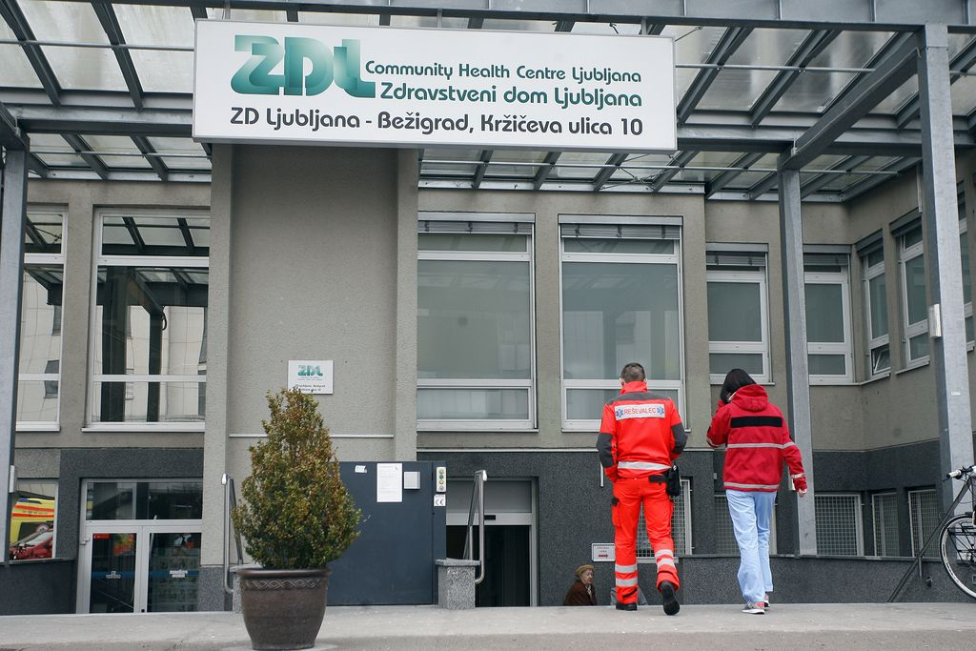

Slide 23
A
HEALTH CENTRE

Slide 24
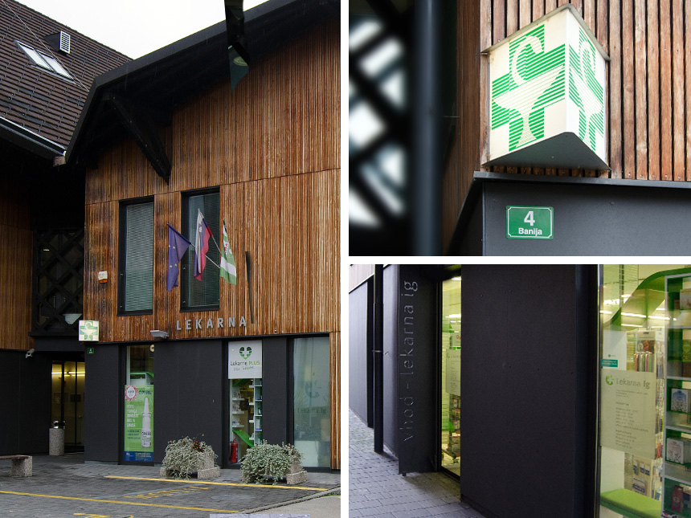

Slide 25
A PHARMACY

Slide 26
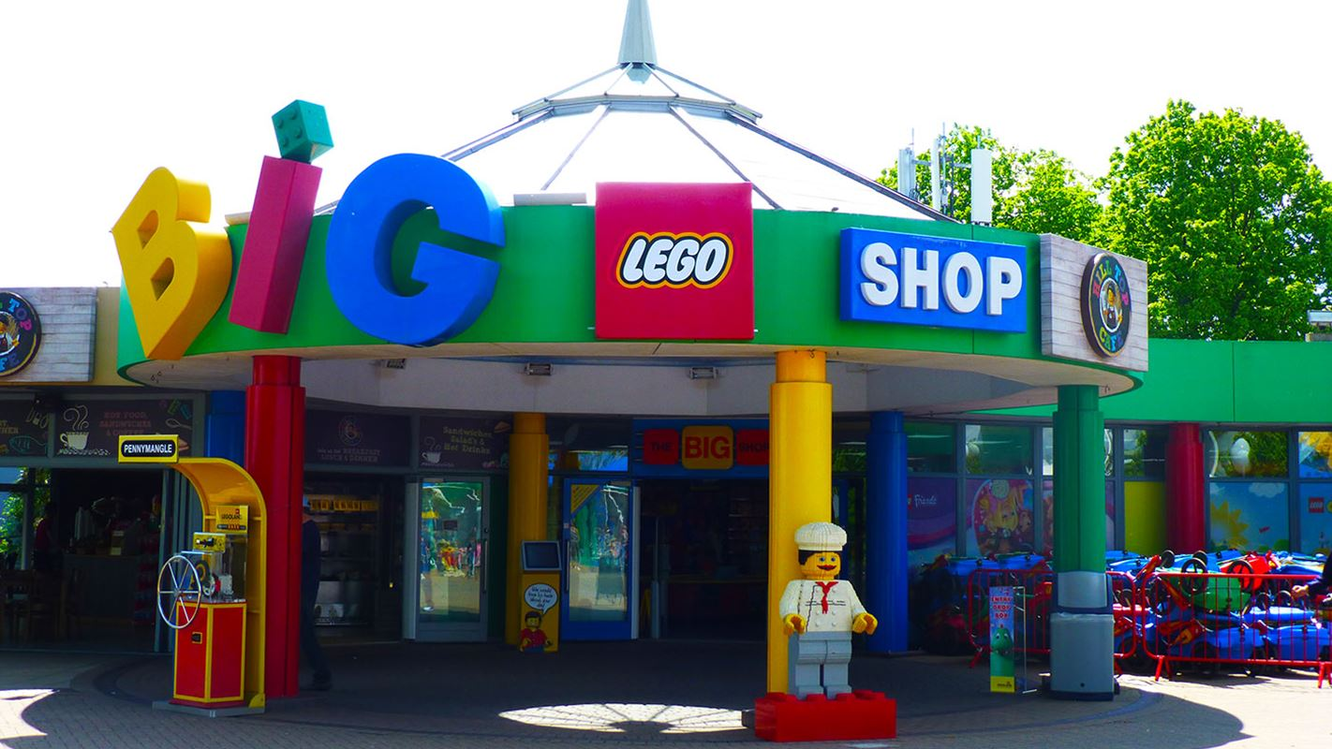

Slide 27
A SHOP

Slide 28
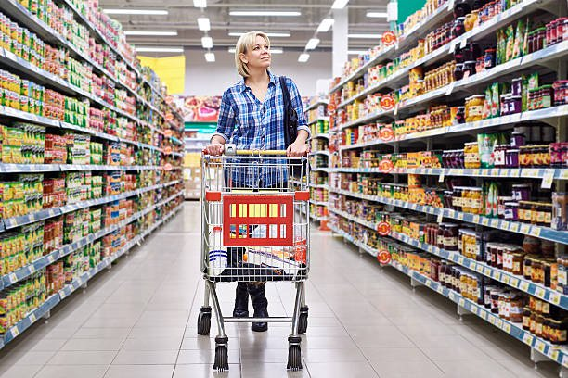

Slide 29
A SUPERMARKET

Slide 30
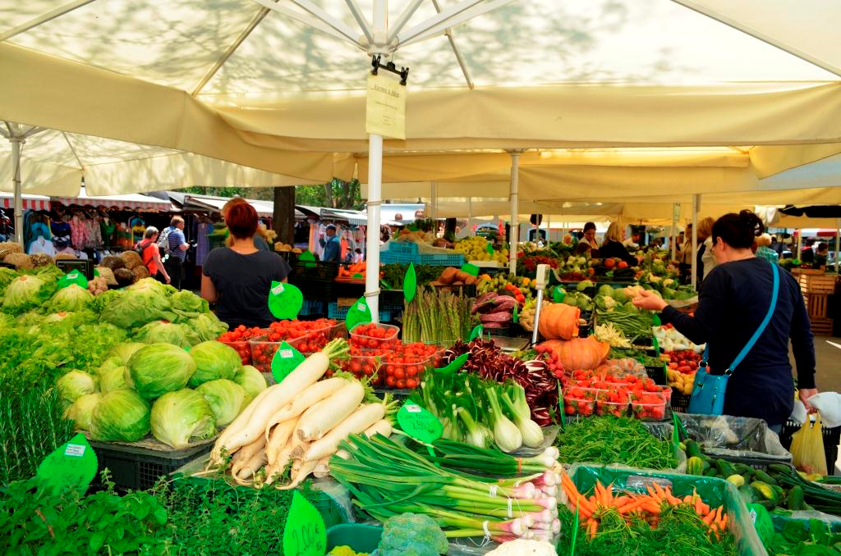

Slide 31
A MARKET

Slide 32
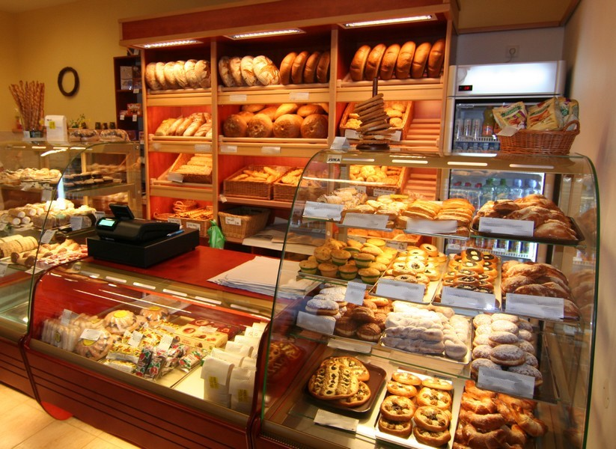

Slide 33
A BAKERY

Slide 34
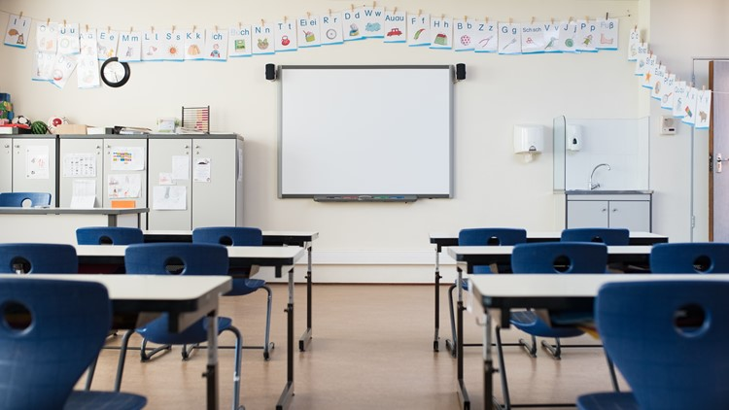

Slide 35
A SCHOOL

Slide 36
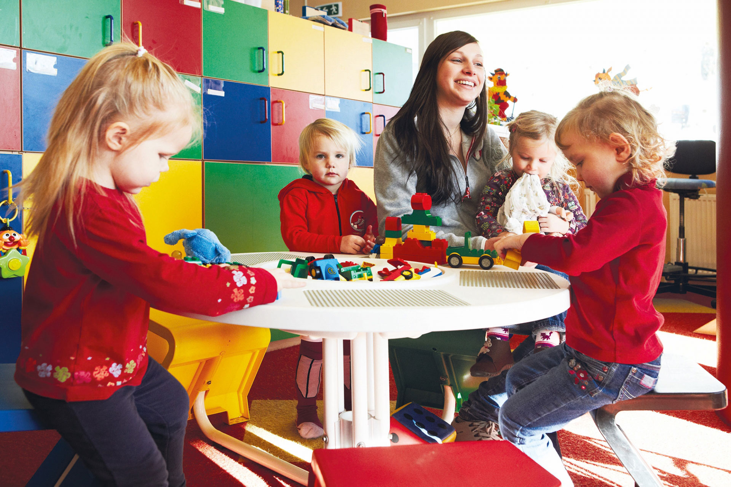

Slide 37
A KINDERGARTEN

Slide 38
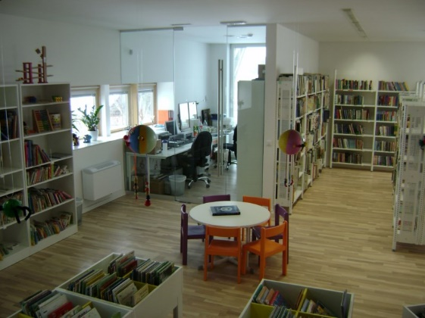
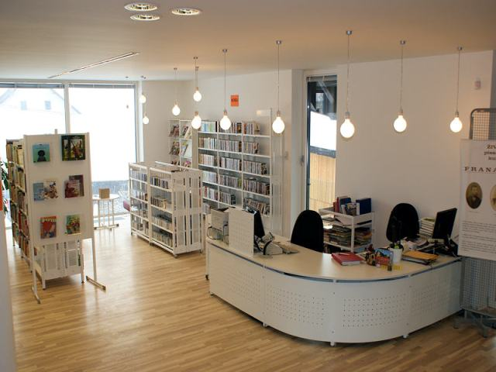

Slide 39
A library

Slide 40
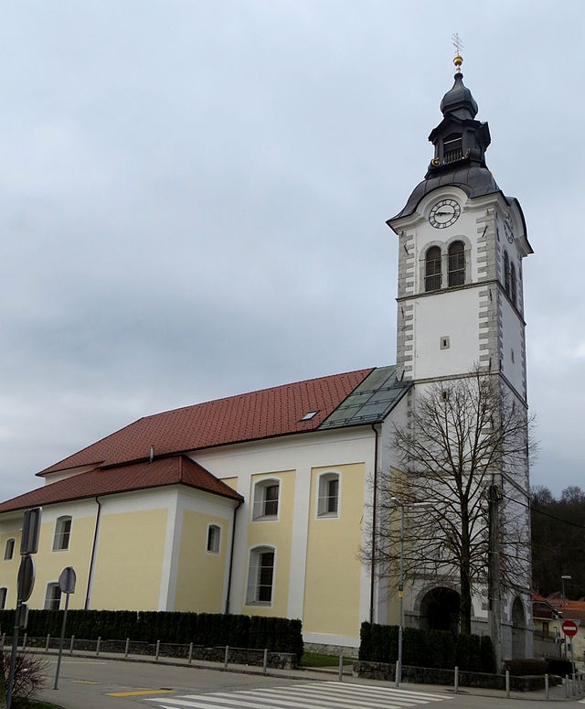

Slide 41
A CHURCH

Slide 42
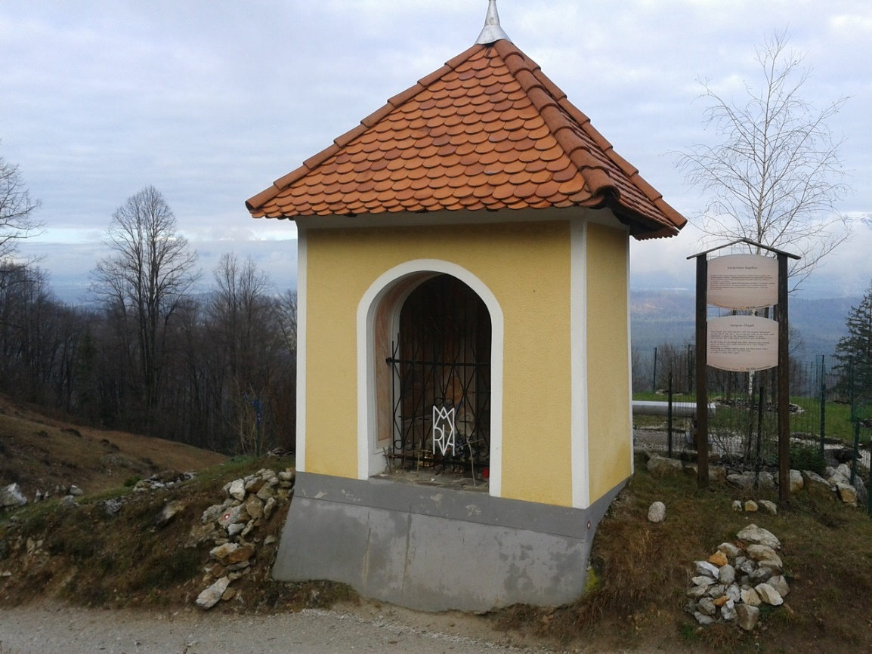

Slide 43
A CHAPEL

Slide 44
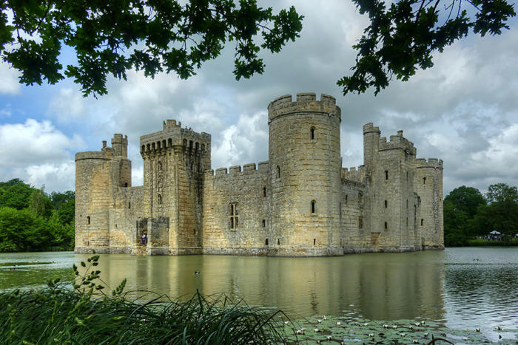

Slide 45
A CASTLE

Slide 46
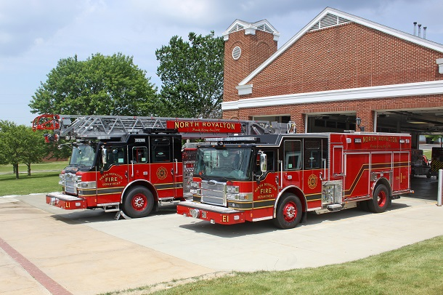

Slide 47
A FIRE STATION

Slide 48
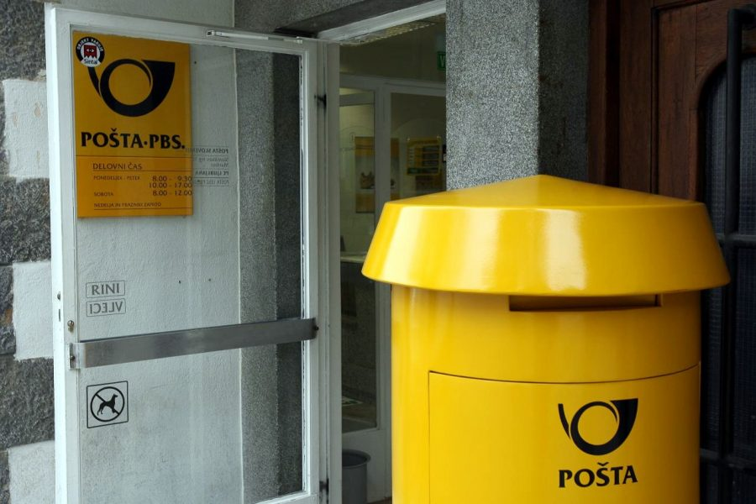

Slide 49
A POST OFFICE

Slide 50
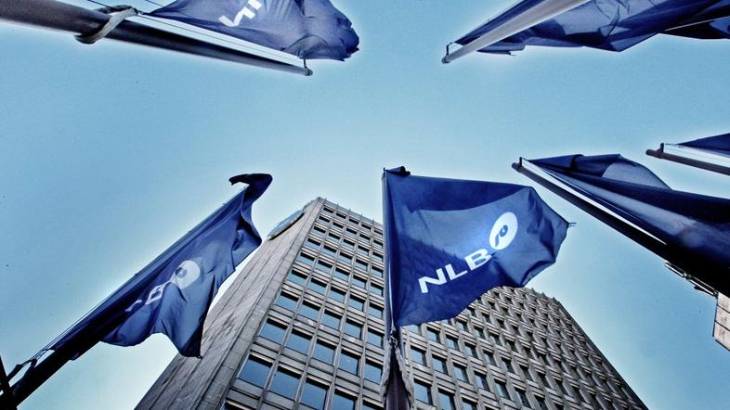

Slide 51
A BANK

Slide 52
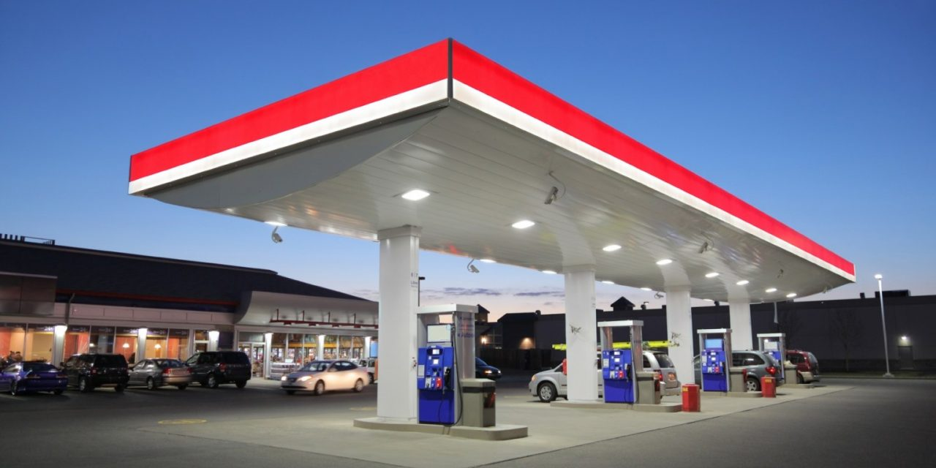

Slide 53
A PETROL STATION

Slide 54
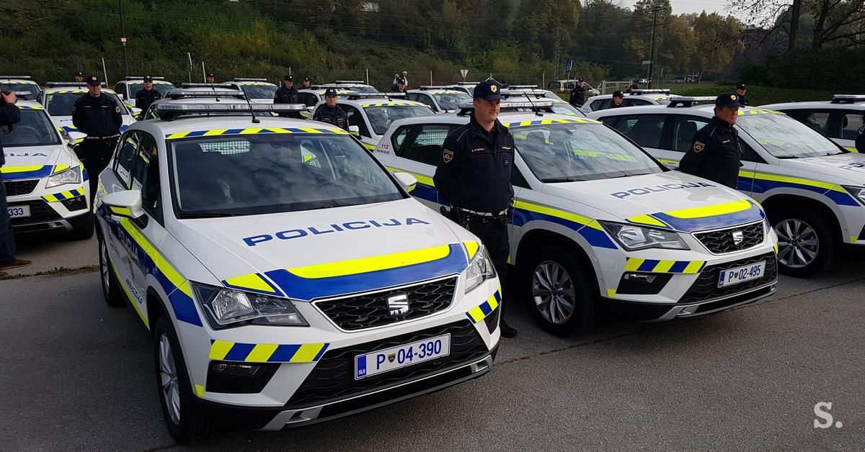

Slide 55
A POLICE STATION

Slide 56
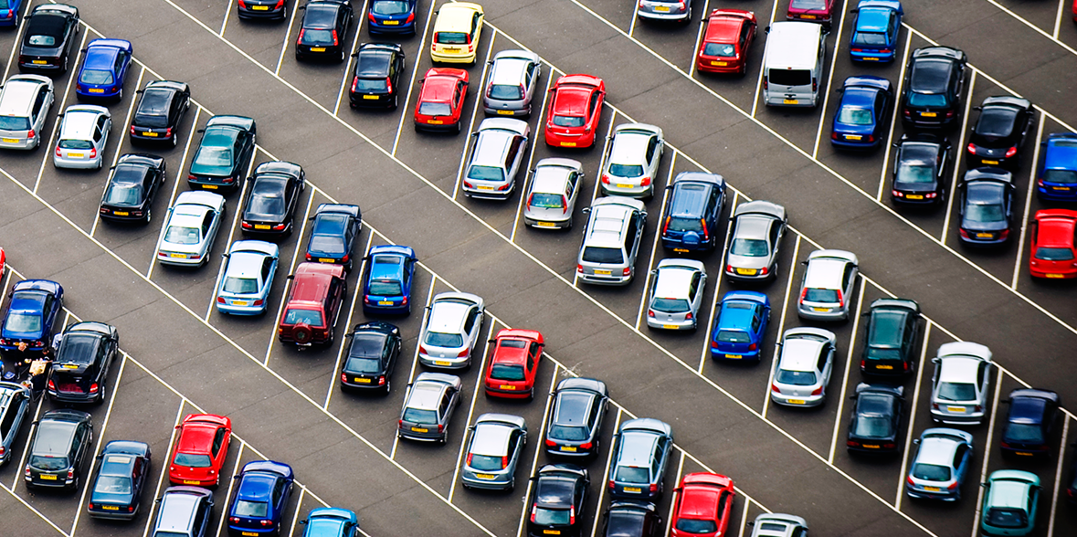

Slide 57
A car park

Slide 58
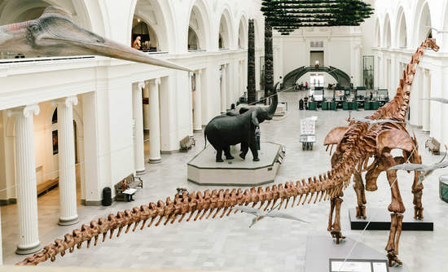

Slide 59
A MUSEUM

Slide 60


Slide 61
A ZOO

Slide 62
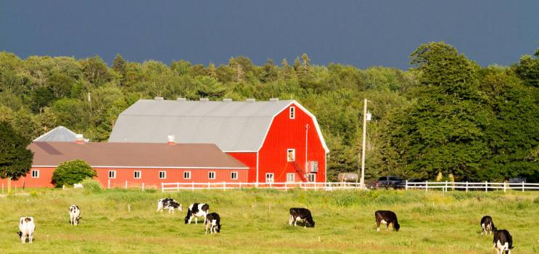

Slide 63
A FARM

Slide 64
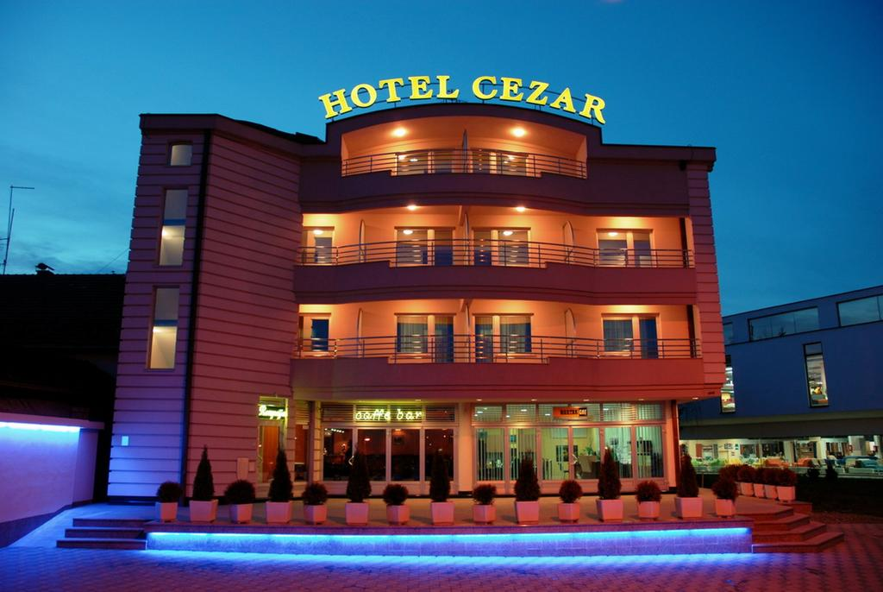

Slide 65
A HOTEL

Slide 66
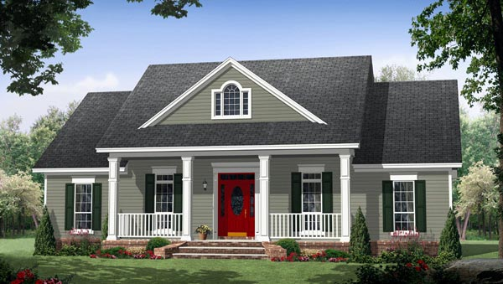

Slide 67
A HOUSE

Slide 68
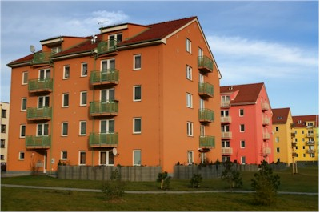

Slide 69
A BLOCK OF FLATS

Slide 70
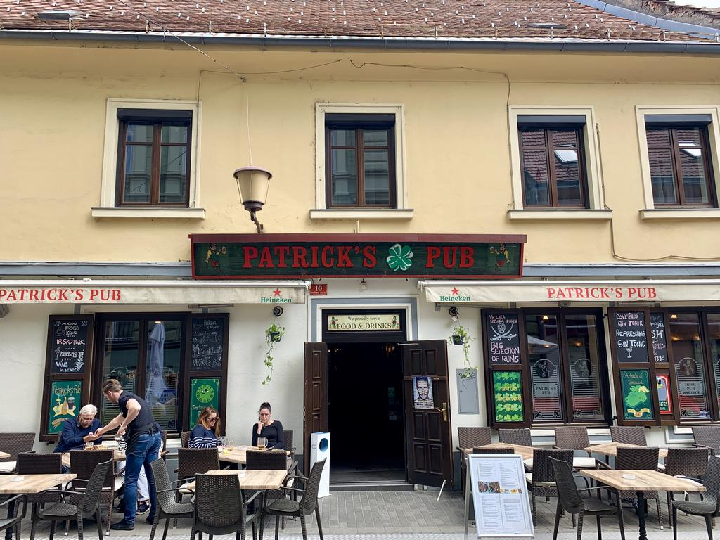

Slide 71
A pub

Slide 72
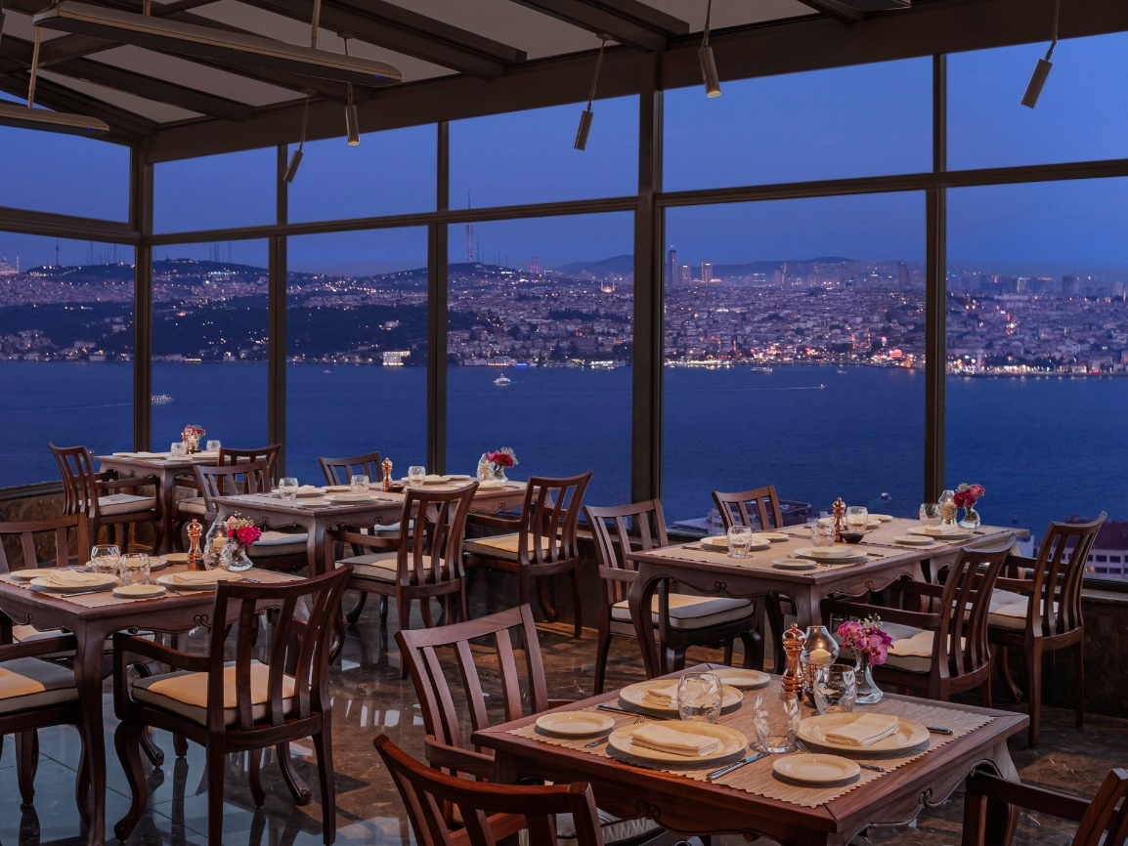

Slide 73
A restaurant

Slide 74
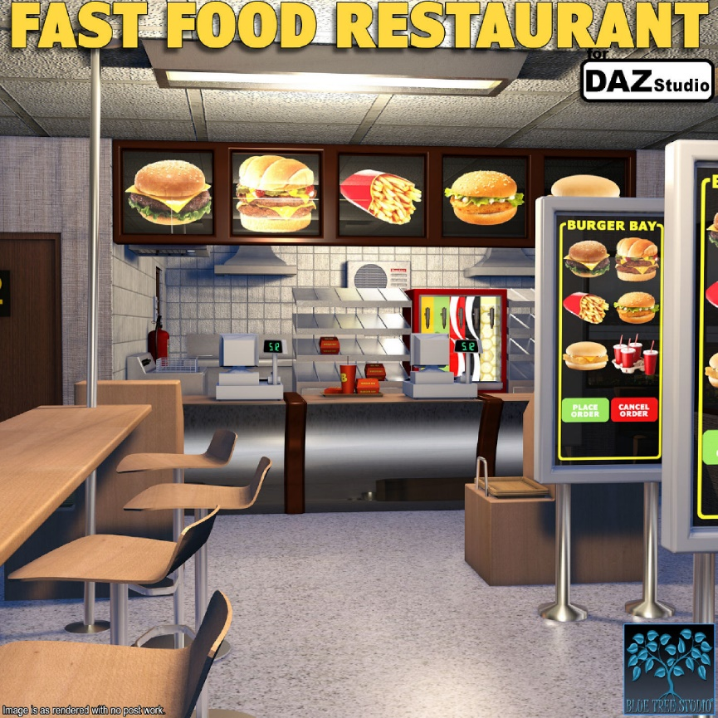

Slide 75
A FAST FOOD RESTAURANT

Slide 76
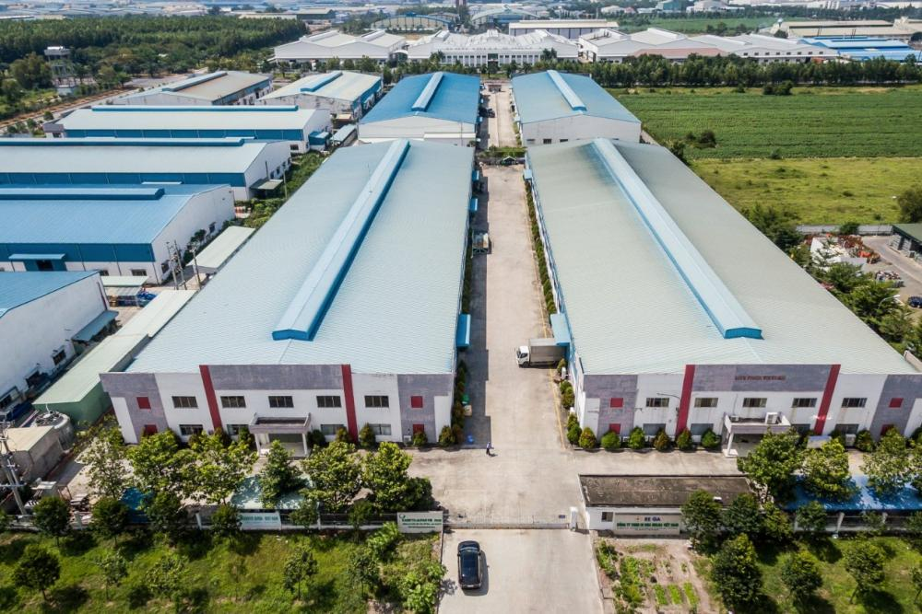

Slide 77
A FACTORY

Slide 78
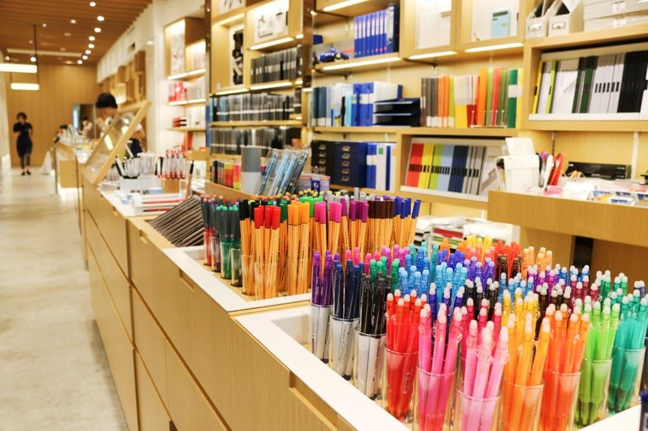

Slide 79
A
STATIONERY SHOP

Slide 80
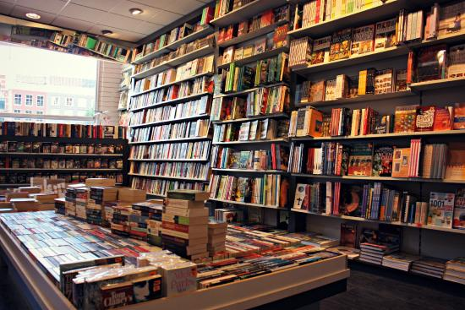

Slide 81
A BOOKSHOP

