Slide 1
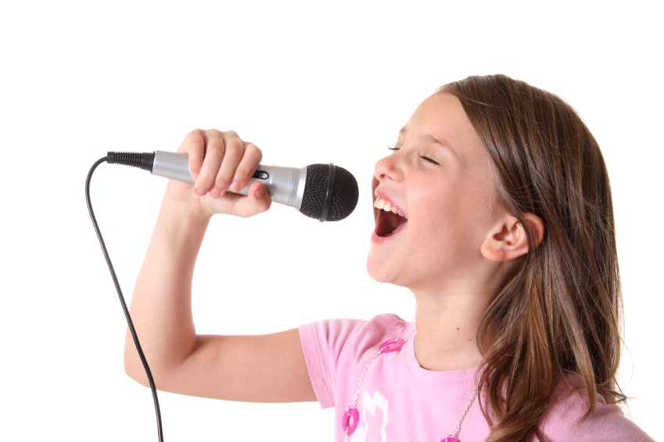
UPEVALNE VAJE https://www.youtube.com/watch?v=m-3i2CJQo4I
Mmmmm
Super duper double bubble gum
Mary had a little lamb who’s fleece was white as snow. Everywhere that Mary went the lamb was sure to go (mini OPZ to vajo preskoči ☺).
Zoo zoo zoo zoo zoo (zu)
Luwi luwi luwi luwi lu
Gu-gu-gu-gu-gum (ga-ga-ga-ga-gam)
Bu-bu-bu-bu-bu-bu-bu (ba-ba-ba-ba-ba-ba-ba)

Slide 2

PESEM ZA DOBER DAN https://www.youtube.com/watch?v=5QdCQFSu-Es
Naj dober bo ta dan,
Le s soncem obsijan,
Naj vsak oblak gre stran,
naj bo lep dan!
Naj se ti ne zgodi,
Da žalost te ulovi,
Ohrani upanje,
Nasmehni se.
Naj bo dober dan!
Daj preženi prazne skrbi,
Naj ne bo te strah noči,
Ob tebi smo, če dan se ti stemni,
Tvoji smo prijatelji.
Naj dober bo ta dan,
Le s soncem obsijan,
Naj vsak oblak gre stran,
naj bo lep dan!
NAJ BO DOBER DAN!

