Slide 1
ANIMALS

Slide 2
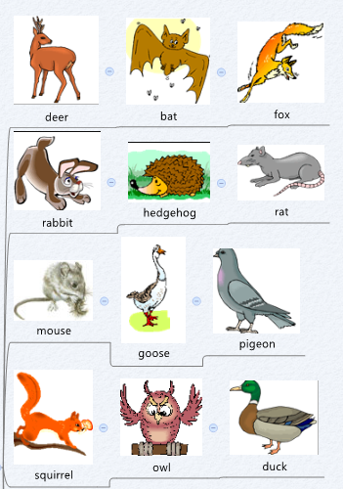
WILD ANIMALS

Slide 3
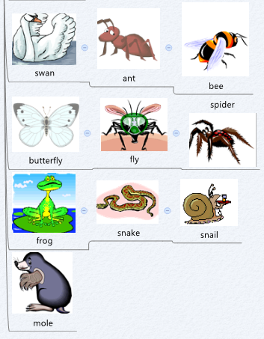

Slide 4
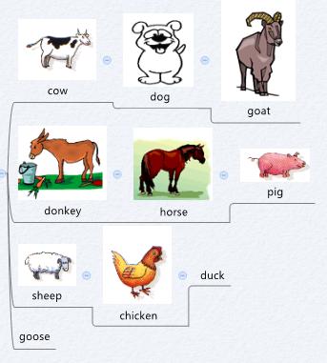
FARM ANIMALS

Slide 5
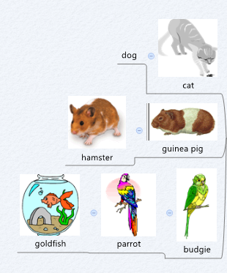
PETS

Slide 6
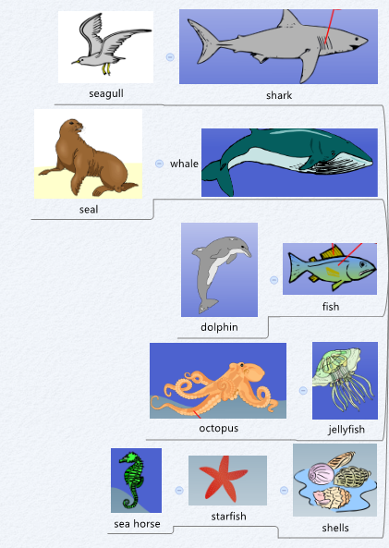
SEA ANIMALS

